Slide 1
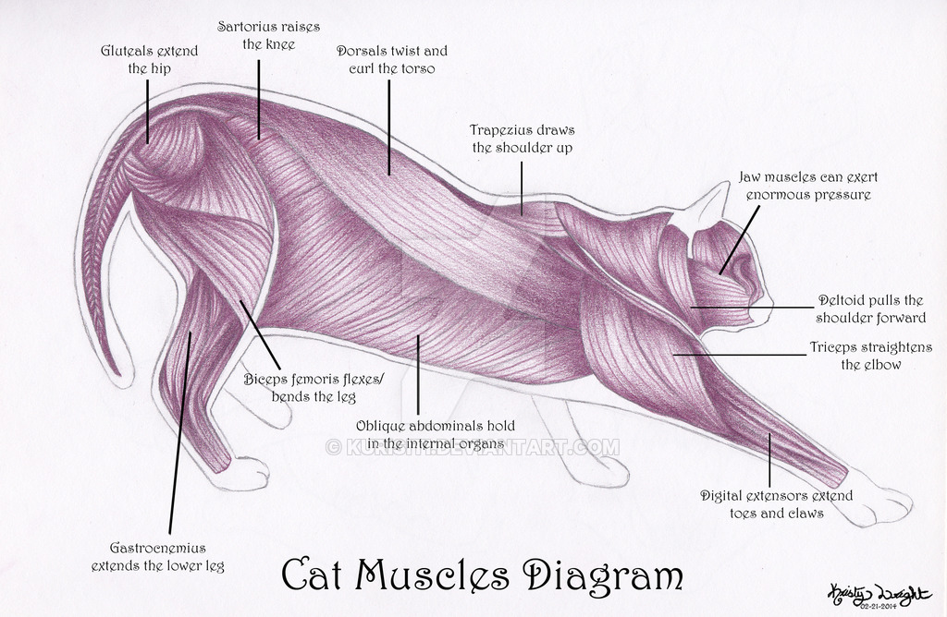
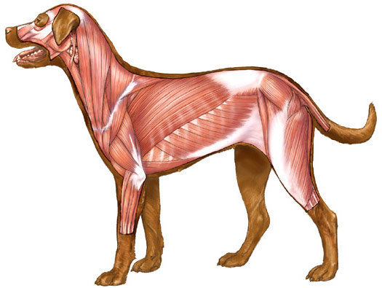
MUSCLE PHYSIOLOGY
Assoc. Prof. Dr. Yasemin SALGIRLI DEMİRBAŞ

Slide 2
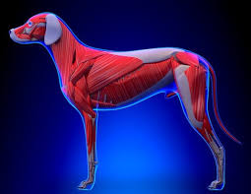
MUSCLE PHYSIOLOGY
The most visible aspect of muscle function is that which is related to locomotion.
Animals are able to stand and lie down, graze in pastures, run when threatened, or compete at racetracks.
Other functions include muscles for respiration, digestion, parturition, blood and lymph circulation, swallowing, and generation of body heat.

Slide 3
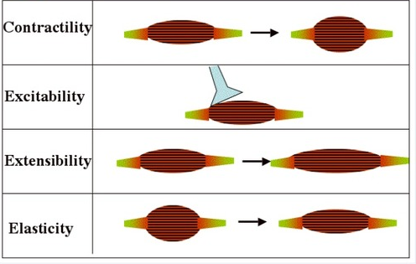
Properties of Muscles
In addition to shortening, muscle has other properties that include:
excitability, the capacity to receive and respond to a stimulus,
extensibility, the ability to be stretched, and
elasticity, the ability to return to original shape after being stretched.
There are 3 types of muscle fibers in the animal body: skeletal, smooth, and cardiac.
Each is characterized by
microscopic structural differences
their location,
function,
and innervation.

Slide 4
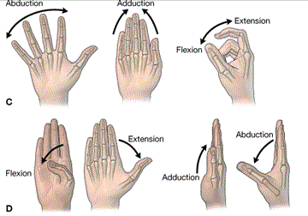
Types of movement
Skeletal muscles are often described according to the type of movement performed.
They are strategically located to best serve the structure they affect.
Flexors are located on the side of the limb toward which the joint bends when decreasing the joint angle.
Extensors are located on the side of the limb toward which the joint bends when increasing the joint angle.
Adductors are muscles that pull a limb toward the median plane,
Abductors pull a limb away from the median plane.
Sphincters are arranged circularly to constrict body openings.

Slide 5
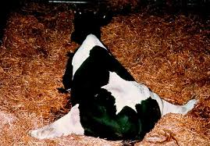
Case Discussion
Pelvic delivery of an unusually large calf has caused a cow to be down and unable to bring her hindlegs together. Obturator nerve paralysis is suspected, and the affected muscles are classified as: ??????

Slide 6
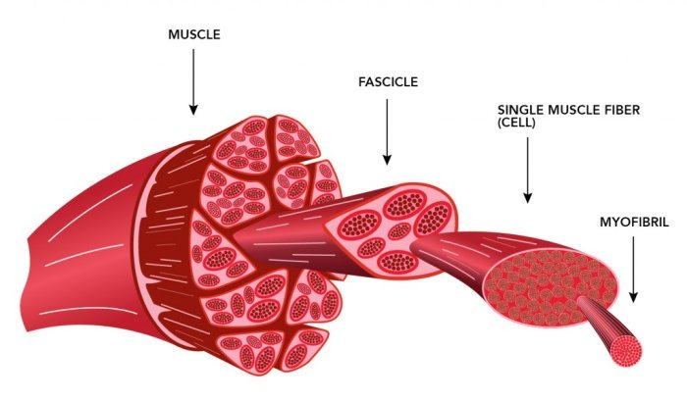
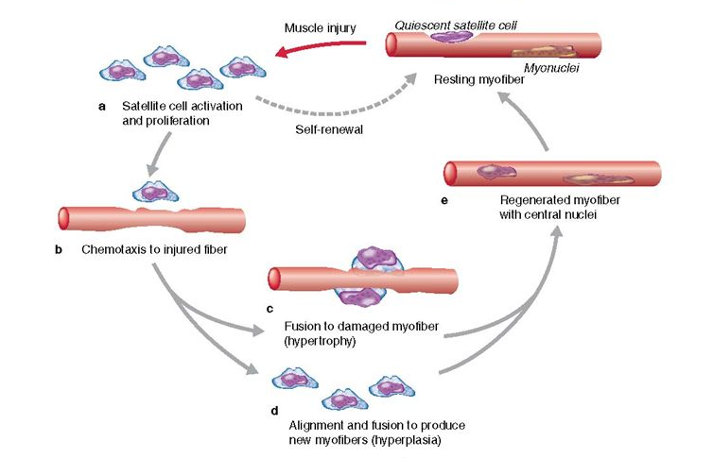
SKELETAL MUSCLE
A single skeletal-muscle cell is known as a muscle fiber.
Each muscle fiber is formed during development by the fusion of a number of undifferentiated,mononucleated cells, known as myoblasts, into a single cylindrical, multinucleated cell.
New fibers can be formed from undifferentiated cells known as satellite cells
Satellite cells are located adjacent to the muscle fibers and undergo differentiation similar to that followed by embryonic myoblasts.
This capacity for forming will not restore a severely damaged muscle to full strength.
Much of the compensation for a loss of muscle tissue occurs through an increase in the size of the remaining muscle fibers

Slide 7
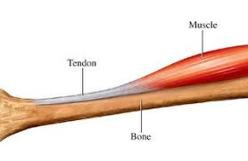
SKELETAL MUSCLE
The term muscle refers to a number of muscle fibers bound together by connective tissue.
Muscles are usually linked to bones by bundles of collagen fibers known as tendons, which are located at each end of the muscle.
In some muscles, the individual fibers extend the entire length of the muscle.
The transmission of force from muscle to bone is like a number of people pulling on a rope, each person corresponding to a single muscle fiber and the rope corresponding to the connective tissue and tendons.

Slide 8
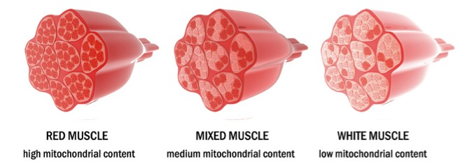
Fiber types
Individual skeletal muscles can be observed by gross anatomic inspection and by dissection.
Skeletal muscle fibers can be classified into three types:
(i) red or dark (type I; slow twitch);
(ii) white or pale (type II; fast twitch); and
(iii) intermediate with characteristics between those of red and white fibers
Most skeletal muscles are probably a mixture of these three types
In some animals the red, and in others the white, predominates.
Multiple peripherally arranged nuclei are present in each fiber

Slide 9
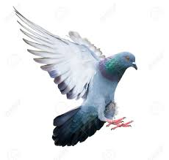
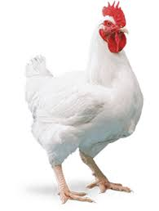
Fiber types
The crimson red pectoralis muscle (breast muscle) of pigeons contrasts sharply with the white color of the chicken pectoralis muscle.
In birds, the amount of red pigmentation in the pectoralis muscle can be correlated directly with the ability to sustain flight.
Red fibers are also known as slow twitch fibers.
The reddish appearance is due to the large amounts of myoglobin.
A large number of mitochondria and capillaries are present in red fibers
Substantial amounts of myoglobin, support the greater oxidative metabolism needed for sustained flight or other activities of this nature (e.g., horses in competition or sustained running to a destination).

Slide 10
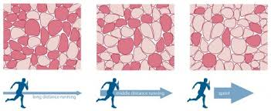
White fibers
White fibers are also known as fast twitch fibers
Are characteristic of the white pectoralis muscle of the chicken and pheasant.
These are muscles that react rapidly and with short duration and consist of large fibers with great strength of contraction.
They have an extensive sarcoplasmic reticulum for rapid release of energy via the glycolytic process.
There is a less extensive blood supply and fewer mitochondria because oxidative metabolism is of secondary importance.

Slide 11
Skeletal muscle harnessing
Muscle tissue contains a connective tissue component that provides for harnessing.
The whole muscle is wrapped in an outer connective tissue sheath known as the epimysium,
Connective tissue extensions from the epimysium, known as the perimysium, surround the muscle bundles.
Extensions from the perimysium, known as the endomysium, surround each of the muscle fibers and are attached to the sarcolemma (muscle fiber membrane).
The muscle fiber is the contractile unit that shortens, and the pull that it exerts is transmitted by endomysium, perimysium, and epimysium to the tendon or aponeurosis that is attached to a bone, thereby causing its movement.

Slide 12
Microstructure of skeletal muscle
The sarcomere is the basic contractile unit for both striated and cardiac muscle.
Sarcomeres of a myofibril are in alignment with the sarcomeres of all the other myofibrils of the muscle fiber.
The Z line is located at each end of a sarcomere and is common to both sarcomeres that it separates.
Actin filaments project from the Z line into the sarcomeres that it separates.
The actin of two sarcomeres common to the same Z line compose an I band.
The myosin filaments are centrally located within a sarcomere and, coupled with the overlay of actin filaments, provide the dark banding (A band) of the characteristic striations.
The actin and myosin filaments have a regular spatial arrangement to each other, as shown in the crosssection of a myofibril which has a 2 : 1 ratio of actin to myosin.

Slide 13
Microstructure of skeletal muscle
Filaments composed of the protein titin extend from the Z line to the M line and are linked to both the M-line proteins and the thick filaments.
Both the M-line linkage between thick filaments and the titin filaments act to maintain the regular array of thick filaments in the middle of each sarcomere.
Thus, neither the thick nor the thin filaments are free-floating.

Slide 14
Sarcotubular system
Skeletal muscle fibers contain a network of tubules known as the sarcotubular system.
These tubules are located within the muscle fiber, but are outside the myofibrils.
The sarcotubular system is composed of two separate tubule sets, with each set having a different arrangement among the myofibrils.
The tubules arranged parallel to the myofibrils and which encircle them are known as the sarcoplasmic reticulum.
The tubules arranged transversely (right angles) to the myofibrils are known as T tubules.
T tubules extend transversely from one side of the fiber to the other.
They open to the outside of the fiber (surface of the sarcolemma), and therefore their lumens contain extracellular fluid.

Slide 15
Sarcotubular system
The T tubules do not open into the sarcoplasmic reticulum;
The bulbous ends of the sarcoplasmic reticulum are closely associated with the T tubules.
The point of closeness of a T tubule with the bulbous ends of two adjoining sarcoplasmic reticula is known as a triad.
The principal function of the sarcotubular system is to provide a means for conduction of an impulse from the surface of the muscle fiber to its innermost aspects.
The sarcoplasmic reticulum is an important storage site for calcium ions and has a prominent role in the initiation and termination of muscle contraction.

Slide 16
EXCITATION-CONTRACTION COUPLING

Slide 17
The neuromuscular junction
A motor unit consists of a motor neuron and the muscle fibers that it innervates.
The largest motor units, in which one axon supplies many muscle fibers, are found in the limbs and postural muscles.
The smallest motor units, in which one axon may supply only a few muscle fibers, are found in association with eye movements.
The end bulb of each terminal branch makes contact with an individual muscle fiber at a specialized area known as the neuromuscular junction
It occurs at the approximate midpoint of the muscle fiber.
The terminal branch of the axon does not actually make contact with the muscle fiber but is separated from it by a gap approximately 50 nm wide known as the synaptic cleft

Slide 18
The neuromuscular junction
A neurotransmitter, acetylcholine (Ach), is stored in the membrane‐ bound vesicles within the terminal branch of the axon.
Voltage‐gated Ca2+ and Na+ channels are opened when the action potential reaches the neuromuscular junction.
An influx of calcium ions enters the terminal bulb of the axon, increasing the calcium ion concentration 10–100 times.
Calcium ions trigger the binding of synaptic vesicles to the plasma membrane of the terminal bulb and the release of ACh into the synaptic cleft.
ACh diffuses into invaginations of the muscle fiber sarcolemma located immediately below the synaptic cleft and is bound to ACh receptors at that site.

Slide 19
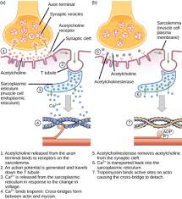
Depolarization of muscle fibers
ACh begins depolarization of muscle fibers by increasing the permeability of the sarcolemma for Na+ ions, whereby the action potential is by the opening and closing of Ca2+ and Na+ channels.
The action potential is conducted into all parts of the muscle fiber beginning with the T tubules.
Depolarization of the sarcolemma continues in the T tubules and calcium ions (stored in the sarcoplasmic reticulum) are released into the cytosol of the muscle fiber, allowing contraction to begin.
The signal which has caused depolarization has proceeded from the sarcolemma, into the T tubules, sarcoplasmic reticulum, myofibrils, and every sarcomere in the myofibril within milliseconds.
Thus, all the myofibrils within a muscle fiber will contract at the same time and a more synchronized contraction results.
Almost immediately after its release, ACh is hydrolyzed by the enzyme acetylcholinesterase (AChE) into acetic acid and choline.

Slide 20
Skeletal muscle contraction
Muscle activity involves repeated cycles of contraction and relaxation.
Contraction, or shortening, occurs when calcium ions are released from the sarcoplasmic reticulum into the myofibrils.
This is followed by relaxation after the calcium ions are rapidly returned by active transport to the sarcoplasmic reticulum.
Another cycle begins when calcium ions are again released following the next depolarization of the sarcolemma.
These cycles are referred to as excitation–contraction coupling.

Slide 21
Mechanical changes of actin and myosin
The contraction process involves an interaction between the actin and the myosin myofilaments.
There is a natural attraction between actin and myosin for each other that involves active sites on the actin molecule.
Attraction is inhibited during relaxation because the active sites are covered, but when calcium ions enter the myofibril the active sites are uncovered.

Slide 22
Mechanical changes of actin and myosin
The projecting portions of the myosin molecules (cross‐bridges) attach to the active sites during contraction and bend toward the center, causing the actin to slide toward the myosin molecule center.
The actin filament has three major components (all protein): actin, tropomyosin, and troponin .
Actin and tropomyosin are arranged in helical strands interwoven with each other.
Troponin is located at regular intervals along the strands and contains three proteins, two of which bind actin and tropomyosin together and a third which has an affinity for calcium ions.

Slide 23
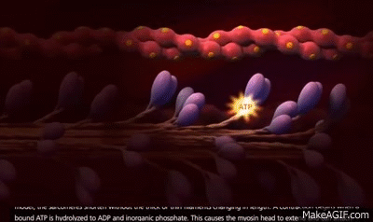
Mechanical changes of actin and myosin
Active sites (places where myosin cross‐bridges attach) are located on the actin strands and are normally covered by the tropomyosin strands.
When calcium ions bind to the troponin complex, a conformational change occurs between the actin and tropomyosin strands that causes the active sites to be uncovered.
The uncovered sites favor activation of the natural attraction that exists between actin and myosin and allows attachment of myosin cross‐bridge heads.

Slide 24
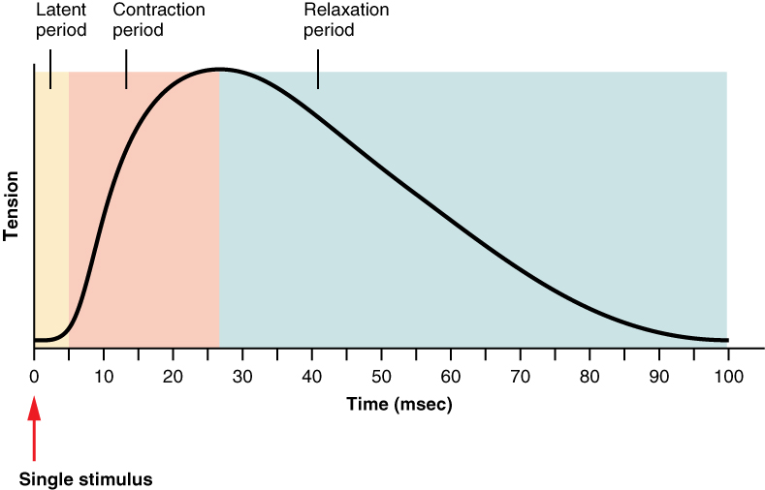
Single Contraction=Twitch
The contraction generated by a single action potential is called a muscle twitch.
A single muscle twitch has three components:
The latent period, a short delay (1-2 msec) from the time when the action potential reaches the muscle until tension can be observed in the muscle.
This is the time required for calcium to diffuse out of the SR, bind to troponin, the movement of tropomyosin off of the active sites, formation of cross bridges, and taking up any slack that may be in the muscle.
The contraction phase, when the muscle is generating tension and is associated with cycling of the cross bridges
The relaxation phase is the time for the muscle to return to its normal length.
*The length of the twitch varies between different muscle types and could be as short as 10 ms (milliseconds) or as long as 100 ms (more on this later).

Slide 25
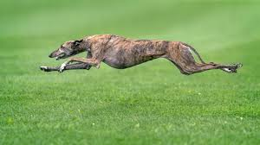
Q: If a muscle twitch is just a single quick contraction followed immediately by relaxation, how do we explain the smooth continued movement of our muscles when they contract and move bones through a large range of motion?
The answer lies in the ordering of the firing of the motor units.
when a muscle contracts, motor units fire asynchronously, that is, one contracts and then a fraction of a second later another contracts before the first has time to relax and then another fires and so on.
So, instead of a quick, jerky movement the whole muscle contraction is very smooth and controlled.

Slide 26
Q: Even when a muscle is at rest, there is random firing of motor units. This random firing is responsible for what is known as muscle tone. So, a muscle is never "completely" relaxed, even when asleep. Why??
There are several benefits of muscle tone:
First it takes up the "slack" in the muscle so that when it is asked to contract, it can immediately begin to generate tension and move the limb.
The second thing muscle tone does is deter muscle atrophy.

Slide 27
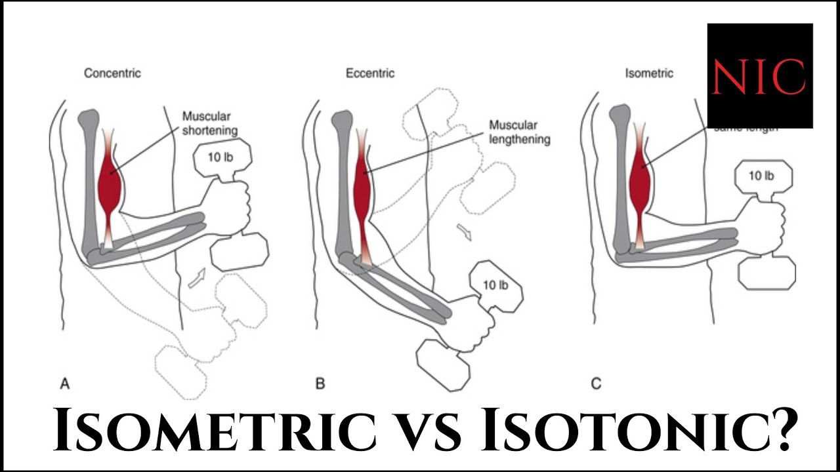
Types of Muscle Contraction
Muscle contractions are described based on two variables: force (tension) and length (shortening).
When the tension in a muscle increases without a corresponding change in length, the contraction is called an isometric contraction (iso = same, metric=length). *Isometric contractions are important in maintaining posture or stabilizing a joint.
If the muscle length changes while muscle tension remains relatively constant, then the contraction is called an isotonic contraction (tonic = tension).
Isotonic contractions can be classified based on how the length changes.
If the muscle generates tension and the entire muscle shortens than it is a concentric contraction.
An example would be curling a weight from your waist to your shoulder; the biceps muscle used for this motion would undergo a concentric contraction.
when lowering the weight from the shoulder to the waist the bicep would also be generating force but the muscle would be lengthening, this is an eccentric contraction.

Slide 28
Factors that Influence the Force of Muscle Contraction
Our muscles are capable of generating differing levels of force during whole muscle contraction.
Some actions require much more force generation than others; think of picking up a pencil compared to picking up a bucket of water.
The question becomes, how can different levels of force be generated?

Slide 29
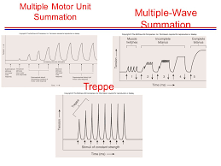
Multiple-motor unit summation
All of the motor units in a muscle usually don't fire at the same time.
One way to increase the amount of force generated is to increase the number of motor units that are firing at a given time.
Motor unit summation or spatial summation is the recruitment of additional motor units within a muscle to develop more force.
The greater the load we are trying to move the more motor units that are activated.
However, even when generating the maximum force possible, we are only able to use about 1/3 of our total motor units at one time.
Normally they will fire asynchronously in an effort to generate maximum force and prevent the muscles from becoming fatigued.
As fibers begin to fatigue they are replaced by others in order to maintain the force.
*There are times, however, when under extreme circumstances we are able to recruit even more motor units.

Slide 30
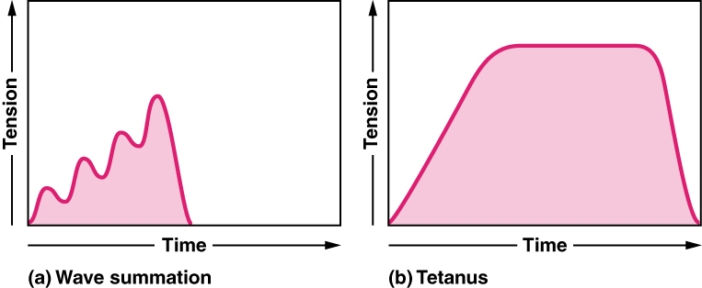
Wave summation:
A muscle twitch can last up to 100 ms and that an action potential lasts only 1-2 ms.
Also, with the muscle twitch, there is not refractory period so it can be re-stimulated at any time.
If you were to stimulate a single motor unit with progressively higher frequencies of action potentials you would observe a gradual increase in the force generated by that muscle.
This phenomenon is called wave summation.

Slide 31
Tetanus
Sustained contraction of a muscle due to increased frequencyof stimulation.
Result of a summation of twitches (a normal muscle contraction)
When the frequency of the stimulation is such that there is no hint of reduced tension or force between stimuli, it is called complete tetany or fused tetany. 80-100 stim/sec
When the frequency of stimulation is reduced slightly, you can see partial muscle relaxation occurring between contractions, this is called incomplete tetany or unfused tetany. 20-30 stim/sec•
Incomplete tetany can result in trembling (shaky) movements of the limbs observed in some individuals.

Slide 32
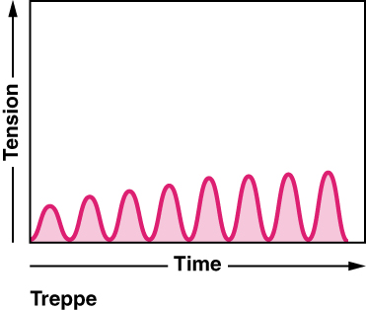
Treppe
Increased strength of contraction as muscle “warms up” due to identical stimuli too far apart for wave summation to occur.
Each successive muscle twitch has slightly more strength than the preceding one, until optimal contraction strength is reached.
It is also known as the ‘staircase effect’, as the muscle steps up its strength with each contraction

Slide 33
Treppe can be explained as follows:
A progressive buildup of Ca++in the sarcoplasm probably accumulates because the stimuli release Ca++faster than the Ca++pump can move them back in to the SR.
The troponin becomes saturated for maximum binding to myosin heads.
Eventually the inflow and outflow of calcium ions equalize and the strength of contraction level off
Treppe can be differentiated from summation because the strength of stimulus remains the same in treppe, but increases in summation.

Slide 34
Energy changes
1 Adenosine triphosphatase (ATPase) of the myosin crossbridge heads hydrolyzes ATP to adenosine diphosphate (ADP) and inorganic phosphate (Pi), leaving the ADP and Pi bound to the heads.
Energy from the hydrolysis of ATP “cocks” the heads so that they increase their angle of attachment to the cross‐bridge arm and become perpendicular to the active sites of the actin myofilaments.
2 After depolarization of the sarcotubular system, calcium ions diffuse from the sarcoplasmic reticulum into myofibrils and bind to the troponin complexes;
The natural attraction of myosin to actin is now permitted, and the “cocked” heads bind with active sites.
3 Binding with actin causes conformational changes in the cross‐bridge heads (“uncocking”) and they bend (tilt) toward the cross‐bridge arms (toward the center of the sarcomere), pulling actin with it. The energy is derived from previous ATP hydrolysis.
4 Tilting of the cross‐bridge heads causes release of ADP and Pi and sites on the heads are exposed for binding of new ATP.
The binding of new ATP causes detachment of myosin crossbridge heads from actin myofilaments.
Repetition of the process causes the actin myofilaments to be pulled further into the center, thus shortening the sarcomere.

Slide 35
Source of energy
The immediate energy for muscle contraction is thus derived from ATP, forming ADP and Pi.
The amount of ATP in muscle fibers is limited, and rephosphorylation of ADP must occur so that contraction can continue.
This is accomplished by the transfer from creatine phosphate (CP), which is about five times more plentiful than ATP.
Because the amount of CP is also limited, the necessary rephosphorylation of creatine (C) to CP and ADP is ultimately derived from intermediary metabolism within the muscle fiber and from the associated reoxidation of reduced cofactors that occurs in the electron transfer chain of the mitochondria.
This process is an aerobic system known as oxidative phosphorylation.

Slide 36
Source of energy
Aerobic metabolism is important as an energy source for muscle contractions of animal athletes and for endurance exercise required of migrating animals, where repetitive skeletal muscle contractions continue for hours or days.
The primary fuel for muscle contractions during prolonged endurance exercise is fatty acids rather than glucose.
The fatty acids are broken down to acetyl‐CoA and enter the citric acid cycle resulting in the formation of ATP.
Muscle contraction is 50–70% efficient in regard to accomplishment of work.
The nonwork portion is dissipated as heat.
This heat source is important to the body for the maintenance of body temperature.

Slide 37
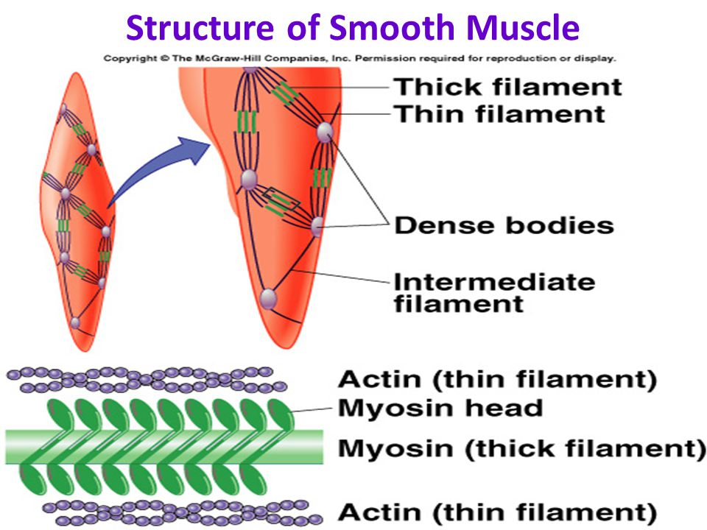
SMOOTH MUSCLE
Smooth muscle is so named because it has no visible striations.
Myofilaments are present and are composed of the contractile proteins actin and myosin, as in skeletal muscle.
The filaments are more loosely organized than those in skeletal muscle, which accounts for the lack of visible striations.
Smooth muscle is an important functional part of many organs, including the contractile aspect of the intestines, urinary bladder, ureter etc.
These structures receive innervation from the autonomic nervous system but some may also respond, directly or indirectly, to stretch or extracellular fluid change.

Slide 38
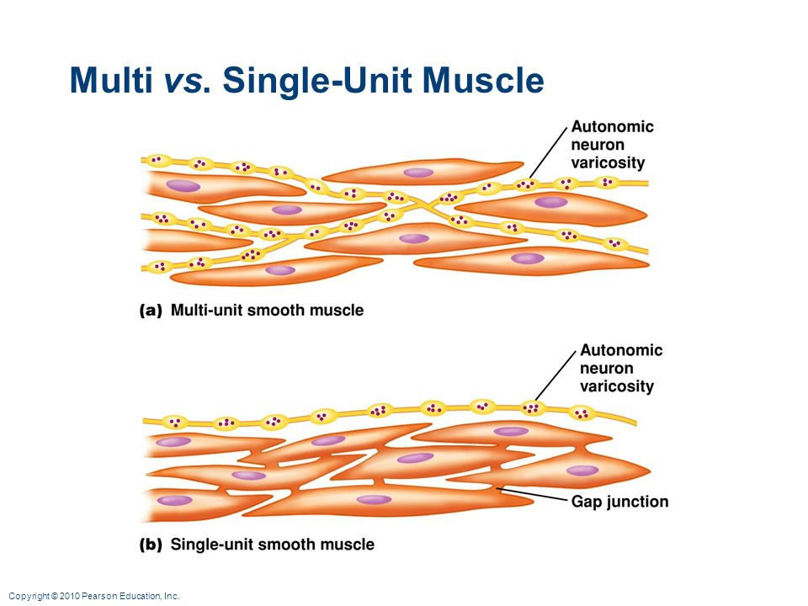
Smooth muscle types
According to their location, function, organization into sheets or bundles, and characteristics of innervation.
These general types are (i) multiunit smooth muscle and (ii) single‐unit smooth muscle (also known as unitary and visceral)
Multiunit smooth muscle
This type of muscle is found in the ciliary body and iris of the eye and the walls of large arteries.
Each muscle fiber is innervated separately and contracts only when it receives synaptic stimuli.
Therefore, each fiber can contract independent of the others.
Conduction of impulses from one cell to the next does not exist.

Slide 39
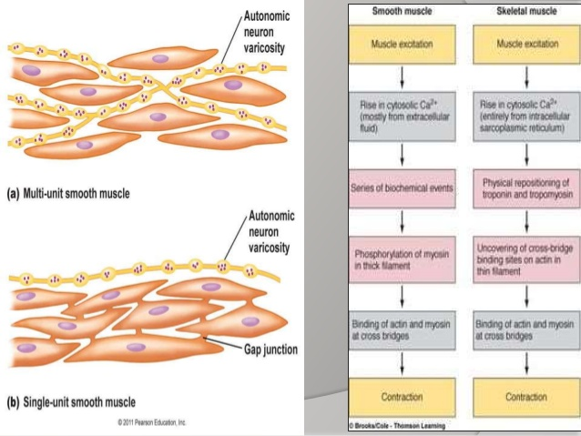
Single‐unit (visceral) smooth muscle
The term “single‐unit” does not mean single muscle fibers but rather a large mass of muscle fibers.
In this type of smooth muscle, large areas of muscle tissue contract simultaneously and are responsible for peristaltic waves of contraction that move intestinal contents from one end of the digestive tract to the other.
These waves also occur in the uterus and ureters.

Slide 40
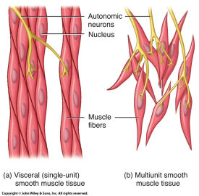
Single‐unit (visceral) smooth muscle
Harnessing of single‐unit smooth muscle occurs in the following manner:
1 Cell membranes of the fibers within a sheet of fibers are adherent to each other at multiple points.
2 There are also gap junctions between cell membranes that allow ions to flow freely from one muscle fiber to the next.
This allows actions potentials to travel from one fiber to the next causing the muscle fibers to contract together.

Slide 41
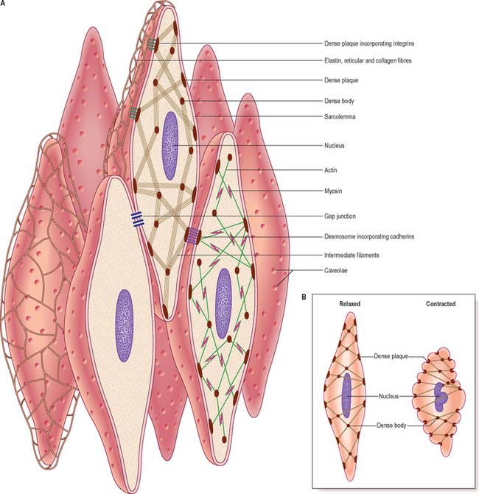
Microstructure of smooth muscle
The individual cells are spindle‐shaped and have a centrally located nucleus.
The tapered portion of each fiber lies adjacent to the wide portion of the neighboring.
This arrangement permits adjacent fibers to be packed closely together, which is most favorable for contractile function.
Note the presence of dense bodies that are points of attachment for actin thin filaments.
Some dense bodies are scattered throughout the cytoplasm attached to an intermediate filament that links several dense bodies together, while others are attached to the sarcolemma.

Slide 42
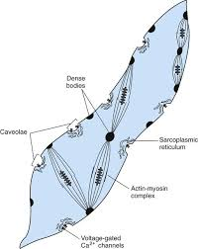
Microstructure of smooth muscle
The dense bodies are rigid stable structures that retain their original shape and attachment during contraction.
In this manner, the dense bodies correspond to the Z lines of skeletal muscle.
The myosin filaments have a diameter more than twice that of the actin filaments and the ratio of actin to myosin is 15 : 1.
The actin filaments from two separate dense bodies extend toward each other and surround a myosin filament, thereby providing a contractile unit that is similar to a contractile unit of skeletal muscle (i.e., the sarcomere).
T tubules are absent in smooth muscle fibers, but there are numerous invaginations in the fiber membrane called caveolae.
It is believed that they may have a function similar to T tubules.

Slide 43
Excitation–contraction coupling in smooth muscle
Smooth muscle does not have the tropomyosin–troponin complex, the protein that covers active sites on the actin filament in skeletal muscle.
Instead of the tropomyosin– troponin complex, smooth muscle contains another protein known as calmodulin.
After the influx of calcium ions following depolarization of the fiber membrane, the calcium ions bind with calmodulin.

Slide 44
Smooth muscle contraction
The calcium–calmodulin combination binds with and activates myosin kinase (phosphocreatine kinase in skeletal muscle), a phosphorylating enzyme.
Each of the myosin cross‐bridge heads a regulatory chain that becomes phosphorylated in response to myosin kinase.
When the regulatory chain is phosphorylated, the head is “cocked” and has the ability to bind repetitively with the uncovered active sites on the actin filament.
Repetitive binding with the actin active sites continues through the entire cycling process, with each binding adding to the muscle fiber contraction and development of tension.
Relaxation of contracted smooth muscle fibers requires the presence of the enzyme myosin phosphatase located in the intracellular fluid of the smooth muscle fiber.
Variations in the amount of time for contraction and maintenance of tension are probably determined by the amount of myosin phosphatase in the fibers.

Slide 45
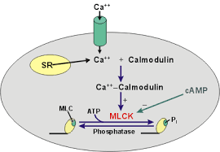
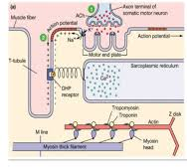
Contrasts between smooth and skeletal muscle contraction
Functional differences:
1 The cycling of cross‐bridge head attachment and detachment to actin sites is much slower in smooth muscle.
The sarcoplasmic reticulum is rudimentary in smooth muscle fibers and calcium ions must enter the fiber from the extracellular fluid.
Also, the Ca2+ pumps are in the fiber membrane and are much slower than those in the sarcoplasmic reticulum of skeletal muscles.

Slide 46
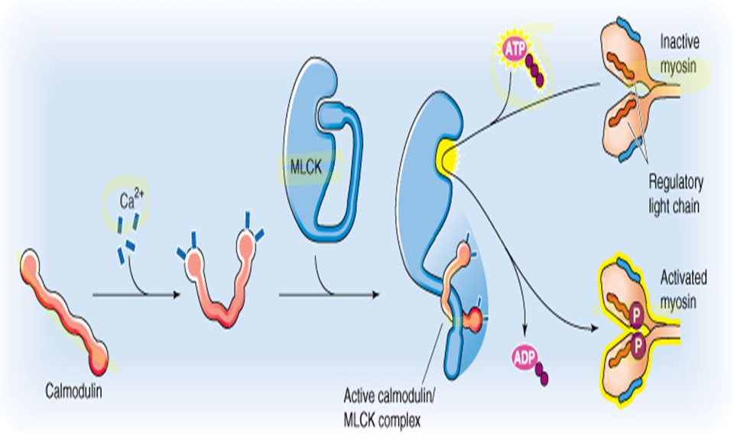
Contrasts between smooth and skeletal muscle contraction
2. Cross‐bridge heads have less ATPase activity in smooth muscle, thereby reducing movements of the crossbridge heads and slowing the rate of cycling.
3 Much less energy is required to sustain contraction tension in smooth muscle because slow attachment and detachment cycling requires only one molecule of ATP for each cycle, regardless of its duration.
Maintenance of tonic contractions (e.g., intestines, urinary bladder) without cycling provides energy economy for the body.
4 The maximum force of contraction attained by smooth muscle can be greater than that of skeletal muscle because of the prolonged attachment of myosin cross‐bridge heads to the actin filaments.

Slide 47
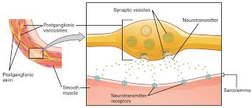
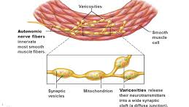
Smooth muscle contraction stimuli
Neuromuscular junctions found in skeletal muscle fibers do not occur in smooth muscle.
The autonomic nerve fibers innervating single‐unit smooth muscle branch diffusely on top of a sheet of muscle fibers.
Instead of making direct contact, there are multiple varicosities (similar to a terminal bulb of presynaptic neurons) distributed along the nerve fiber with vesicles containing the transmitter substance, either acetylcholine or norepinephrine.
Smooth muscle fibers are usually innervated by both sympathetic and parasympathetic nerve fibers, each having opposite effects on the muscle fibers.
The neurotransmitter released by the varicosities diffuses over a large area and affects numerous single‐unit smooth muscle fibers.
In this way, large areas of smooth muscle contract simultaneously, with electrical stimuli being transmitted repeatedly among neighboring fibers by way of gap junctions.
This kind of activity is common in the large peristaltic waves of contraction that move intestinal contents from one end of the digestive tract to the other and similar peristaltic waves that occur in the uterus and the ureters.

Slide 48
Stimuli other than autonomic
The membrane of single‐unit smooth muscle fibers is sensitive to mechanical stimuli.
Stretching the membrane of these fibers leads to depolarization and consequently contraction.
With autoregulation of blood flow in arterioles, a rise in blood pressure causes stretch of the encircling smooth muscle that stimulates contraction.
This maintains a fairly constant blood flow in the tissue they supply.
Multiunit smooth muscle is found in the ciliary body and the iris of the eye, in the ductus deferens, and the walls of large arteries.
In these units of smooth muscle, each muscle fiber is innervated separately and contracts only when it receives a synaptic stimuli.
In addition to the above stimuli, smooth muscle may be affected directly or indirectly by changes in oxygen concentration, pH, or ion concentrations in the extracellular fluid

Slide 49
ANY QUESTIONS?

