Slide 1
Semen collection in Cats
Koray tekin
Ankara Üniversitesi, Veteriner Fakültesi
Reprodüksiyon ve Suni Tohumlama Anabilim Dalı
Notes:
değerli dinleyiciler, sizlere köpeklerde suni tohumlama ile ilgili bir seminer sunacağım.
Sunum sırasın

Slide 2
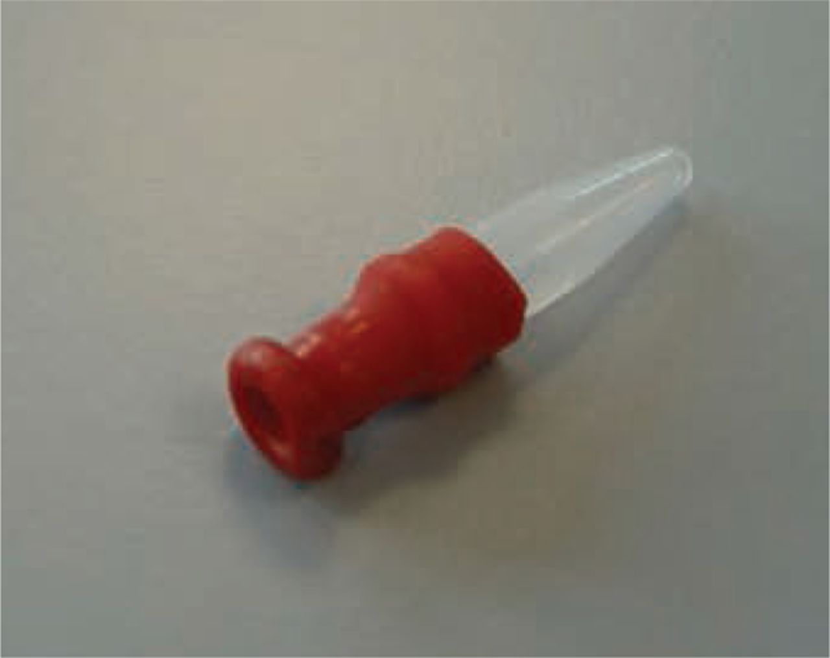
Semen collection and preservation
Fertility
Cryopreservation
Sperm morphology
Poor motility
Longevity.
Semen collection and handling
contamination with urine, cellular debris or water,
in many cases the tom cat will not show mounting behaviour until left alone with the queen.
to collect semen using either sedation with an alpha₂ adrenoceptor agonist combined with urethral catheterisation
homemade artificial vagina
Gary C. W. England, and Marco Russo In Practice 2014;36:249-254

Slide 3
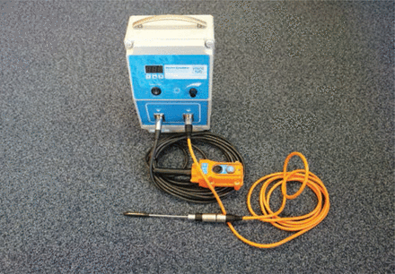
Semen collection
to collect semen using either sedation with an alpha₂ adrenoceptor agonist combined with urethral catheterisation or general anaesthesia and electro-ejaculation.
An electro-ejaculator.

Slide 4
Semen preservation
The principles of semen preservation are similar to other species, the ejaculate is a small volume and extra care has to be taken to prevent loss of sperm during handling and processing.
Fresh
collect the semen into a small volume of non-glycerol-containing semen extender to increase the volume of the sample that will be handled.
This minimises the percentage lost during the handling and insemination steps, although some volume is always lost by a thin coating on the inside of the Eppendorf tube, inseminating syringe and catheter.
Physiological saline.
cool to room temperature (20ºC)

Slide 5
Storage
Chilled-rewarmed semen
the sample should be diluted with a semen extender and cooled at a slow rate to 5ºC for storage.
It is relatively common for equine extenders to be used, such as the simple skimmed-milk (Kenney) extender.
Frozen semen
tris-glycerol-egg yolk appears to be most common.
standard 1:4 dilution (semen:extender)
A period of equilibration
Diluted semen is normally loaded into 0.25 ml straws and then frozen either in nitrogen vapour for 10 minutes in a basket suspended 4 cm above liquid nitrogen,

