Slide 1
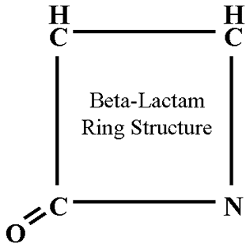
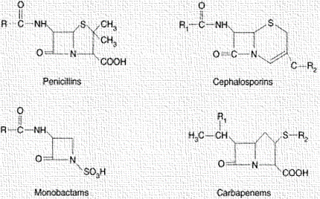
Carbapenems

Slide 2
Pharmacokinetics
Carbapenems (synthetic β-lactams)
Imipenem/cilastatin, Meropenem, Doripenem,
Ertapenem (slightly different)
Good penetration to body fluids (including CSF)
Elimination through kidneys
DOSE ADJUSTMENT CRUSIAL
İn kidney dysfunction

Slide 3
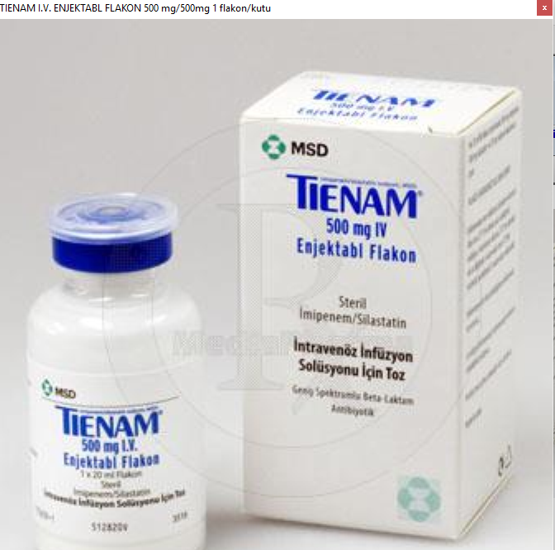
Carbapenems
Imipenem/cilastatin
Imipenem is metabolized
in the kidney
(to a nephrotoxic product)
Cilastatin blocks the renal
dehydropeptidase that
catalyzes this rxn

Slide 4
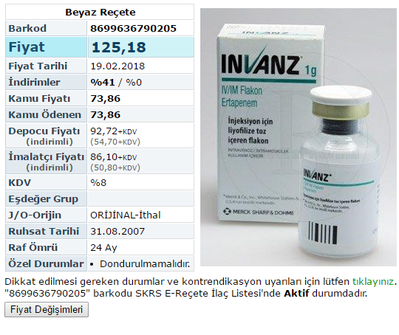
The major benefit of ertapenem over other carbapenems is that it has a long half-life and can be administered once daily
(caution: im application)

Slide 5
What are they good for?
For infections that are resistant to other drugs
i.e. P. aeruginosa (not ertapenem)
Mixed aerobic/anaerobic infections,
Infections caused by ESML-producing organisms
Intraabdominal infections
Imipenem/cilastatin, Meropenem, Doripenem for
nosocomial infections, febrile neutropenia,

Slide 6
They may induce seizures (especially IMIPENEM)

Slide 7
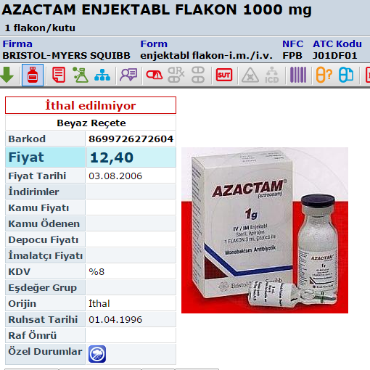
Monobactam
Aztreonam

Slide 8
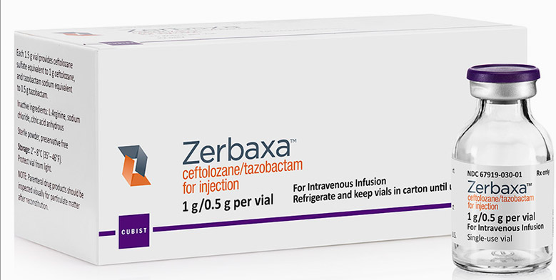
Ceftolozan + Tazobactam
Ceftolozane is a novel cephalosporin antibiotic, developed for the treatment of infections with gram-negative bacteria that have become resistant to conventional antibiotics. It was studied for urinary tract infections, intra-abdominal infections and ventilator-associated bacterial pneumonia

Slide 9
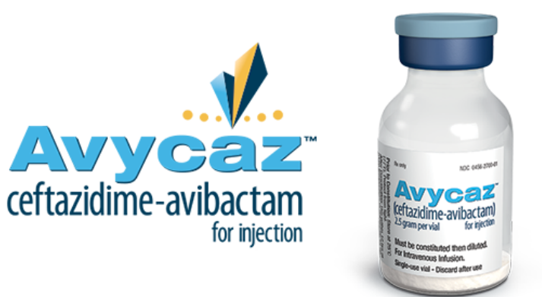
Ceftazidime-avibactam
Avibactam is a novel
broad-spectrum beta-lactamase inhibitor
The addition of avibactam to ceftazidime extends the spectrum of activity to include most Enterobacteriaceae (including those that produce AmpC beta-lactamase, ESBL, and some K. pneumoniae and OXA-type carbapenemases) as well as P. aeruginosa species with high MICs to ceftazidime alone

Slide 10
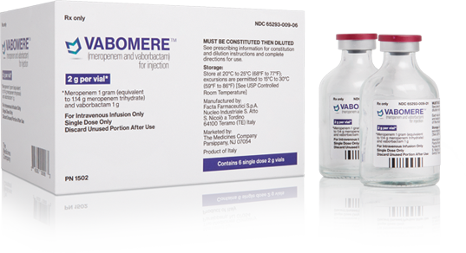
Meropenem-vaborbactam
Vaborbactam is a novel broad-spectrum beta-lactamase inhibitor that potently inhibits class A carbapenemases (including K. Pneumoniae carbapenemases [KPC])
It is not active against class B or D carbapenemases (ie, metallo-beta-lactamases and OXA-type enzymes)

Slide 11
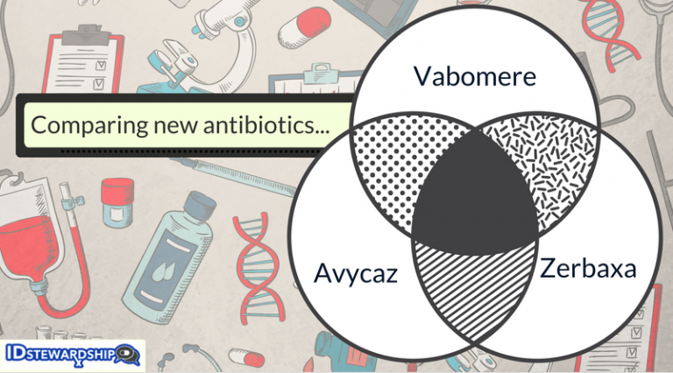

Slide 12
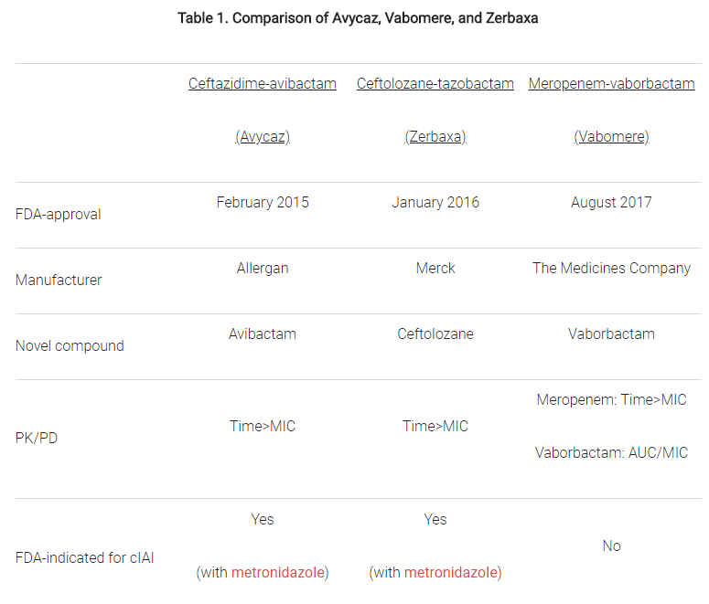

Slide 13
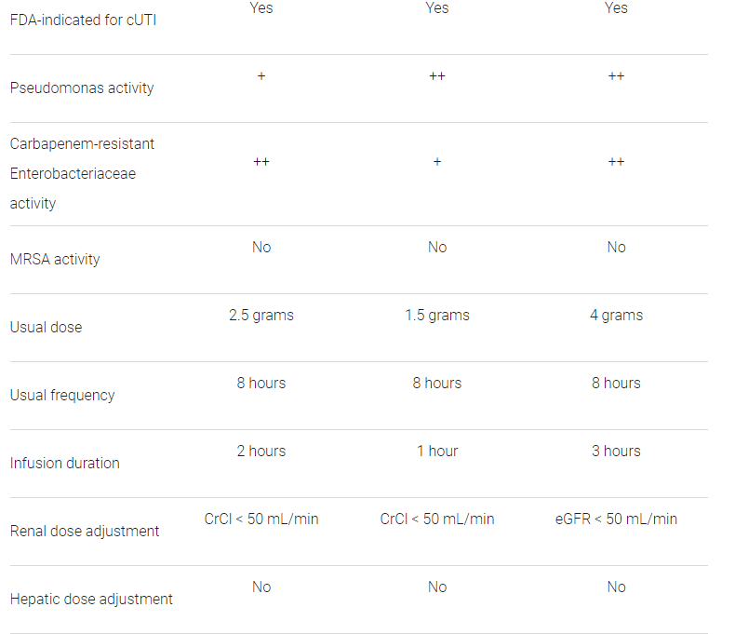

Slide 14
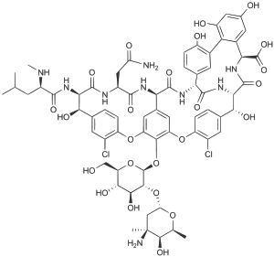
Other Inhibitors of Cell Wall Synthesis
Vancomycin (no oral drug available in Turkey)
DOES NOT have beta- lactam ring
DOES NOT bind to PBPs

Slide 15
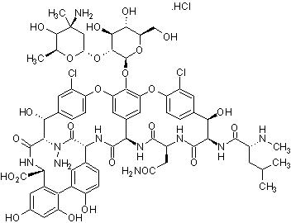
f AUC:MIC
Concentration AND
Time-Dependent
Interaction between
free [AB] exposure and
MIC
Prototype vancomycin (+quinolons and teicoplanin)
vancomycin

Slide 16
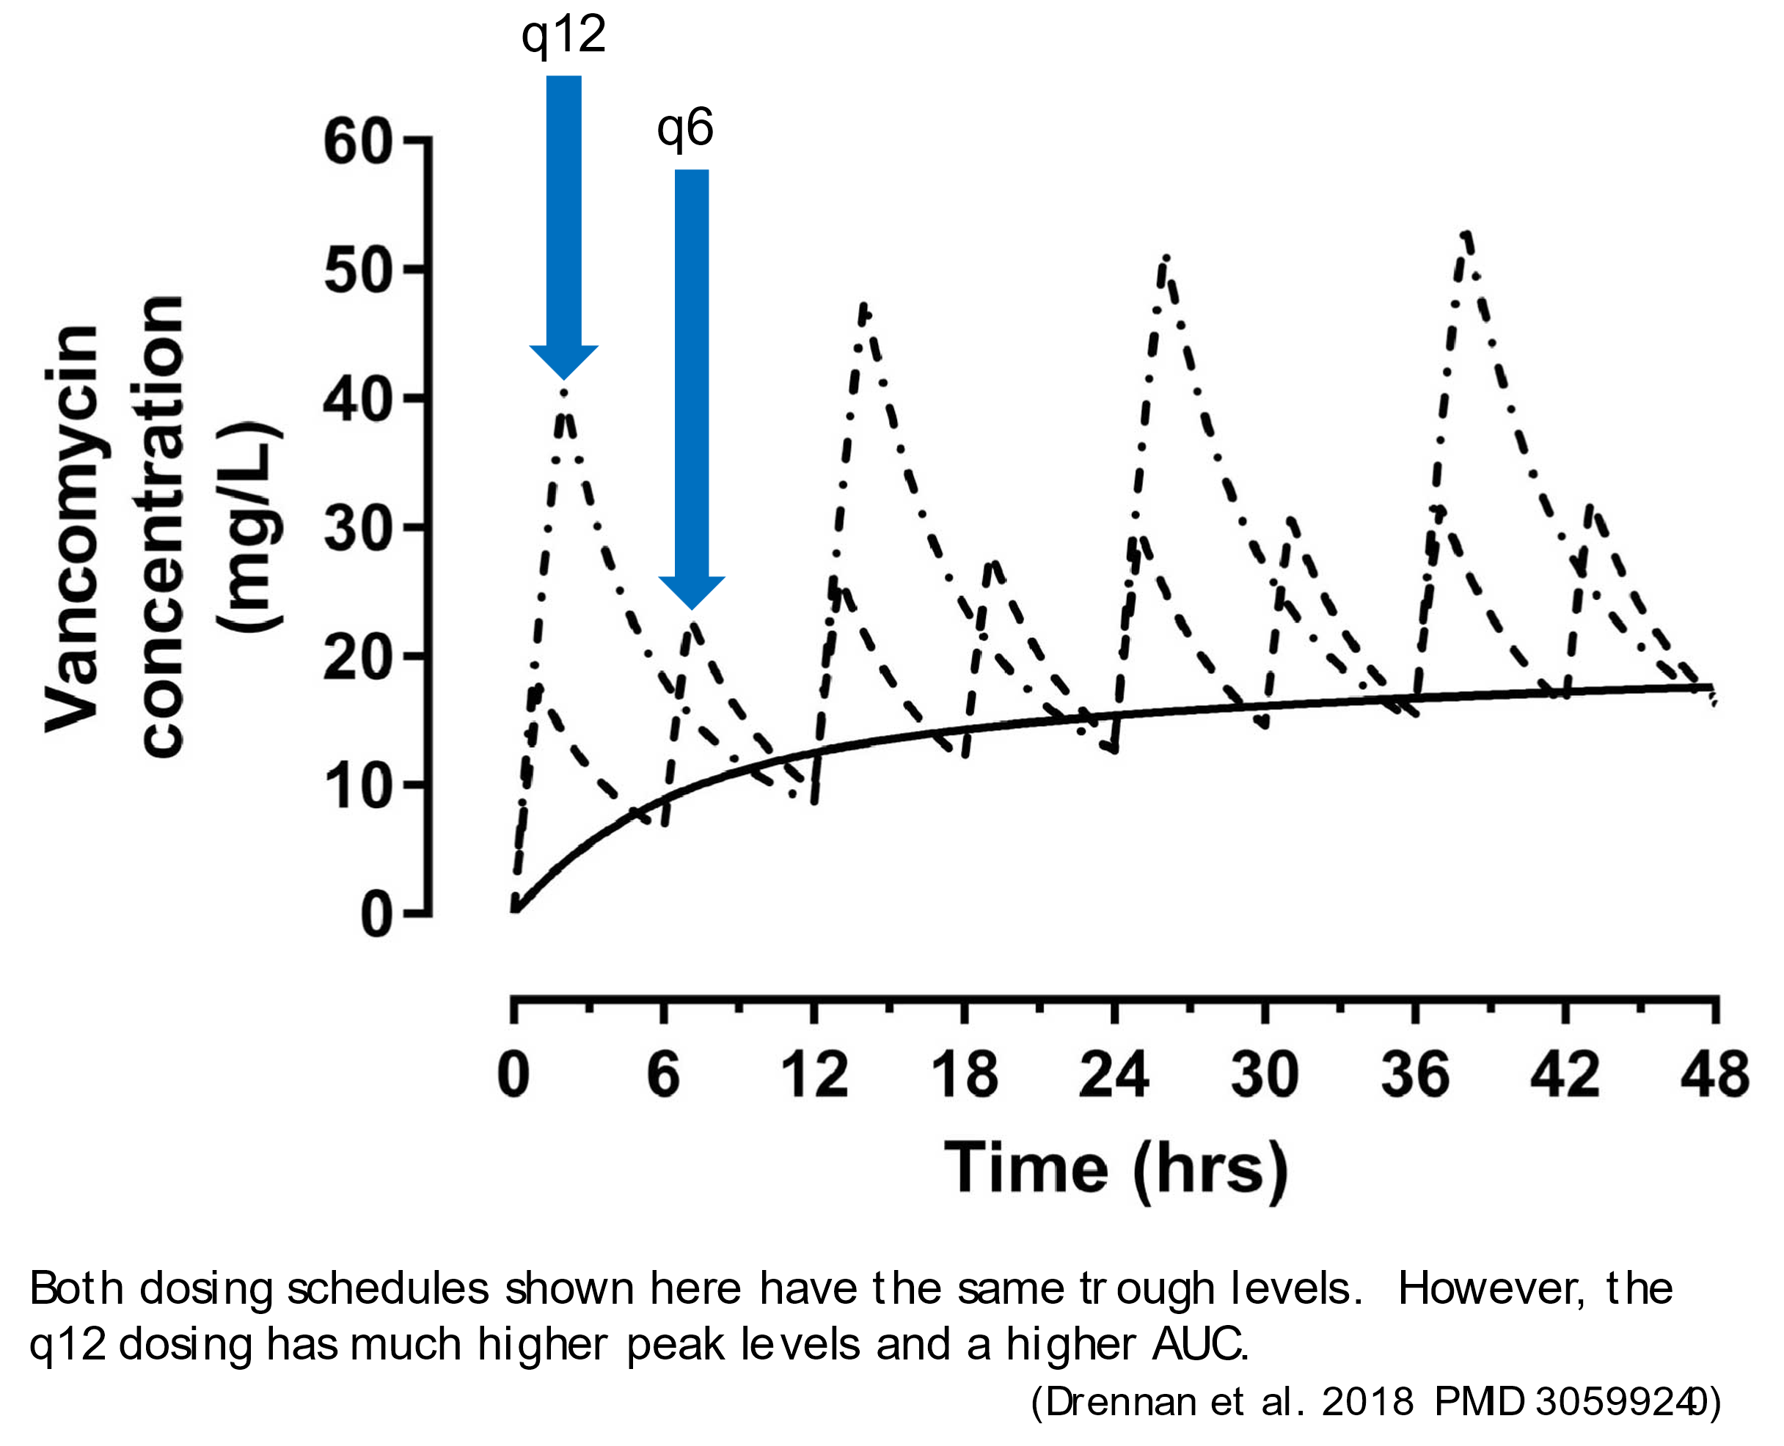
f AUC:MIC
Somewhat flexible on dosing : may reach the same fAUC by different dose as well as dosing schedule
…

Slide 17
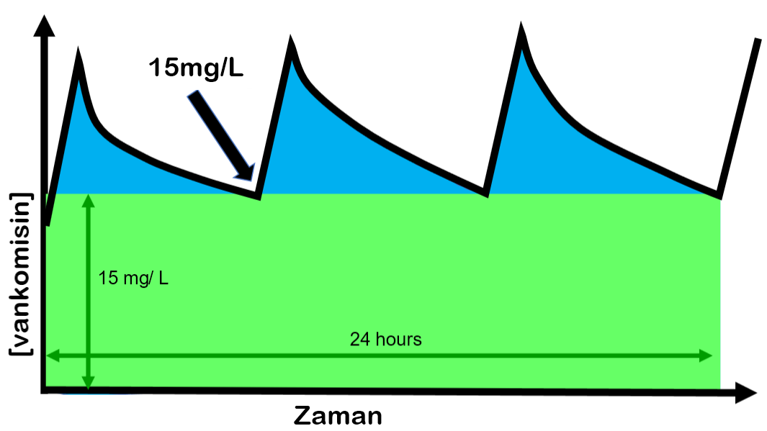
Grudge match: Dip vs. AUC
MIC creep
Through 5-10mg/L → →15 (20)mg/L
15x24=360mg/L
…
24 saat

Slide 18
AUC₂₄ 630mg/L
AUC₂₄ 500mg/L
Conti.
infusion
AUC₂₄ 370mg/L
Drennan et al. 2019. The dosing and monitoring of vancomycin: what is the best way forward? Int J Antimicrob Agents
https://emcrit.org/squirt/vanco/

Slide 19
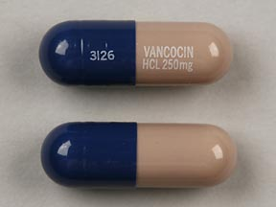
Teicoplanin (available only in Europe)
Telavancin
Similar to vancomycin
used in antibiotic-induced pseudomembranous colitis (ORAL USE!!)
NA in Turkey
«Flakon hazırlandıktan sonra, seçilen dozlar 250 mg (5ml) veya 125 mg (2.5ml), 30 ml su ile seyreltilebilir ve hastaya içmesi için verilebilir veya seyreltilen madde nazogastrik tüp ile uygulanabilir. Psödomembranöz kolit ve stafilokokal enterokolit dışındaki durumlar için vankomisin oral olarak etkili değildir»

Slide 20
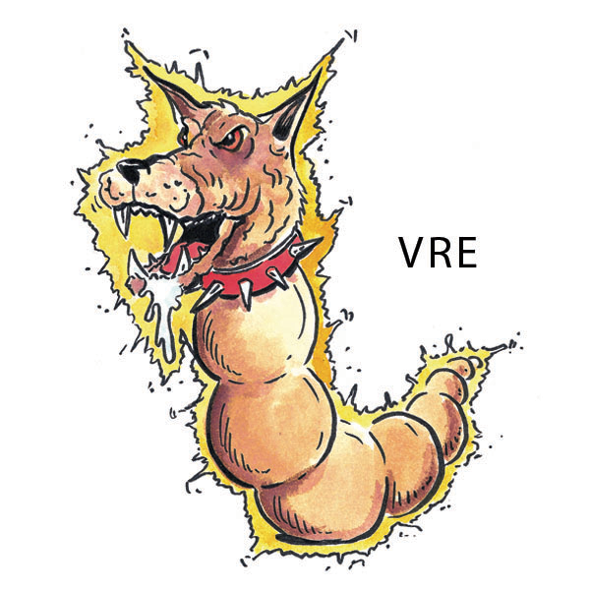
Vancomycin has activity against all Gram +
that have not learned to become resistant
to it
Many Enterococci are resistant: VRE
People with colonized VRE (bacteria are present, but have no symptoms of an infection) do not need treatment.
Most VRE infections can be treated with antibiotics other than vancomycin.
Laboratory testing of the VRE can determine which antibiotics will work. For people who get VRE infections in their bladder and have urinary catheters, removal of the catheter when it is no longer needed can also help get rid of the infection.

Slide 21
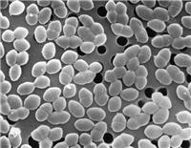
ADVERSE EFFECTS
NEPHROTOXICITY
OTOTOXICITY

Slide 22
Daptomycin
Similar to vancomycin in terms of spectrum
Skin and soft tissue infections; bacteremia and endocarditis
Basitrasin (Thiocilline®)
Topical only for mixed bacterial flora in surface
lesions of skin or mucous membranes
Highly nephrotoxic
Cycloserine
Exclusively to treat TB caused by M. Tuberculosis resistant
to first-line agents
Serious neurotoxicity
Fosfomycin
Single 3-g dose for uUTI

