Slide 1
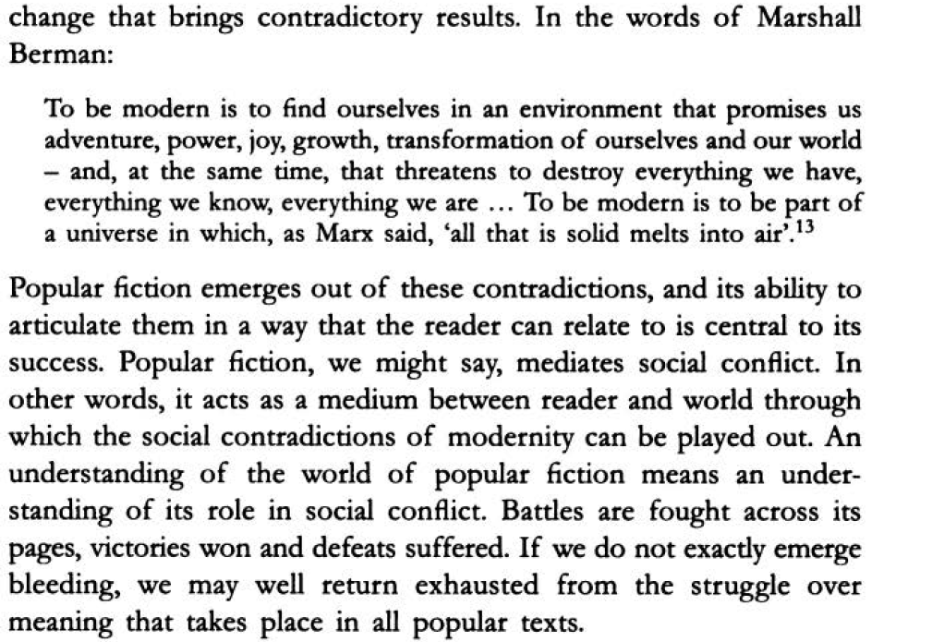
Pulp: Reading Popular Fiction, Scott McCracken

Slide 2
What Are We Doing?
Together we will take a close look at examples from different genres of popular literature
and
a) explore the reasons for their inclusion in the popular literature field
b) establish their literary value.

Slide 3
Genres
Epic
Lyric
Dramatic
Novel
Poetry
Drama

Slide 4
The Novel
Romance
Gothic
Adventure
Bildungsroman
Epistolary
Realist
Magical Realist
Historical
Sentimental
Modernist
Postmodern
Notes:
Some of these are popular fiction genres. How come we read them in the classroom? Thanks to the efforts of feminist scholars. Charlotte Brontë for instance. Her works were included in the canon much later and at the time they were written they were taken seriously only because they were published under a male name. So we might say that works produced by women belonged to the category of popular fiction by default up until the twentieth century (with some exceptions of course).

Slide 5
Why Genres?

Slide 6
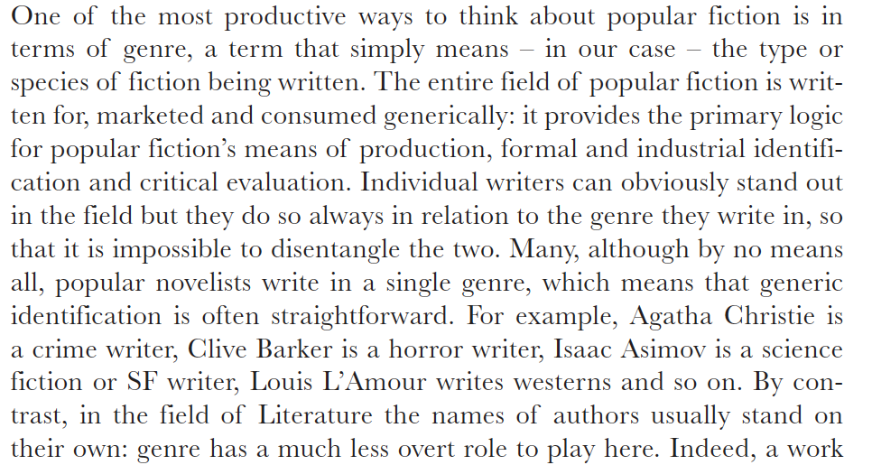
Ken Gelder, Popular Fiction

Slide 7
Consider your own experience
Why do you read popular literature?
What does it provide for you?
How do you feel when you read them?
What kind of an experience is it?

Slide 8
Addiction
Victoria Nelson explains the experience of reading popular literature as “addiction” – devouring book after book.
Do you agree?
Why is it addictive?

Slide 9
A Sense of Belonging
Each genre has its own community.
Each of these communities share a common culture.
They have many other cultural interests in common: movies, music, language, hobbies, clothes
Through literature they find a means to share all this with others.
Notes:
Example: My relationship with Terry Pratchett. When and why I read his works. If a person likes him, he/she must be a nice person, someone I can talk to, someone who speaks the same language as I do, someone who shares a similar view of life. Is this stereotyping and discrimination? Maybe. But when you look at it from the group member’s perspective, we all feel this need to be included in a community of people “just like us.” Whether it is right or wrong is another debate. I personally believe it works the other way around: people who appreciate such a sense of community develop a tendency to be more inclusive. It is not a coincidence that a majority of scholars who study posthumanism are s/f readers.

Slide 10
Which Genres?
Science-fiction
Fantasy
Horror/Thriller
Crime/Detective
Humour
Flash Fiction / Micro Fiction / Fan Fiction
Graphic Novel

