Slide 1
COM258
Chapter 9: ER and EER to Relational Mapping

Slide 2
Outline
Mapping ER to Relations
Mapping EER to Relations

Slide 3
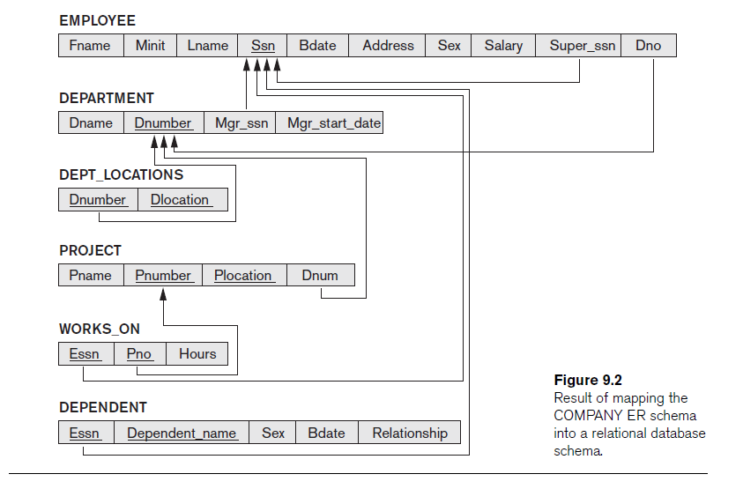
Mapping ER to Relations
A relational database schema is produced using conceptual schema ER or EER and seven plus one – eight steps algorithm

Slide 4
Mapping ER to Relations
Step 1. Mapping Regular Entity Types
For each entity type in ER schema, a relation R is created
R includes all the simple attributes of given entity

Slide 5
Mapping ER to Relations
Step 2. Mapping Weak Entity Types
For each weak entity type in ER schema, a relation R is created
R includes all the simple attributes of given entity and primary key attribute of owner as foreign key attributes of R

Slide 6
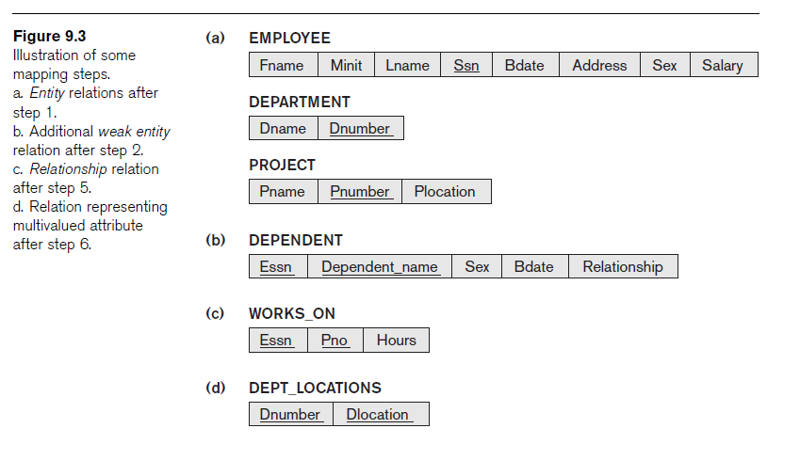
Mapping ER to Relations

Slide 7
Mapping ER to Relations
Step 3. Mapping of Binary 1:1 Relationship Types
In this step we have three approaches:
Foreign key approach
Merged relationship approach
Relationship relation approach

Slide 8
Mapping ER to Relations
Step 4. Mapping of Binary 1:N Relationship Types
For each binary 1:N relationship type
We need to identf relation tha is at the N side of relation.
Other entity’s primary key is included as foreign key.
The simple attributes in 1:N relationship is included.

Slide 9
Mapping ER to Relations
Step 5. Mapping of Binary M:N Relationship Types
For each M:N relationship:
Create a new relation S
The primary key attributes of the entities that participate in this relationship are included as foreign key attributes in S
Include simple attributes of M:N relationship

Slide 10
Mapping ER to Relations
Step 6. Mapping of Multivalued Attributes
For each multivalued attribute
Create a new relation R
Primary key of R will be the combination of attribute itself and primary key of the owner of that multivalued attribute.

Slide 11
Mapping ER to Relations
Step 7. Mapping of N-ary Relationship Types
For each n-ary relationship type R
Create a new relation
Include primary keys of all participating entity types as foreign keys
Include simple attributes

Slide 12
Mapping EER to Relations
Step 8 (for EER). Mapping Specialization or Generalization
8A: Multiple Relations-Superclass and subclasses
8B: Multiple Relations-Subclass relations only
8C: Single relation with one type attribute
8D: Single relation with multiple type attributes

Slide 13
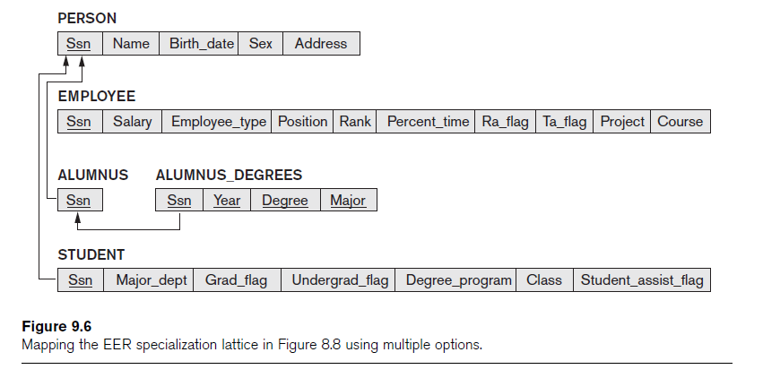
Mapping EER to Relations

