Slide 1
ENGLISH FOR BUSINESS LIFE
Lecture 5
Congress, symposiums, conferences, workshops

Slide 2
Conferences, Meetings, Symposiums,
Workshops,
What do you expect when attending international or national meetings, symposiums, conferences, workshops etc in the field of geosciences?
a) while you are studying; undergraduate, graduate, Ms,PhD
b) while you have already a job or looking for another job
-New books, journals, equipments, methods are displayed,
-To meet people to discuss your technical and scientific needs, problems?
To search for job,
?? What else?

Slide 3
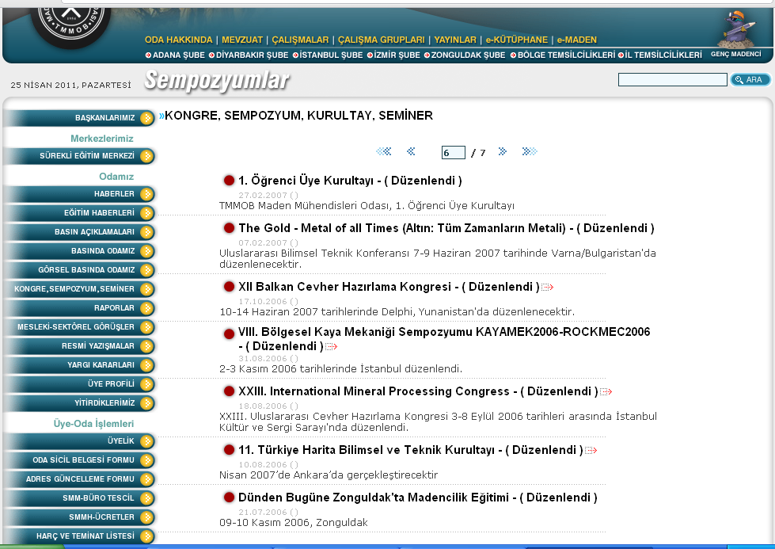

Slide 4
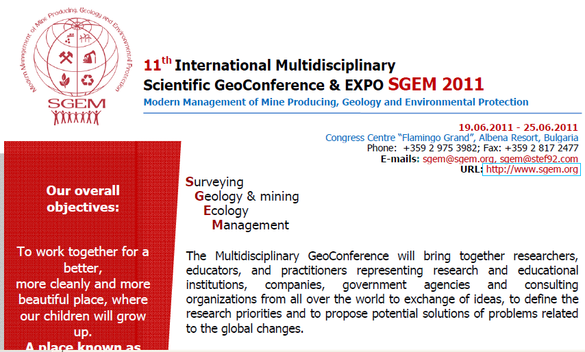

Slide 5
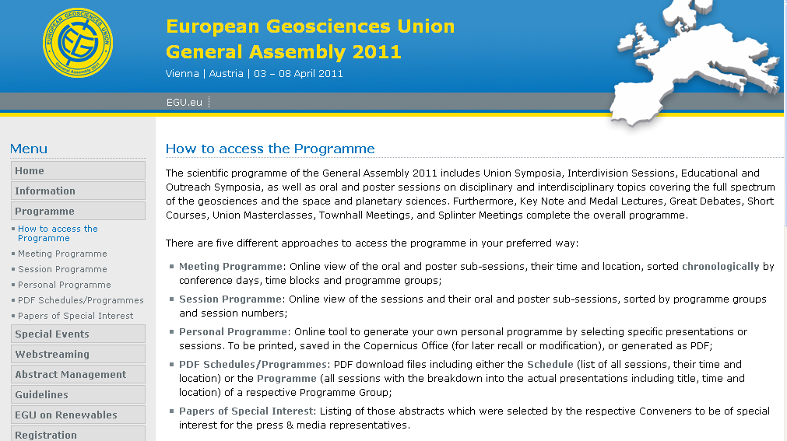
Key Note and Medal Lectures, Great Debates, Short Courses, Townhall Meetings, Splinter Meetings etc.

Slide 6
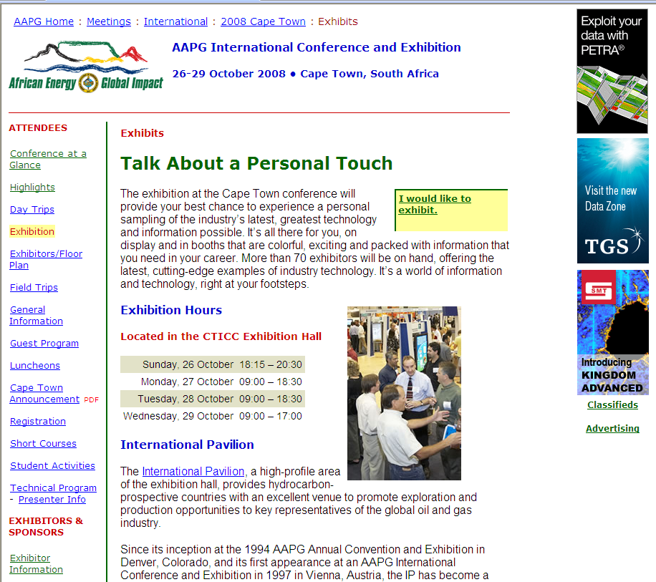

Slide 10
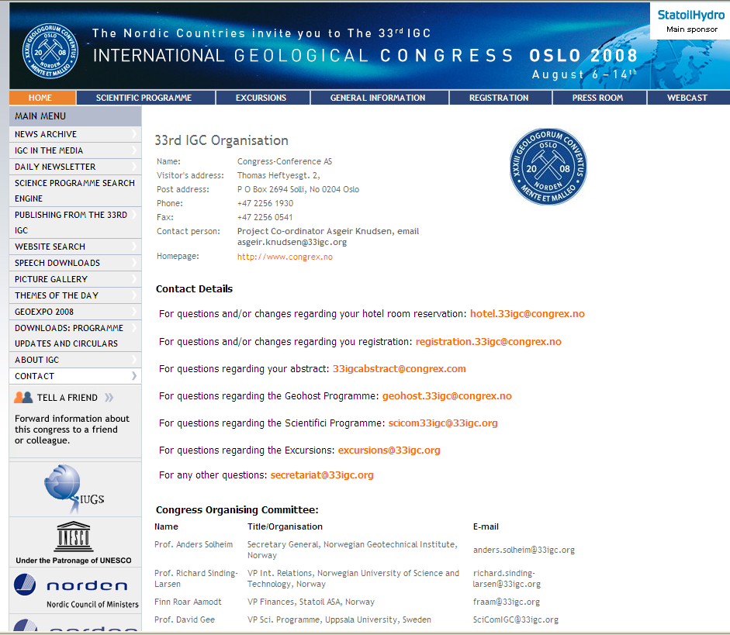

Slide 14
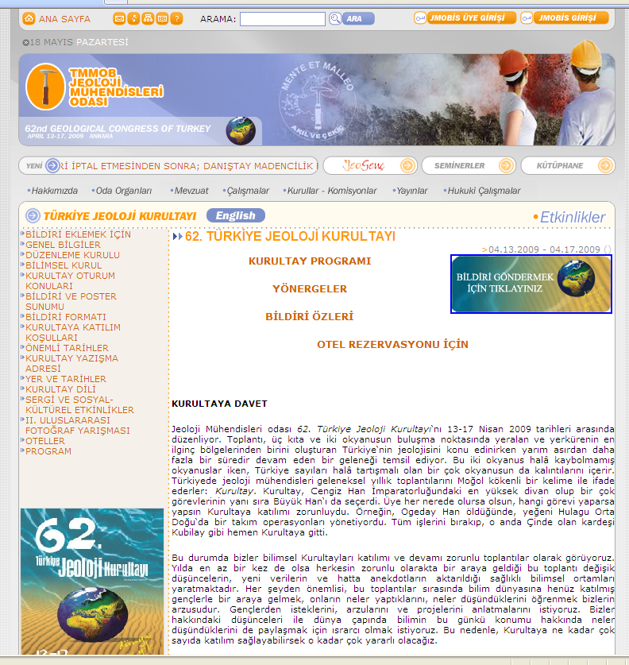

Slide 15
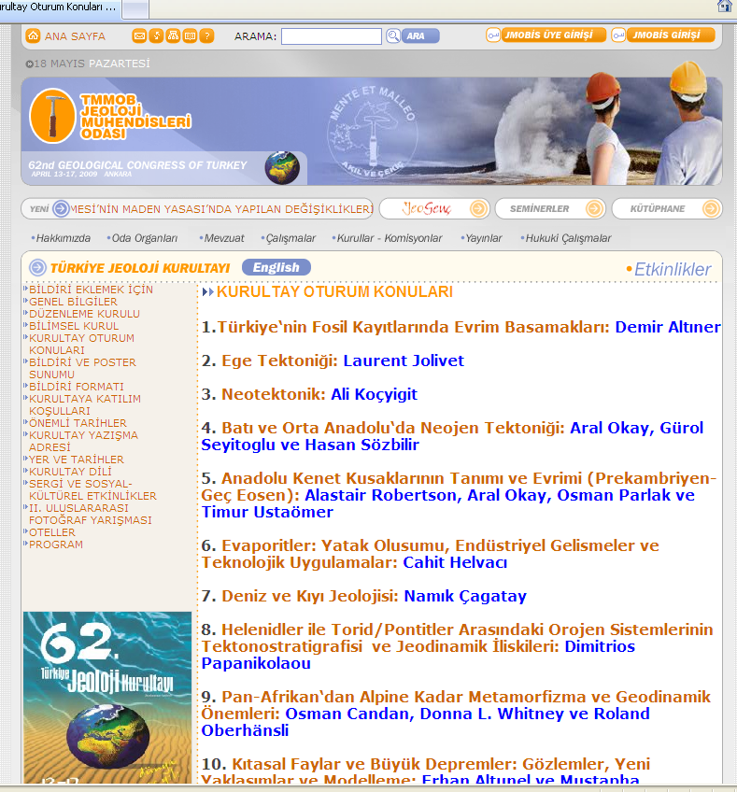

Slide 17
