Slide 1
AVIAN PHYSIOLOGY Digestive System
Doç. Dr. Dr. Yasemin SALGIRLI DEMİRBAŞ
Resident ECAWBM (BM)

Slide 2
Large Intestines
Description
Large intestine is much shorter when compared to small intestine
The length of large intestine is 10 cm.
The diameter is twice the diameter of small intestine.
It extends from small intestine to cloaca.
Function
It helps to maintain water balance by water absorption.
Chloride (Cl−) ions are secreted in the rectum, ceca, and coprodeum
dries out indigestible foods and eliminates waste products.

Slide 3
Ceca
In some species, the ceca may be absent (e.g., Psittaciformes, Apodiforms, and Piciforms) or rudimentary (e.g., Columbiformes and Piciformes).
In other species, they are either paired (e.g., herbivores, most granivores, and owls), singular (Ardeidae), or consist of a double pair (secretary bird).
The ceca empty their contents two or three times a day.
The cecae empty themselves, resulting in a cecal dropping, which is sticky, somewhat foamy, and lighter in colour.
They produce pasty droppings that often smell worse than regular droppings and often mustard to dark brown in color.
The frequency of cecal droppings, as well as their appearance among regular droppings, tells you if the digestive tract is functioning normally.

Slide 4
Ceca
Function
It takes part in digestion of carbonhydrate, proteins, and crude fiber with the help of bacterial action.
Re-absorption of water takes place in the ceca.
Fermentation of coarse materials and roduction of the eight B vitamins (Thiamine, riboflavin, niacin, pantothenic acid, pyridoxine, biotin, folic acid and vitamin B12) also occur in the ceca.
Acts as an immune organ
Because the ceca are located near the end of the digestive tract there is minimal absorption of any nutrients released.

Slide 5
Colon
The colon, sometimes called the rectum, is relatively short, linking the ileum with the coprodeal compartment of the cloaca.
Although the colon of mammals has no villi and many goblet cells, the colon of birds has numerous flat villi and relatively few goblet cells.
The avian rectum has relatively few crypts, and they are shorter than in mammals

Slide 6
Cloaca
Also known as the vestibule.
Function: responsible for expulsion of feces and urine through the vent.
It is the bulbous/enlarged area located at the end of large intestine
It is also known as common sewer because it receives the openings from digestive system, reproductive system and urinary system
External opening of the cloaca is known as vent and its size is variable depending upon the productivity of the birds.

Slide 7
Accessory Digestive Glands
There are three accessory digestive glands which play a vital role in the process of digestion
Salivary Glands
Pancreas
Liver

Slide 8
The salivary glands
The saliva has following functions:
Lubrication of the feed.
Digestion, it contains salivary amylase which is responsible for carbohydrates digestion.
Acts as a buffer, it contains bicarbonate and other salts.
Helps tasting the feed.
Protects the mucous membrane and keeps it moist.
Helps regulate the body temperature.
Contain enzyme known as muramidase which is bacteriocidal in nature and thus it produces the local immunity

Slide 9
Pancreas
Pancreas produces a pancreatic juice.
Its pH is 6.9
It is released in the distal end of the loop of duodenum.
Pancreatic juice contains four kinds of enzymes;
Proteolytic Enzymes
Lipolytic Enzyme
Carbonhydrate splitting Enzymes
Nucleolytic Enzymes

Slide 10
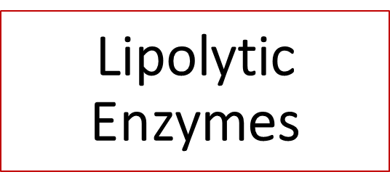
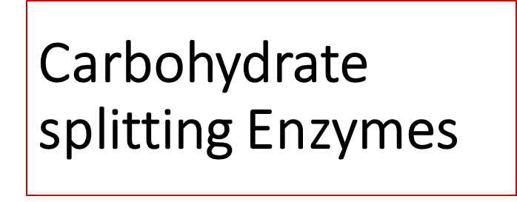
Proteolytic Enzymes
Carbohydrate splitting Enzymes
These consist of:
Pancreatic amylase, acts on the starch and converts it into simpler units.
Invertase, acts on the sucrose and convert it into simpler sugar.
There are five different kinds of proteolytic enzymes
Trypsinogen
Chymotrypsinogen A
Chymotrypsinogen B
Procarboxy peptidase A
Procarboxy peptidase B
These enzymes are responsible for the break down of protein molecules into simpler units.
There are three type of lipolytic enzymes which are produced by the pancreas;
Phospholipase, lipid breakdown.
Pancreatic lipase, lipid breakdown.
Cholesterol esterase, esterification of cholesterol.

Slide 11
Nucleolytic Enzymes
There are two kinds of nucleolytic enzymes:
Ribonuclease
Deoxyribonuclease
Besides enzymes, pancreatic juice also contains cations and anions.
Cations:
Na+, K+, Mg++, etc.
These act as buffer, cofactors, and osmotic regulators.
Anions:
HCO3-
These mainly act as buffer and osmotic regulators

Slide 12
Liver
Multi-lobed organ
Functions:
Detoxification.
Store of vitamins and carbohydrates, carbohydrates are stored in the form of glycogen.
Formation plasma protein like albumin and globulin.
It activates and inactivates the protein and peptide hormones.
Liver is a site for the destruction of old RBCs.
Formation of bile, which is responsible for the emulsification of the fat.

Slide 13
Control of GIS
The activities of gastrointestinal tract are controlled by:
Nervous system
Endocrine system
The nervous system
In particular, the autonomic nervous is responsible for controlling the activity of gastrointestinal tract.
The nervous system has two parts;
Parasympathetic nervous system
Sympathetic nervous system

Slide 14
Mechanism of Enzyme Production and Activation
The parasympathetic nervous system activates the gastrointestinal tract while sympathetic nervous system activates as well as deactivates the gastrointestinal tract
Stimulation of the parasympathetic to the produce saliva is occurred by:
Feed enter the oral cavity
Visual stimuli
Smell
Taste
Feed enters the Proventriculus and the walls are stretched
This stimulate the release of Gastrin hormone which stimulates secretion of gastric juice.
Feed enters small intestine
Duodenum produces secretin hormone which stimulates the pancreas to produce pancreatic juice
Fats in the duodenum
Duodenum produces cholecystokinin hormone which stimulates gall bladder to release bile.

Slide 15
Mechanism of Hunger
There are two systems or centers located in the brain or liver which controls the feeding behavior of animals
Satiety center
Appetite center
Satiety Center
It is located in the liver of the birds, while in other animals it is located in the brain.
This center is also known as glucostatiety Centre.
Level of glucose in the blood activates and stimulates the satiety center leading to cessation of feed in take.
Appetite Center
The stimulation of this Centre results in feed intake or hunger.
This centre is stimulated by low concentration of glucose in the blood.
This is located in the brain.

Slide 16
Neuropeptides
In most cases, neurotransmitters and metabolites have similar effects in birds and mammals
There are several noteworthy differences:
Peptide YY and pancreatic polypeptide decrease food intake in mammals, they stimulate food intake in birds.
Ghrelin is a potent orexigenic peptide in mammals, it is anorexigenic in birds.
Other peptides shown to be orexigenic in mammals, including melaninconcentrating hormone, orexins (A and B), and motilin, have no effect on food intake in chickens.

