Slide 1
Vascular Access techniques
ANKARA UNIVERSITY FACULTY OF MEDICINE
CARDIOVASCULAR SURGERY DEPARTMENT
NUR DIKMEN, MD.
CardIovascular surgERY, CONGENITAL HEART surgeRY

Slide 2
CENTRAL VENOUS CATHETERIZATION
1667, LOWER_ HUMAN IJV, SHEEP CAROTID ARTERY BLOOD TRANSFUSION
1928, WERNER FORSSMANN , 25 YEAR-OLD , GERMAN SURGEON, VENOUS CUTDOWN, LEFT ANTECUBITAL VEIN, 65 centimeters catheter insertion, distal part:RA.
1956 NOBEL PRIZE
NUR DIKMEN, MD.
CARDIOVASCULAR SURGERY, CONGENITAL HEART SURGERY

Slide 3
NUR DIKMEN, MD.
CARDIOVASCULAR SURGERY, CONGENITAL HEART SURGERY

Slide 4
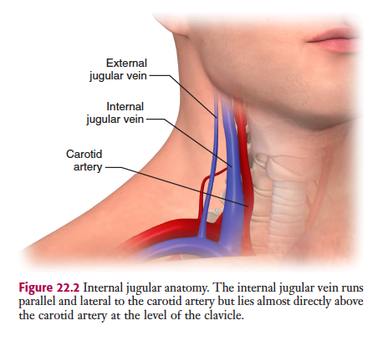
NUR DIKMEN, MD.
CARDIOVASCULAR SURGERY, CONGENITAL HEART SURGERY

Slide 5
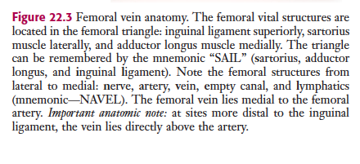
NUR DIKMEN, MD.
CARDIOVASCULAR SURGERY, CONGENITAL HEART SURGERY

Slide 6
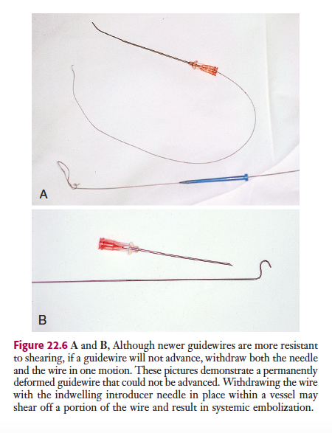
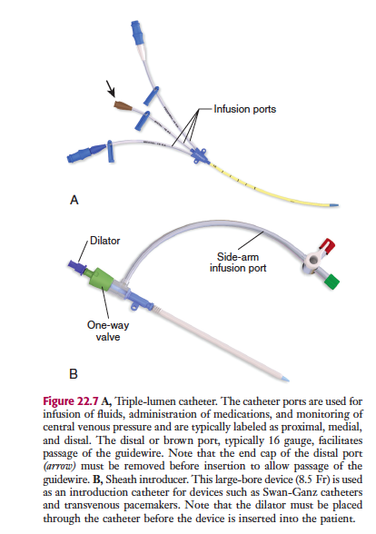
NUR DIKMEN, MD.
CARDIOVASCULAR SURGERY, CONGENITAL HEART SURGERY

Slide 7
NUR DIKMEN, MD.
CARDIOVASCULAR SURGERY, CONGENITAL HEART SURGERY

Slide 9
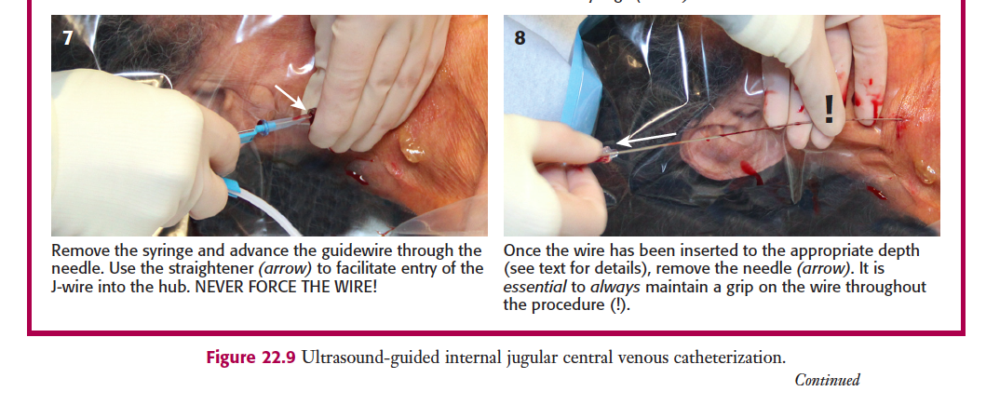

Slide 12
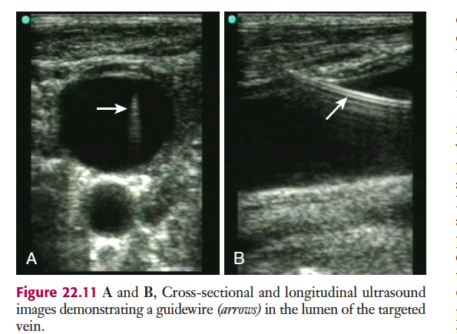

Slide 14
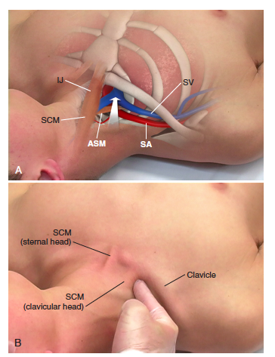

Slide 15
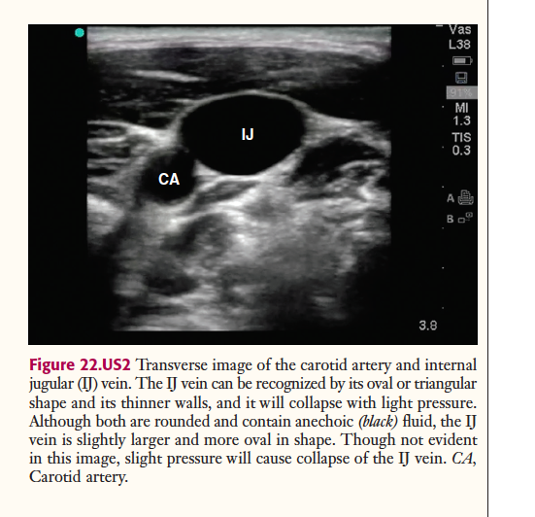
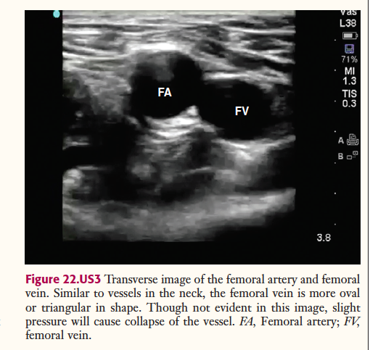

Slide 18
NUR DIKMEN, MD.
CARDIOVASCULAR SURGERY, CONGENITAL HEART SURGERY

Slide 19
THANK YOU.
NUR DIKMEN, MD.
CARDIOVASCULAR SURGERY, CONGENITAL HEART SURGERY

