Slide 1
Voltammetry-Polarography

Slide 2
Historically, the branch of electrochemistry we now call voltammetry developed from the discovery of polarography in 1922 by the Czech chemist Jaroslav Heyrovsky, for which he received the 1959 Nobel Prize in chemistry. The early voltammetric methods experienced a number of difficulties, making them less than ideal for routine analytical use.

Slide 3
However, in the 1960s and 1970s significant advances were made in all areas of voltammetry (theory, methodology, and instrumentation), which enhanced the sensitivity and expanded the repertoire of analytical methods. The coincidence of these advances with the advent of low-cost operational amplifiers also facilitated the rapid commercial development of relatively inexpensive instrumentation

Slide 4
The common characteristic of all voltammetric techniques is that they involve the application of a potential (E) to an electrode and the monitoring of the resulting current (i) flowing through the electrochemical cell. In many cases the applied potential is varied or the current is monitored over a period of time (t).

Slide 5
Thus, all voltammetric techniques can be described as some function of E, i, and t. They are considered active techniques (as opposed to passive techniques such as potentiometry) because the applied potential forces a change in the concentration of an electroactive species at the electrode surface by electrochemically reducing or oxidizing it.

Slide 6
The analytical advantages of the various voltammetric techniques include excellent sensitivity with a very large useful linear concentration range for both inorganic and organic species (10–12 to 10–1 M), a large number of useful solvents and electrolytes, a wide range of temperatures, rapid analysis times (seconds), simultaneous determination of several analytes, the ability to determine kinetic and mechanistic parameters, a well-developed theory and thus the ability to reasonably estimate the values of unknown parameters, and the ease with which different potential waveforms can be generated and small currents measured.

Slide 7
Analytical chemists routinely use voltammetric techniques for the quantitative determination of a variety of dissolved inorganic and organic substances. Inorganic, physical, and biological chemists widely use voltammetric techniques for a variety of purposes, including fundamental studies of oxidation and reduction processes in various media, adsorption processes on surfaces, electron transfer and reaction mechanisms, kinetics of electron transfer processes, and transport, speciation, and thermodynamic properties of solvated species. Voltammetric methods are also applied to the determination of compounds of pharmaceutical interest and, when coupled with HPLC, they are effective tools for the analysis of complex mixtures.

Slide 8
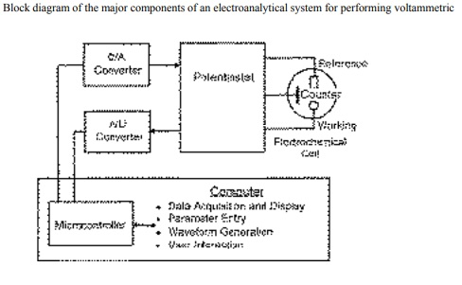

Slide 9
