Slide 1
Diversity And Classification of Flowering Plants: Eudicots: Rosids

Slide 2
ROSIDS

Slide 3
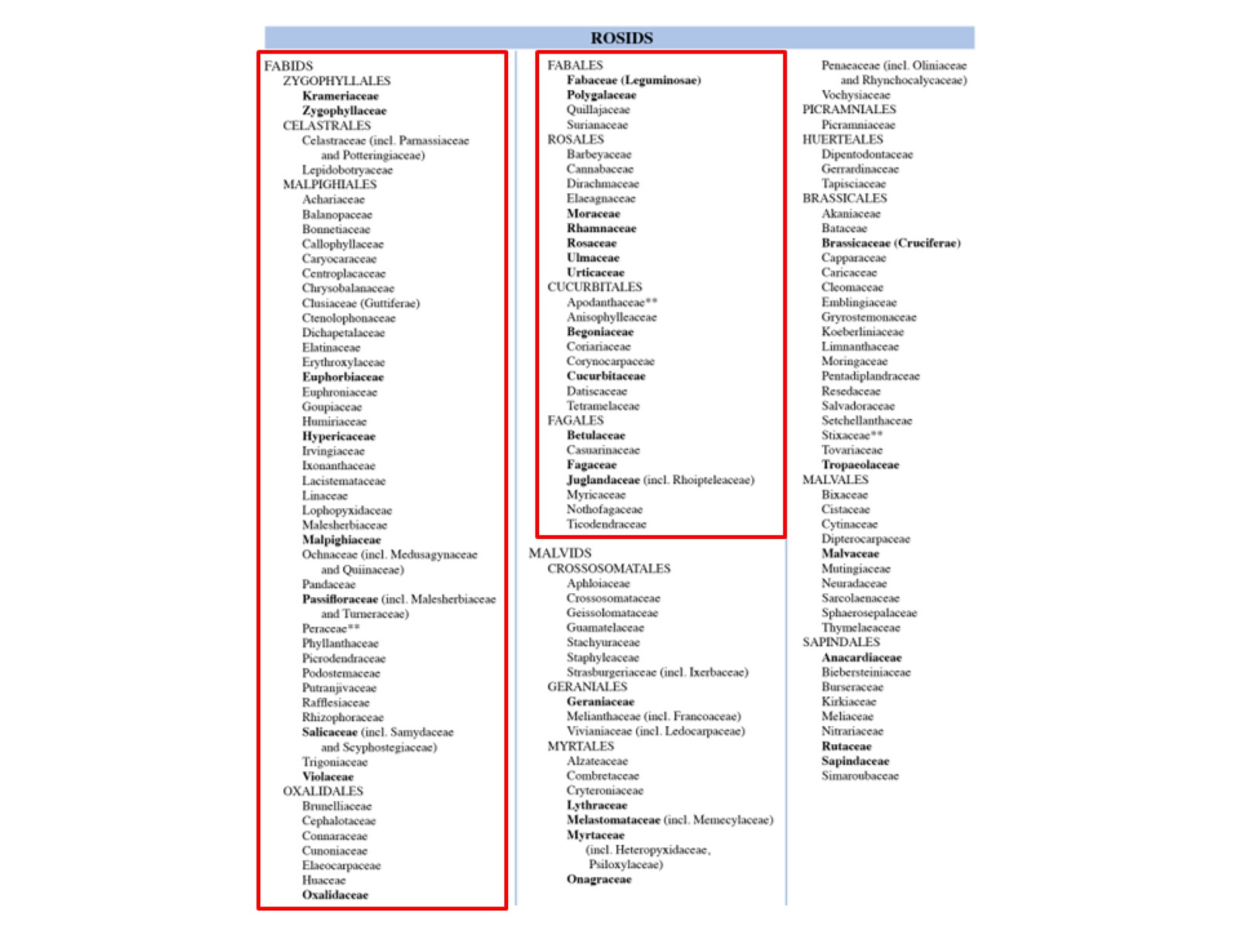

Slide 4
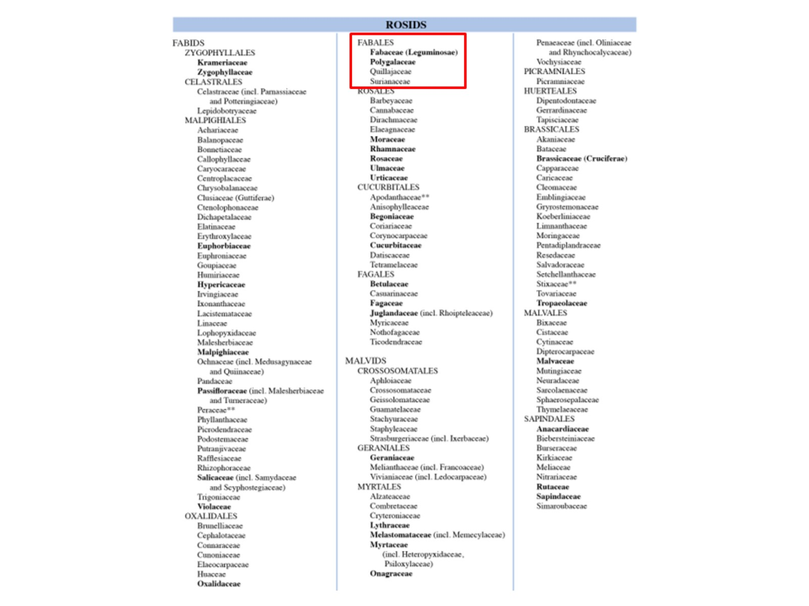

Slide 5
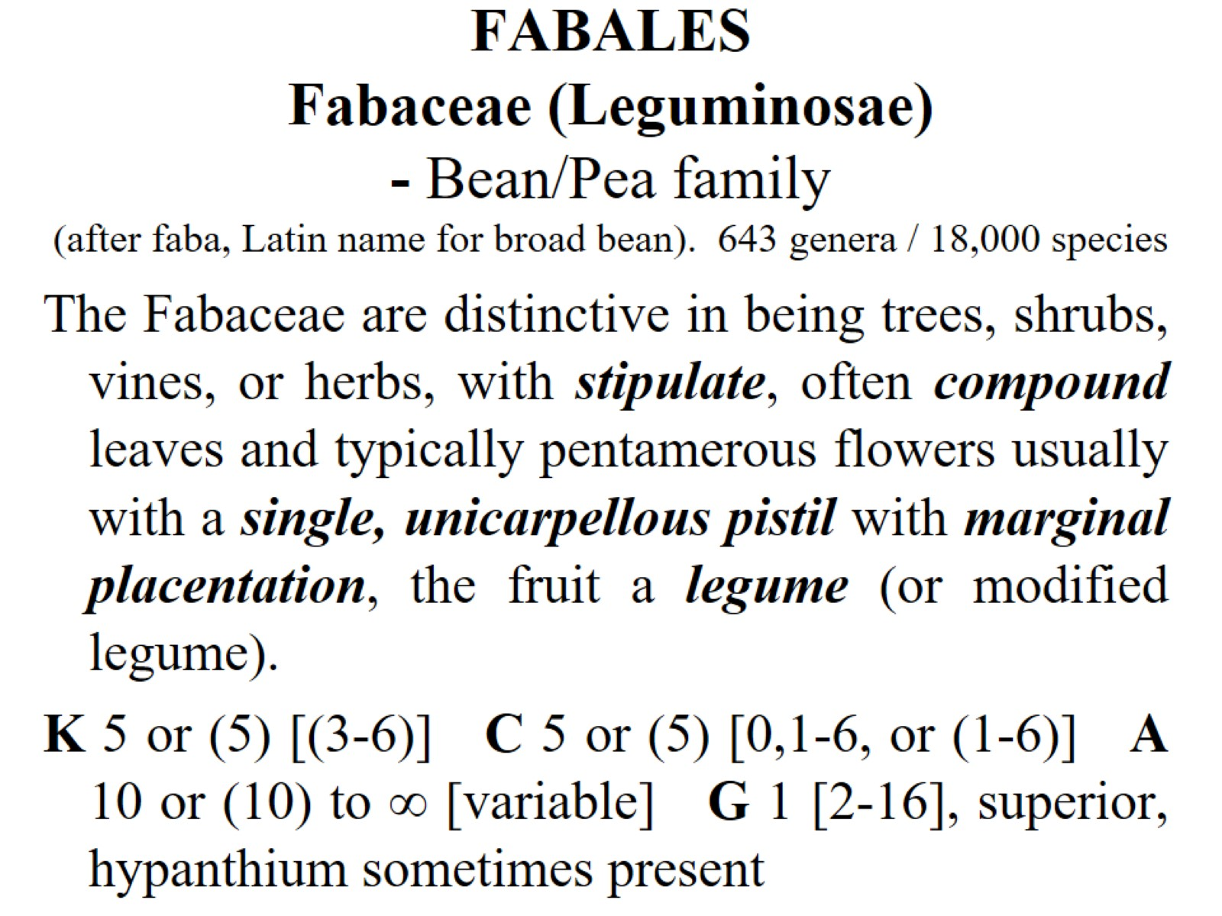
FABALES Fabaceae (Leguminosae) - Bean/Pea family (after faba, Latin name for broad bean). 643 genera / 18,000 species

Slide 6
stipulate

Slide 7
Fabaceae: 3 subfamilies

Slide 8
Caesalpinioideae

Slide 9
Mimosoideae

Slide 10
Faboideae (Papilionoideae)

Slide 11
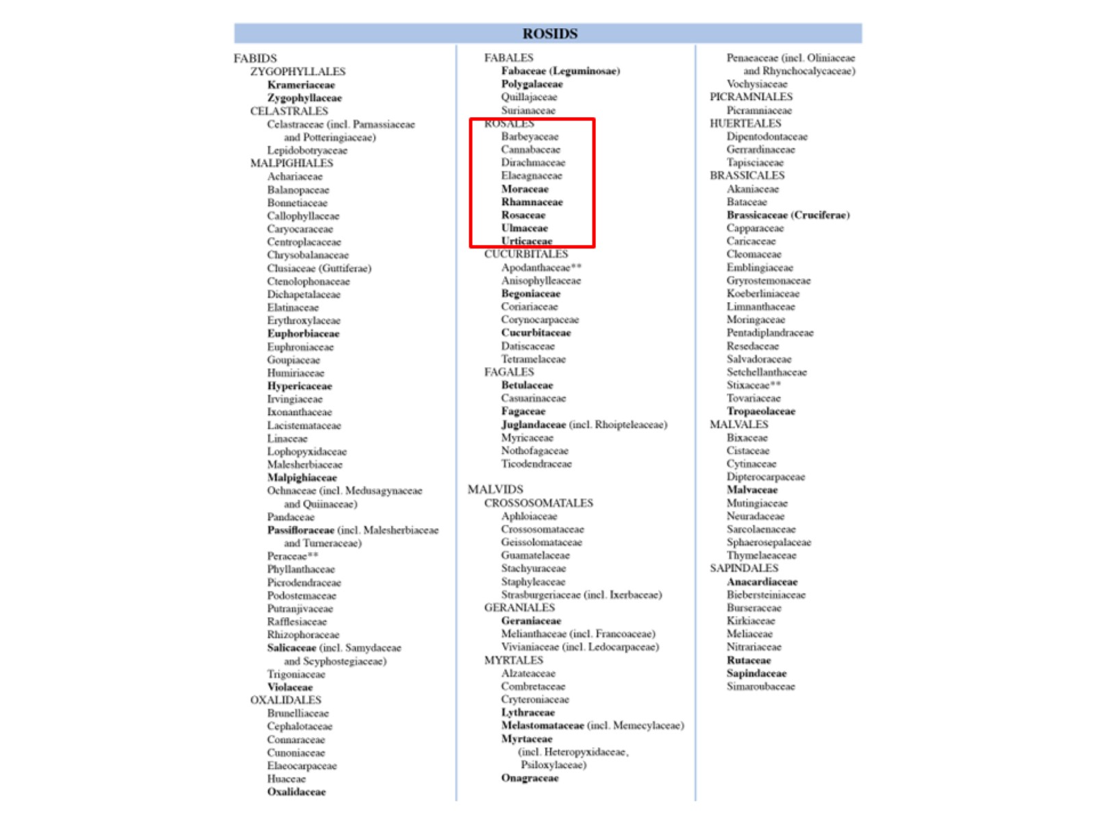

Slide 12
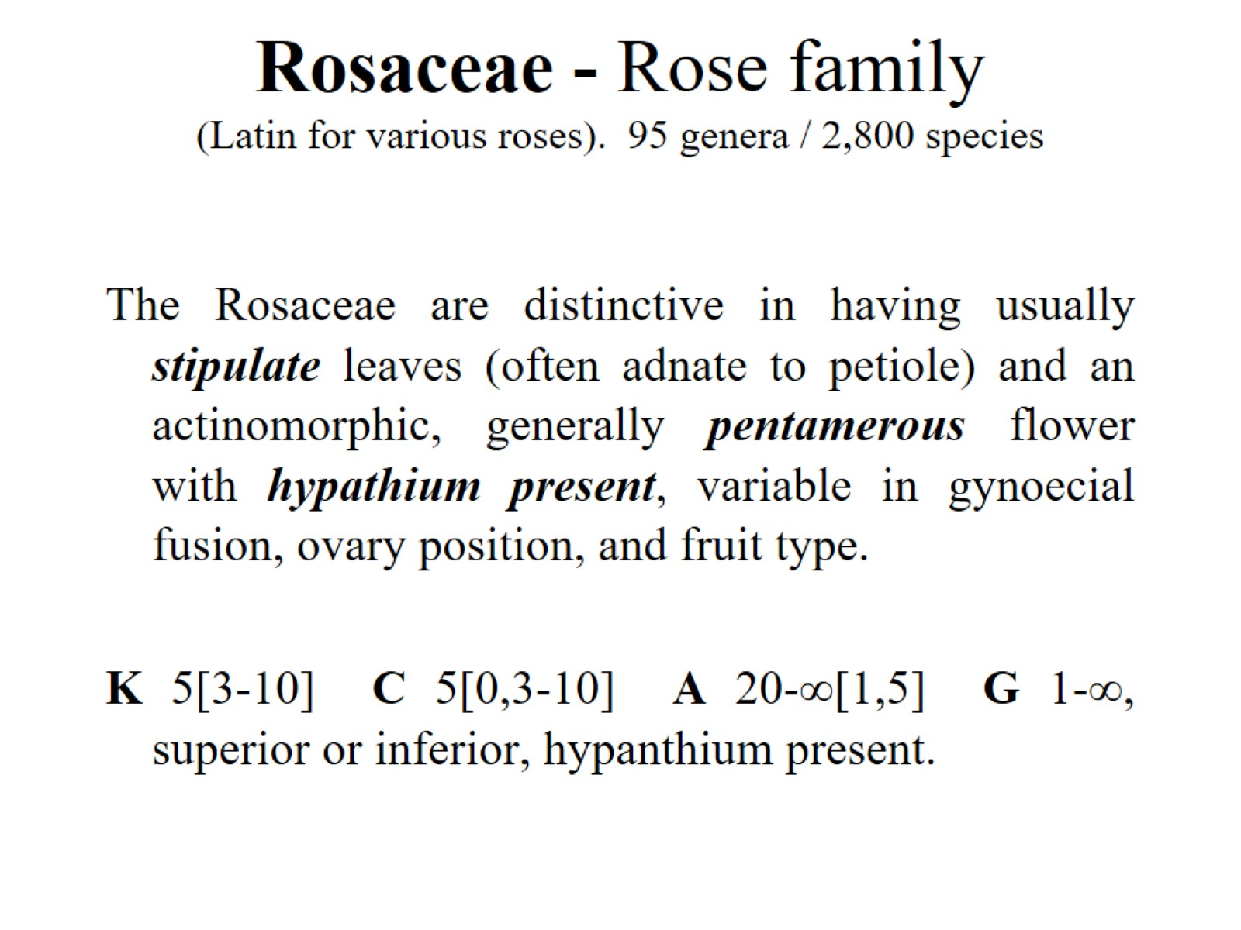
Rosaceae - Rose family (Latin for various roses). 95 genera / 2,800 species

Slide 13
pentamerous flower

Slide 14
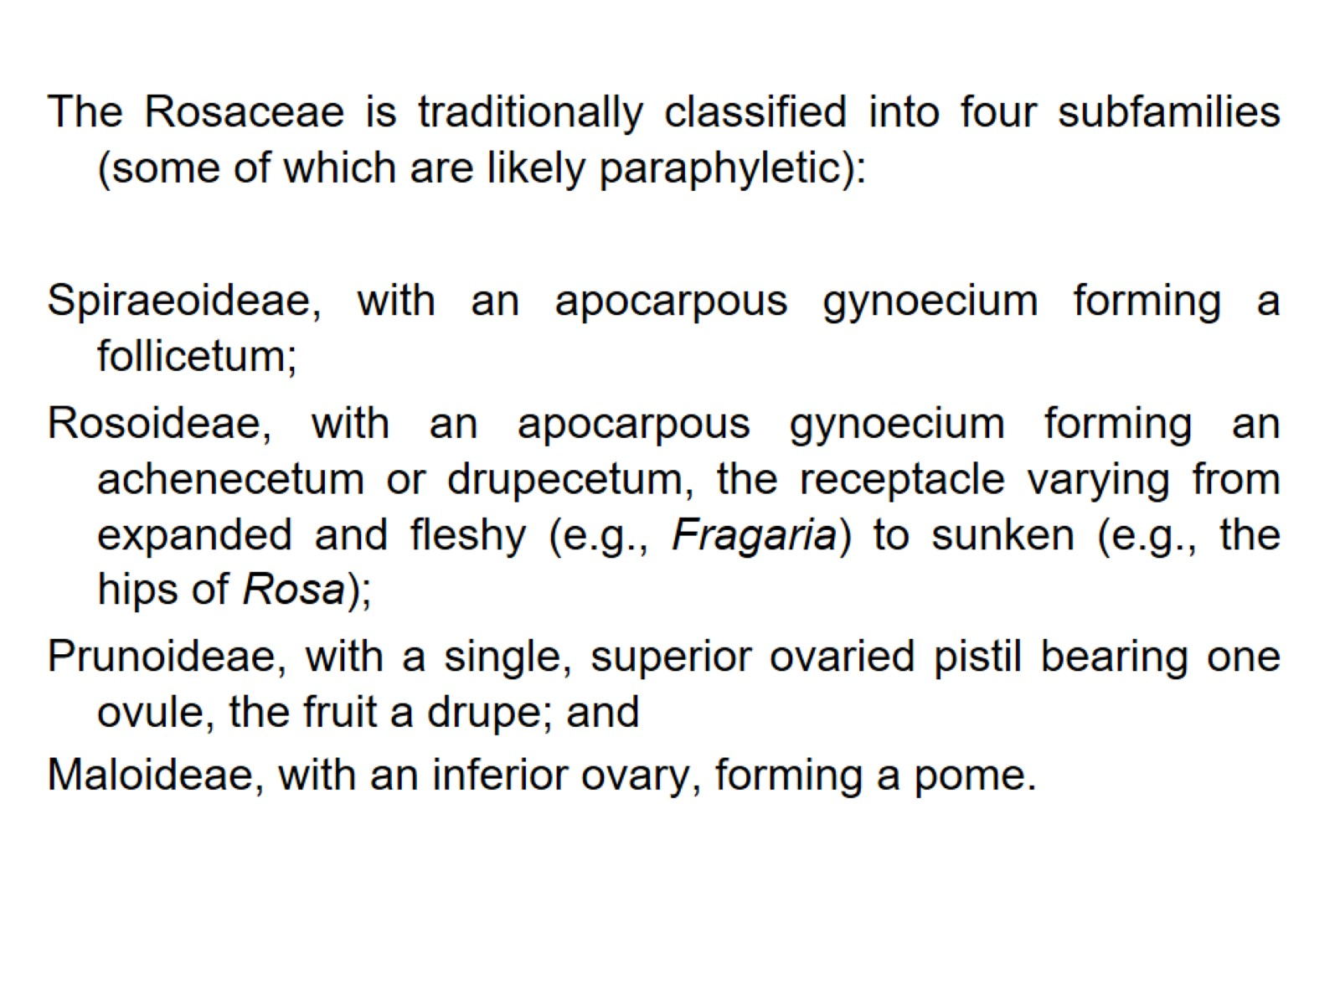

Slide 15
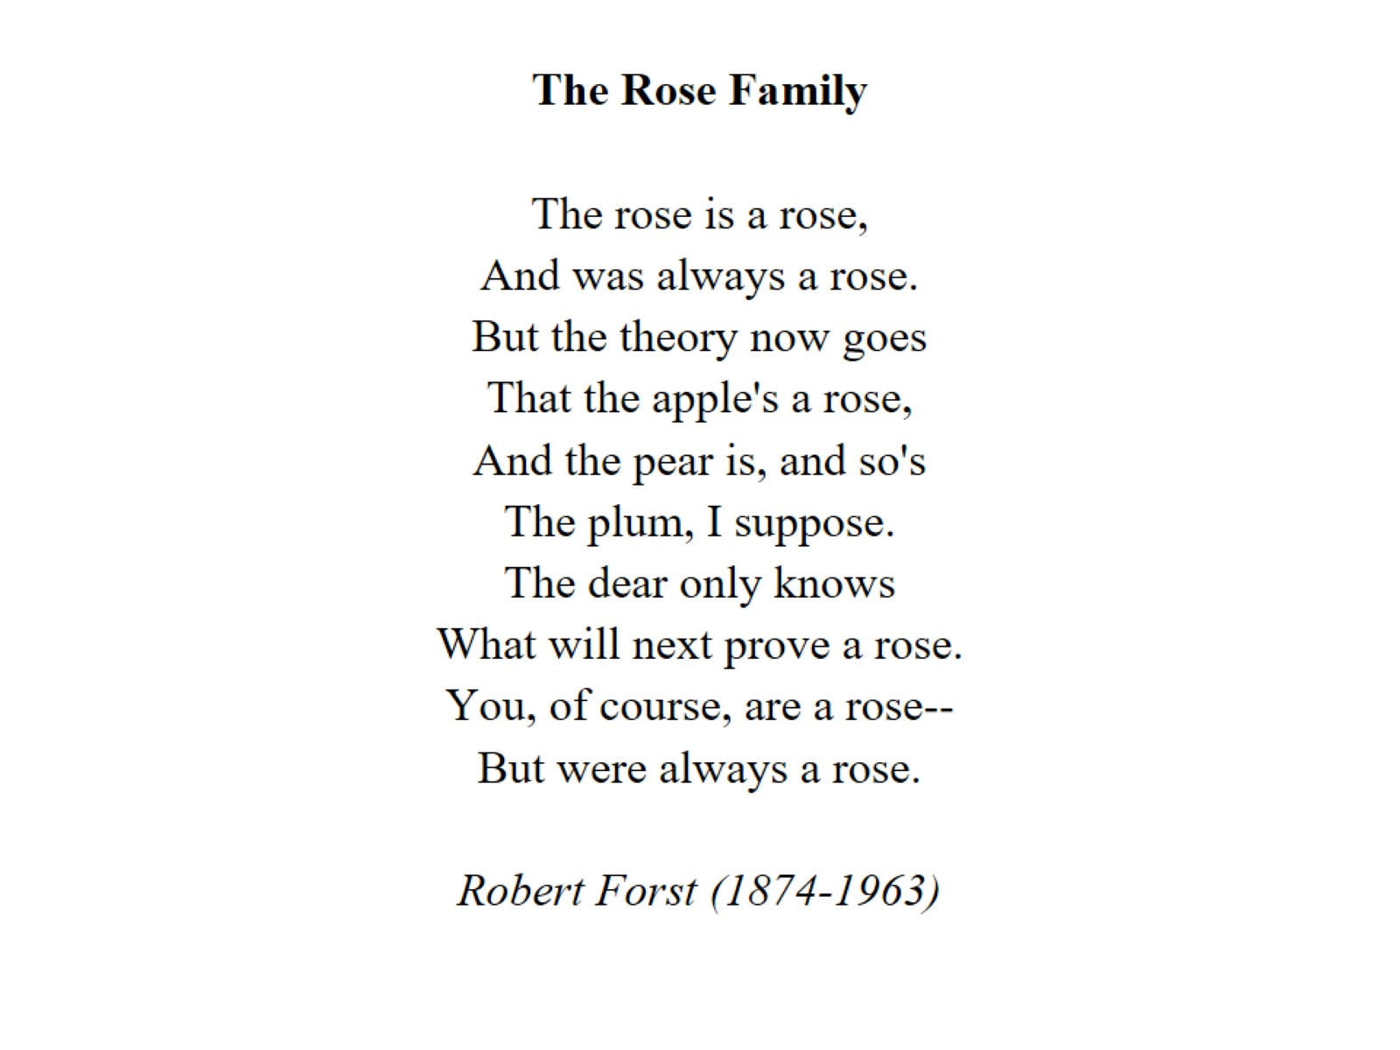

Slide 16
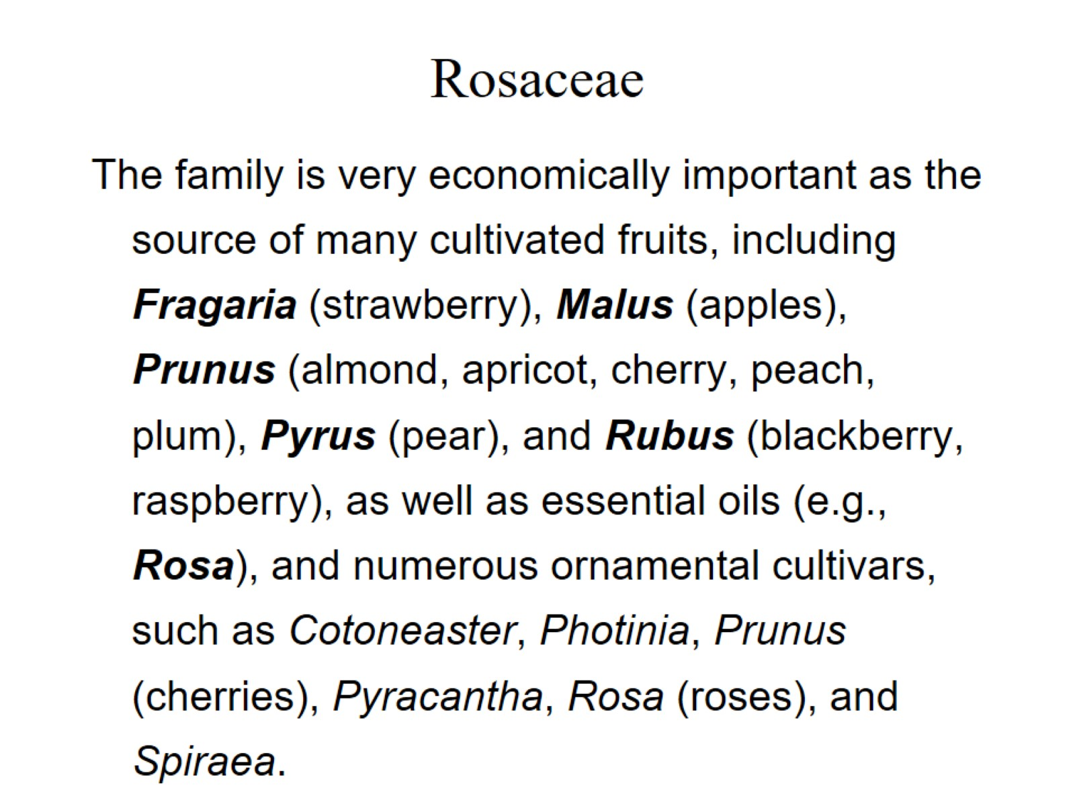
Rosaceae

Slide 17
Cucurbitaceae Cucumber / Gourd family (L. for gourd). 120 genera / 775 species.

Slide 18
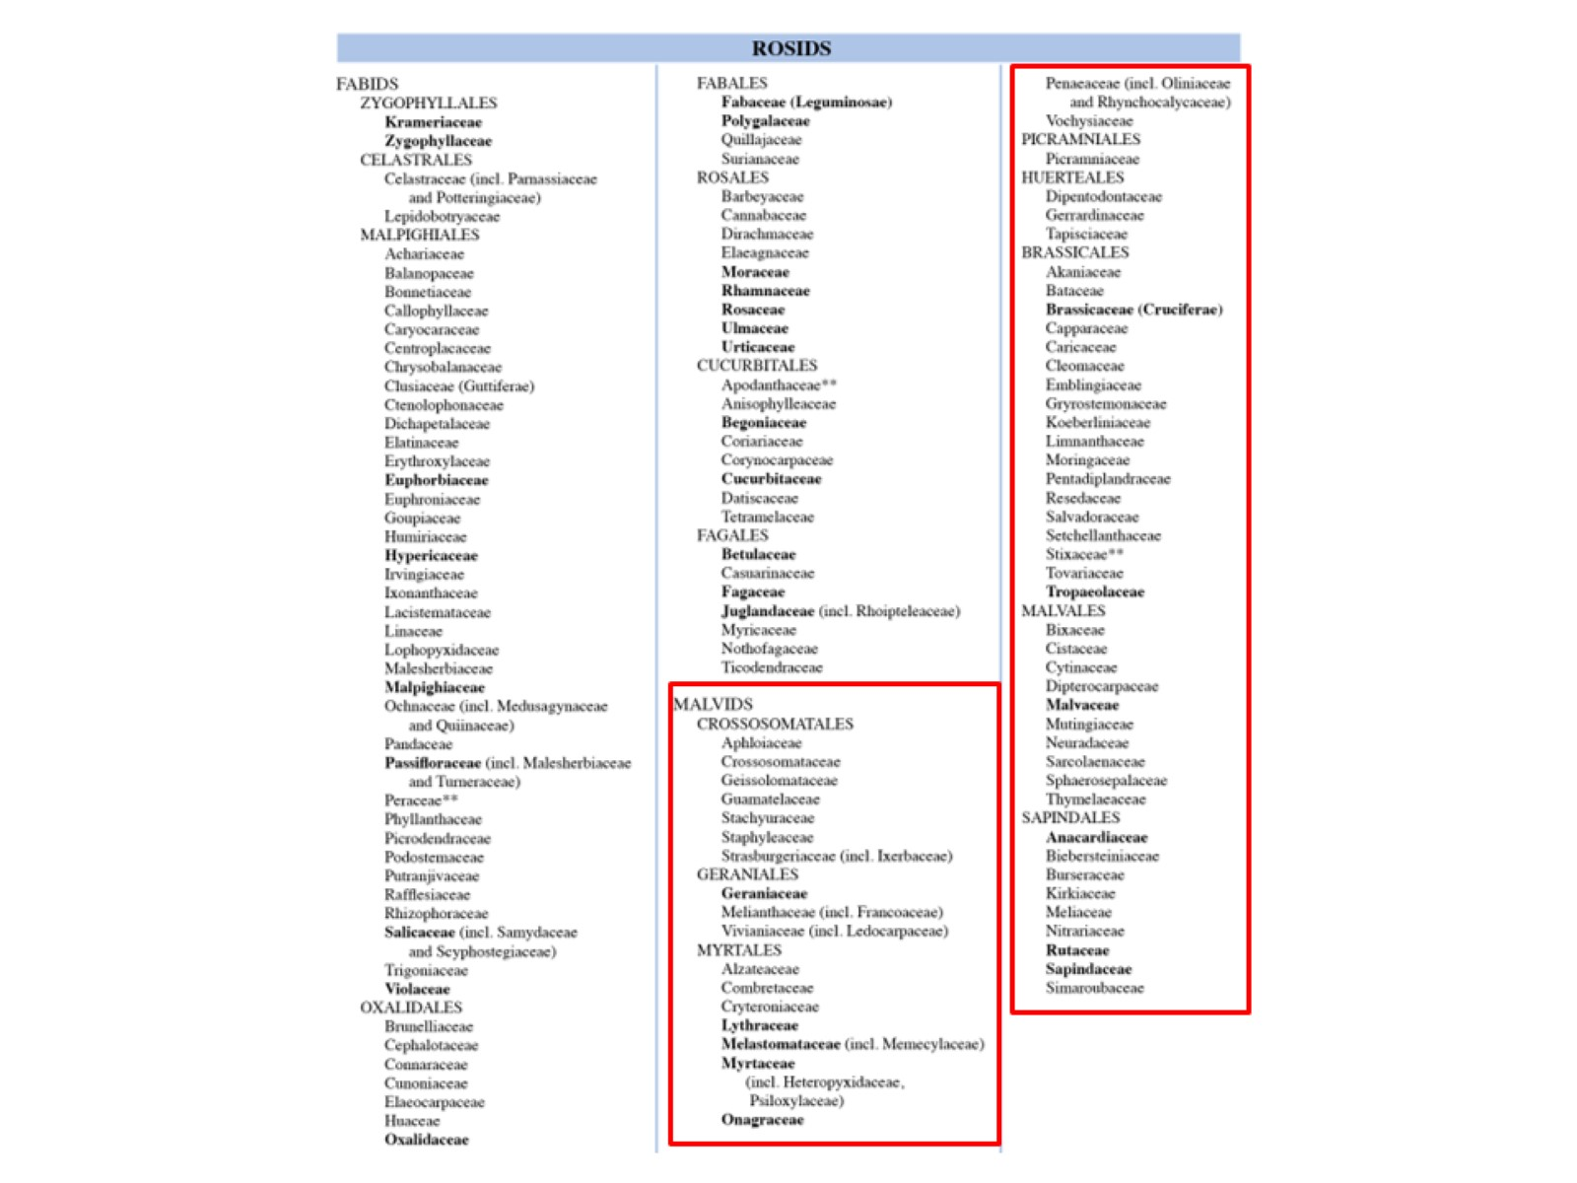

Slide 19
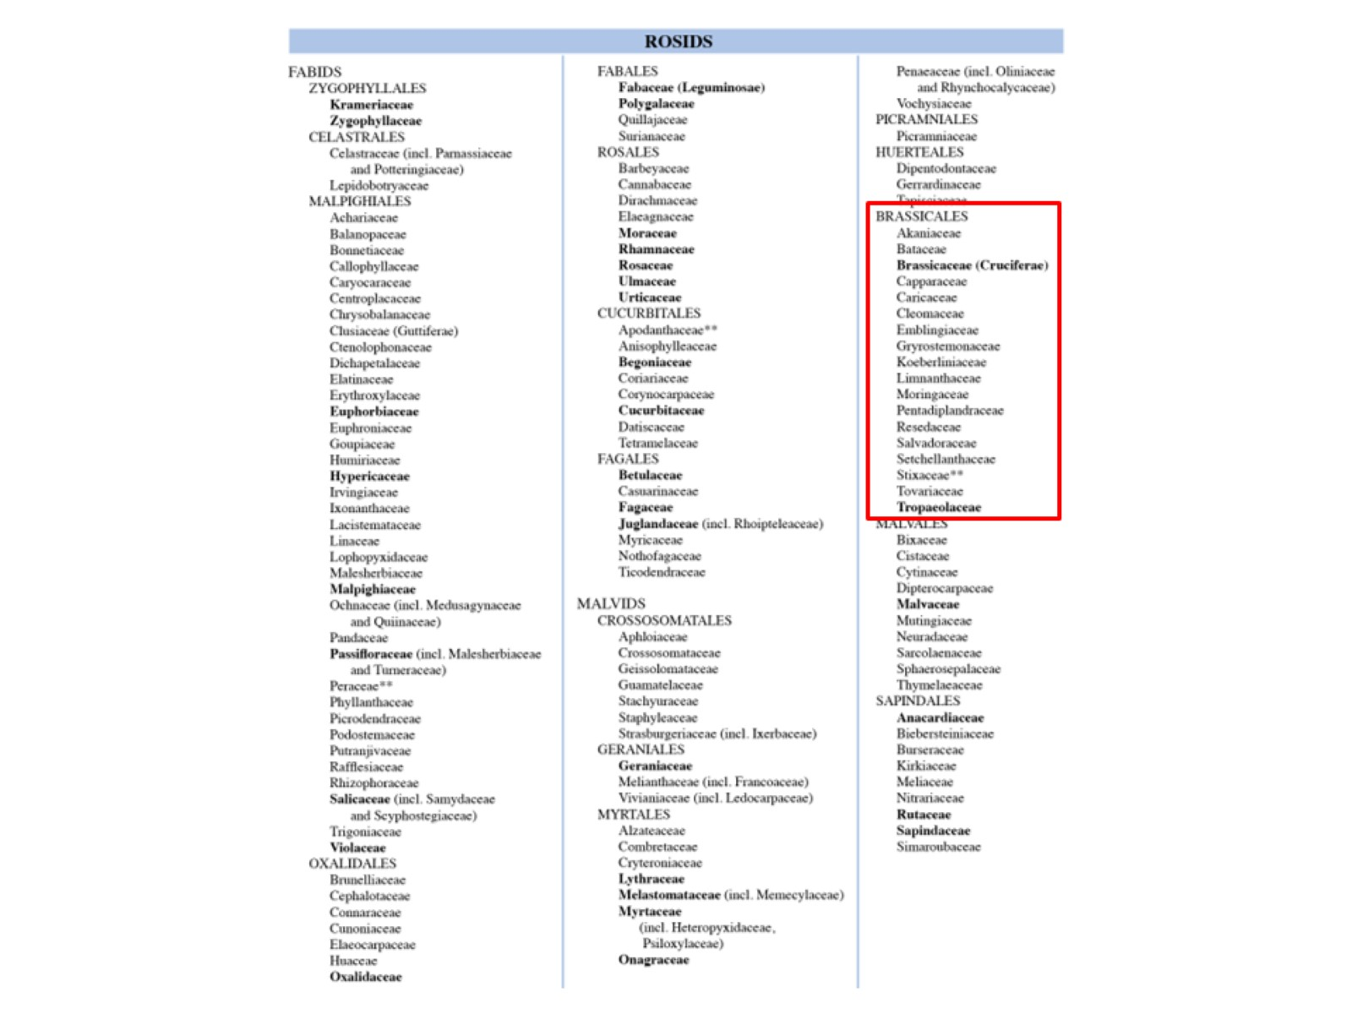

Slide 20
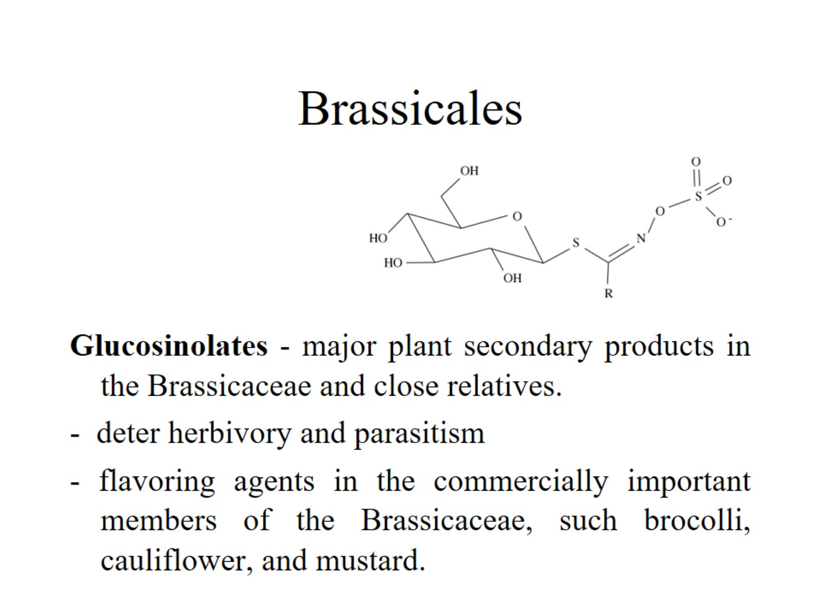
Brassicales

Slide 21
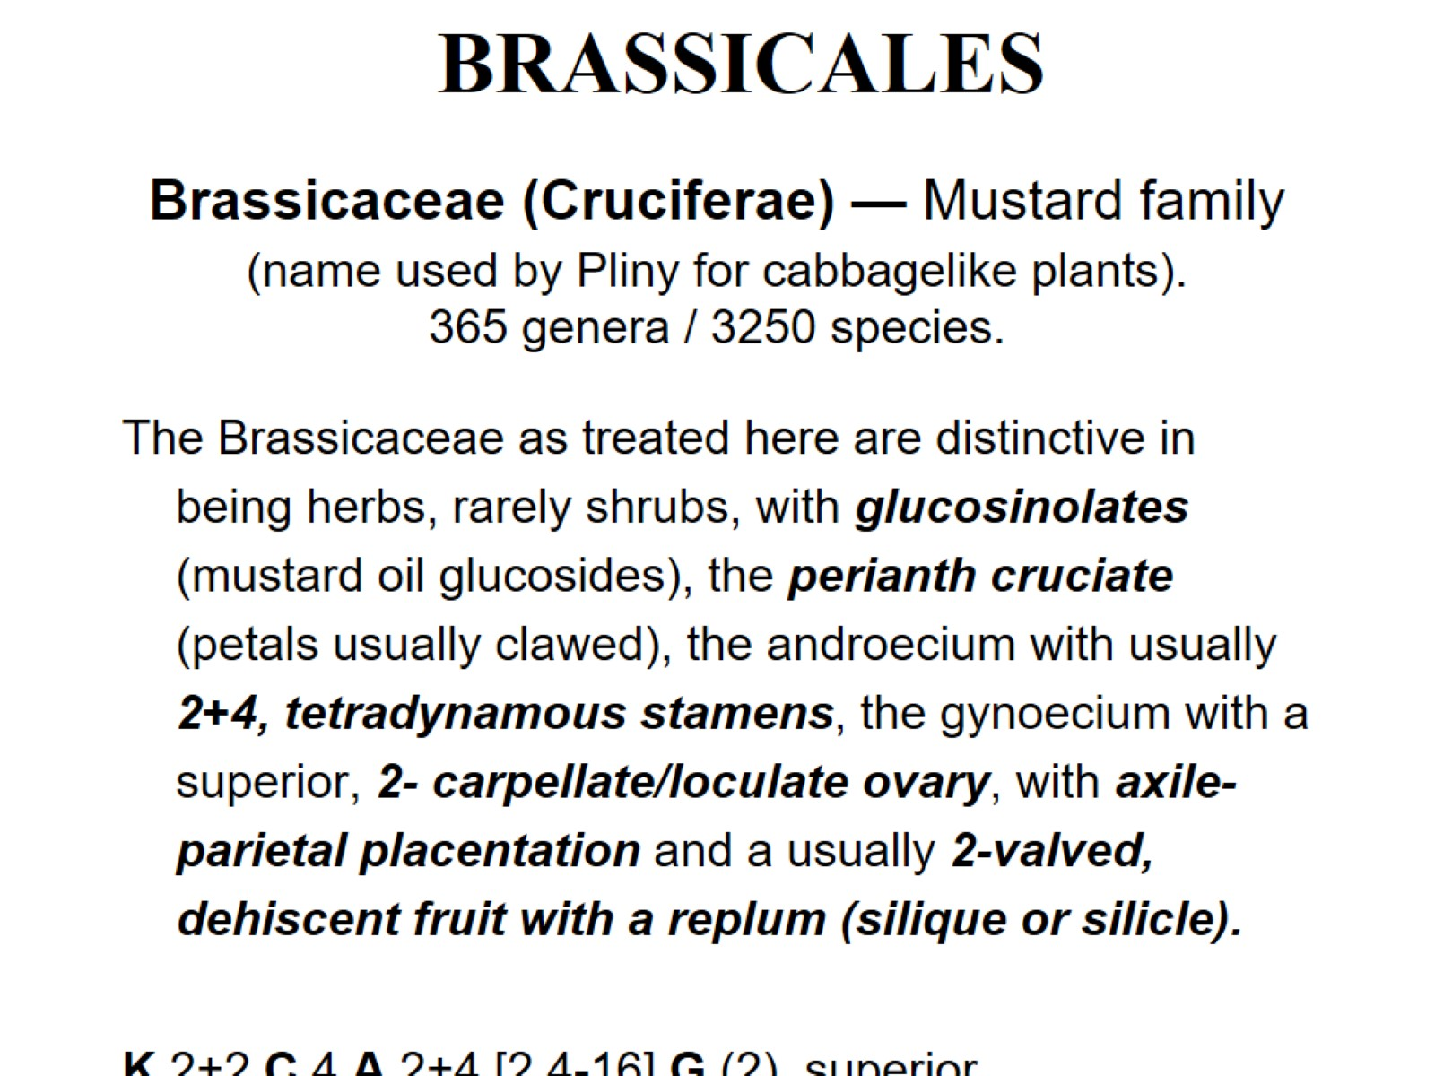
Brassicaceae (Cruciferae) — Mustard family (name used by Pliny for cabbagelike plants). 365 genera / 3250 species.

Slide 22
perianth cruciate

Slide 23
axile-parietal placentation

Slide 27
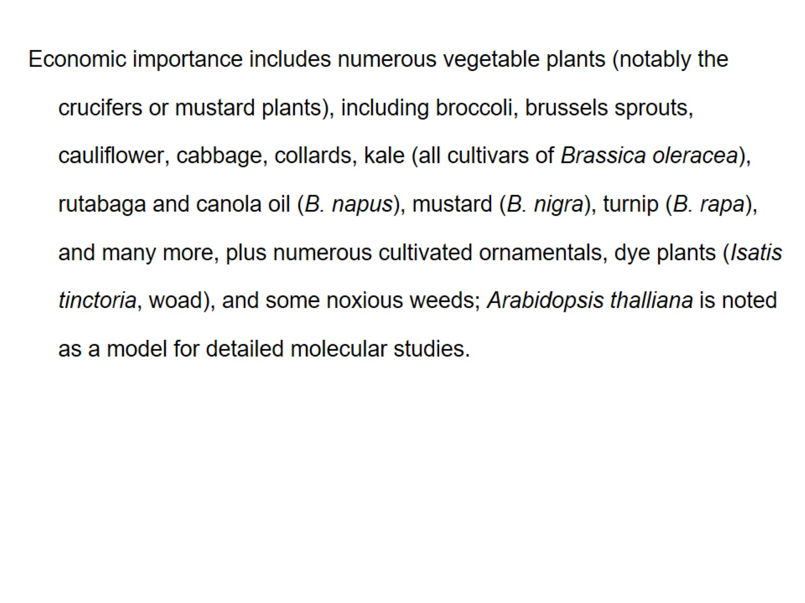

Slide 28
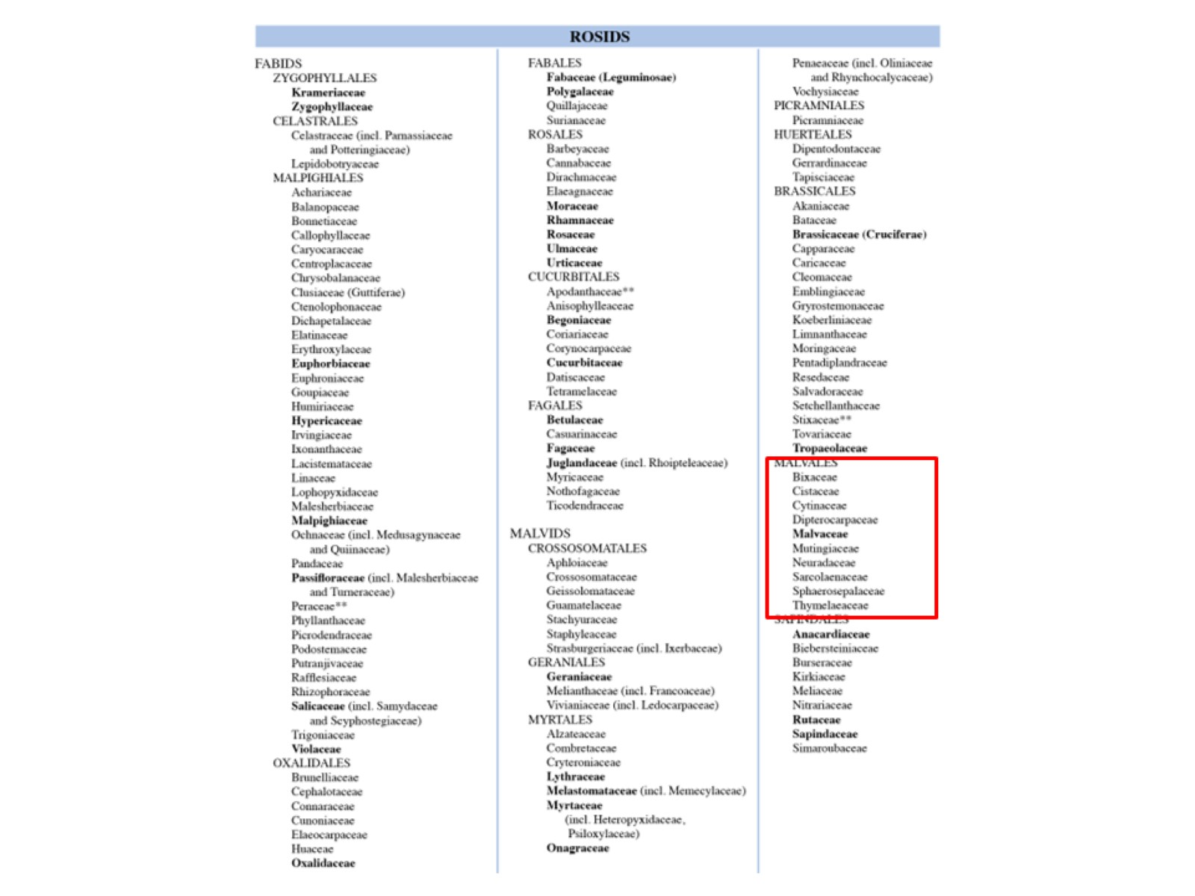

Slide 29
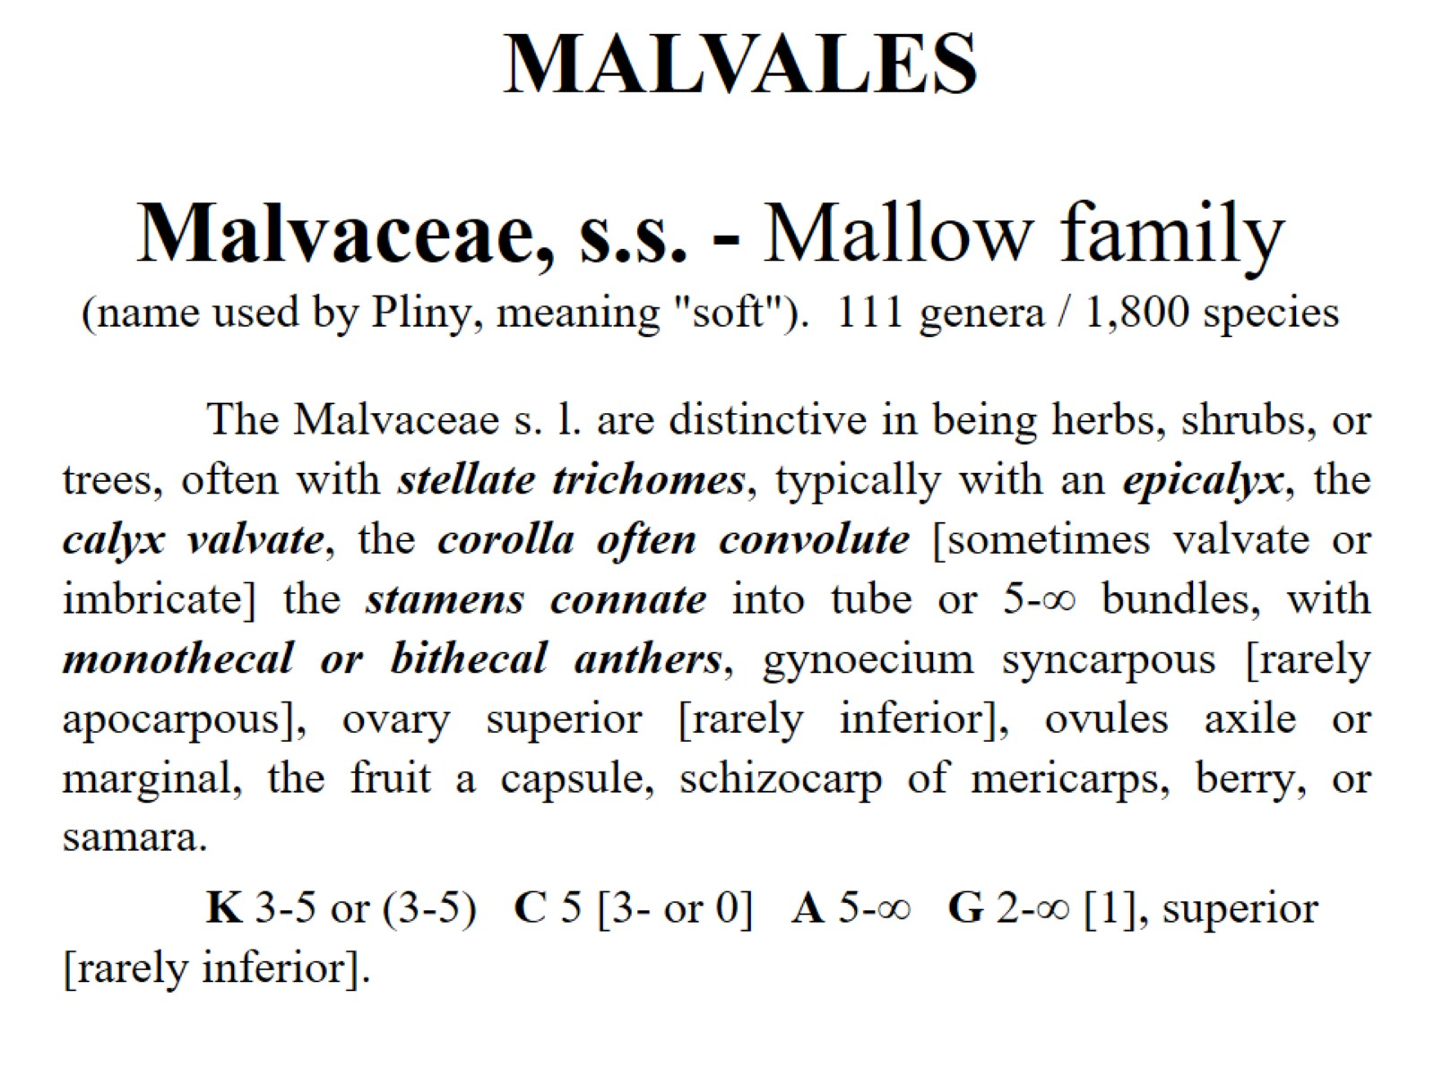
Malvaceae, s.s. - Mallow family (name used by Pliny, meaning "soft"). 111 genera / 1,800 species

Slide 30
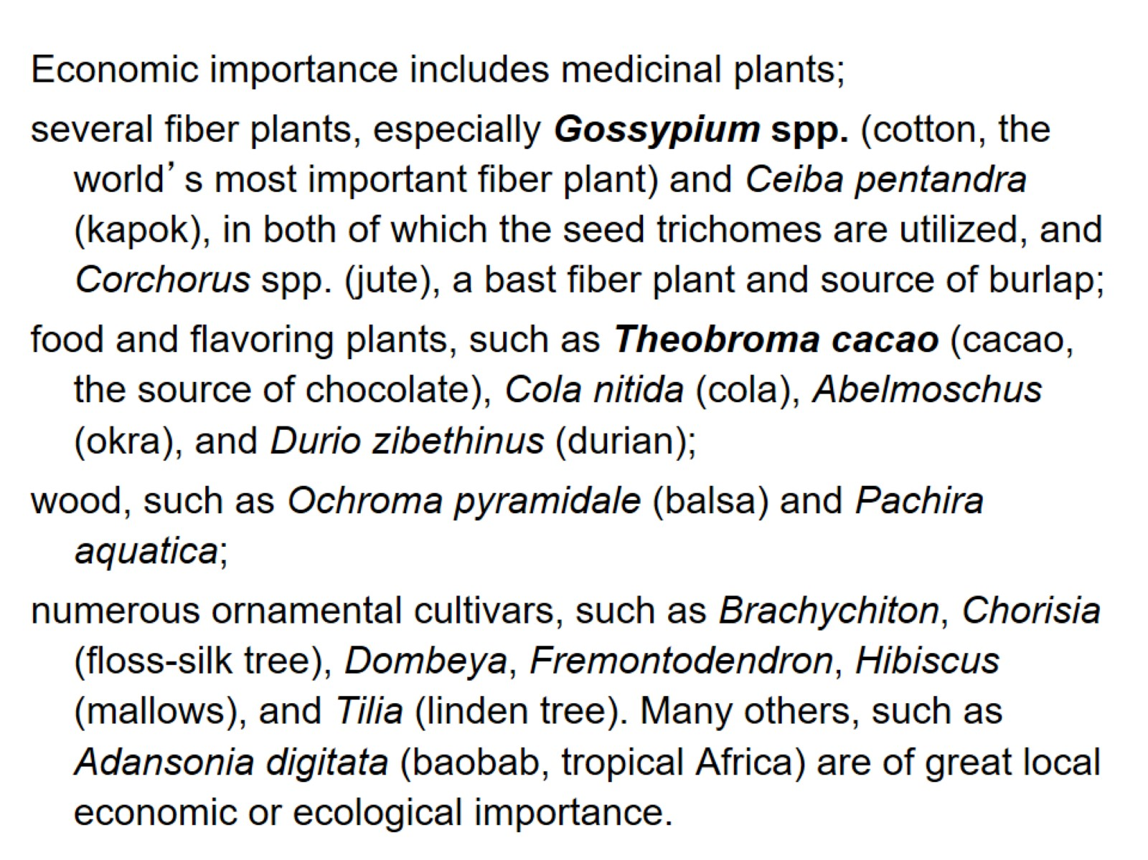

Slide 31
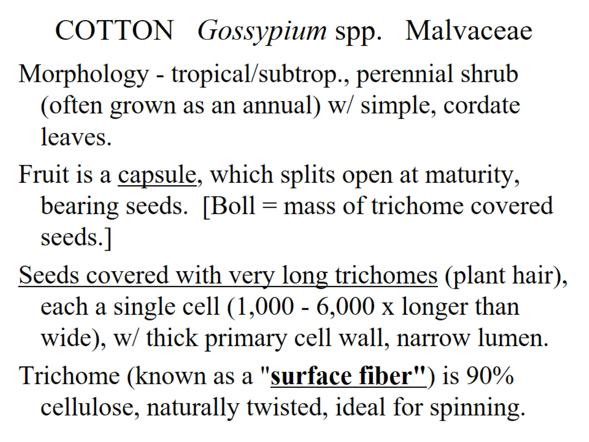
COTTON Gossypium spp. Malvaceae

Slide 32
Old World diploids (2n=26)

Slide 33
Apomorphies of Malvaceae

Slide 34
Epicalyx

Slide 35
Diversity And Classification of Flowering Plants: Eudicots: Asterids

Slide 36
Asterids

Slide 37
Ovules unitegmic

Slide 38
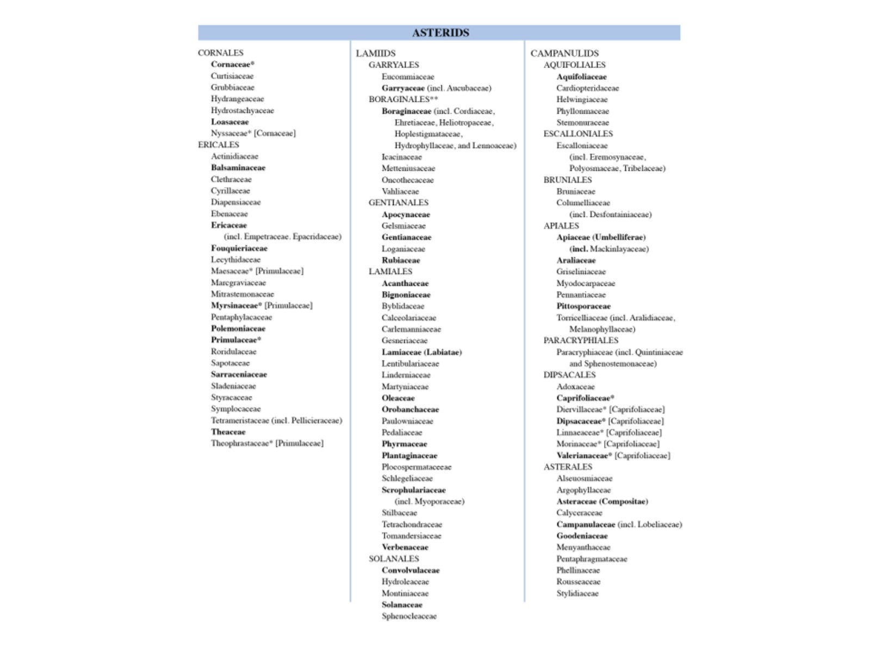

Slide 39
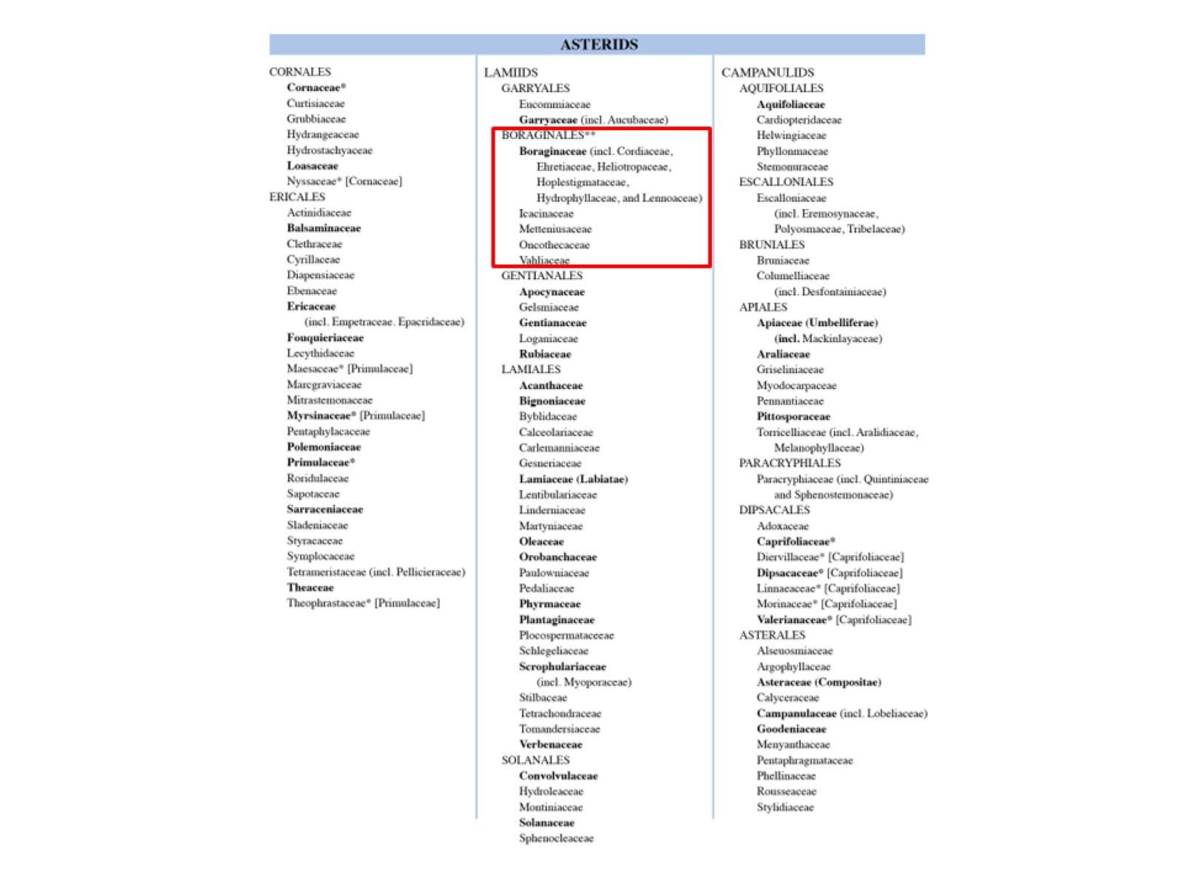

Slide 40
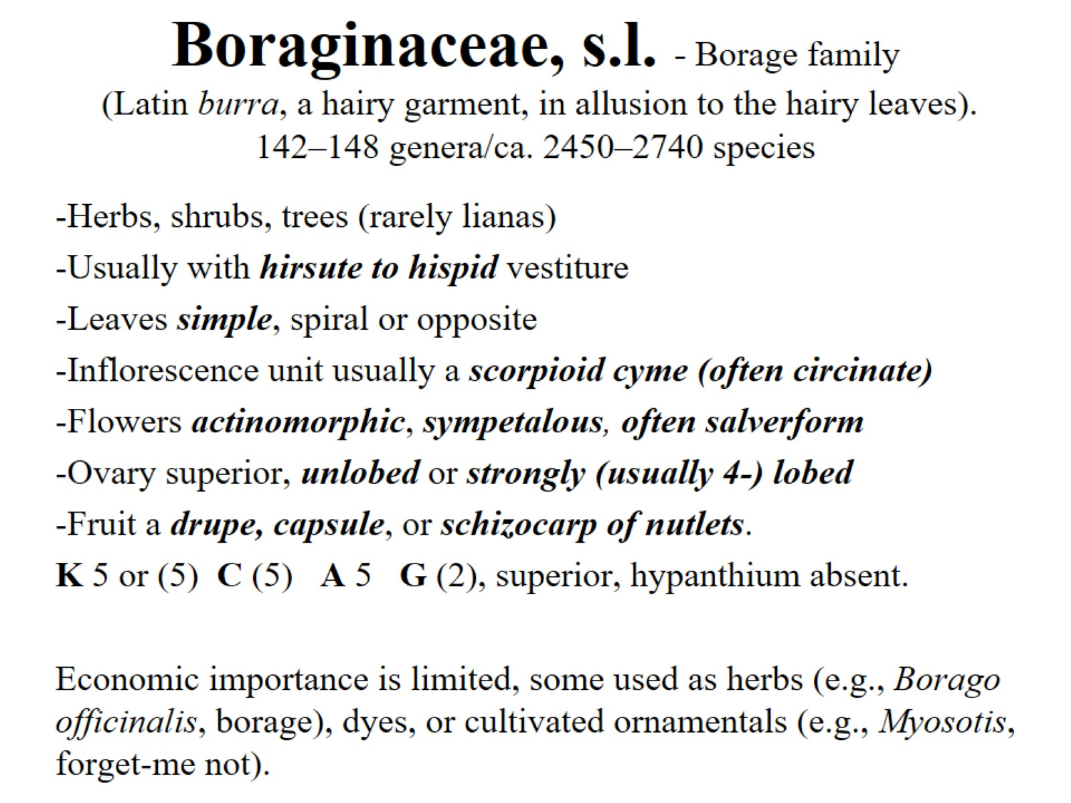
Boraginaceae, s.l. - Borage family (Latin burra, a hairy garment, in allusion to the hairy leaves). 142–148 genera/ca. 2450–2740 species

Slide 41
Boraginaceae, s.l. - Borage family

Slide 42
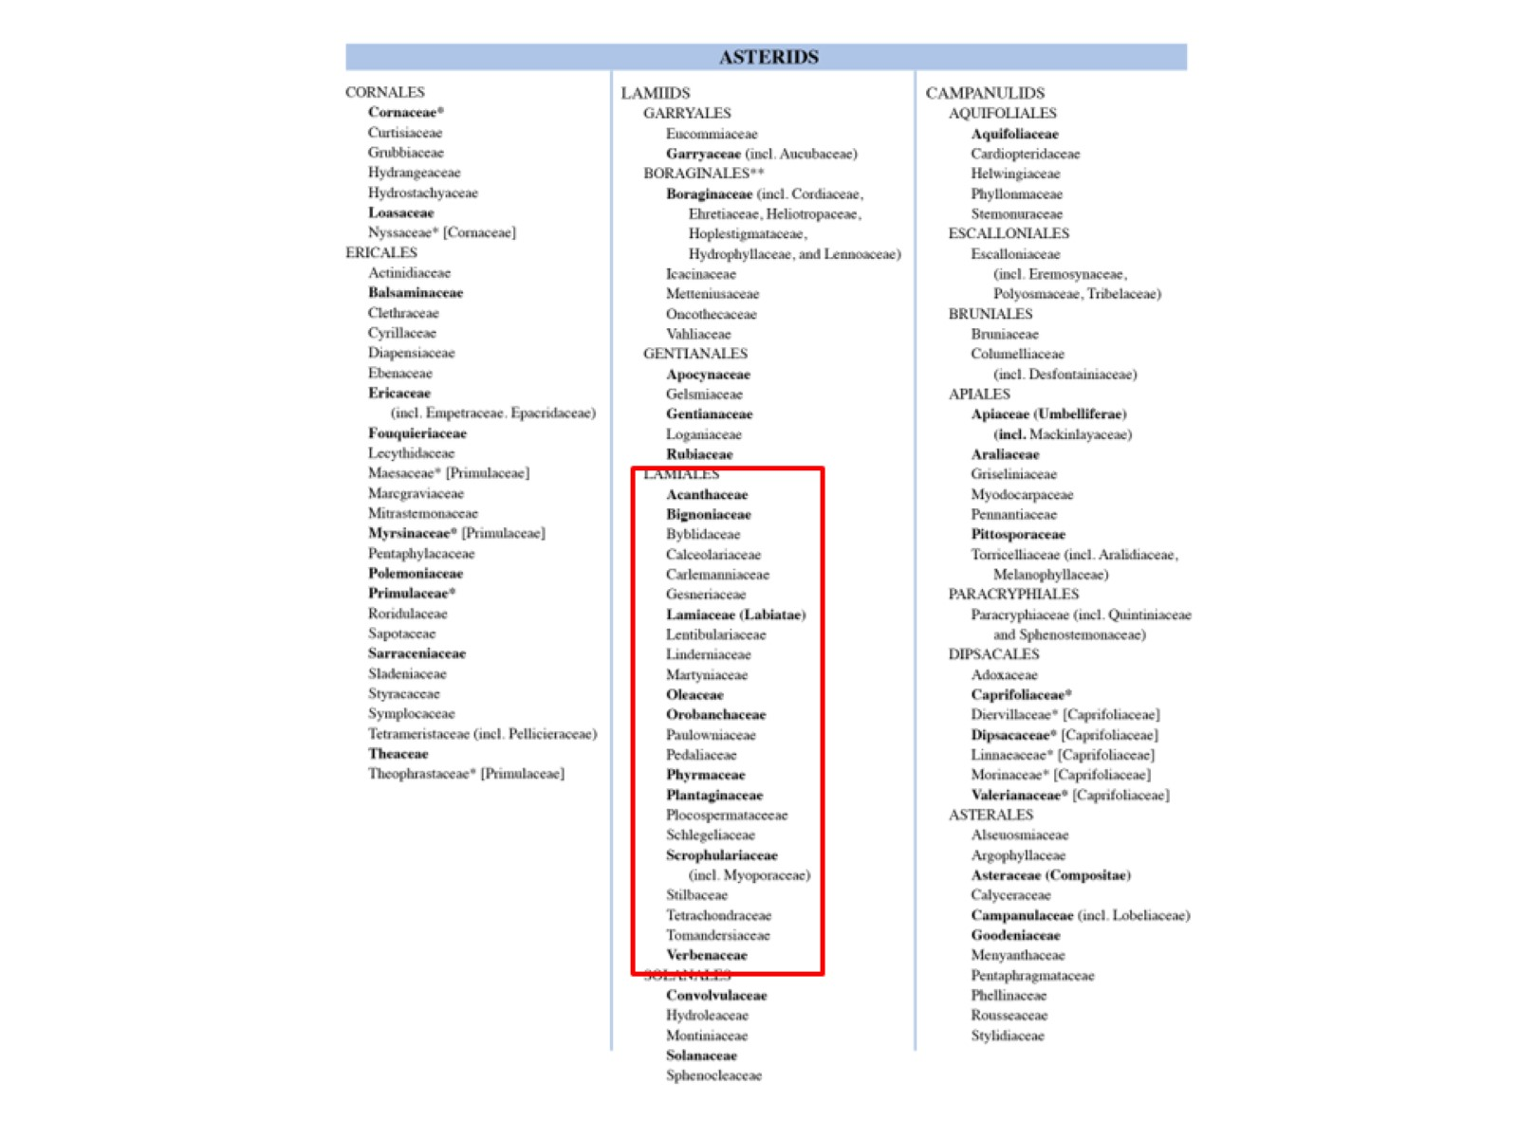

Slide 43
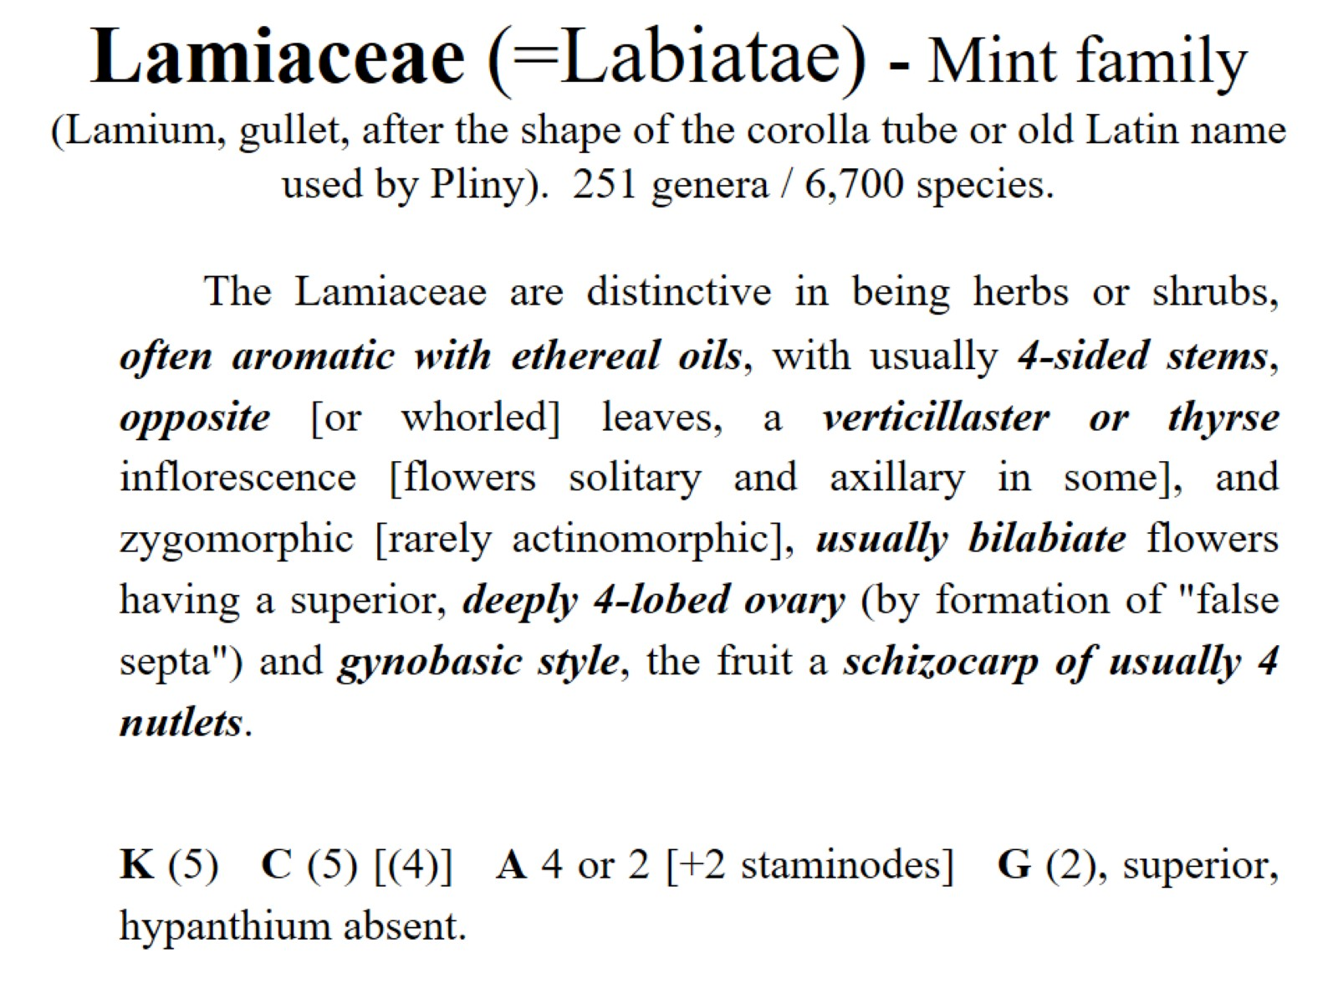
Lamiaceae (=Labiatae) - Mint family (Lamium, gullet, after the shape of the corolla tube or old Latin name used by Pliny). 251 genera / 6,700 species.

Slide 44
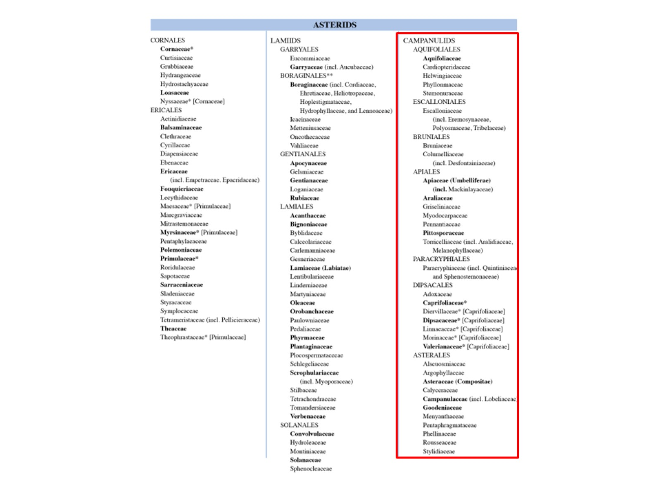

Slide 45
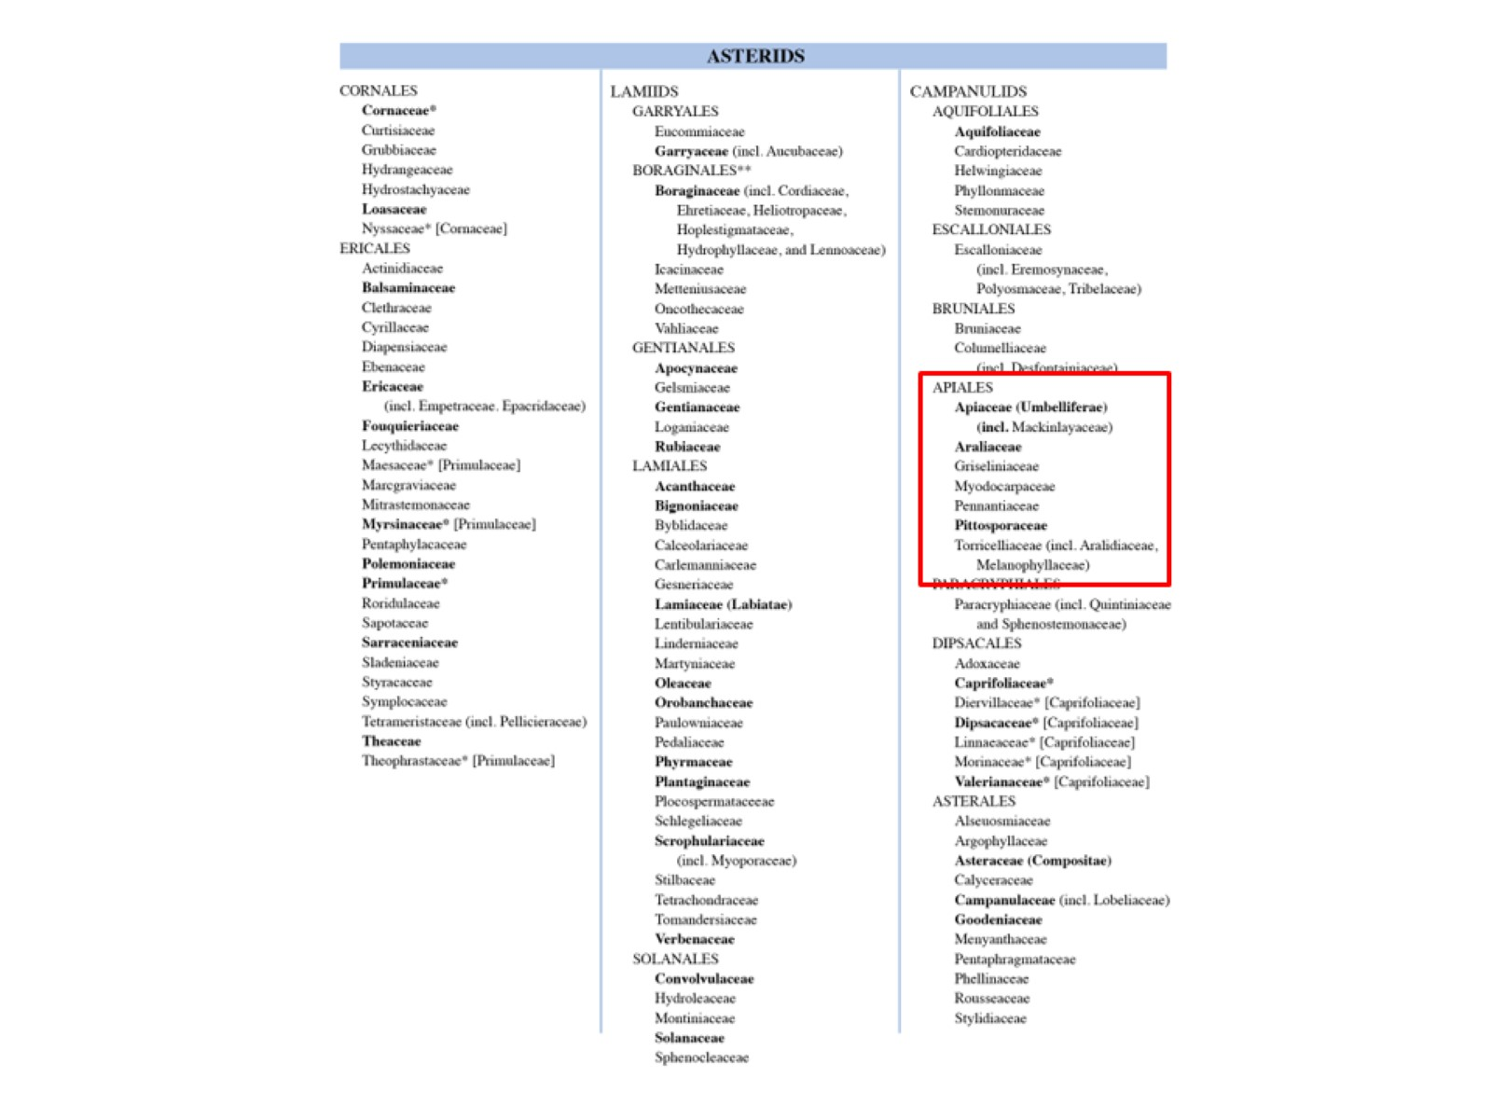

Slide 46
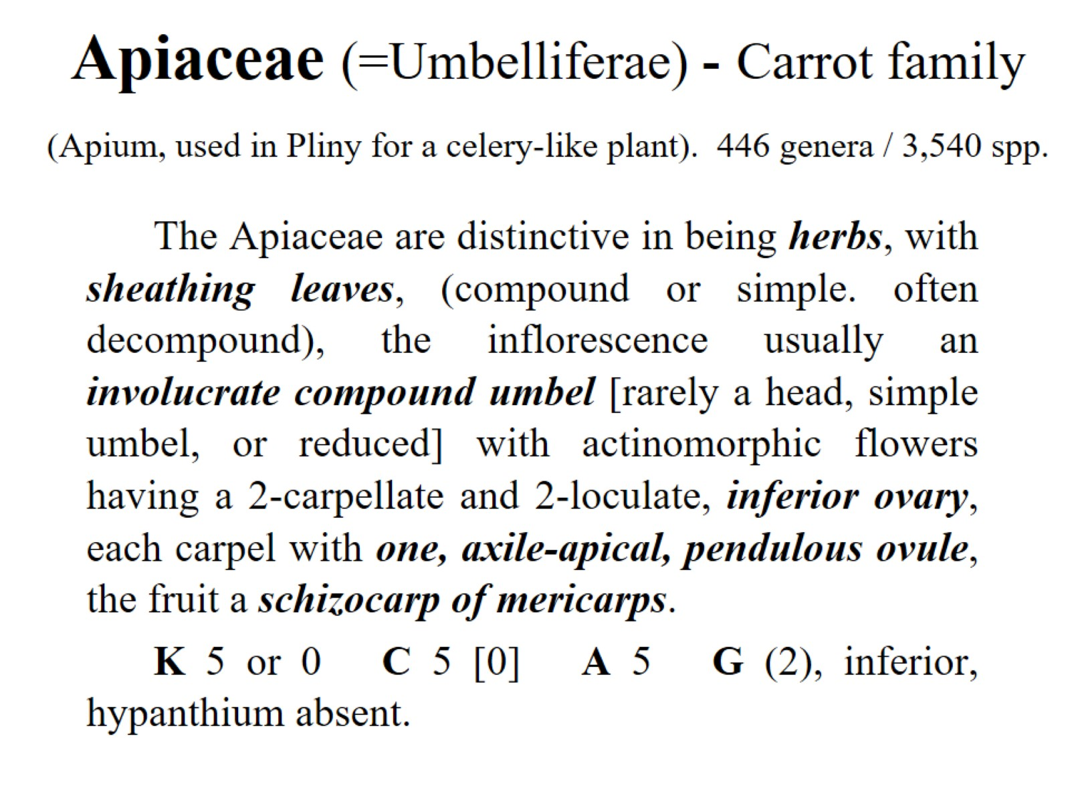
Apiaceae (=Umbelliferae) - Carrot family (Apium, used in Pliny for a celery-like plant). 446 genera / 3,540 spp.

Slide 47
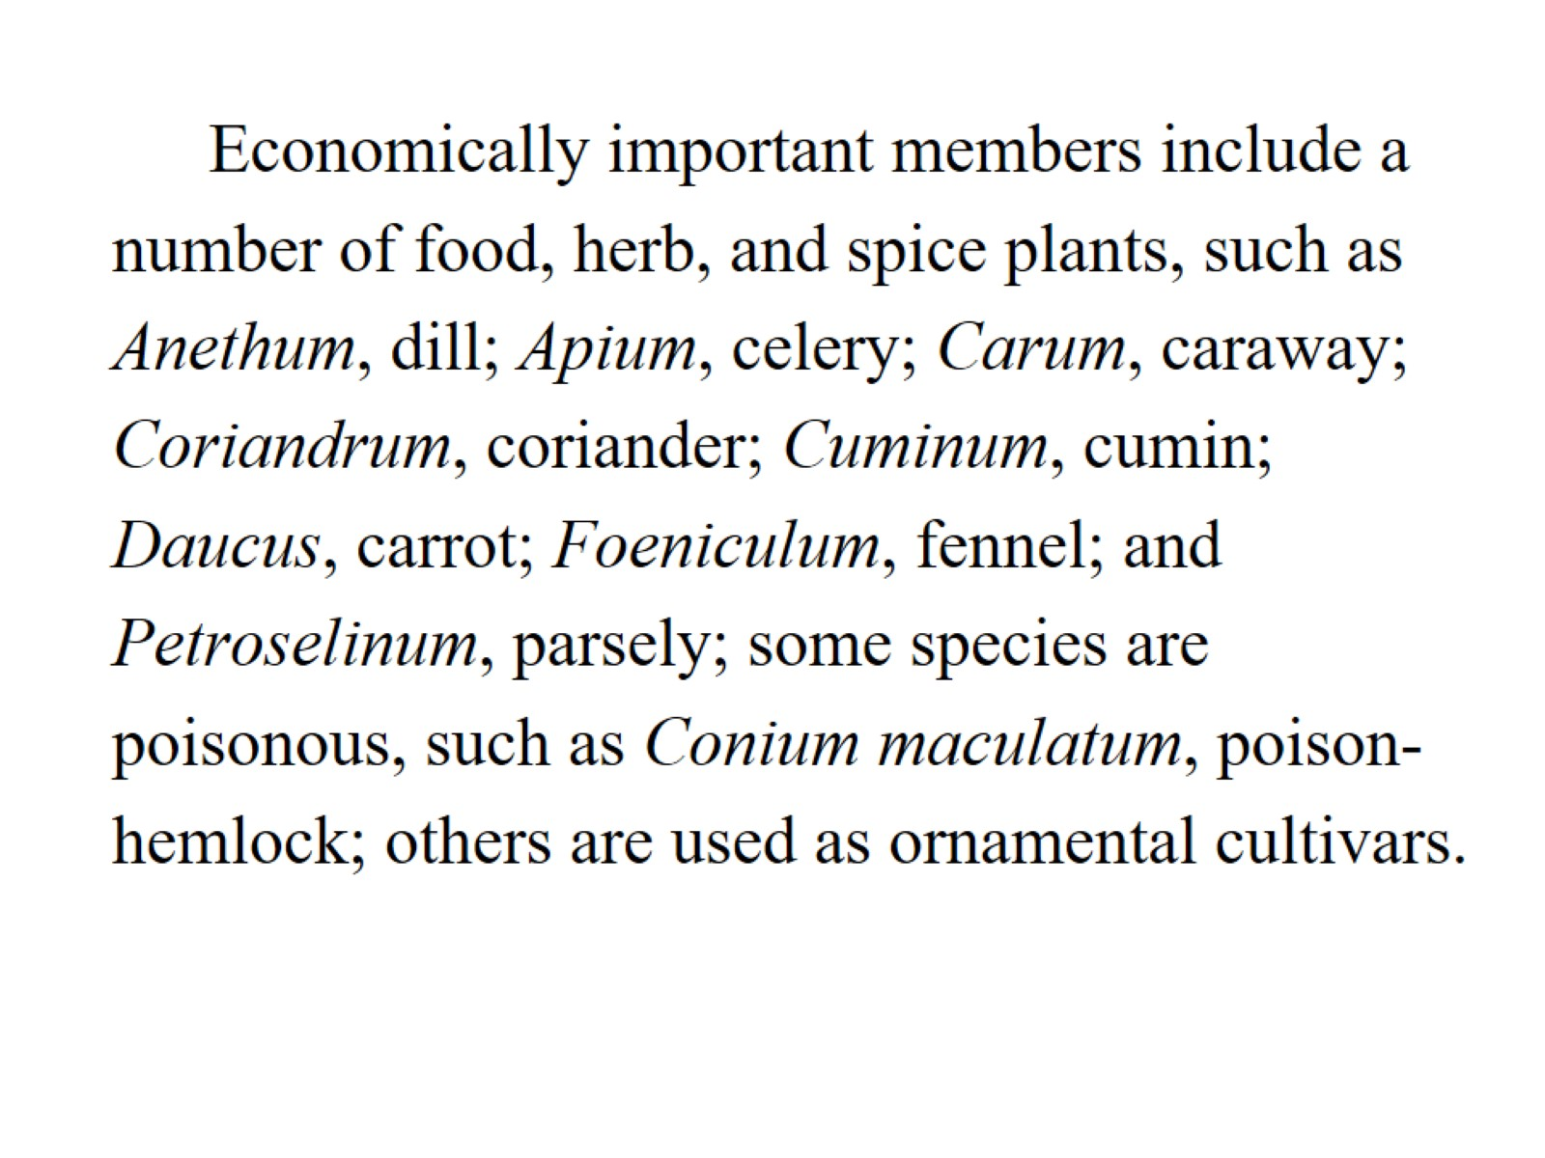

Slide 48
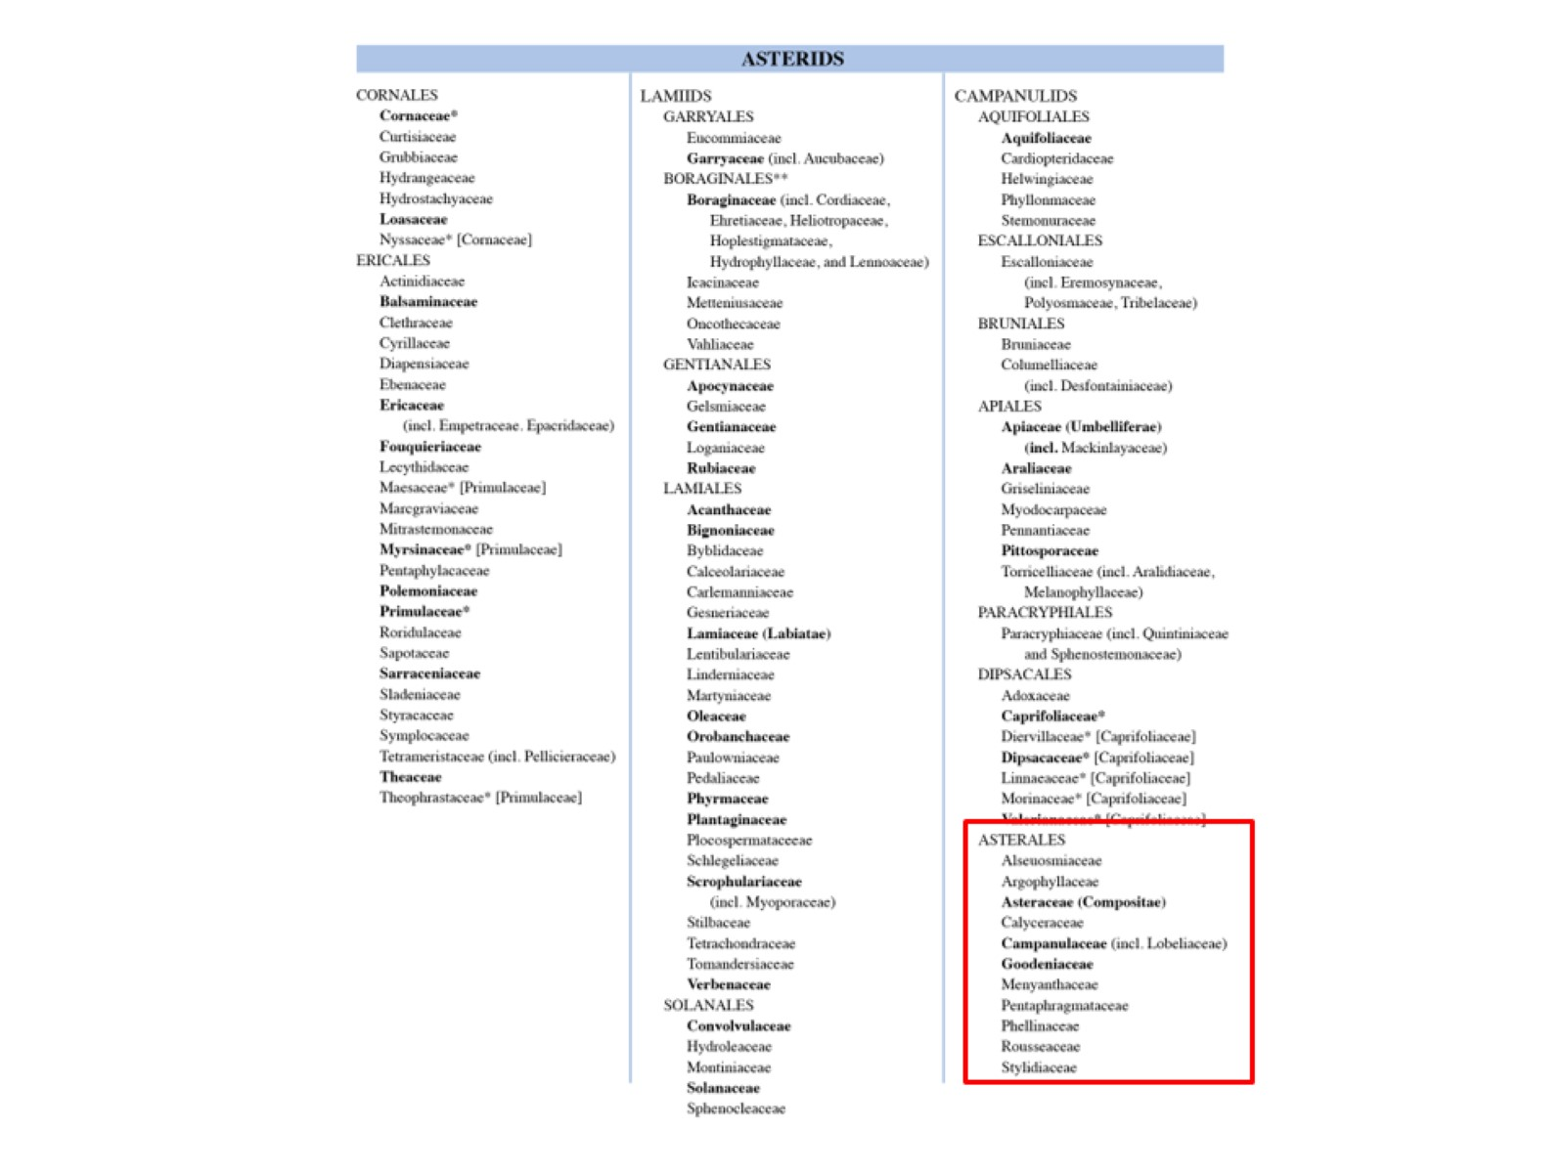

Slide 49
Asteraceae (Compositae)

Slide 50
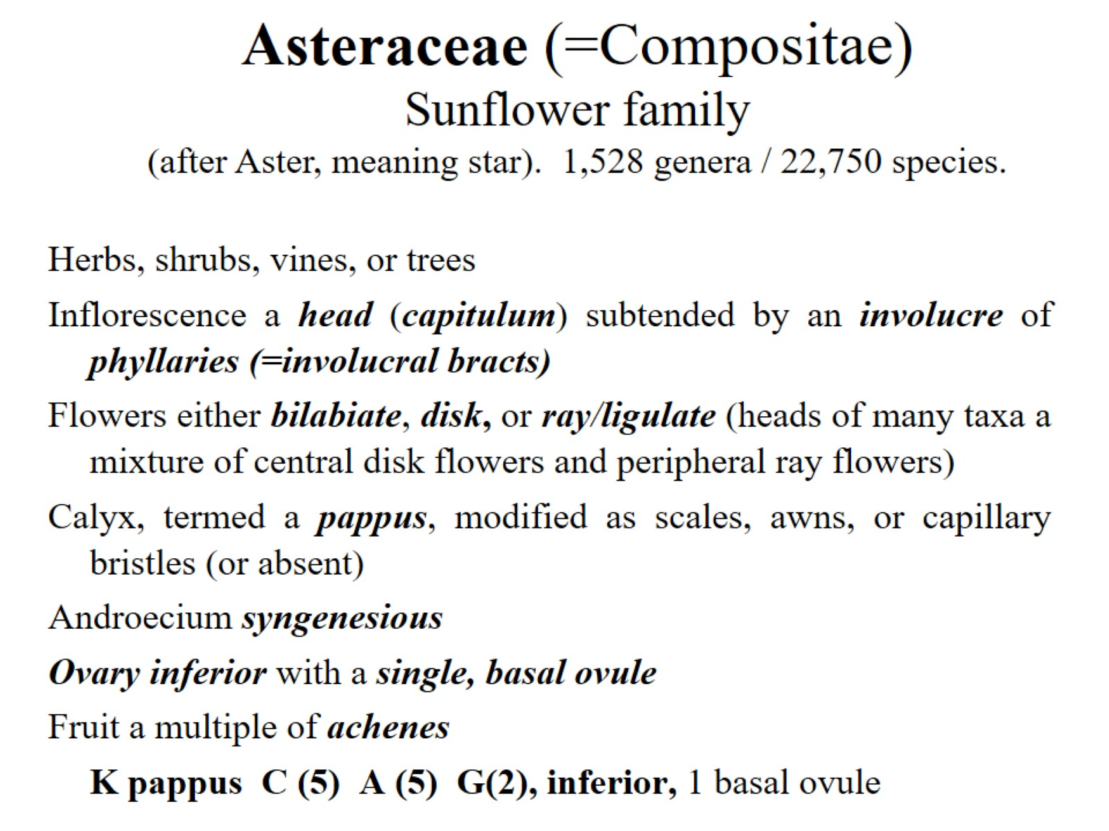

Slide 51
Asteraceae (=Compositae)

Slide 52
Asteraceae (=Compositae) - Sunflower family (after Aster, meaning star). 1,528 genera / 22,750 species.

Slide 53
Asteraceae: floral variation

Slide 54
Five types of heads:

