Slide 1
İleri Üreme Teknikleri Araçları Nelerdir?
Senkronizasyon
IVP uygulaması
USG & TG
OPU
Sperm, embriyo and oosit
kriyoprezervasyon
ICSI

Slide 2
Östrus Senkronizasyonu
İntravaginal sünger/CIDR/sc implant
Süngeri çıkarmadan 48 saat önce eCG (PMSG) ve PGF2∝ enjeksiyonu
Süngerin çıkarılması
Kızgınlık tespiti
45±2 saat
Suni Tohumlama
Notes:
14 Synchronization
Synchronisation techniques are key element of all the ART-protocols like AI, ET, IVP, also Transgen and Cloning technologies especially for small rum. which they are seasonal breeders and have non-breeding season. Estrus synchronization also plays a major role in fixed time breeding with AI techniques, LOPU for oocyte or embryo collection and transfer for donors and recipient
There are 2 main strategies in order to synchronisation of estrus.
Control of the luteal phase
Control of the follicular phase
but we generally control the luteal phase. because its longer than follicular phase, more easy to control and monitore the CL.
Hormonal control of estrous and ovulation
Progestogens can be used to extend the lifespan of the corpus luteum during the breeding season when animals are already cycling.The intra-vaginal sponge or CIDR has been used for estrus synchronization as well as for out-of-season breeding in small ruminants. These sponges inserted into the vagina usually contain about 20 to 60 milligrams of a synthetic progesterone (progestogen) and are left in place for 8 to 14 days. The most common progestogen used in sponges are fluorogestone acetate (FGA); and methylacetoxy progesterone (MAP). Controlled internal drug release (CIDR) intravaginal plastic device impregnated with progesterone (300 mg) can also be used. The CIDR is maintained in the vagina for 7 days, and a luteolytic dose of PGF2α administered 1 day before or at device removal.
During the breeding season, prostaglandin administered at a dose of 5 to 125 milligrams (mg), given 10 to 14 days apart has been effective in synchronizing estrus. Two injections given 11 days apart is the common protocol. The second injection ensures an increased chance of lysing the corpus luteum to allow the doe to return to estrus.
There are also different synchronization methods; such as male effect, artificial lighting or photoperiod and administration of melatonin
Buck effect
Introducing bucks to anovulatory females, after a period of complete isolated with buck at least 4-6 weeks and enough distance can be used for inductions and synchronization estrus in the ensuing days in the breeding and non-breeding season without additional treatment in goats. The contact with males induces the appearance of a pre-ovulatory surge of LH that triggers ovulation.
Artificial lighting or photoperiod regime is used to mimic a long day (16 hours of either sunlight or artificial light) followed by eight hours of darkness. Then, the does are exposed to 8 hours of day and 16 hours of dark. It takes quite a long time to get the animals cycling using this protocol and a light-proof barn with adequate lighting is needed to house the goats.
Administration of melatonin to mimic a different day length may be an effective alternative to light treatment. The typical protocol includes giving melatonin orally or as an implant for two or three months. To enhance the effectiveness of a shorter light treatment, a combination treatment of light and melatonin might also be an option.
5-7-9 günler ve oranlar in breeding season

Slide 3
Transgen ve Klonlama teknolojileri gibi tüm ART protokollerinin kilit unsurudur.
Üreme mevsimi yoktur.
Östrus senkronizasyonu önemli bir rol oynar.
Kızgınlığın senkronizasyonu için 2 ana strateji vardır.
Luteal fazın kontrolü
Foliküler fazın kontrolü
ancak genellikle luteal fazı kontrol ederiz. Çünkü foliküler fazdan daha uzundur, CL'yi kontrol etmek ve izlemek daha kolaydır.
Östrojen ve yumurtlamanın hormonal kontrolü
Progestojenler, corpus luteumun ömrünü uzatmak için kullanılabilir.
Vajinal sünger veya CIDR, östrus senkronizasyonu için ve küçük ruminantlarda mevsim dışı üreme için kullanılmıştır.
Notes:
14 Synchronization
Synchronisation techniques are key element of all the ART-protocols like AI, ET, IVP, also Transgen and Cloning technologies especially for small rum. which they are seasonal breeders and have non-breeding season. Estrus synchronization also plays a major role in fixed time breeding with AI techniques, LOPU for oocyte or embryo collection and transfer for donors and recipient
There are 2 main strategies in order to synchronisation of estrus.
Control of the luteal phase
Control of the follicular phase
but we generally control the luteal phase. because its longer than follicular phase, more easy to control and monitore the CL.
Hormonal control of estrous and ovulation
Progestogens can be used to extend the lifespan of the corpus luteum during the breeding season when animals are already cycling.The intra-vaginal sponge or CIDR has been used for estrus synchronization as well as for out-of-season breeding in small ruminants. These sponges inserted into the vagina usually contain about 20 to 60 milligrams of a synthetic progesterone (progestogen) and are left in place for 8 to 14 days. The most common progestogen used in sponges are fluorogestone acetate (FGA); and methylacetoxy progesterone (MAP). Controlled internal drug release (CIDR) intravaginal plastic device impregnated with progesterone (300 mg) can also be used. The CIDR is maintained in the vagina for 7 days, and a luteolytic dose of PGF2α administered 1 day before or at device removal.
During the breeding season, prostaglandin administered at a dose of 5 to 125 milligrams (mg), given 10 to 14 days apart has been effective in synchronizing estrus. Two injections given 11 days apart is the common protocol. The second injection ensures an increased chance of lysing the corpus luteum to allow the doe to return to estrus.
There are also different synchronization methods; such as male effect, artificial lighting or photoperiod and administration of melatonin
Buck effect
Introducing bucks to anovulatory females, after a period of complete isolated with buck at least 4-6 weeks and enough distance can be used for inductions and synchronization estrus in the ensuing days in the breeding and non-breeding season without additional treatment in goats. The contact with males induces the appearance of a pre-ovulatory surge of LH that triggers ovulation.
Artificial lighting or photoperiod regime is used to mimic a long day (16 hours of either sunlight or artificial light) followed by eight hours of darkness. Then, the does are exposed to 8 hours of day and 16 hours of dark. It takes quite a long time to get the animals cycling using this protocol and a light-proof barn with adequate lighting is needed to house the goats.
Administration of melatonin to mimic a different day length may be an effective alternative to light treatment. The typical protocol includes giving melatonin orally or as an implant for two or three months. To enhance the effectiveness of a shorter light treatment, a combination treatment of light and melatonin might also be an option.
5-7-9 günler ve oranlar in breeding season

Slide 4
Vajinaya yerleştirilen bu süngerler genellikle yaklaşık 20 ila 60 miligram sentetik bir progesteron (progestojen) içerir ve 8 ila 14 gün boyunca yerinde bırakılır. Süngerlerde kullanılan en yaygın progestojen florogestone asetattır (FGA); ve metilasetoksi progesteron (MAP). Progesteron (300 mg) ile emprenye edilmiş kontrollü dahili ilaç salımı (CIDR) intravajinal plastik cihaz da kullanılabilir. CIDR vajinada 7 gün tutulur ve luteolitik bir PGF2a dozu, cihazın çıkarılmasından 1 gün önce veya sonra uygulanır. Üreme mevsimi boyunca, 10 ila 14 gün arayla verilen 5 ila 125 miligram (mg) dozunda uygulanan prostaglandin, estrinin senkronize edilmesinde etkili olmuştur. 11 gün arayla verilen iki enjeksiyon ortak protokoldür. İkinci enjeksiyon, dişinin östrusa dönmesine izin vermek için corpus luteum'un lize olma şansını arttırır.
Notes:
14 Synchronization
Synchronisation techniques are key element of all the ART-protocols like AI, ET, IVP, also Transgen and Cloning technologies especially for small rum. which they are seasonal breeders and have non-breeding season. Estrus synchronization also plays a major role in fixed time breeding with AI techniques, LOPU for oocyte or embryo collection and transfer for donors and recipient
There are 2 main strategies in order to synchronisation of estrus.
Control of the luteal phase
Control of the follicular phase
but we generally control the luteal phase. because its longer than follicular phase, more easy to control and monitore the CL.
Hormonal control of estrous and ovulation
Progestogens can be used to extend the lifespan of the corpus luteum during the breeding season when animals are already cycling.The intra-vaginal sponge or CIDR has been used for estrus synchronization as well as for out-of-season breeding in small ruminants. These sponges inserted into the vagina usually contain about 20 to 60 milligrams of a synthetic progesterone (progestogen) and are left in place for 8 to 14 days. The most common progestogen used in sponges are fluorogestone acetate (FGA); and methylacetoxy progesterone (MAP). Controlled internal drug release (CIDR) intravaginal plastic device impregnated with progesterone (300 mg) can also be used. The CIDR is maintained in the vagina for 7 days, and a luteolytic dose of PGF2α administered 1 day before or at device removal.
During the breeding season, prostaglandin administered at a dose of 5 to 125 milligrams (mg), given 10 to 14 days apart has been effective in synchronizing estrus. Two injections given 11 days apart is the common protocol. The second injection ensures an increased chance of lysing the corpus luteum to allow the doe to return to estrus.
There are also different synchronization methods; such as male effect, artificial lighting or photoperiod and administration of melatonin
Buck effect
Introducing bucks to anovulatory females, after a period of complete isolated with buck at least 4-6 weeks and enough distance can be used for inductions and synchronization estrus in the ensuing days in the breeding and non-breeding season without additional treatment in goats. The contact with males induces the appearance of a pre-ovulatory surge of LH that triggers ovulation.
Artificial lighting or photoperiod regime is used to mimic a long day (16 hours of either sunlight or artificial light) followed by eight hours of darkness. Then, the does are exposed to 8 hours of day and 16 hours of dark. It takes quite a long time to get the animals cycling using this protocol and a light-proof barn with adequate lighting is needed to house the goats.
Administration of melatonin to mimic a different day length may be an effective alternative to light treatment. The typical protocol includes giving melatonin orally or as an implant for two or three months. To enhance the effectiveness of a shorter light treatment, a combination treatment of light and melatonin might also be an option.
5-7-9 günler ve oranlar in breeding season

Slide 5
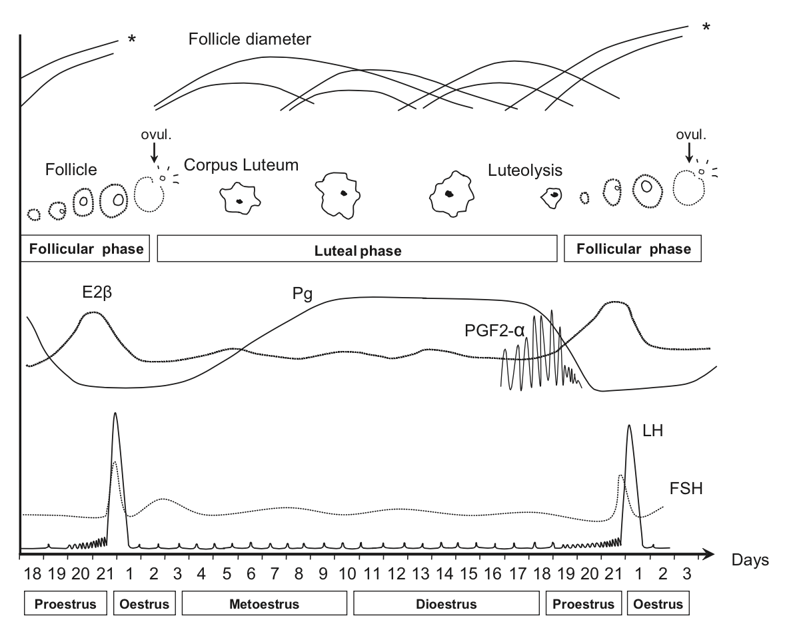
45±2 hours
Notes:
14 Synchronization
Synchronisation techniques are key element of all the ART-protocols like AI, ET, IVP, also Transgen and Cloning technologies especially for small rum. which they are seasonal breeders and have non-breeding season. Estrus synchronization also plays a major role in fixed time breeding with AI techniques, LOPU for oocyte or embryo collection and transfer for donors and recipient
There are 2 main strategies in order to synchronisation of estrus.
Control of the luteal phase
Control of the follicular phase
but we generally control the luteal phase. because its longer than follicular phase, more easy to control and monitore the CL.
Hormonal control of estrous and ovulation
Progestogens can be used to extend the lifespan of the corpus luteum during the breeding season when animals are already cycling.The intra-vaginal sponge or CIDR has been used for estrus synchronization as well as for out-of-season breeding in small ruminants. These sponges inserted into the vagina usually contain about 20 to 60 milligrams of a synthetic progesterone (progestogen) and are left in place for 8 to 14 days. The most common progestogen used in sponges are fluorogestone acetate (FGA); and methylacetoxy progesterone (MAP). Controlled internal drug release (CIDR) intravaginal plastic device impregnated with progesterone (300 mg) can also be used. The CIDR is maintained in the vagina for 7 days, and a luteolytic dose of PGF2α administered 1 day before or at device removal.
During the breeding season, prostaglandin administered at a dose of 5 to 125 milligrams (mg), given 10 to 14 days apart has been effective in synchronizing estrus. Two injections given 11 days apart is the common protocol. The second injection ensures an increased chance of lysing the corpus luteum to allow the doe to return to estrus.
There are also different synchronization methods; such as male effect, artificial lighting or photoperiod and administration of melatonin
Buck effect
Introducing bucks to anovulatory females, after a period of complete isolated with buck at least 4-6 weeks and enough distance can be used for inductions and synchronization estrus in the ensuing days in the breeding and non-breeding season without additional treatment in goats. The contact with males induces the appearance of a pre-ovulatory surge of LH that triggers ovulation.
Artificial lighting or photoperiod regime is used to mimic a long day (16 hours of either sunlight or artificial light) followed by eight hours of darkness. Then, the does are exposed to 8 hours of day and 16 hours of dark. It takes quite a long time to get the animals cycling using this protocol and a light-proof barn with adequate lighting is needed to house the goats.
Administration of melatonin to mimic a different day length may be an effective alternative to light treatment. The typical protocol includes giving melatonin orally or as an implant for two or three months. To enhance the effectiveness of a shorter light treatment, a combination treatment of light and melatonin might also be an option.
5-7-9 günler ve oranlar in breeding season

Slide 6
Farklı senkronizasyon yöntemleri de vardır;
Erkek etkisi, yapay aydınlatma veya fotoperiyod ve melatonin uygulaması, erkeklerle temas, ovülasyonu tetikleyen LH'nin yumurtlama öncesi artışının ortaya çıkmasına neden olur.
Yapay aydınlatma veya fotoperiyod rejimi, uzun bir günü (16 saat güneş ışığı veya yapay ışık) ve ardından sekiz saat karanlığı taklit etmek için kullanılır.
Notes:
14 Synchronization
Synchronisation techniques are key element of all the ART-protocols like AI, ET, IVP, also Transgen and Cloning technologies especially for small rum. which they are seasonal breeders and have non-breeding season. Estrus synchronization also plays a major role in fixed time breeding with AI techniques, LOPU for oocyte or embryo collection and transfer for donors and recipient
There are 2 main strategies in order to synchronisation of estrus.
Control of the luteal phase
Control of the follicular phase
but we generally control the luteal phase. because its longer than follicular phase, more easy to control and monitore the CL.
Hormonal control of estrous and ovulation
Progestogens can be used to extend the lifespan of the corpus luteum during the breeding season when animals are already cycling.The intra-vaginal sponge or CIDR has been used for estrus synchronization as well as for out-of-season breeding in small ruminants. These sponges inserted into the vagina usually contain about 20 to 60 milligrams of a synthetic progesterone (progestogen) and are left in place for 8 to 14 days. The most common progestogen used in sponges are fluorogestone acetate (FGA); and methylacetoxy progesterone (MAP). Controlled internal drug release (CIDR) intravaginal plastic device impregnated with progesterone (300 mg) can also be used. The CIDR is maintained in the vagina for 7 days, and a luteolytic dose of PGF2α administered 1 day before or at device removal.
During the breeding season, prostaglandin administered at a dose of 5 to 125 milligrams (mg), given 10 to 14 days apart has been effective in synchronizing estrus. Two injections given 11 days apart is the common protocol. The second injection ensures an increased chance of lysing the corpus luteum to allow the doe to return to estrus.
There are also different synchronization methods; such as male effect, artificial lighting or photoperiod and administration of melatonin
Buck effect
Introducing bucks to anovulatory females, after a period of complete isolated with buck at least 4-6 weeks and enough distance can be used for inductions and synchronization estrus in the ensuing days in the breeding and non-breeding season without additional treatment in goats. The contact with males induces the appearance of a pre-ovulatory surge of LH that triggers ovulation.
Artificial lighting or photoperiod regime is used to mimic a long day (16 hours of either sunlight or artificial light) followed by eight hours of darkness. Then, the does are exposed to 8 hours of day and 16 hours of dark. It takes quite a long time to get the animals cycling using this protocol and a light-proof barn with adequate lighting is needed to house the goats.
Administration of melatonin to mimic a different day length may be an effective alternative to light treatment. The typical protocol includes giving melatonin orally or as an implant for two or three months. To enhance the effectiveness of a shorter light treatment, a combination treatment of light and melatonin might also be an option.
5-7-9 günler ve oranlar in breeding season

Slide 7
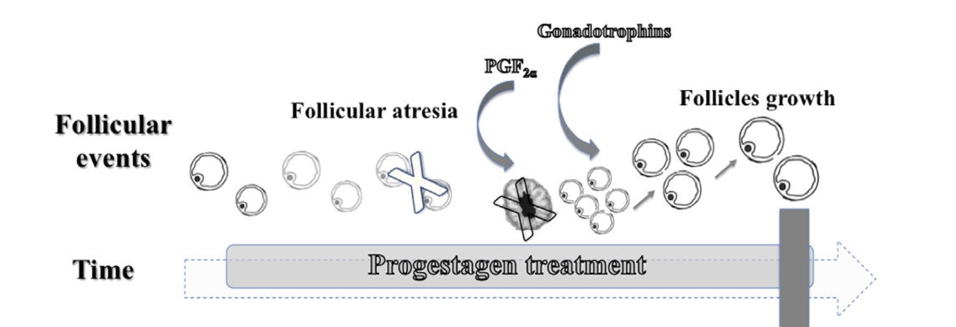
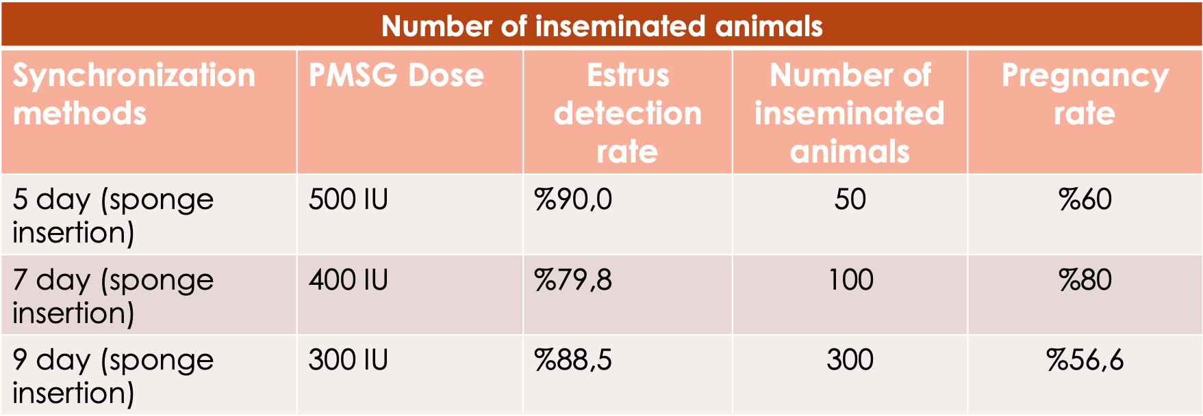
Notes:
14 Synchronization
Synchronisation techniques are key element of all the ART-protocols like AI, ET, IVP, also Transgen and Cloning technologies especially for small rum. which they are seasonal breeders and have non-breeding season. Estrus synchronization also plays a major role in fixed time breeding with AI techniques, LOPU for oocyte or embryo collection and transfer for donors and recipient
There are 2 main strategies in order to synchronisation of estrus.
Control of the luteal phase
Control of the follicular phase
but we generally control the luteal phase. because its longer than follicular phase, more easy to control and monitore the CL.
Hormonal control of estrous and ovulation
Progestogens can be used to extend the lifespan of the corpus luteum during the breeding season when animals are already cycling.The intra-vaginal sponge or CIDR has been used for estrus synchronization as well as for out-of-season breeding in small ruminants. These sponges inserted into the vagina usually contain about 20 to 60 milligrams of a synthetic progesterone (progestogen) and are left in place for 8 to 14 days. The most common progestogen used in sponges are fluorogestone acetate (FGA); and methylacetoxy progesterone (MAP). Controlled internal drug release (CIDR) intravaginal plastic device impregnated with progesterone (300 mg) can also be used. The CIDR is maintained in the vagina for 7 days, and a luteolytic dose of PGF2α administered 1 day before or at device removal.
During the breeding season, prostaglandin administered at a dose of 5 to 125 milligrams (mg), given 10 to 14 days apart has been effective in synchronizing estrus. Two injections given 11 days apart is the common protocol. The second injection ensures an increased chance of lysing the corpus luteum to allow the doe to return to estrus.
There are also different synchronization methods; such as male effect, artificial lighting or photoperiod and administration of melatonin
Buck effect
Introducing bucks to anovulatory females, after a period of complete isolated with buck at least 4-6 weeks and enough distance can be used for inductions and synchronization estrus in the ensuing days in the breeding and non-breeding season without additional treatment in goats. The contact with males induces the appearance of a pre-ovulatory surge of LH that triggers ovulation.
Artificial lighting or photoperiod regime is used to mimic a long day (16 hours of either sunlight or artificial light) followed by eight hours of darkness. Then, the does are exposed to 8 hours of day and 16 hours of dark. It takes quite a long time to get the animals cycling using this protocol and a light-proof barn with adequate lighting is needed to house the goats.
Administration of melatonin to mimic a different day length may be an effective alternative to light treatment. The typical protocol includes giving melatonin orally or as an implant for two or three months. To enhance the effectiveness of a shorter light treatment, a combination treatment of light and melatonin might also be an option.
5-7-9 günler ve oranlar in breeding season

