Slide 1
On the Subtleties of the Isnāds in
al-Ṭabarī’s (d.310/923) Tafsīr
By
Prof. Dr. Mehmet Akif KOÇ

Slide 2
The Purpose of the Presentation
Not Concentrating on ‘Isnād’ Itself
Looking at Problematic Pradigms via ‘Isnād’

Slide 3
Firstly,
‘Tomography’ of the References (isnāds) in al-Ṭabarī’s Tafsīr : Heribert Horst's (d. 2012) Doctoral Dissertation

Slide 4
According to the Horst’s Finding
Total Number of Narrations: Approximately 38000
Total Number of Isnād molds: 13026
Number of Isnād Patterns Passing Only Once: 11360
Number of More Than 100 Times Repeating Isnād Patterns: 21
Number of Narrations with These 21 Isnād Patterns: 15700
Only Companion in These 21 Isnād Patterns: Ibn ʿAbbās
80% Maqṭūʿ, 16% Mawqūf and 4% Marfūʿ of the All Narrations

Slide 5
According to …. Finding,
The number of shakhs in Tabari's commentary is approximately 300
About 3000 human names are mentioned in the commentary of Tabari

Slide 6
It would be proper to rank Claude Gilliot at the forefront among experts of al-Tabari’s exegesis. He did his doctoral dissertation on Taberi tafsir and also wrote about 20 individual articles on this commentary

Slide 7
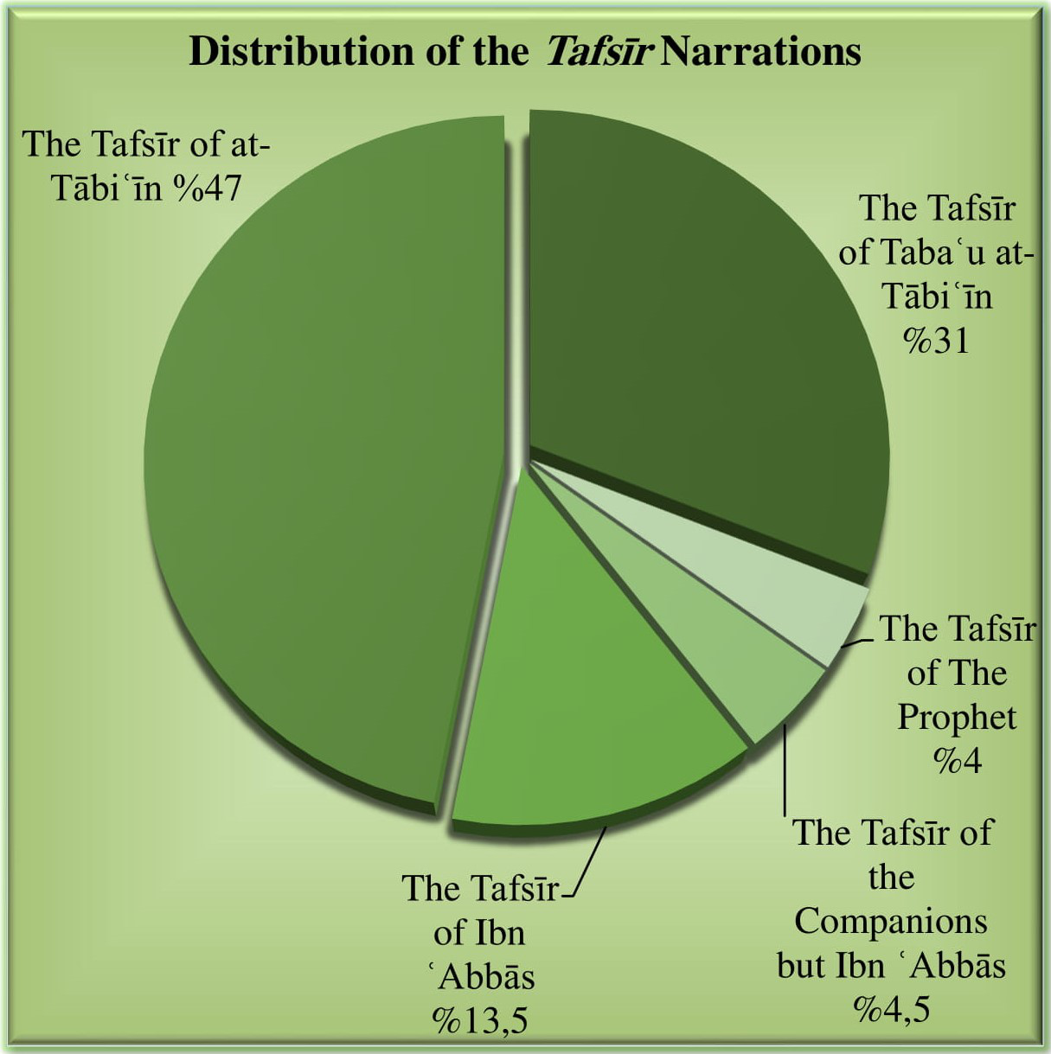
The data of al-Ṭabarī are generally compatible with the data of all tafsīr narrations. If we look at the 396-420 pages of the first volume of the work named Mawsūʿa al-Tafsīr al-Maʾthūr –which is the most comprehensive study in this field– (Dār Ibn Ḥazm, 2017) prepared under the editorship of Musāʿid Ṭayyār, we can see that the total number of tafsīr narrations reached today is 64384. See the distribution of these narrations in the graphic:

Slide 8
What do the isnāds of al-Tabarī’s tafsīr say
about the following problematic paradigms to tafsīr academics?

Slide 9
I.
Aḥmad b. Ḥanbal (d.241/855) said: "Three things are not reliable; Tafsīr, Maghāzī (war stories) and Malāḥim (praise stories)
His Musnad covers many tafsīr narrations
Can we assume that by falling into
such a simple contradiction, he could
risk his existing dignity in society?

Slide 10
Did Aḥmad b. Ḥanbal mean some human errors
such as inqiṭāʿ, tadlīs, and taʿlīq …?
No. Aḥmad b. Ḥanbal made such an evaluation because he saw that most of the tafsīr
narrations were the sayings of tābiʿūn (Maqṭūʿ ) and tabaʿuʿ at-tābiʿīn
Aḥmad b. Ḥanbal’s statement can be a descriptive rather than a critical assesment

Slide 11
II.
Carra de vaux's (d.1953) Approach that ‘at the beginning, tafsīr was part of ḥadīth’
He evaluated the issue in the light of hadith literature. He saw ‘kitab al tafsir’ is very limited part of this literature like ‘kitab al salah, kitab al iman…’. However, most of tafsir reports are not marfūʿ or mawqūf anyway. Then, tafsir reports are mostly fixed maqtu. So, they are left out of this literature.
That’s why, there is inconcistency between
tabaris data and Carra’s approach.

Slide 12
III.
Confusion over Leading Figures of Early Exegetical Activities
Apparently, in our current tafsīr conceptualization, the "periodic arrangement" based on chronology and the general "virtue ranking" have preceded the data-based activity ranking.
Four examples of false imaginations:
first four Khalifa, Alqama, Masruq, Qatada

Slide 13
In All Tafsir Narrations (64384),
Alqama b. Qays
(d. 62/682)
Masrūq b. al-Ajdaʿ
(d. 63/683)
Qatāda b. Diʿāma
(d. 117/735)
29 narrations
59 narrations
5726 narrations
Alqama and Masrūq are presented before Qatāda in the books in tafsir history

Slide 14
IV.
What do the Isnāds Say about the Riḥlas?
I.
II.
isnād : Bishr b. Mudh – Yazīd b. Zurayʿ – Saʿīd b. Abī ʿArūba – Qatāda b. Diʿāma
repeated 3060 times.
Regularly repeated in all of Sīras except 22-27.
isnād : al-Ḥasan b. Yaḥyā – ʿAbd al- Razzāq – Maʿmar b. Rāshid – Qatāda b. Diʿāma
repeated 630 times.
1-6 Sīras regularly repeated. 7-26 frequently repeated. And 27-114 does not occur.

Slide 15
V.
Does the Fact that the Books Written in the Early Period did not Survive Mean that the Tafsir Reports have not Reached the Present?
No. We should try to understand how scientific activities were carried out in early period
Crosschecking Literature
غير مرتضي means “unreliable”. (Jāmiʿ al- Bayān, XXVI. 55) Actually, this riwāya with unreliable isnād chain can be found in Tanwīr al-Miqbās min Tafsīr Ibn ʿAbbās
وروي عن ابن عباس بإسناد غير مرتضي

Slide 16
VI.
The Conflict over Isrāīliyyāt between Early and Contemporary Periods
The most comfortable time to use this type of knowledge was the earliest period.
The most problematic time to use this type of knowledge is the present.
Why?

Slide 17
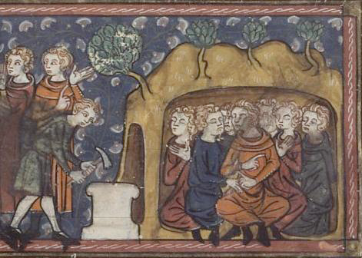
Objective Proof on al-Ṭabarī’s using Christian and Judaic Narrations
Saʿīd b. Jubayr : «al-Raqīm (18:9), ….stone. They wrote stories of the Companions of the Cave’ on it. After that, they put it in front of the door of the cave. (Jāmiʿ al- Bayān, XV. 159)

Slide 18
Finally, Some Questions and Considerations
Was tabari selective in his tafsir?
No. Tabari took the photograph of the first three centuries in tafsir.
His primary goal was to collect all narrations he could reach.
Did he refrain from mentioning any views?
No. But why did he eliminate a few names in his tafsir book?
He did not want his tafsir book to become controversial at once due to the bad reputation of their names

Slide 19
A Few Recent Misunderstandings:
"Tabari is a plagiarist"; For example, he made plagiarism from Muqatil
Taberi narrated the first three centuries by censoring. Hovewer, maturidi is much more inclusive in this regard

Slide 20
The Question Waiting for Answer
Why do riwāyas concerning qirāʿats come generally without isnāds in tabari’s tafsir while isnād is one of the most important conditions for a Qıraa to be accepted?

Slide 21
Thanks!
Prof. Dr. Mehmet Akif KOÇ
-
Head of the Department of Qur’anic Studies in Ankara University
Faculty of Divinity

