Slide 1
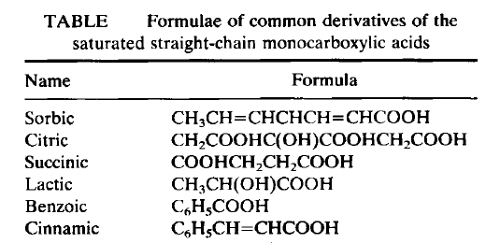
From mono carboxylic acids; Formic (1C), Acetic (2C), Propionic (3C) and Butyric (4C) acids are volatile.
Butyric acids (n and iso) and fatty compounds with aliphatic chains (no rings) with more than 4 carbons are called Fatty Acids.
Lactic acid (with 3C) is a monocarboxylic acid. Contains OH in the structure.
Succinic acid is a 4C dicarboxylic acid.
Lactic and succinic acids show low volatility and are therefore not considered Volatile Acids.
Oxalic (2C), malic (4C) and tartaric (4C) acids are also dicarboxylic.
The energy value of organic acids is considered 3 kcal / g.
They are intermediate products in metabolism. Oxidation of organic acids takes place through Krebs cycle, thus providing energy.
It can be metabolized to many other compounds, including amino acids.
Citric acid is the most known tricarboxylic acid (6 C), (1 OH). Isocitric acid, which is an isomer, is used as a reliability criterion in fruit juices. (Food additive: E 330)

Slide 2
Structures of main organic acids found in foods
Acetic acid Propionic acid Butyric acid Lactic acid Citric acid
Oxalic acid Fumaric acid Succinic acid Malic acid Tartaric acid

Slide 3
Fruits | Acids (mg/100 g)
 | Malik | Sitrik | Salisilik
Apple | 270-790 | 9-30 | 0.31
Apricot | 700-1300 | 140-700 | 2,6
Banana | 240-500 | 80-390
Sour cherry | 1800 | -
Cherry | 730-1140 | 10-15 | 0.85
Dates | 1260 | - | 4,5
Gooseberry | 720 | 720
Grape | 220-650 | 23 | 1,4
Grape fruit | 50-310 | 1000-1460 | 0.68
Kiwi | 470-530 | 980-1010 | 0.32
Lemon | 200 | 3500-7200 | 0.18
Mango | 74 | 200-327 | 0.11
Orange | 40-190 | 600-1880 | 2,4
Peach | 280-370 | 160-320 | 0.58
Pear | 100-240 | 80-200
Pineapple | 87-100 | 580-670 | 2,1
Plum | 820-1990 | 23-55 | 0.14
Pomegranate | 100 | 500 | 0.07
Quince | 930 | -
Rose hip | 1900-4000 | -
Strawberry | 90-340 | 670-940 | 1,4
Vegetables | Acids (mg/100g)
 | Malik | Sitrik | Salisilk
Artichoke | 170 | 100
Asparagus | 70-120 | 30-90 | 0.14
Eggplant | 170 | 10 | 0.3
Beet | 37 | 195 | 0.18
Broccoli | 120 | 210 | 0.65
Brussel sprout | 200 | 240-450 | 0.07
Carrot | 240-309 | 10-55 | 0.23
Cauliflower | 201 | 20 | 0.16
Cucumber | 240 | 20 | 0.78
Green pepper | 60 | 262 | 1,2
Kale | 50-380 | 90-350 | 32
Lettuce | 13-130 | 13
Mushroom | 124 | 8,5 | 0.24
Onion | 170-190 | 20 | 0.16
Pea | 6 | 85
Potatoes | 80-104 | 142-650 | 0.12
Pumpkin | 199 | 6,5 | 0.12
Radish |  | 100 | 1,2
Spinach | 42 | 24 | 0.58
Maize | 29 | 21 | 0.13
Tomatoes | 20-230 | 130-680
Cabbage | 60-600 | 50-150

Slide 4
The main acids in wines are malic, tartaric and citric acids.
Tartaric acid is, from a winemaking perspective, the most important in wine due to the prominent role it plays in maintaining the chemical stability of the wine and its color and finally in influencing the taste of the finished wine.
Malic acid, along with tartaric acid, is one of the principal organic acids found in wine grapes. It is found in nearly every fruit and berry plant, but is most often associated with green (unripe) apples, the flavor it most readily projects in wine. Its name comes from the Latin malum meaning “apple”.
While very common in citrus fruits, such as limes, citric acid is found only in very minute quantities in wine grapes. It often has a concentration about 1/20 that of tartaric acid. The citric acid most commonly found in wine is commercially produced acid supplements derived from fermenting sucrose solutions. These inexpensive supplements can be used by winemakers in acidification to boost the wine's total acidity. It is used less frequently than tartaric and malic due to the aggressive citric flavors it can add to the wine.
Acids (mg/L) | White wine |  | Red wine
Acetic | 210-250 | 271 | 530-650 | 709
Citric | 290-1170 | 272 | 890-1560 | 677
Lactic | 410-560 | 4753 | 2660-3370 | 1083
Malic | 2370-3170 | 484 | 0.0-30 | 410
Succinic | 400-550 | 250 | 450-580 | 236
Tartaric | 1190-1680 | 1450 | 1060-1310 | 2918

Slide 5
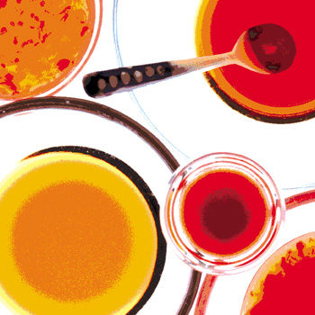
Organic acids as antimicrobials
Many parameters govern the survival and growth of microorganisms in food. The acidity of a food can affect the type and number of microorganisms, as well as their potential to replicate and thrive, present in a product.
For micro-organisms, organic acids can act either as a source of carbon and energy, or as inhibitory agents, depending on the concentration of the acid, its ability to enter the cell and the capacity of the organism to metabolize the acid. Organic acids and their salts have been employed for many years as preservative agents in food, drink and pharmaceutical products.

