Slide 1
PAIN
International Association for the Study of Pain:
Unpleasant sensory and emotional experience associated with actual or potential tissue damage
Alerts us to ongoing/potential tissue damage..vital
Nociception: physiological process by which pain is perceived

Slide 2
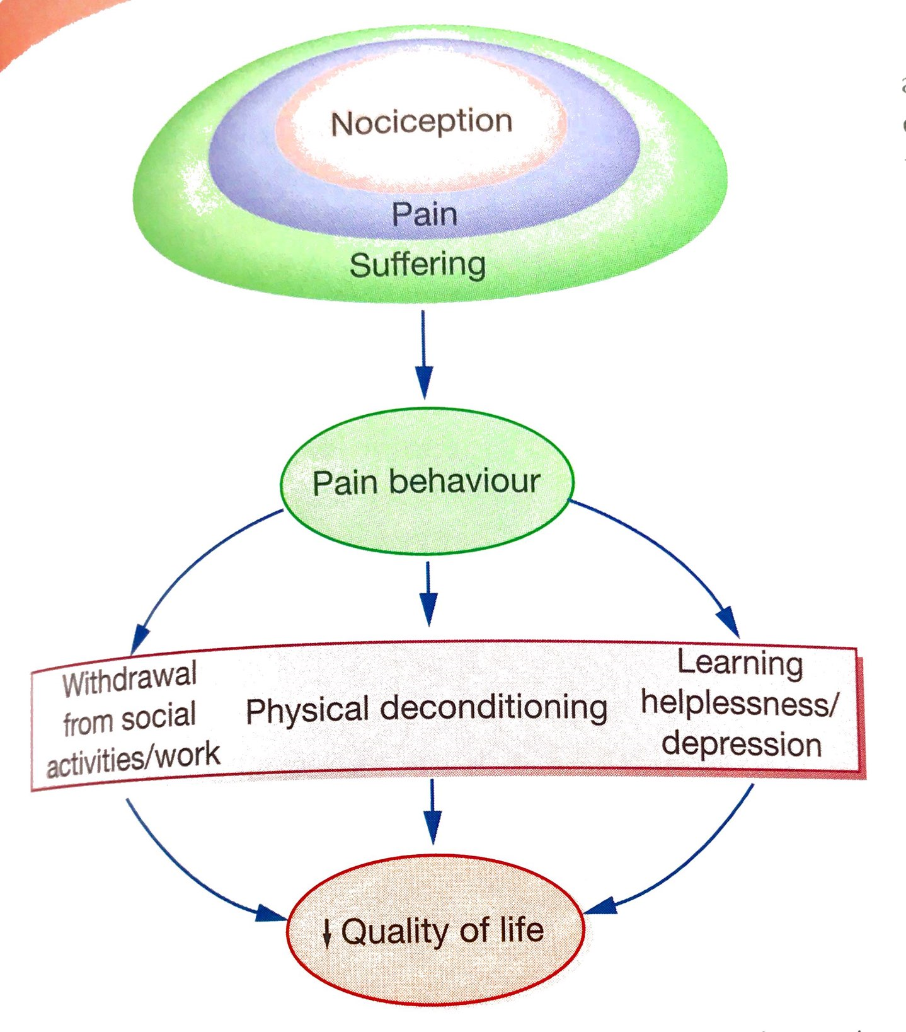

Slide 3
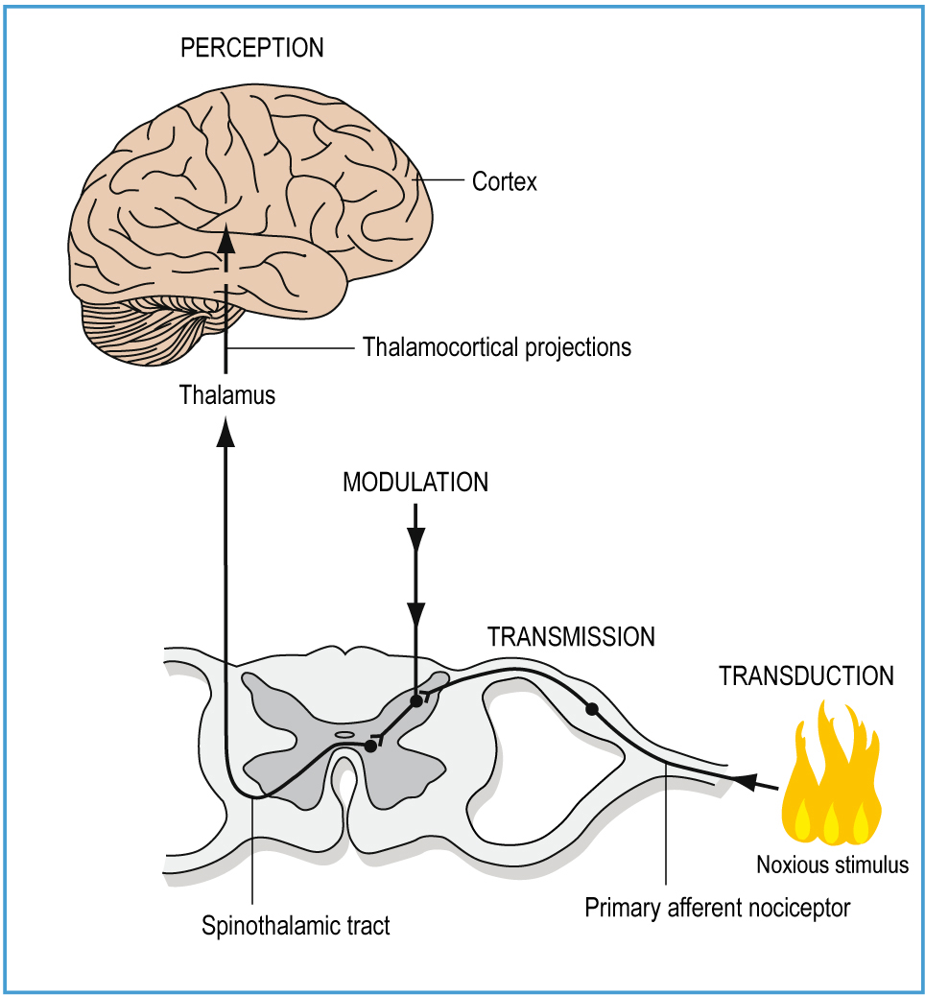

Slide 4
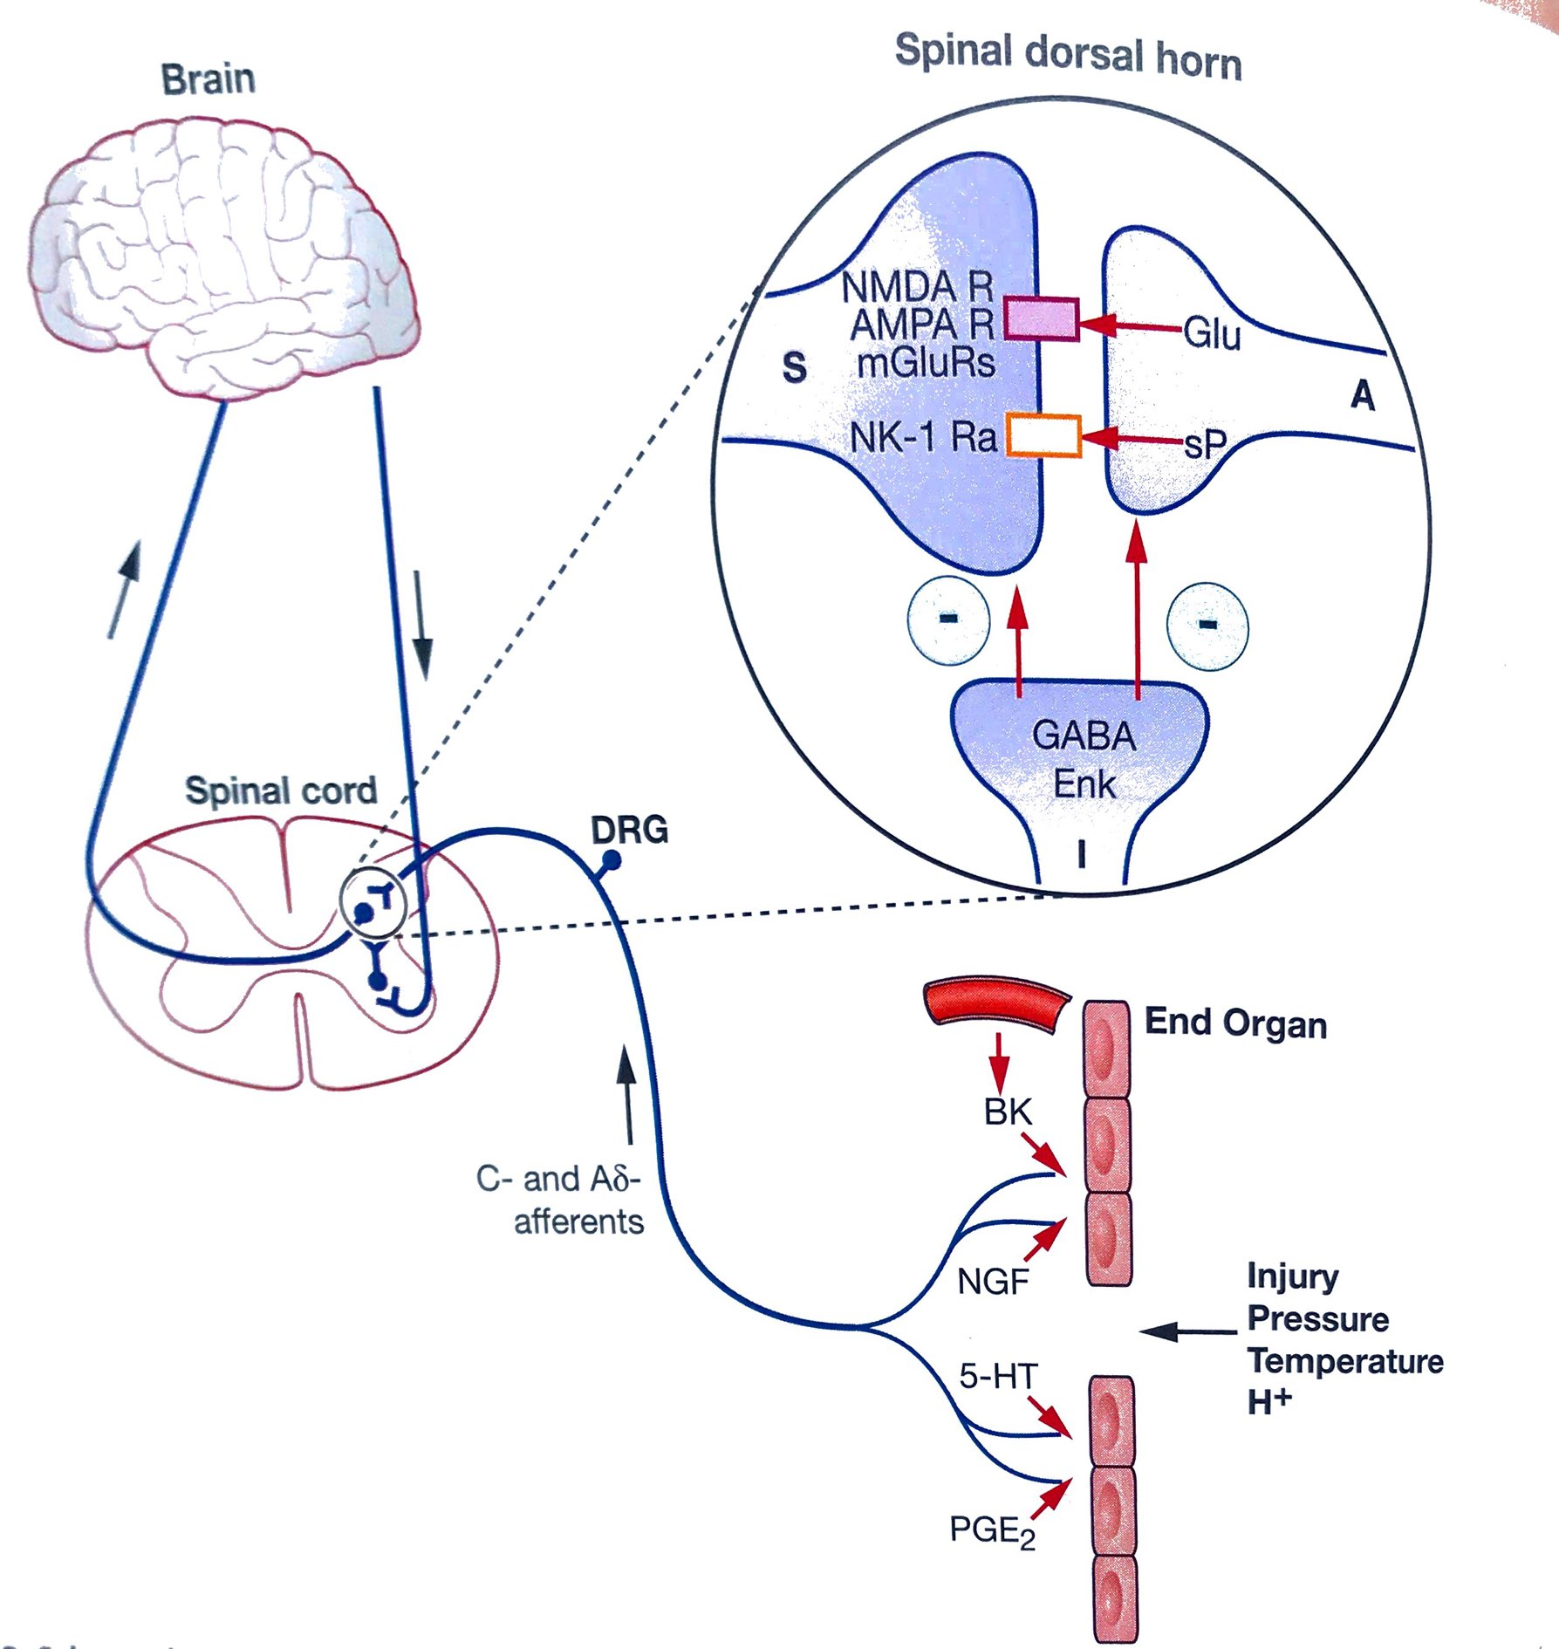
Peripheral terminals of primary sensory neurons: nociceptors have unmyelinated (C-fibre) or thinly myelinated (Aδ-fibre) axons
Their cell bodies lie in the dorsal root ganglia or in the trigeminal ganglia
Different nociceptors encode discrete intensities/modalities of pain
They are transducers: they convert noxious stimuli into AP

Slide 5
Some of them are identified: respond to heat, cold or chemical irritants like capsaisin
Their cell bodies contact with dorsal horn neurons; 1. exitatory amino acid glutamate
Glutamate release is blocked by opioids, cannabinoids, GABA ligands, pregabalin and gabapentin

Slide 6
2. exitatory neurotransmitter: Substance P
These synapses are INHIBITED by GABA and enkephalins
Activation of descending NA or serotonergic leads to the activation of inhibitory neurons: antinociception

Slide 7
After trauma/surgery
Usually effectively managed
Associated w progressive, non-malignant disease
Maybe due to persistent stimulation of nociceptors (inflammationin RA)

Slide 8
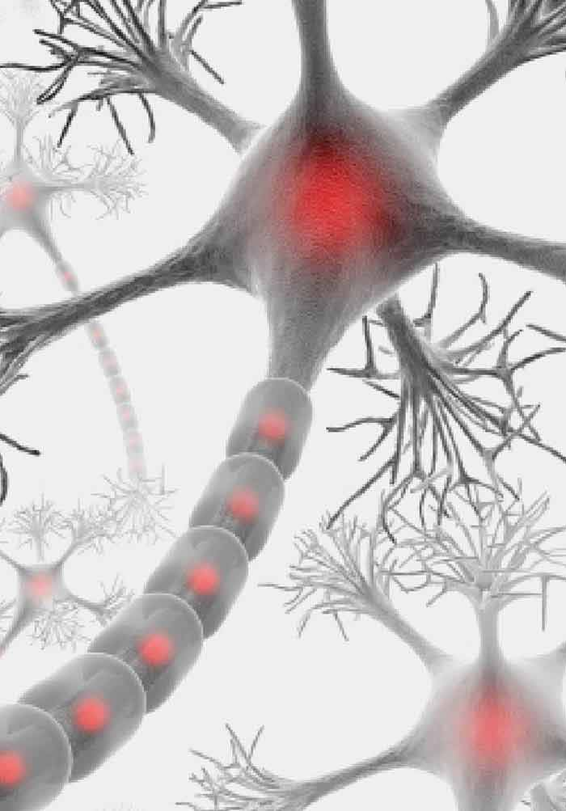
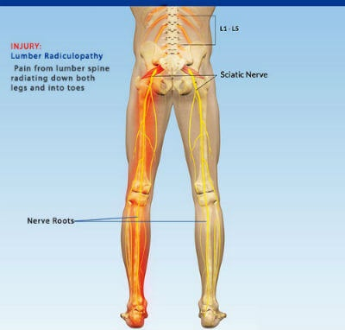
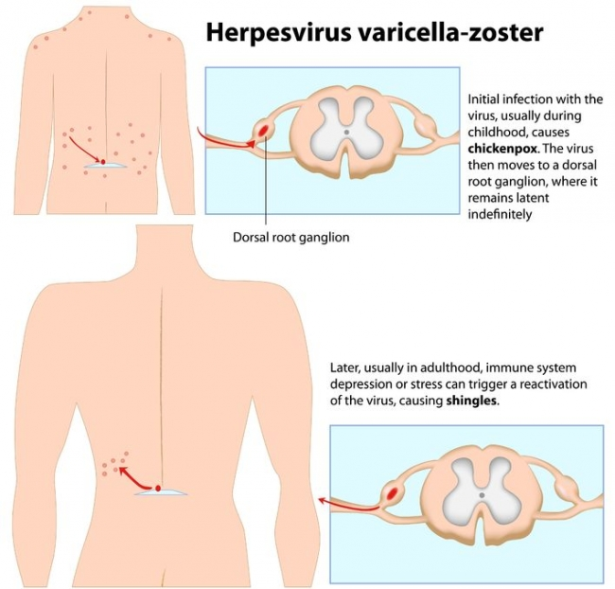
NEUROPATHIC PAIN results from damage to somatosensory nervous system
1. Damage to sensory afferents: diabetic or AIDS polyneuropathy; post-herpetic neuralgia or lumbar radiculopathy

Slide 9
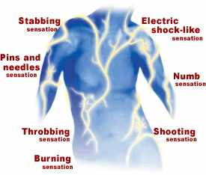
NEUROPATHIC PAIN
2. Damage to CENTRAL somatosensory pathways: spinal cord injury; multiple sclerosis; stroke
CANCER-RELATED PAIN
Primary tumour growth; metastatic disease; toxic effects chemotherapy and radiation

Slide 10
TREATMENT
Primary treatment of underlying cause
Pharmacotherapy
- Systemic, local agents (opioids & non-opiods; adjuvants)
- Also invasive manupulations (nerve block, neurostimulation)
Supportive treatment

Slide 12
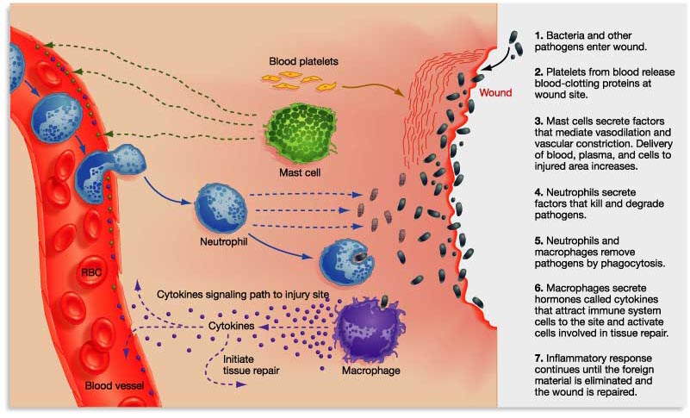
Endothelial damage produces inflammatory response
Damaged cells release ATP, H, K..
Inflammatory cells produce cytokines, chemokines and
growth factors
Some chemicals directly activate nociceptors
others SENSITISE the terminal (prostanoids!!)

Slide 13
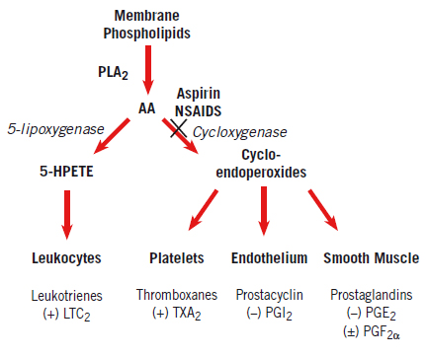
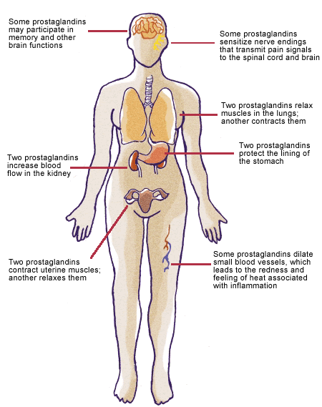
COX- 1, Good COX?
House-keeping
COX-2, Bad COX?

Slide 14
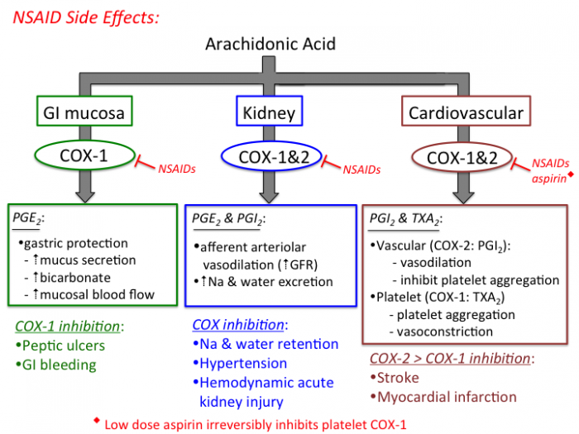

Slide 15
NSAID decrease renal blood flow and glomerular filtration rate

Slide 18
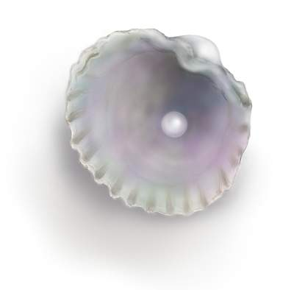
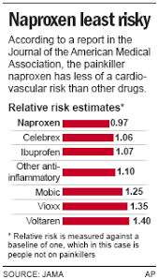
Clinical Pearls
Common advers effects:
-- these apply to pediatric doses as well-- dispepsia, nausea, loss of appetite, stomach pain
GI ulceration, perforation and bleeding is not common; risk higher age > 60, history of GI disease
Drugs may be taken w milk, food and antacids
NSAIDs are associated w MI: patients with CV diseases should avoid (naproxen less risky)

Slide 19
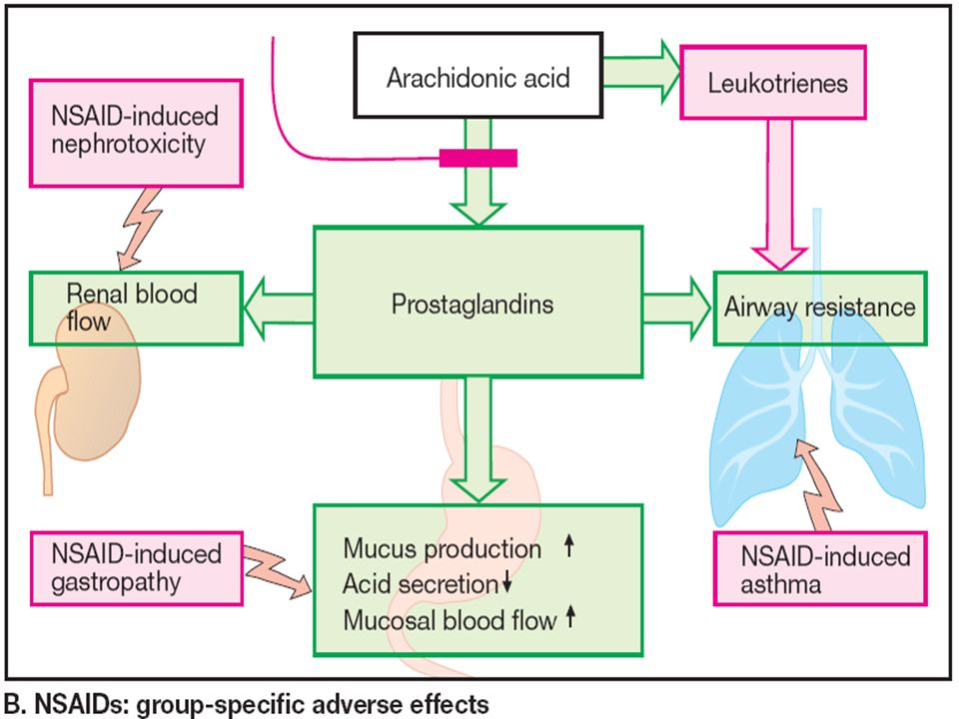

Slide 20
 | Sensible | Max (mg) | İnteracts..
Aspirin | 4-6 saatte bir 300-650mg | 4000 | Antitrombotikler Antihipertansifler SSRI
İbuprofen | 4-6 saatte 200mg | 1200
Naproksen | 8-12 saatte bir | 750

Slide 21
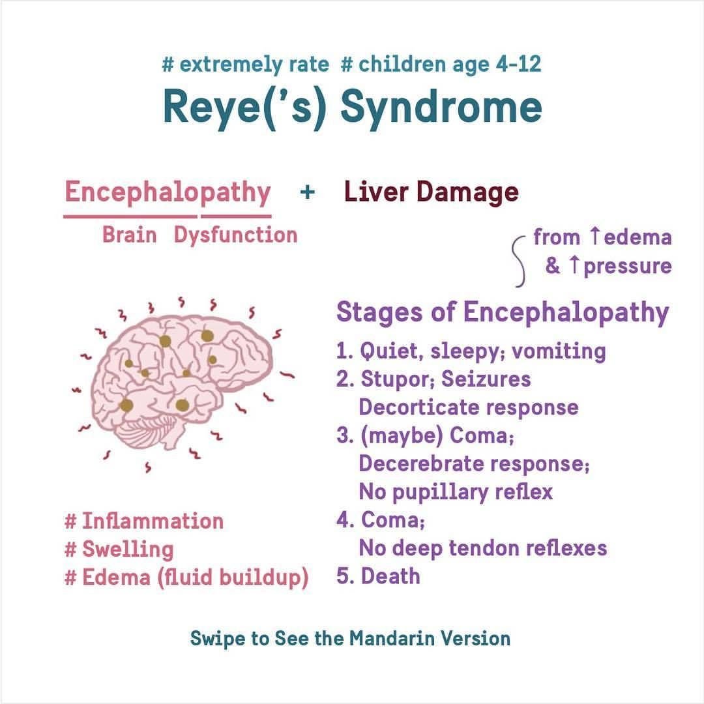
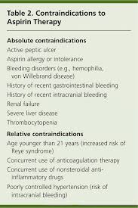
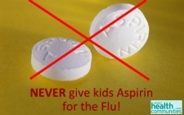

Slide 22
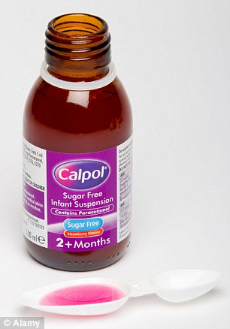
PARACETAMOL

Slide 23
PARACETAMOL
Major drawback: liver toxicity seen MOSTLY in acute overdose due to accumulation of toxic metabolites

Slide 24
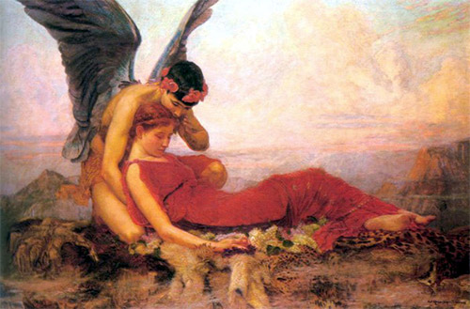
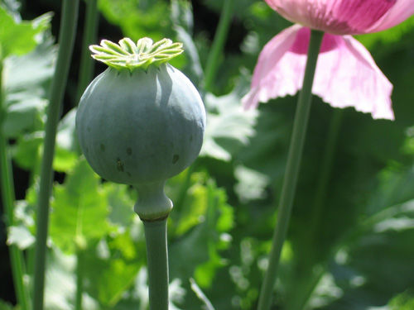
OPIOID AGONISTS &
ANTAGONISTS
Morpheus, God of Dreams
Sertürner , 1803

Slide 25
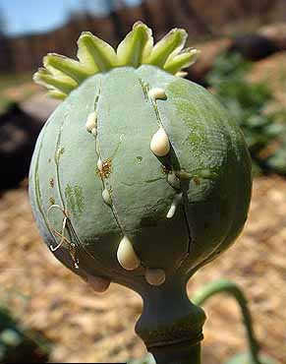
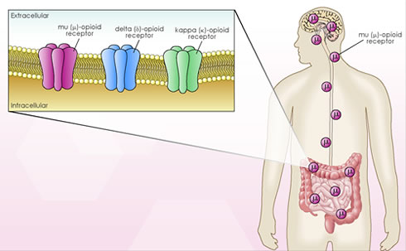
~20 alkaloids
morphine (%10)
codeine
thebaine
papaverine
....
Full agonist, partial agonist or
antagonist

Slide 26
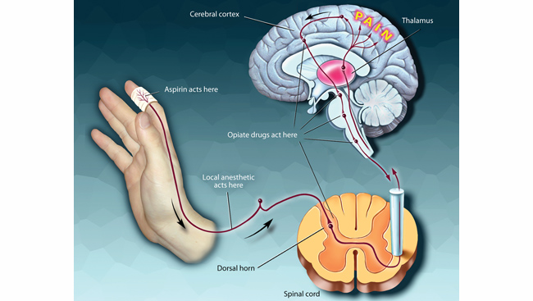
ENDORPHINS
ENKEPHALINS
DYNORPHINS
Painful stimuli / anticipation of pain evoke release

Slide 27
Pharmacokinetics
Good absorption, but HIGH and VARIABLE first pass effect
Less first pass: Codein, oxycodone
Lozenges and transdermal apps very usefull
Localize in highly perfused organs: brain, lungs, liver, spleen AND skeletal muscle
Also in fatty tissue!!
Most converted to polar metabolites
Accumulation of metabolites is problematic in renal failure
3A4 and 2D6
Genetic polymorphism with 2D6
Excretion in urine

Slide 28
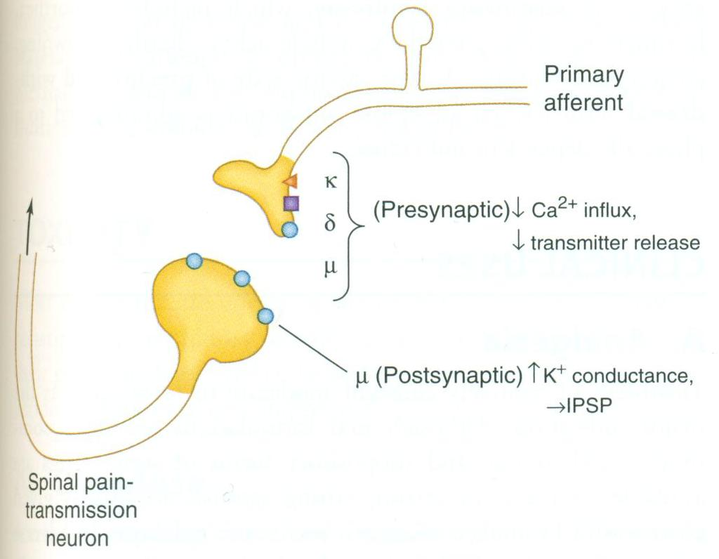
Pharmacodynamics
applied systematically, opioids act simultaneously at multiple sites

Slide 29
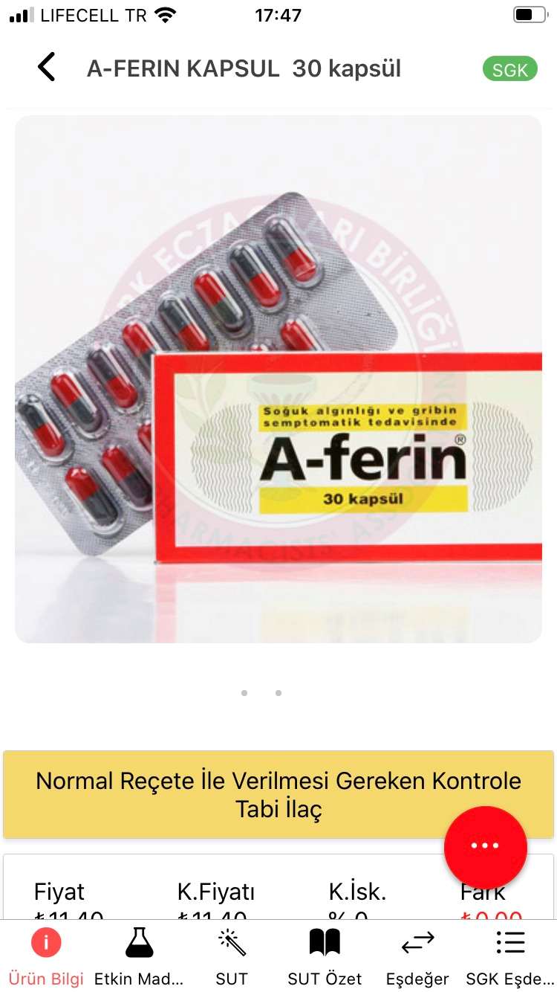
 | Receptor | Dose (mg) | Oral Parenteral | Duration (hrs)
Morphine | µ, δ, κ | 10 | low | 4-5
Hydromorphone | µ | 1,5 | low | 4-5
Mepheridine | µ | 60-100 | medium | 2-4
Fentanyl | µ, δ, κ | 0,1 | Low | 1-1,5
Sufentanil | µ, δ, κ | 0,02 | Parenteral only | 1-1,5
Alfentanil | µ | Titrated | Parenteral only | 0,25-0,75
Remifentanil | µ | Titrated | Parenteral only | 0,05
Oxymorphone *
Methadone *
* Dünya dopingle mücadele kurallarına göre düzenlenen yasaklı (müsabaka sırasında) maddeler listesinde

Slide 30
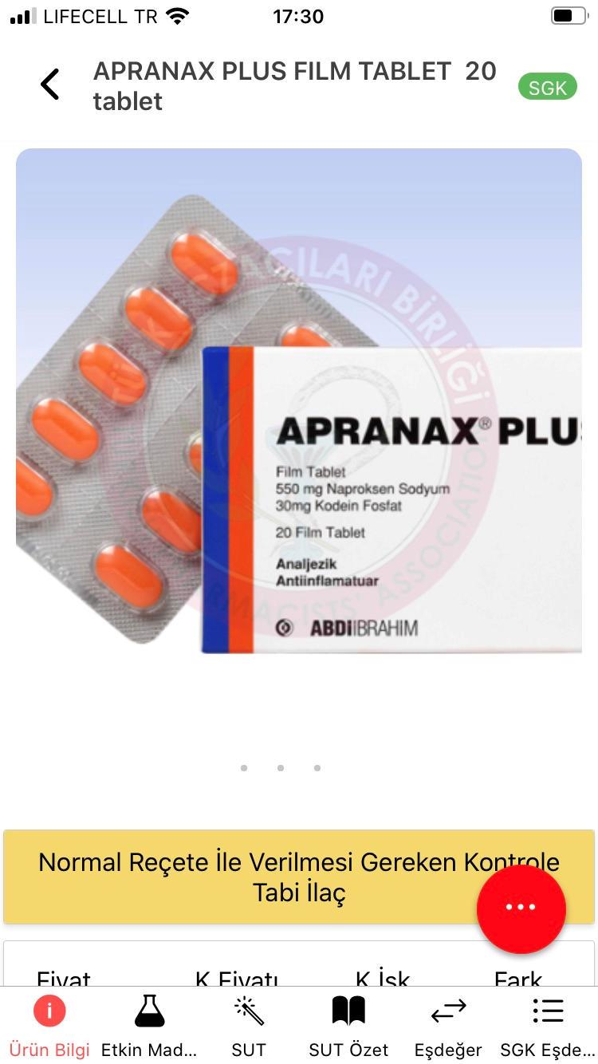
 | Receptor |  | Dose (mg) | Oral Parenteral | Duration (hrs)
Codein | µ (±) |  | 30-60 | high | 3-4
Hydrocodone | NOT AVAILABLE IN TURKEY
Oxycodone | µ | 4,5 |  | medium | 3-4
Pentazocine | NOT AVAILABLE IN TURKEY
Nalbuphine | NOT AVAILABLE IN TURKEY
Buprenorphine | µ (±) κ,δ | 0,3 |  | Low | 4-8
Butorphanol | µ (±) κ | 2 |  | Parenteral only | 3-4
± partial or weak agonist

Slide 31
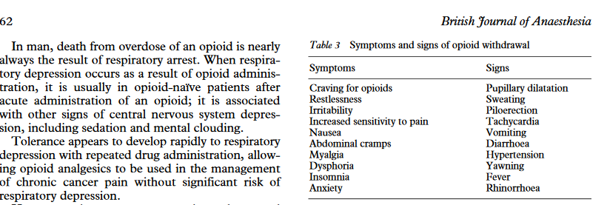
http://bja.oxfordjournals.org/content/81/1/58.full.pdf
60 mg morphine induces respiratory arrest in a nontolerant person
2000 mg morphine for cancer pain over 2-3 hours may not produce significant respiratory depression

Slide 32
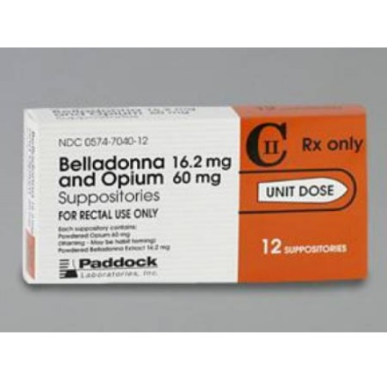
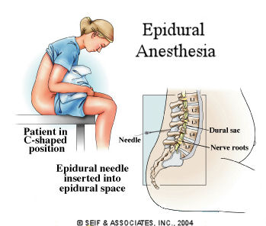
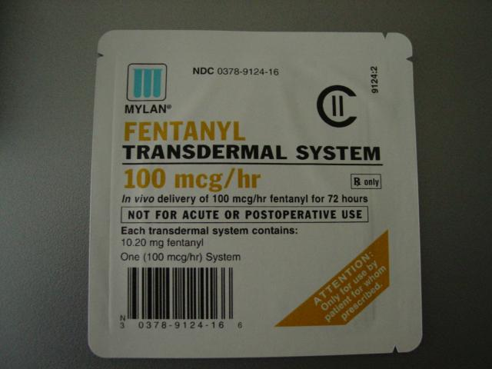
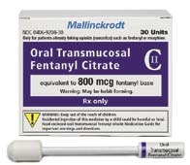
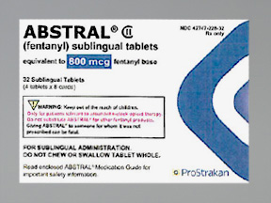
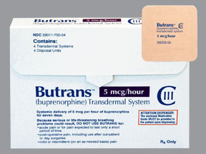
Alternative Routes
Epidural
morphine, hydromorphone
rectal suppositories,
NOT AVAILABLE in Turkey
buccal, TTS, losenge
(fentanyl)
buprenorphine TTS, for detox

Slide 33
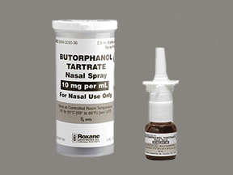
Alternative Routes

Slide 34
There is cross tolerence, however…
OPIOID ROTATION

Slide 35
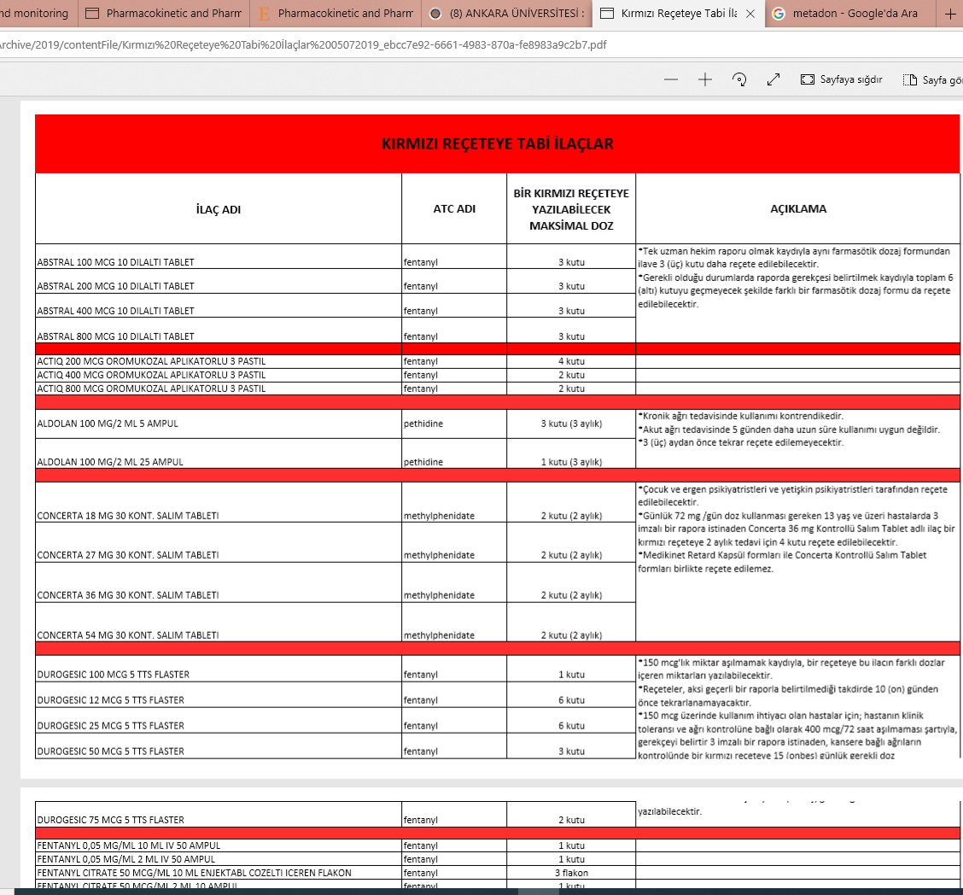

Slide 36
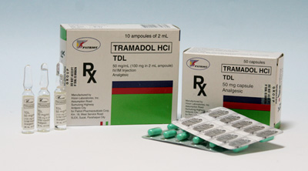
Tramadol
Analgesic effect seem to be UNRELATED to
opioid receptos
(5-HT reuptake inhibisyonu+NE transport inhibisyonu)
No significant depression of respiration
Used in chronic neuropatic pain
Toxic effects: seizures, serotonin syndrome

Slide 37
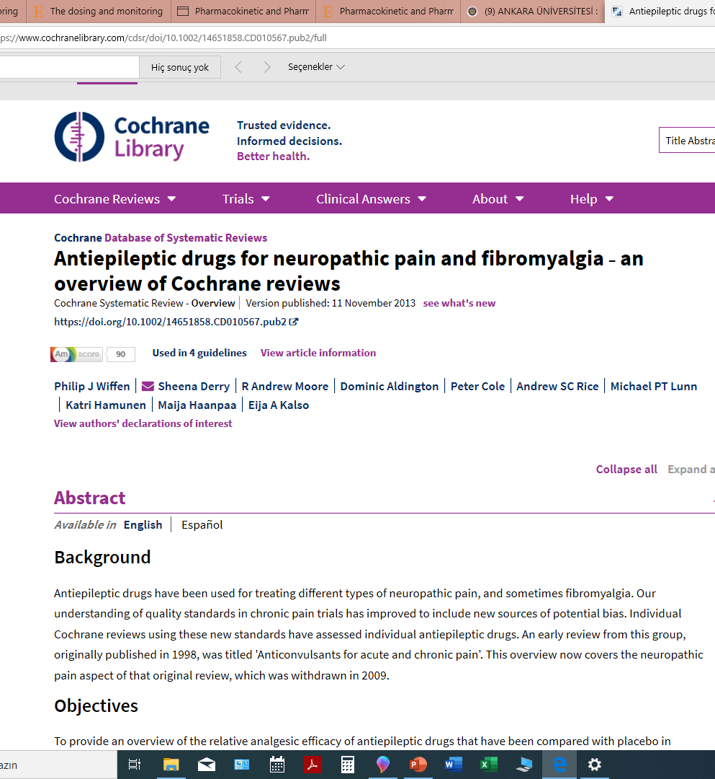

Slide 38
COCHRANE SAYS..
For gabapentin (600 mg 3 times a day) and pregabalin [50 (100) mg 3 times a day] only we found reasonably good second tier evidence for efficacy in painful diabetic neuropathy and postherpetic neuralgia.
In addition, for pregabalin, we found evidence of efficacy in central neuropathic pain and fibromyalgia.

Slide 39
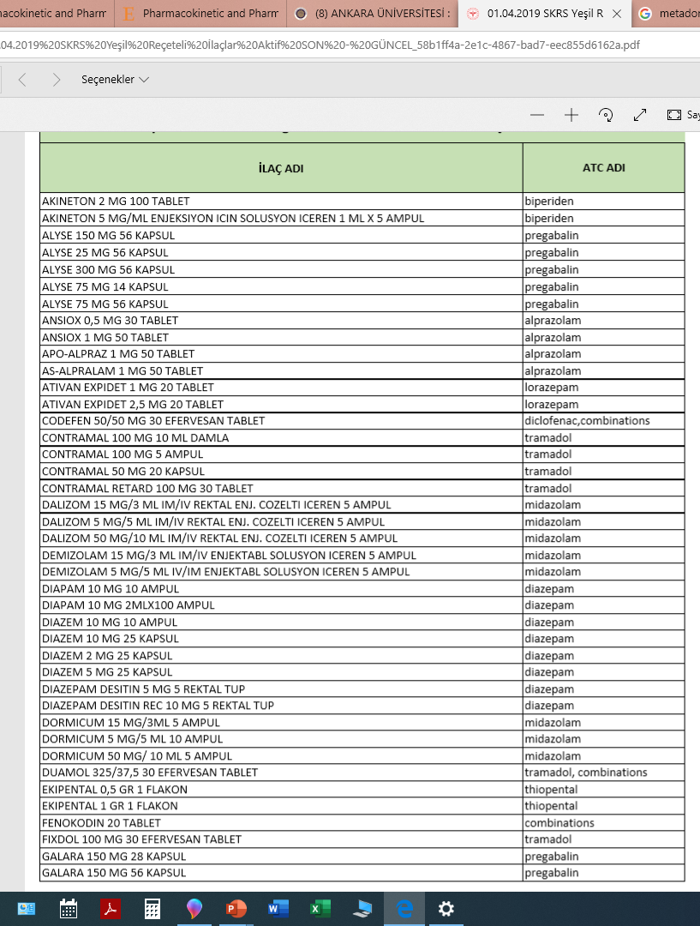

Slide 40
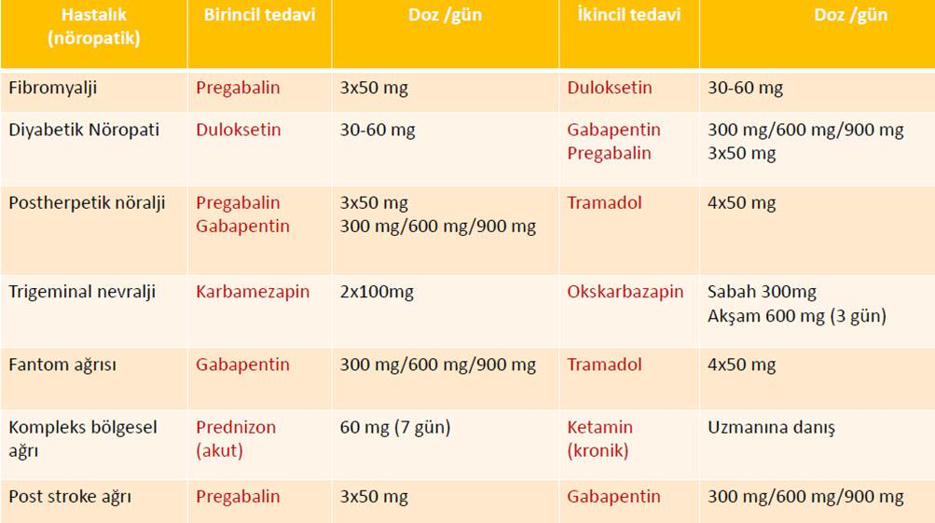

Slide 41
> 40 years, we know that TCA are analgesic
TCAs have been used since 1940 for neuropathic pain, fibromyalgia
Duloxetine indicated for diabetic neuropathy

Slide 42
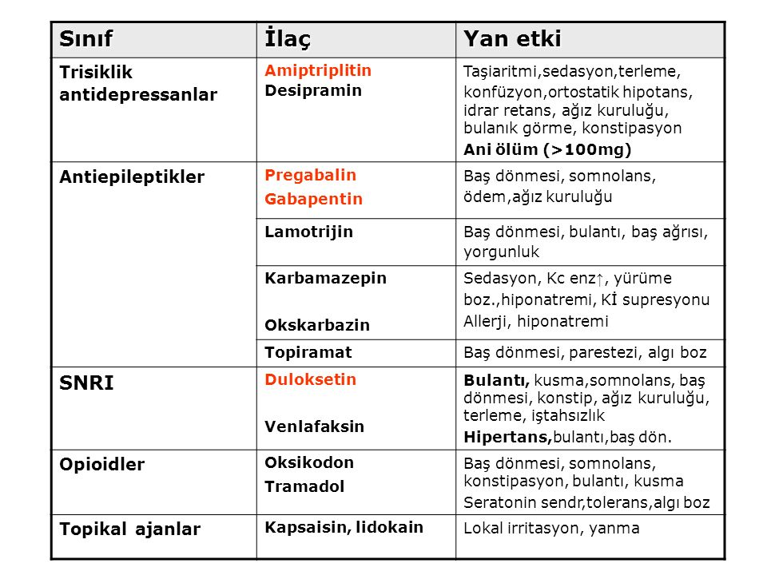

Slide 43
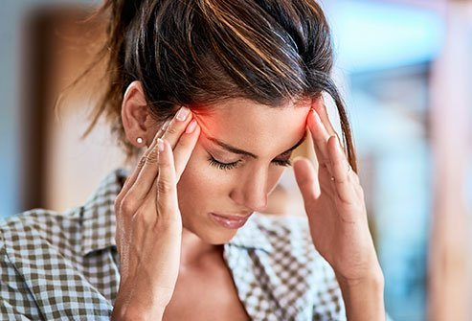

Slide 44
Pathophysiology
neurovascular disorder that involves
dilation and inflammation of intracranial
blood vessels
platelets release 5-HT
CGRP (calcitonin gene-related peptide)
and Substance P ⬆
Headache generation begins with neural
events that trigger vasodilation

Slide 45
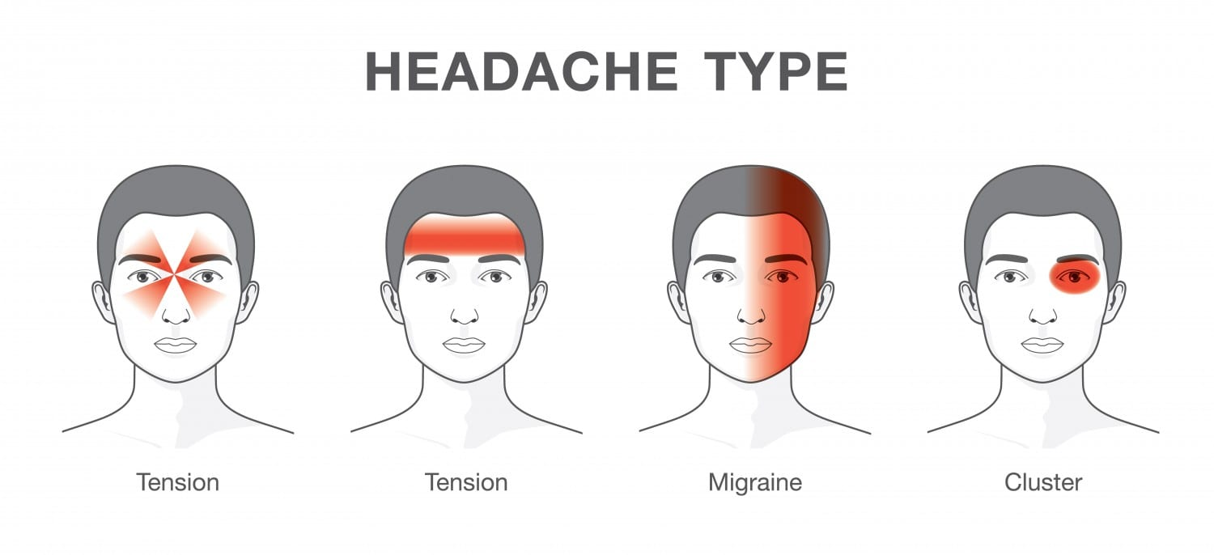
Acute treatment of migraine in adults
abortive (symptomatic) therapy of migraine: simple analgesics such as nonsteroidal anti-inflammatory drugs (NSAIDs) or paracetamol to triptans, antiemetics, or the less commonly used dihydroergotamine

Slide 46
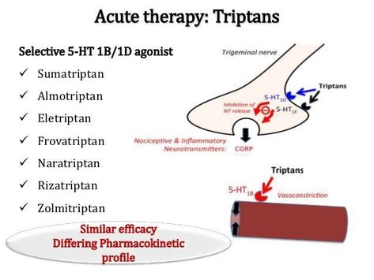
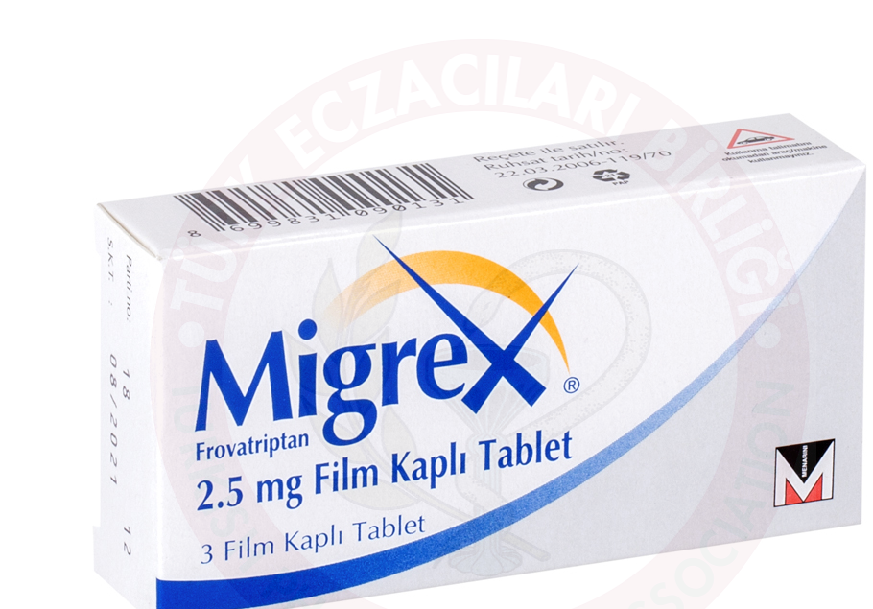
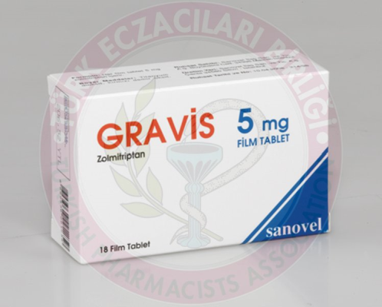

Slide 47
β-Blockers: propranolol (preventive)
Ca channel blockers (preventive):
flunarizin (SIBELIUM®)
TCA and SSRI: amitriptyline,
fluoxetin
Some antiepileptics:
divalproex, topiramate

