Slide 1
The term of Indian Religions
Indian religions, also termed as Dharmic faiths or religions, are the religions that originated in the Indian subcontinent; namely Hinduism, Jainism, Buddhism and Sikhism that follow the rules of Dharma. These religions are also classified as Eastern religions. Although Indian religions are connected through the history of India, they constitute a wide range of religious communities, and are not confined to the Indian subcontinent

Slide 2
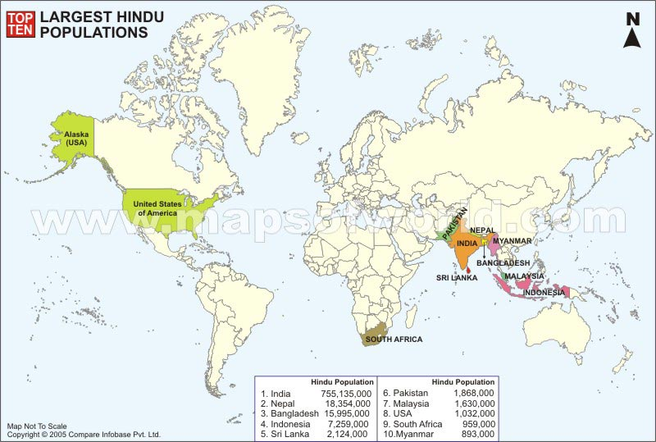

Slide 3
History of Hinduism Hinduism is a term for a wide variety of related religious traditions native to India. Historically, it encompasses the development of Religion in India since the Iron Age traditions, which in turn hark back to prehistoric religions such as that of the Bronze Age Indus Valley Civilization followed by the Vedic religion.
According to historians, the origin of Hinduism dates back to 5,000 or more years. The word "Hindu" is derived from the name of River Indus, which flows through north-western India. In ancient times the river was called the "Sindhu", but the Persians who migrated to India called the river "Hindu," the land "Hindustan" (Sanskrit, Hindi), and its inhabitants "Hindus". Thus the daily life practices evolved as the religion followed by the Hindus came to be known as "Hinduism

Slide 4
Hinduism is the third largest religion in the world, with approximately 900 million adherents
It is also the oldest known religion in the world today
The origins cannot be ascribed to any single founder or a specific time or a single place

Slide 5
Hinduism is Sanatana Dharma
Hinduism is often referred to as Sanatana Dharma meaning 'the eternal path'. The belief is a conglomerate of religious, philosophical and cultural ideas characterized by the belief in reincarnation, the path to righteousness, and the desire to liberate from the cycle of births and deaths.

