Slide 1
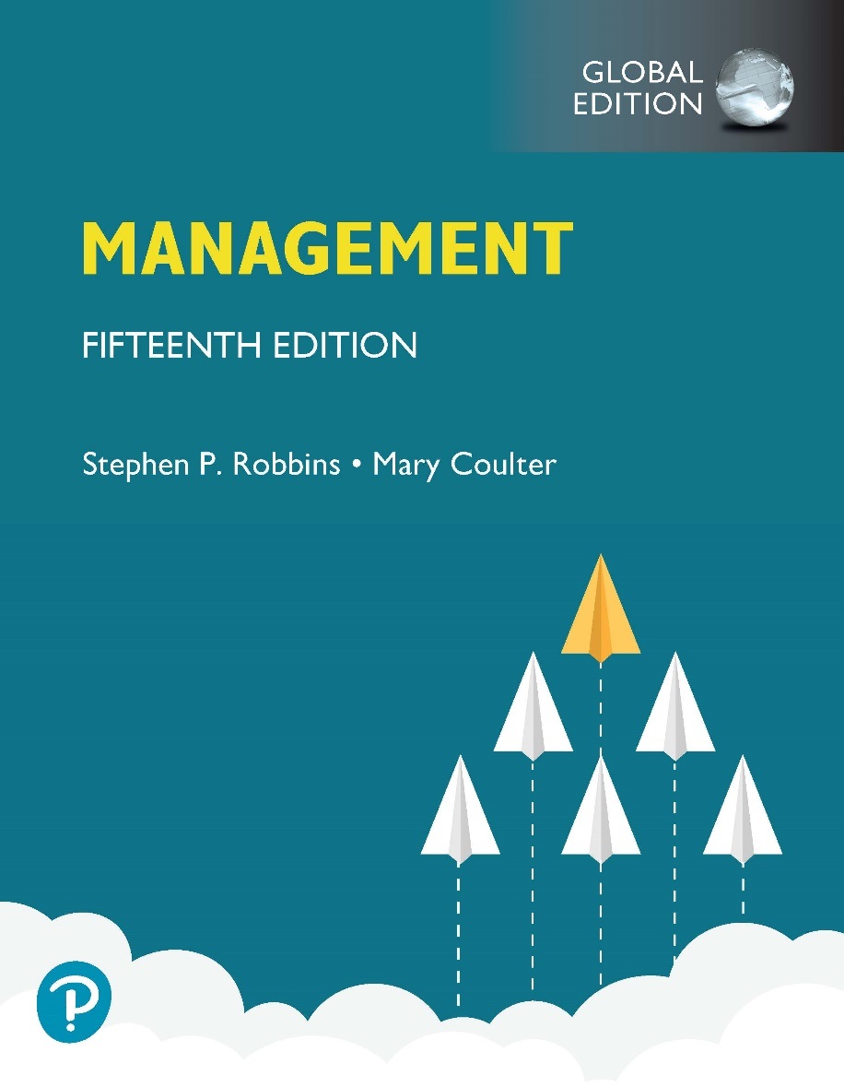
Management
Fifteenth Edition, Global Edition
Chapter 3
Influence of the External Environment and the Organization’s Culture
Copyright © 2021 Pearson Education Ltd.
Notes:
If this PowerPoint presentation contains mathematical equations, you may need to check that your computer has the following installed:
1) MathType Plugin
2) Math Player (free versions available)
3) NVDA Reader (free versions available)

Slide 2
Learning Objectives
3.1 Contrast the actions of managers according to the omnipotent and symbolic views.
3.2 Describe the constraints and challenges facing managers in today’s external environment.
3.3 Discuss the characteristics and importance of organizational culture.

Slide 3
The Manager: Omnipotent or Symbolic?
Omnipotent view: managers are directly responsible for an organization’s success or failure
Symbolic view: much of an organization’s success or failure is due to external forces outside managers’ control
Notes:
How much difference does a manager make in how an organization performs? The dominant view in management theory and society in general is that managers are directly responsible for an organization’s success or failure. We call this perspective the omnipotent view of management. In contrast, others have argued that much of an organization’s success or failure is due to external forces outside managers’ control. This perspective is called the symbolic view of management.

Slide 4
Managerial Constraints
In reality, managers are neither all-powerful nor helpless. But their decisions and actions are constrained.
External constraints come from the organization’s environment and internal constraints come from the organization’s culture
Notes:
In reality, managers are neither all-powerful nor helpless. But their decisions and actions are constrained. As you can see in Exhibit 3-1, external constraints come from the organization’s environment and internal constraints come from the organization’s culture.

Slide 5
Exhibit 3.1 Constraints on Managerial Discretion
Exhibit 3.1 shows that external constraints come from the organization’s environment and internal constraints come from the organization’s culture.

Slide 6
The Environment and Environmental Uncertainty
Environment: institutions or forces outside of the organization that could potentially affect performance.
Environments differ on degree of environmental uncertainty
Environmental uncertainty has two dimensions
Degree of change
Degree of complexity
Notes:
Organizations do not operate in a vacuum. Hundreds of external factors can impact the organization in varying degrees. Part of a manager’s job is to identify the key factors and determine how to respond to those factors, if at all.

Slide 7
Exhibit 3.2 Environmental Uncertainty Matrix
Exhibit 3.2 shows the two dimensions of environmental uncertainty.
Notes:
Each cell identifies the key characteristics of that environment. For example, Cell 1 shows a stable environment with a low degree of complexity. Managers operating in this environment will not be faced with the same challenges as managers of organizations that fit into other cells.
Long Description:
The matrix is made of two dimensions, “Degree of Change” and “Degree of Complexity.” The values of each dimension are as follows.
Degree of Change: Stable, Dynamic
Degree of Complexity: Simple, Complex
The matrix cell values for the combination of dimensional values are as follows.
Cell 1: Simple; Stable
Stable and predictable environment
Few components in environment
Components are somewhat similar and remain basically the same
Minimal need for sophisticated knowledge of components
Cell 2: Simple; Dynamic
Dynamic and unpredictable environment
Few components in environment
Components are somewhat similar but are continually changing
Minimal need for sophisticated knowledge of components
Cell 3: Complex; Stable
Stable and predictable environment
Many components in environment
Components are not similar to one another and remain basically all the same
High need for sophisticated knowledge of components
Cell 4: Complex; Dynamic
Dynamic and unpredictable environment
Many components in the environment
Components are not similar to one another and are continually changing
High need for sophisticated knowledge of components.

Slide 8
Degree of Change
Environments can be either dynamic or stable
In a dynamic environment the components in an organization’s environment change frequently
In a stable environment the components in an organization’s environment change very little
Notes:
The first dimension of uncertainty is the degree of change. If the components in an organization’s environment change frequently, it’s a dynamic environment. If change is minimal, it’s a stable one. A stable environment might be one with no new competitors, few technological breakthroughs by current competitors, little activity by pressure groups to influence the organization, and so forth. When we talk about degree of change, we mean change that’s unpredictable. If change can be accurately anticipated, it’s not an uncertainty for managers.
The text uses the example of Zippo Manufacturing (known for making lighters) operating in a stable environment. The example used for a dynamic environment is the recorded music industry where almost constant change in formats creates uncertainty.

Slide 9
Degree of Environmental Complexity
Environmental complexity looks at the number of components in an organization’s environment and the extent of the knowledge the organization has about those components.
Depending on the organizational environment, managers may need to know a lot about the components, or very little.
Notes:
The other dimension of uncertainty describes the degree of environmental complexity, which looks at the number of components in an organization’s environment and the extent of the knowledge that the organization has about those components. An organization with fewer competitors, customers, suppliers, government agencies, and so forth faces a less complex and uncertain environment. Complexity is also measured in terms of the knowledge an organization needs about its environment.
A firm with few competitors, customers, suppliers, etc. has much less environmental complexity than a firm operating in an environment with numerous competitors, several government regulators, and dozens of potential suppliers.

Slide 10
The External Environment
Those factors and forces outside the organization that affect its performance
Economic
Demographic
Political/Legal
Sociocultural
Technological
Global
Notes:
The economic component encompasses factors such as interest rates, inflation, changes in disposable income, stock market fluctuations, and business cycle stages.
The demographic component is concerned with trends in population characteristics such as age, race, gender, education level, geographic location, income, and family composition.
The political/legal component looks at federal, state, and local laws as well as global laws and laws of other countries. It also includes a country’s political conditions and stability.
The sociocultural component is concerned with societal and cultural factors such as values, attitudes, trends, traditions, lifestyles, beliefs, tastes, and patterns of behavior.
The technological component is concerned with scientific or industrial innovations.
The global component encompasses those issues associated with globalization and a world economy.

Slide 11
Exhibit 3.3 Components of External Environment
Exhibit 3.3 shows the different components that make up the external environment.
Notes:
Long Description:
The components are as follows:
Political/Legal
Demographic
Economic
Sociocultural
Technological
Global

Slide 12
The Specific Environment (1 of 2)
Specific Environment: the part of the environment directly relevant to the achievement of organizational goals
Most of management’s attention typically focuses on the specific environment
Notes:
The specific environment consists of those external constituencies or stakeholders that can affect the organization in some way.

Slide 13
The Specific Environment (2 of 2)
The specific environment includes one or more of the following:
Suppliers
Customers
Competitors
Government agencies
Special interest groups
Notes:
The nature of stakeholder relationships is another way in which the environment influences managers. The more obvious and secure these relationships, the more influence managers will have over organizational outcomes.
Stakeholders are any constituencies in the organization’s environment affected by an organization’s decisions and actions. These groups have a stake in or are significantly influenced by what the organization does. In turn, these groups can influence the organization.
Management researchers who have looked at this issue are finding that managers of high-performing companies tend to consider the interests of all major stakeholder groups as they make decisions.

Slide 14
Specific Environment Components (1 of 2)
Suppliers: Managers need to ensure a steady flow of inputs
Customers: Organizations exist to meet customer needs
Competitors: All organizations have competitors that they need to monitor
Notes:
Managers need to monitor each of these components and be ready to respond to changes. For example, even monopolies like the US Postal Service discovered it had competitors in FedEx and UPS. Ignoring competitors can cost market share and threaten long-term survival.

Slide 15
Specific Environment Components (2 of 2)
Government: Federal, state, and local governments influence what the organization can and cannot do.
Pressure Groups: Special interest groups can have a significant impact on the organization. Lobbyists, protestors, various action groups all effect change.
Notes:
The federal government imposes numerous labor laws, but state and local governments also impact the firm. Recent examples include cities and states with higher minimum wages taking effect.
Recent examples of pressure groups affecting organizations include Black Lives Matter protests against Starbucks and the vilification of gun makers by the Coalition to Stop Gun Violence. Managers must be vigilant and ready to respond to pressure groups when necessary.

Slide 16
Exhibit 3.6 Strong vs. Weak Cultures
Exhibit 3.4 shows the different components that make up the specific environment.
Notes:
As you can see there are a lot of moving parts that managers need to keep track of and be ready to respond to or to proactively respond to potential threats.
Long Description:
The chart shows “Organization” in the center. The entities of the environment placed around the “Organization” are as follows.
Suppliers
Customers
Competitors
Government
Public pressure groups
A circle surrounds the organization and the five entities. The organization influencing factors listed on the circle are as follows.
Economic
Global
Political
Social
Technological

Slide 17
Organizational Culture
Just as each individual has a unique personality, an organization, too, has a personality.
Notes:
Just as each individual has a unique personality—traits and characteristics influence the way we act and interact with others. An organization, too, has a personality, which is referred to as organizational culture.
An organization’s culture can make employees feel included, empowered, and supported or it can make them feel the opposite.
Because culture can be a very powerful agent in organizations, it is very important for managers to pay attention to it.

Slide 18
What is Organizational Culture?
Organizational culture: the shared values, principles, traditions, and ways of doing things that influence the way organizational members act and that distinguish the organization from other organizations
Notes:
In most organizations, these shared values and practices have evolved over time and determine, to a large extent, how “things are done around here.”
Our definition of culture implies three things. First, culture is a perception. It’s not something that can be physically touched or seen, but employees perceive it on the basis of what they experience within the organization. Second, organizational culture is descriptive. It’s concerned with how members perceive the culture and describe it, not with whether they like it. Finally, even though individuals may have different backgrounds or work at different organizational levels, they tend to describe the organization’s culture in similar terms. That’s the shared aspect of culture.

Slide 19
Six Dimensions of Organizational Culture
Research shows there are six dimensions that appear to capture an organization’s culture:
Adaptability
Attention to detail
Outcome orientation
People orientation
Team orientation
Integrity
Notes:
Each of these dimensions ranges from high to low with high meaning it is typical of the organization’s culture. Exhibit 3-5 describes how these dimensions can create significantly different cultures.

Slide 20
Exhibit 3.5 Contrasting Organizational Culture
Risk taking and change discouraged
Creativity discouraged
Close managerial supervision
Work designed around individual employees
Risk taking and change rewarded
Creativity and innovation rewarded
Management trusts employees
Work designed around teams
Notes:
Exhibit 3.5 illustrates how the dimensions of culture can create significantly different cultures.
Both Organization A and Organization B are manufacturing firms, but each company emphasizes a different dimension that has shaped organizational culture.
Long Description:
The chart shows three icons as follows.
A stack of documents labeled “Rules”
A tree diagram
A single stick figure
Long Description:
The chart shows three icons as follows.
A light bulb
A pentagon shape with rectangles at its vertices; two-sided arrows connect each box with the others
Three stick figures

Slide 21
Strong Cultures
Strong cultures: organizational cultures in which the key values are intensely held and widely shared
Notes:
Strong cultures have a greater influence on employees than weaker cultures. (Exhibit 3-6 contrasts strong and weak cultures.)
The more employees accept the organization’s key values and the greater their commitment to those values, the stronger the culture. Most organizations have moderate to strong cultures; that is, there is relatively high agreement on what’s important, what defines “good” employee behavior, what it takes to get ahead, and so forth. The stronger a culture becomes, the more it affects the way managers plan, organize, lead, and control.

Slide 22
Exhibit 3.6 Strong Versus Weak Cultures
Strong Cultures | Weak Cultures
Values widely shared | Values limited to a few people – usually top management
Culture conveys consistent messages about what’s important | Culture sends contradictory messages about what’s important
Most employees can tell stories about company history or heroes | Employees have little knowledge of company history or heroes
Employees strongly identify with culture | Employees have little identification with culture
Strong connection between shared values and behaviors | Little connection between shared values and behaviors
Notes:
Why is having a strong culture important? For one thing, in organizations with strong cultures, employees are more loyal than employees in organizations with weak cultures.
Research also suggests that strong cultures are associated with high organizational performance. However, the drawback is that a strong culture also might prevent employees from trying new approaches, especially when conditions change rapidly.

Slide 23
Where Culture Comes From and How it Continues
The original source of the culture usually reflects the vision of the founders.
Once the culture is in place, certain organizational practices help maintain it.
The actions of top managers also have a major impact on the organization’s culture.
Notes:
Company founders are not constrained by previous customs or approaches and can establish the early culture by articulating a vision of what they want the organization to be. Also, the small size of most new organizations makes it easier to instill that vision with all organizational members.
Once the culture is in place, however, certain organizational practices help maintain it. For instance, during the employee selection process, managers typically judge job candidates not only on the job requirements, but also on how well they might fit into the organization. At the same time, job candidates find out information about the organization and determine whether they are comfortable with what they see.
Through what they say and how they behave, top managers establish norms that filter down through the organization and can have a positive effect on employees’ behaviors. For instance, Gravity CEO, Dan Price, raised the minimum wage at his firm to $70,000 annually and has cut his million-dollar salary to fund those pay increases. Since making this decision, Gravity’s financial performance has soared.
However, as we’ve seen in numerous corporate ethics scandals, the actions of top managers also can lead to undesirable outcomes.

Slide 24
Exhibit 3.7 Establishing and Maintaining Culture
Exhibit 3.7 illustrates how an organization’s culture is established and maintained.
Notes:
Exhibit 3.7 illustrates how an organization’s culture is established and maintained.
Long Description:
The process map shows the following.
“Philosophy of Organization’s Culture” pointing to “Selection Criteria”
“Selection Criteria” pointing to “Top Management” and “Socialization”
“Top Management” pointing to “Socialization”
“Top Management” and “Socialization” pointing to “Organization’s Culture”

Slide 25
How Employees Learn Culture
Stories
Rituals
Material Artifacts and Symbols
Language
Notes:
Organizational “stories” typically contain a narrative of significant events or people, including such things as the organization’s founders, rule breaking, reactions to past mistakes, and so forth. To help employees learn the culture, organizational stories anchor the present in the past, provide explanations and legitimacy for current practices, exemplify what is important to the organization, and provide compelling pictures of an organization’s goals.
Corporate rituals are repetitive sequences of activities that express and reinforce the important values and goals of the organization. One of the best-known corporate rituals is Mary Kay Cosmetics’ annual awards ceremony for its sales representatives.
The layout of an organization’s facilities, how employees dress, the types of automobiles provided to top executives, and the availability of corporate aircraft are examples of material symbols. Others include the size of offices, the elegance of furnishings, executive “perks” (extra benefits provided to managers such as health club memberships, use of company-owned facilities, and so forth), employee fitness centers or on-site dining facilities, and reserved parking spaces for certain employees.
Many organizations and units within organizations use language as a way to identify and unite members of a culture. Over time, organizations often develop unique terms to describe equipment, key personnel, suppliers, customers, processes, or products related to its business. New employees are frequently overwhelmed with acronyms and jargon that, after a short period of time, become a natural part of their language. Once learned, this language acts as a common denominator that bonds members.

Slide 26
How Culture Affects Managers
Because an organization’s culture constrains what they can and cannot do and how they manage, it’s particularly relevant to managers.
Notes:
Such constraints are rarely explicit. They’re not written down. It’s unlikely they’ll even be spoken. But they’re there, and all managers quickly learn what to do and not do in their organization.
The link between values such as these and managerial behavior is fairly straightforward. Take, for example, a so-called “ready-aim-fire” culture. In such an organization, managers will study and analyze proposed projects endlessly before committing to them. However, in a “ready- re-aim” culture, managers take action and then analyze what has been done.

Slide 27
Exhibit 3.8 Types of Managerial Decisions Affected by Culture
As shown in Exhibit 3.8, a manager’s decisions are influenced by the culture in which he or she operates.
Notes:
As shown in Exhibit 3.8, a manager’s decisions are influenced by the culture in which he or she operates. An organization’s culture, especially a strong one, influences and constrains the way managers plan, organize, lead, and control.
Long Description:
The types and the decisions are as follows.
Planning
The degree of risk that plans should contain
Whether plans should be developed by individuals or teams
The degree of environmental scanning in which management will engage
Leading
The degree to which managers are concerned with increasing employee job satisfaction
What leadership styles are appropriate
Whether all disagreements-even constructive ones- should be eliminated
Organizing
How much autonomy should be designed into employees’ jobs
Whether tasks should be done by individuals or in teams
The degree to which department managers interact with each other
Controlling
Whether to impose external controls or to allow employees to control their own actions
What criteria should be emphasized in employee performance evaluations
What repercussions will occur from exceeding one’s budget

Slide 28
Review Learning Objective 3.1
Contrast the actions of managers according to the omnipotent and symbolic views.
Omnipotent view: Managers are directly responsible for the organization’s success or failure.
Symbolic view: Much of the organization’s success or failure is due to external forces outside of the manager’s control.
The two constraints on managers' discretion are organizational culture (internal) and the environment (external).

Slide 29
Review Learning Objective 3.2
Describe the constraints and challenges facing managers in today’s external environment.
The external environment includes those factors and forces outside the organization that affect its performance.
The main components of the external environment are economic, demographic, political/legal, sociocultural, technological, and global.
These components can constrain and challenge managers because they have an impact on jobs, environmental uncertainty, and stakeholder relationships.

Slide 30
Review Learning Objective 3.3
Discuss the characteristics and importance of organizational culture.
The seven dimensions of culture are: attention to detail, outcome orientation, people orientation, team orientation, aggressiveness, stability, innovation, and risk taking.
The stronger the culture, the greater the impact on the way managers plan, organize, lead, and control.
The original source of the organizational culture reflects the founder’s vision.
Culture is transmitted through stories, rituals, material symbols, and language.

