Slide 1
Zoonosıs ın turkey
Dr. Bahar Onaran

Slide 2
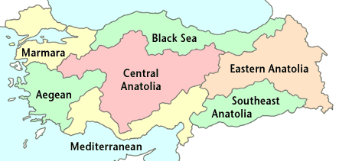
Tuberculosis
Antrax

Slide 3
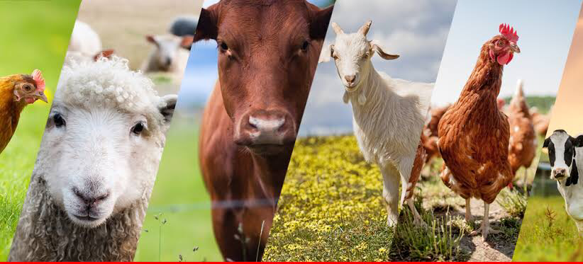
Tuberculosıs

Slide 4
Tuberculosıs
Tuberculosis is a chronic bacterial disease caused by mycobacterium.
Bovine tuberculosis is common in Turkey and causes economical loss. Mycobacterium bovum is the causatve agent of bovine tuberculosis.
Bovine TB usually affects animals such as cattle, but it can affect practically all mammals causing a general state of illness, coughing and eventual death.
It can be transmitted from animals to humans as well as to other animals.
The name Tuberculosis comes from the nodules, called ‘tubercles’ which form in the lymph nodes of affected animals.

Slide 5
Tuberculosıs
Until the 1920s when control measures began in developed countries, it was one of the major diseases of domestic animals throughout the world. Today TB remains an important disease of cattle, wild animals, and is a significant zoonosis (a disease of animals which can also infect humans).
TB is found throughout the world. The disease is more prevalent in most of Africa, parts of Asia and America.

Slide 6
What are the symptoms?
TB usually has a prolonged course, and symptoms take months or years to appear. The usual clinical signs include:
weakness
loss of appetite
weight-loss
fluctuating fever
intermittent hacking cough
diarrhea
large prominent lymph nodes
However, the bacteria can also lie dormant in thehost without causing disease.

Slide 7
What ıs the publıc health rısk?
Mycobacterium bovis is not the major cause of human tuberculosis, which is caused by M. tuberculosis, but humans are susceptible to bovine TB.
Humans can be infected both by drinking raw milk from infected cattle, or by inhaling infective droplets. It is estimated in some countries that up to ten percent of human tuberculosis is due to Bovine TB.

Slide 8
What ıs being done to preventor control thıs dısease?
The standard control measure applied to TB is test and slaughter.
Disease eradication programs consisting of post mortem meat inspection, intensive surveillance including on-farm visits, systematic individual testing of cattle and removal of infected and in- contact animals as well as movement controls have been very successful in reducing or eliminating the disease.
Post mortem meat inspection of animals looks for the tubercles in the lungs and lymph nodes. Detecting these infected animals prevents unsafe meat from entering the food chain and allows veterinary services to trace-back to the herd of origin of the infected animal which can then be tested and eliminated if needed.

Slide 9
What ıs beıng done to preventor control thıs dısease?
Pasteurisation of milk of infected animals to a temperature sufficient to kill the bacteria has prevented the spread of disease in humans.
Treatment of infected animals is rarely attempted because of the high cost, lengthy time and the larger goal of eliminating the disease.
Vaccination is practiced in human medicine, but it is not widely used as a preventive measure in animals: the efficacy of existing animal vaccines is variable and it interferes with testing to eliminate the disease. A number of new candidate vaccines are currently being tested.

Slide 10
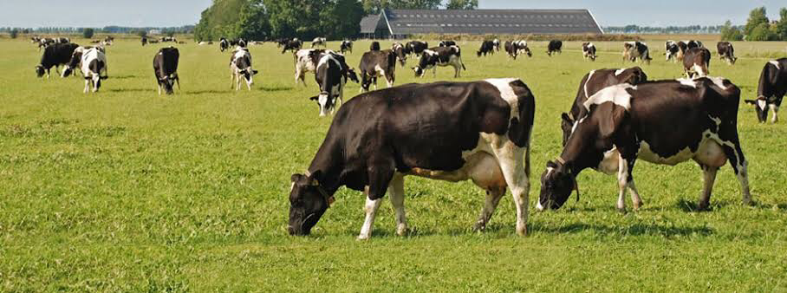
Anthrax

Slide 11
What ıs anthrax?
Anthrax, a highly infectious and fatal disease of mammals and humans, is caused by a relatively large spore-forming rectangular shaped bacterium called Bacillus anthracis.
Anthrax occurs on all the continents, causes acute mortality in ruminants and is a zoonosis. The bacteria produce extremely potent toxins which are responsible for the ill effects, causing a high mortality rate. While most mammals are susceptible, anthrax is typically a disease of ruminants and humans.
It does not typically spread from animal to animal nor from person to person. The bacteria produce spores on contact with oxygen.

Slide 12
Clınıcal Sıgns
Sudden death (often within 2 or 3 hours of being apparently normal) is by far the most common sign
Very occasionally some animals may show trembling, a high temperature, difficulty breathing, collapse and convulsions before death. This usually occurs over a period of 24 hours
After death blood may not clot, resulting in a small amount of bloody discharge from the nose, mouth and other openings

Slide 13
Preventıon
nfection is usually acquired through the ingestion of contaminated soil, fodder or compound feed. Anthrax spores in the soil are very resistant and can cause disease when ingested even years after an outbreak. The spores are brought to the surface by wet weather, or by deep tilling, and when ingested or inhaled by ruminants the disease reappears.
Where an outbreak has occurred, carcases must be disposed of properly, the carcase should not be open (exposure to oxygen will allow the bacteria to form spores) and premises should be quarantined until all susceptible animals are vaccinated.
Vaccination in endemic areas is very important. Although vaccination will prevent outbreaks veterinary services sometimes fail to vaccinate when the disease has not appeared for several years. But because the spores survive for such lengthy periods, the risk is always present.

Slide 14
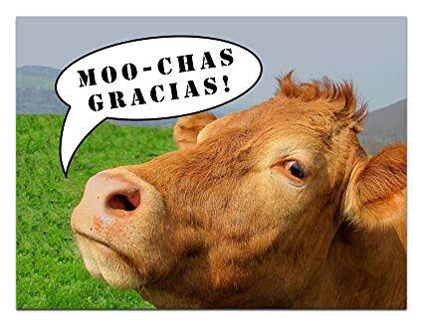
THE END

