Slide 1
BIO 206 PLANT MORPHOLOGY
LECTURE NOTES
7th WEEK
DR. AYDAN ACAR ŞAHİN

Slide 2
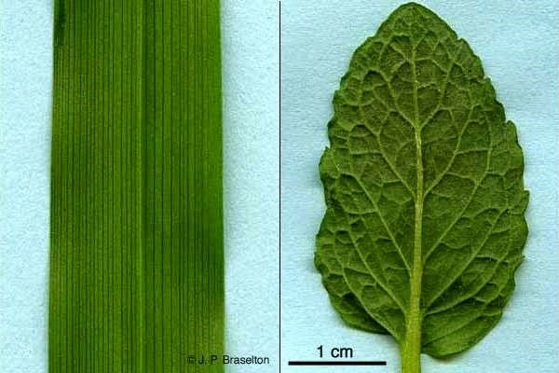
Leaf structure
Leaf is any usually flattened green outgrowth from the stem of a vascular plant.
Typically, a leaf consists of a broad, expanded blade (the lamina), attached to the plant stem by a stalklike petiole.
Leaves are, however, quite diverse in size, shape, and various other characteristics, including the nature of the blade margin and the type of venation (arrangement of veins).
Veins, which support the lamina and transport materials to and from the leaf tissues, radiate through the lamina from the petiole. The types of venation are characteristic of different kinds of plants: for example, dicotyledons have netlike venation (=irregularly scattered, reticulate venation) and usually free vein endings; monocotyledons have parallel venation and rarely free vein endings.
The leaf may be simple—with a single blade—or compound—with separate leaflets; it may also be reduced to a spine or scale.

Slide 3
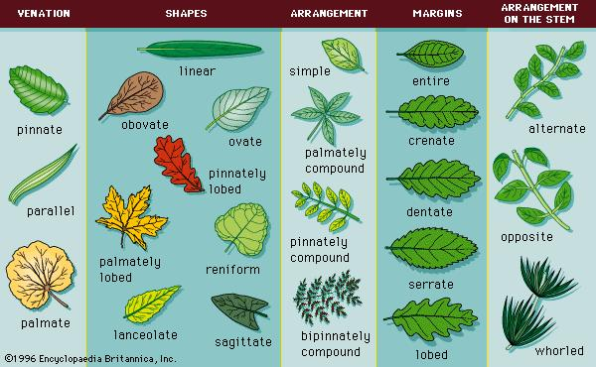

Slide 4
Main Parts of a Leaf
Tip/Apex
Blade
Midrib
Leaf
Margin
Veins
Base
Petiole
Courtesy of Corinne Banowski

Slide 5
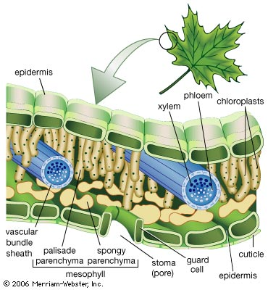
Functions of the leaf
The main function of a leaf is to produce food for the plant by photosynthesis. (Other functions are respiration and sweating) Chlorophyll, the substance that gives plants their characteristic green colour, absorbs light energy. The internal structure of the leaf is protected by the leaf epidermis, which is continuous with the stem epidermis. The central leaf, or mesophyll, consists of soft-walled, unspecialized cells of the type known as parenchyma. As much as one-fifth of the mesophyll is composed of chlorophyll-containing chloroplasts, which absorb sunlight and, in conjunction with certain enzymes, use the radiant energy in decomposing water into its elements, hydrogen and oxygen. The oxygen liberated from green leaves replaces the oxygen removed from the atmosphere by plant and animal respiration and by combustion. The hydrogen obtained from water is combined with carbon dioxide in the enzymatic processes of photosynthesis to form the sugars that are the basis of both plant and animal life. Oxygen is passed into the atmosphere through stomates—pores in the leaf surface.

