Slide 1
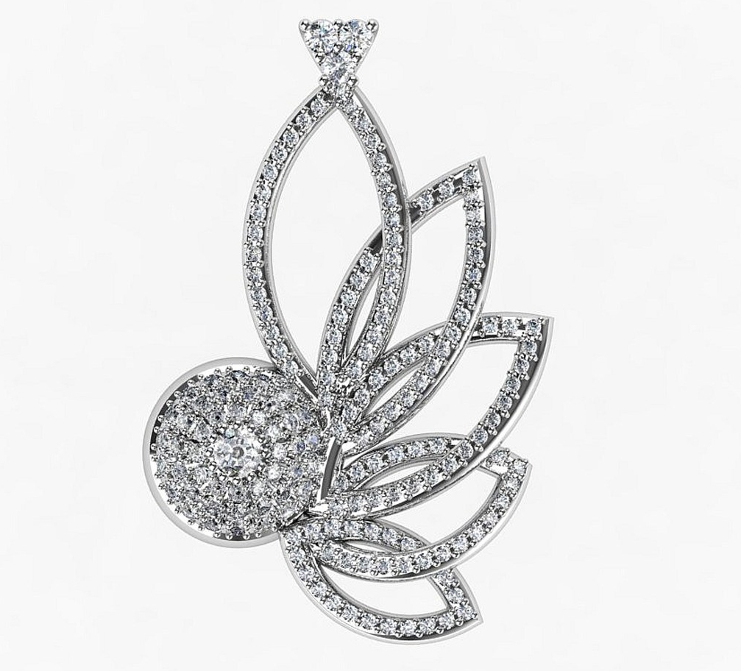
Kolye Çizimi
http://www.jewelturk.net/

Slide 2
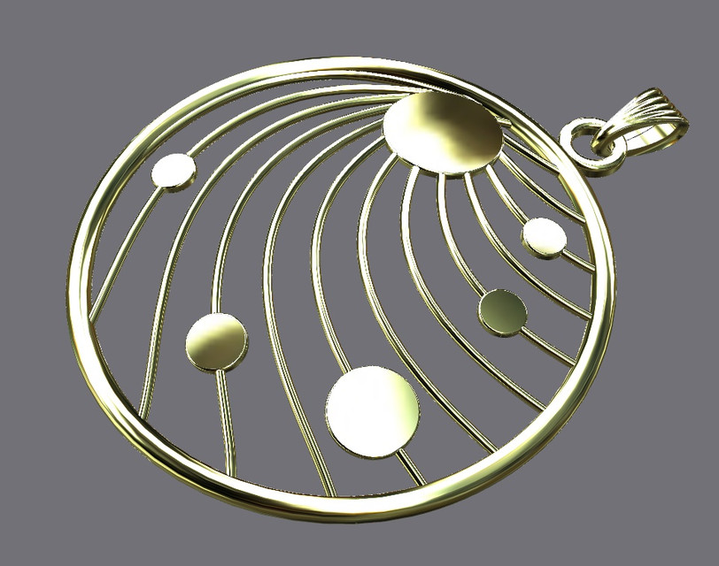
Kolye Çizimi
https://grabcad.com/library/necklace-design-rhinoceros-1

