Slide 1
Gene Therapy

Slide 2
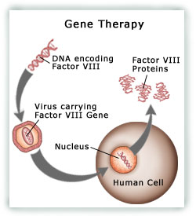
Gene Therapy
has emerged in the late 20th century
a potential approach to the treatment of genetic disorders which are resistant to traditional therapies
to cure genetic diseases by introducing new genetic instructions into the tissues of patients in order to compensate for abnormal or missing genes or to convey a new function
cancer, cardiovascular, infectious, eye or lung diseases
Many success stories in the recent years (ALD, inherited retinal diseases, SCID)
Example: Hemophilia A gene therapy
http://www.nwabr.org/studentbiotech/winners/studentwork/2007/WB_BA_TRONGTHAM/1_index_2.htm

Slide 3
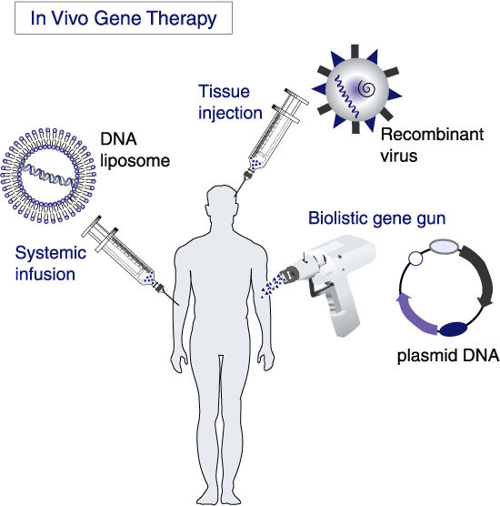
Gene Therapy - vectors
Viral vs non-viral vectors
Viral:
Ad
AAV
Lentivirus
Retrovirus
SFV
Non-viral vectors:
Liposomes
Polymer-based nanoparticles
Dendrimers
http://www.biochem.arizona.edu/classes/bioc471/pages/Lecture25/Lecture25.html
Notes:
So as any drug delıvery/gene delıvery labs do, we are tryıng to ımprove the propertıes of these vectors

Slide 4
Adenovirus (Ad)
the most commonly used viral vector in gene therapy studies
high transfection efficiency in a wide variety of cells
can be amplified at very high titers.
knob
shaft
fiber
RGD motif
Systemic administration
Elicit strong immune responses, hepatotoxicity
Show decreased blood circulation
penton
pXI
hexon

