Slide 1
CARTILAGE and BONE TISSUE

Slide 2
Cartilage is a supportive CT with rubbery matrix
Cartilage is a tremendously strong and flexible fibrous tissue, and it takes many forms and serves multiple purposes throughout the body.
It covers and protects the ends of long bones at the joints, and is a structural component of the
rib cage,
the ear,
the nose,
the bronchial tubes,
the intervertebral discs, and many other body components.

Slide 3
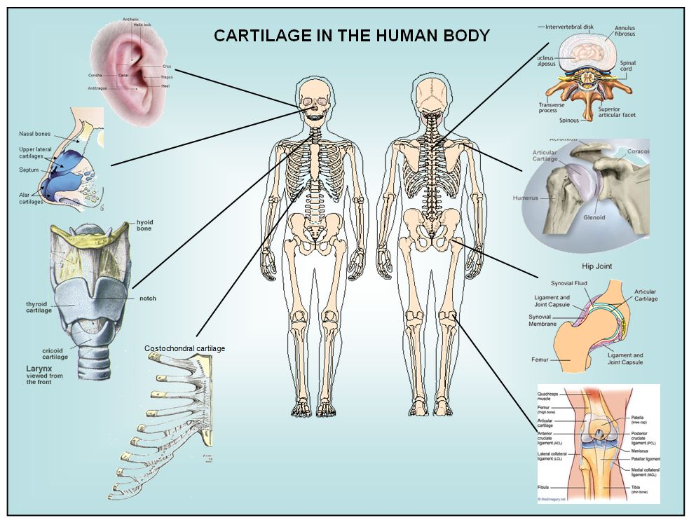
In these regions cartilage can act as structural support, maintain shape or absorb shock during physical exercise.

Slide 4
It is not as hard and rigid as bone, but it is stiffer and flexible than muscle.
As with most CT, the ECM of cartilage consists of a meshwork of macromolecules including
collagens,
elastin fibers,
glycoproteins and
proteoglycans, each of which is present in varying amounts, depending on the type and function of cartilage.

Slide 5
Cartilage is composed of specialized cells called chondrocytes.
There are several cell surface receptors that allow chondrocytes to bind these proteins including the integrins, CD44, and the proteoglycan family of receptors

Slide 6
Cartilage is classified in three types,
elastic cartilage,
hyaline cartilage and
fibrocartilage,
which differ in relative amounts of collagen and proteoglycan.

Slide 7
Cartilage does not contain blood vessels or nerves.
Nutrition is supplied to the chondrocytes by diffusion.
The cartilage’s the dense fibrous sheath is called the perichondrium.
The nutrients are brought pericondrium through the blood vessels and transferred to the matrix by diffusion.

Slide 8
The compression of the articular cartilage or flexion of the elastic cartilage generates fluid flow, which assists diffusion of nutrients to the chondrocytes.
Compared to other connective tissues, cartilage has a very slow turnover of its extracellular matrix and does not repair.

Slide 9
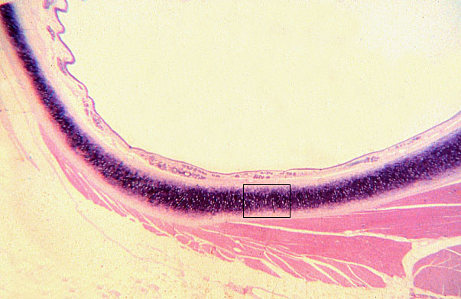

Slide 10
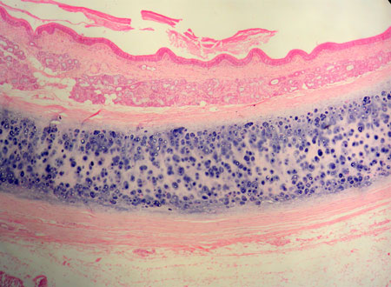

Slide 11
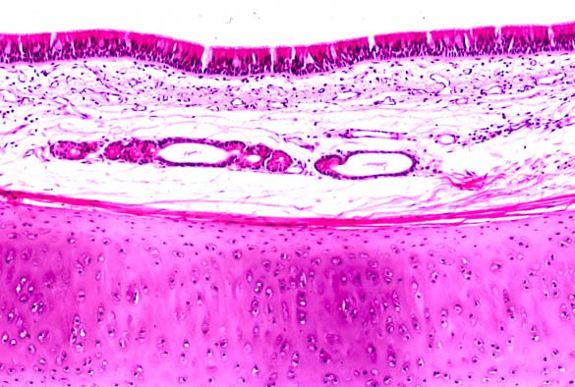

Slide 12
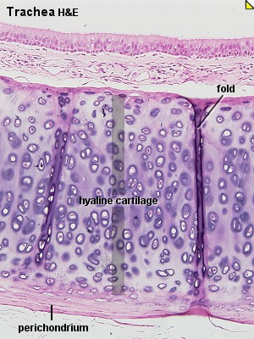

Slide 13
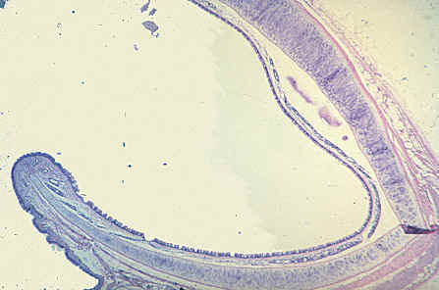

Slide 14
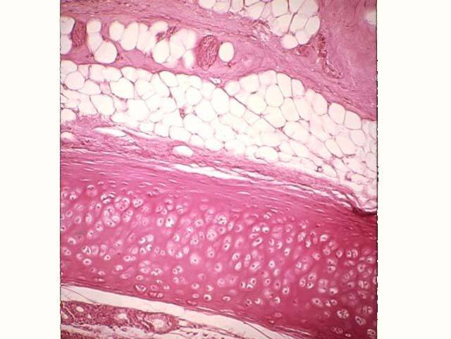

Slide 15
Chondrocytes
Are the only cells found in healthy cartilage.
They produce and maintain the cartilaginous matrix, which consists mainly of collagen and proteoglycans.
The word chondroblast is commonly used to describe an immature chondrocyte,
The progenitor of chondrocytes (mesenchymal stem cells) can differentiate into various cell types, including osteoblasts.

Slide 16
Development
From least- to terminally-differentiated, the chondrocytic lineage is:
Colony-forming unit-fibroblast (CFU-F)
Mesenchymal stem cell / marrow stromal cell (MSC)
Chondrocyte
Hypertrophic chondrocyte

Slide 17
In embryogenesis, the skeletal system is derived from the mesoderm germ layer.
Chondrification (chondrogenesis) is the process by which cartilage is formed from condensed mesenchyme tissue,
Undifferentiated MSC lose their pluripotency, proliferate and crowd together in a dense aggregate of chondrogenic cells (cartilage) at the location of chondrification.

Slide 18
It differentiates into chondroblasts and begins secreting the molecules( aggrecan and collagen type II) that form the extracellular matrix , consisting of a ground substance (proteoglycans, glycosaminoglycans for low osmotic potential) and fibers.

Slide 19
The chondroblast is now a mature chondrocyte that is usually inactive but can still secrete and degrade the matrix, depending on conditions.
Following the initial chondrification that occurs during embryogenesis, cartilage growth consists mostly of the maturing of immature cartilage to a more mature state.
The division of cells within cartilage occurs very slowly

Slide 20
BMP4 (Bone morphogenetic protein 4 )and FGF2 (Basic fibroblast growth factor )have been experimentally shown to increase chondrocyte differentiation.
Chondrocytes undergo terminal differentiation when they become hypertrophic, which happens during endochondral ossification.
This last stage is characterized by major phenotypic changes in the cell.

Slide 21
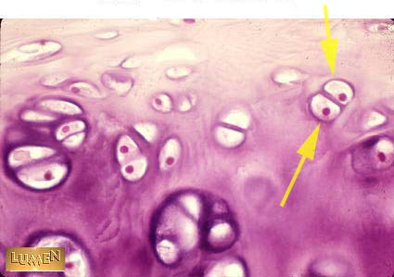
Cartilagetissue and chondrocytes

Slide 22
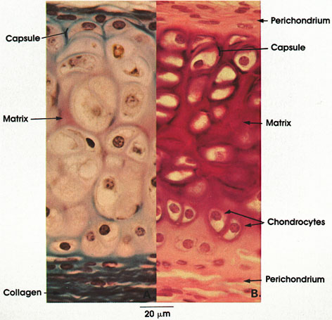
TRAKE

Slide 23
Classification of Cartilage
Differ in relative amounts of collagen and proteoglycan.
elastic cartilage,
hyaline cartilage and
fibrocartilage,

Slide 24
Elastic cartilage
Elastic cartilage or yellow cartilage is a type of cartilage present in the outer ear, Eustachian tube and epiglottis.
It contains elastic fiber networks and collagen type II fibers.
The principal protein is elastin
Structure
Elastic cartilage is histologically similar to hyaline cartilage but contains many yellow elastic fibers lying in a solid matrix.
These fibers form bundles that appear dark under a microscope.

Slide 25
These fibers give elastic cartilage great flexibility so that it is able to withstand repeated bending
Helps holding tubes open in the body.
The chondrocytes lie between the fibres.
It is found in the epiglottis, the pinnae
Elastin fibers stain dark purple/black with Verhoeff's stain.
Function
Provide support
Maintain shape

Slide 26
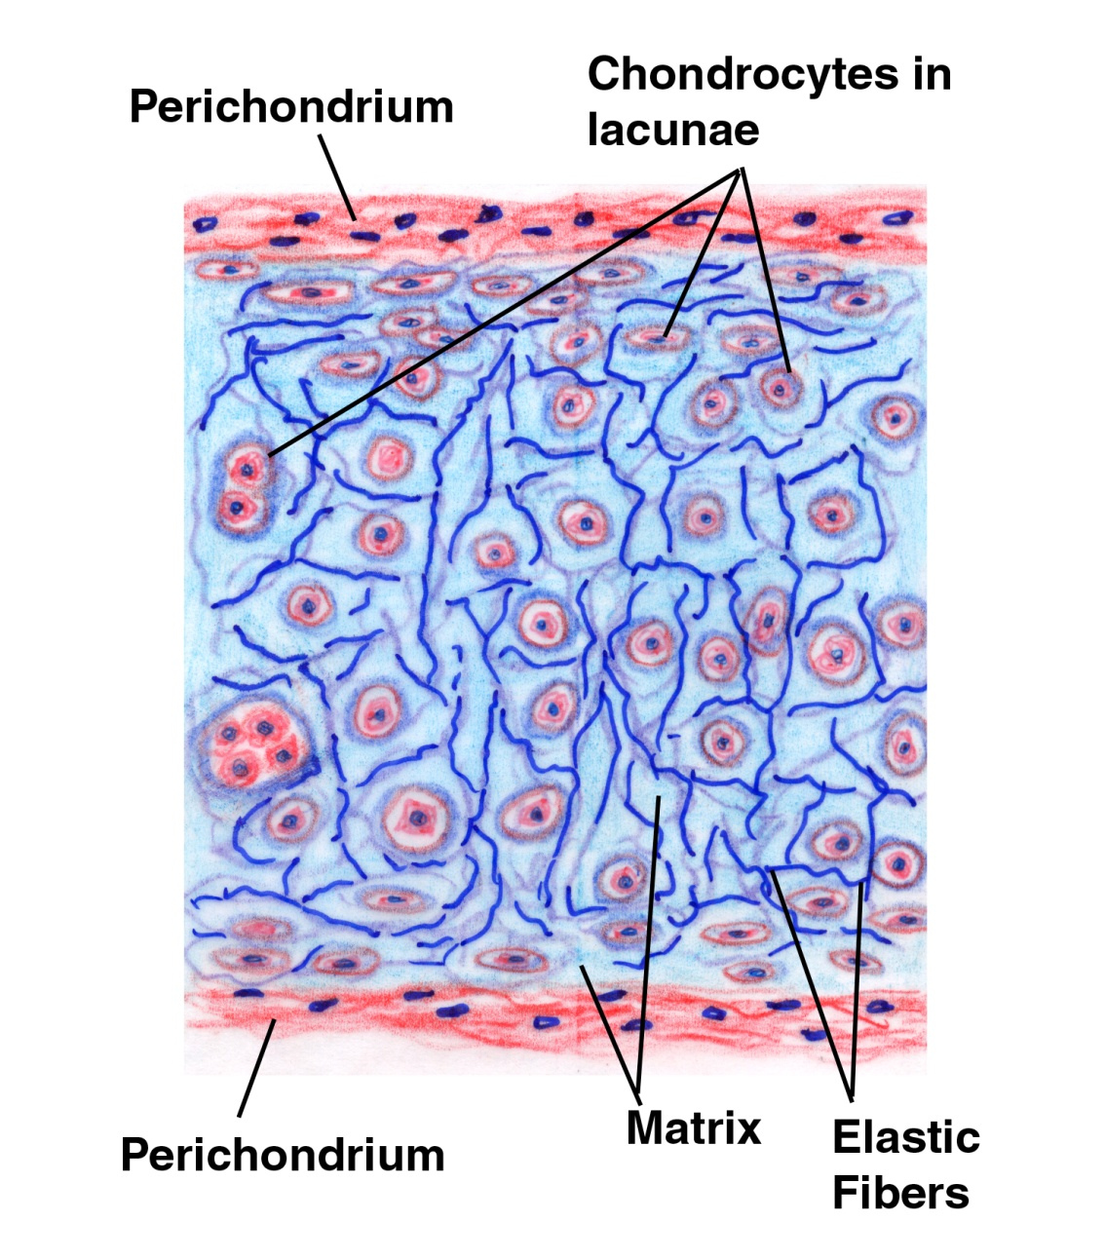

Slide 27
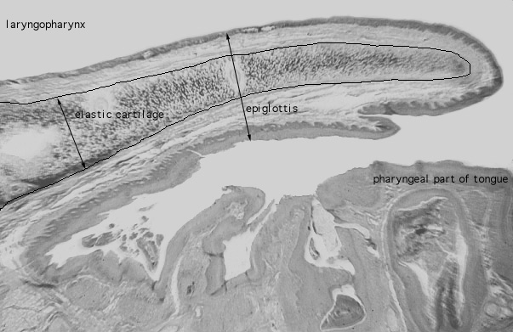

Slide 28
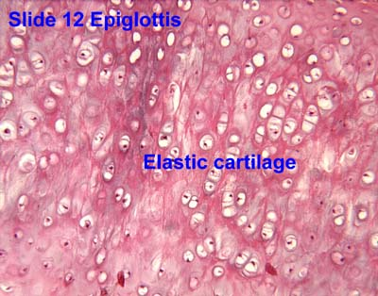

Slide 29
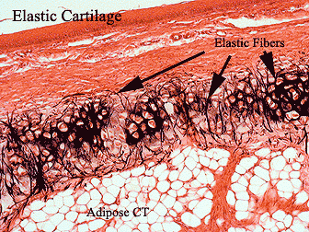

Slide 30
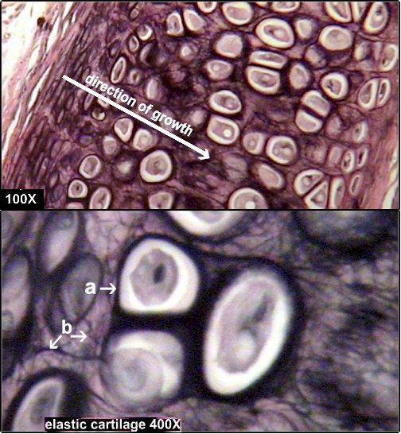
a lacunae with chondrocyte inside b the black material is elastin fibers found: framework of outer ear function: provides elastic shape and support.

Slide 31
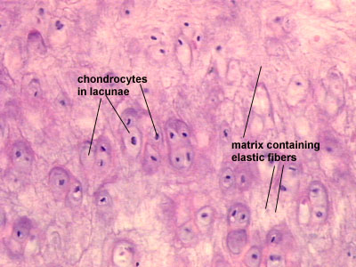

Slide 32
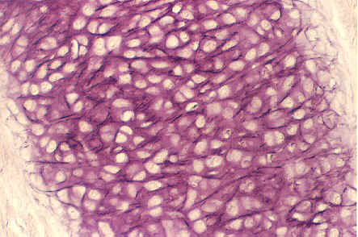

Slide 33
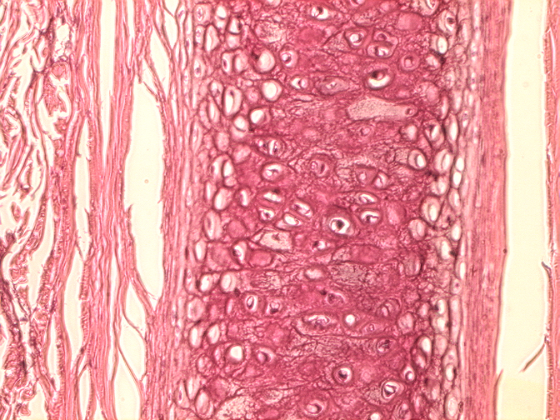
Elastik kıkırdak

Slide 34
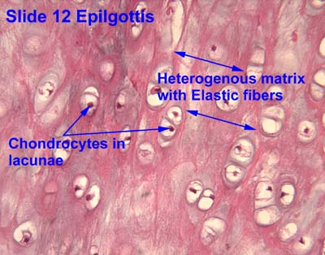

Slide 35
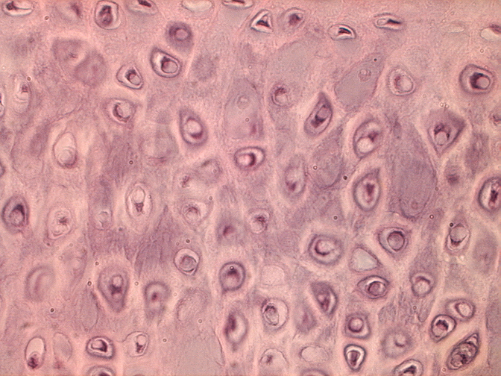
Elastik kıkırdak

Slide 36
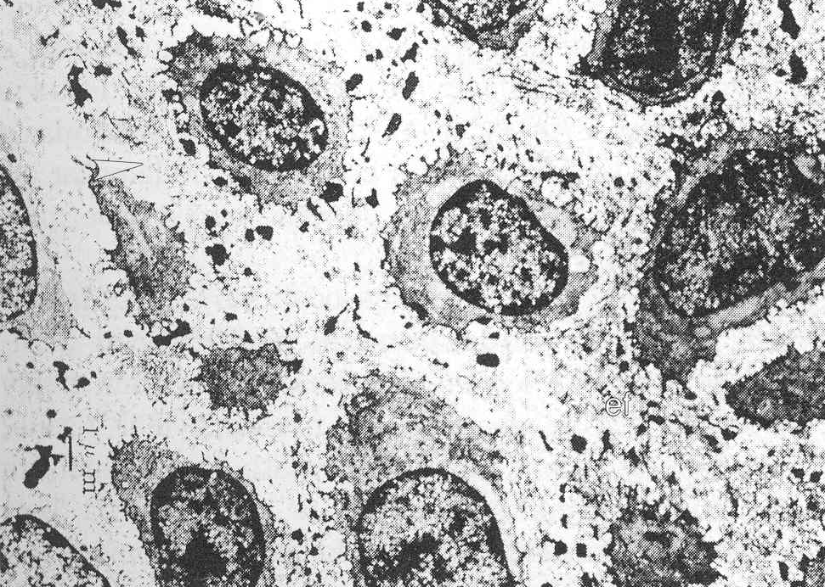
Et
Elastik kıkırdak. İnterteritoryal matriksde kollagen teller (Ok başı), proteoglikan partikülleri, elektron yoğun elastik teller (Et) ve kondrositler (TEM, x3.200)

Slide 37
Hyaline cartilage
Hyaline cartilage is glass-like (hyaline) but translucent cartilage.
It is found on many joint surfaces.
It is pearl-grey in color with firm consistency and has a considerable amount of collagen.
It contains no nerves or blood vessels, and its structure is relatively simple

Slide 38
Structure
Hyaline is the most abundant type, white-blue in colour and macroscopically smooth on its surface
Covered externally by perichondrium or, when it's along articulating surfaces, the synovial membrane.
This membrane contains vessels which provide the cartilage with nutrition through diffusion.
Hyaline cartilage matrix is primarily made of type II collagen and chondroitin sulphate, both of which are also found in elastic cartilage.

Slide 39
It is present on the articular surfaces of joints and in the nasal septum
exists on the ventral ends of ribs,
in the larynx,
trachea, and
bronchi, and
on the articulating surfaces of bones.
It gives the structures a definite but pliable form.
Presence of collagen fibres makes such structures and joints strong, but with limited mobility and flexibility.
Hyaline cartilage is the most prevalent type of cartilage.
It also forms the temporary embryonic skeleton which is gradually replaced by bone, and the skeleton of elasmobranch fish.

Slide 40
Under the microscope, it is shown to consist of cells of a rounded or bluntly angular form, lying in groups of two or more in a granular, or almost homogeneous matrix.
The matrix, is produced by chondrocytes
When arranged in groups of two or more, chondrocytes have rounded, but generally straight outlines, where they are in contact with each other, and in the rest of their circumference are rounded.
They consist of translucent protoplasm with fine interlacing filaments and granules are sometimes present.
Embedded in this are one or two round nuclei, having the usual intranuclear network.

Slide 41
The cells are contained in cavities in the matrix, called cartilage lacuna.
These cavities are actually arteficial gaps formed from the shrinking of the cells during the staining and setting the tissue for examination.
The inter-territorial space between the isogenous cell groups contains relatively more collagen fibers, allowing it to maintain its shape while the actual cells shrink, creating the lacunae.
This constitutes the so-called 'capsule' of the space.
Each lacuna is usually occupied by a single cell, but during mitosis, it may contain two, four, or even eight cells.

Slide 42
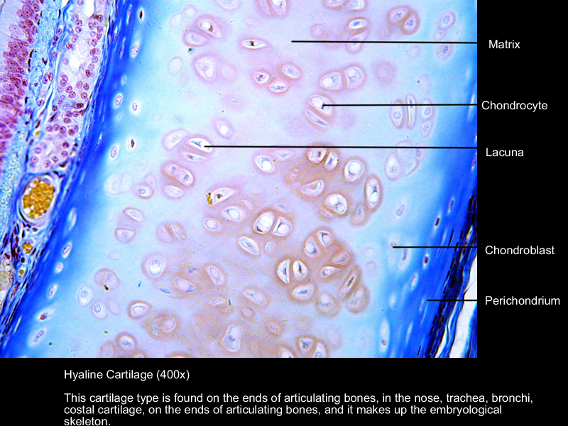

Slide 43
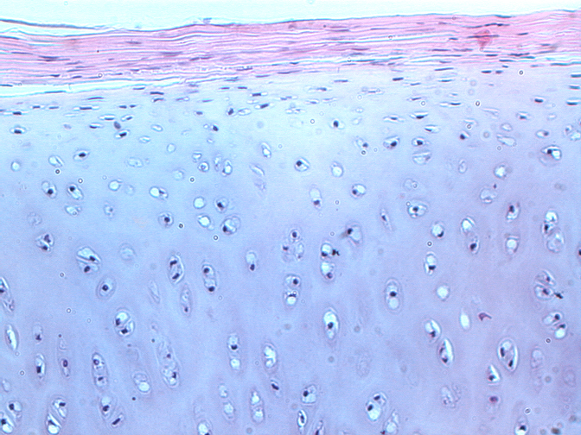
Hiyalin kıkırdak ve perikondriyum

Slide 44
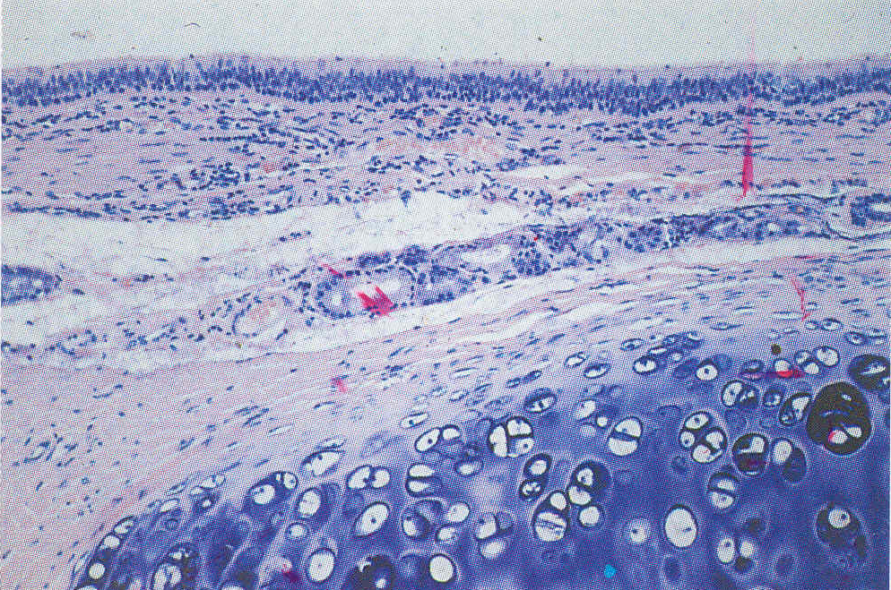
Trake epitelinin altında hiyalin kıkırdak, bazofilik görünen kıkırdak matriksini çevreleyen eozinofilik perikondriyum (H-E, x300)

Slide 45
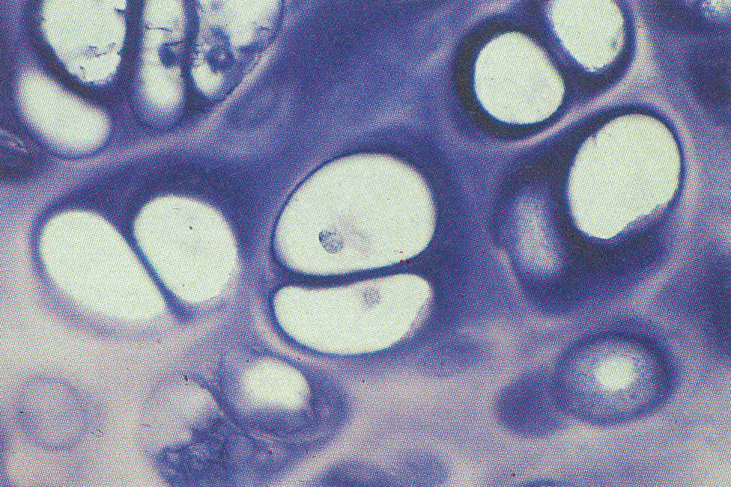
Hiyalin kıkırdakta bazofilik territorial matriksle çevrelenmiş lakün içerisinde grup halinde bulunan kondrositler. Kondrositler fiksasyon sebebiyle lakün duvarından uzaklaşmıştır (H-E; x1.200)

Slide 46
Hiyalin kıkırdağın çoğalmasının TEM resmi. Matriksdeki proteoglikanlar rutenyum hekzamin triklorid ile tespit edilmiştir. P.Hücre dışı, kapsüler matriks; T.interteritoryal matriks; V.Fiksasyon sonucu yapay oluşan vakuoller (x3.900).

Slide 47
Fibrocartilage
White fibrocartilage consists of a mixture of white fibrous tissue and cartilaginous tissue in various proportions.
It owes its flexibility and toughness to the former of these constituents, and its elasticity to the latter.
It is the only type of cartilage that contains type I collagen in addition to the normal type II.

Slide 48
Fibrocartilage is found in the pubic symphysis, the anulus fibrosus of intervertebral discs, menisci, the triangular fibrocartilage
It is also present at the tendon bone interface, where there is a transition from soft tendon to uncalcified then calcified fibrocartilage before becoming bone.
During labor, relaxin loosens the pubic symphysis to aid in delivery, but this can lead to later joint problems

Slide 49
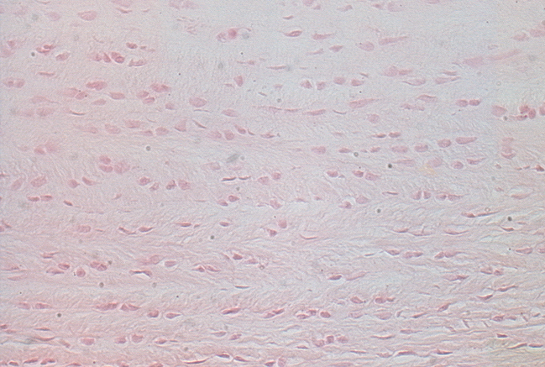
Fibrocartilage and chondrocytes in lacune.

Slide 50
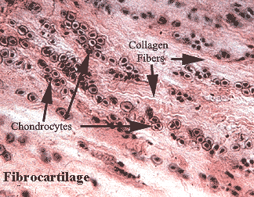

Slide 51
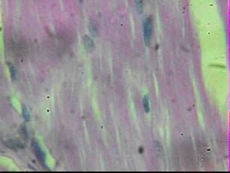

Slide 52
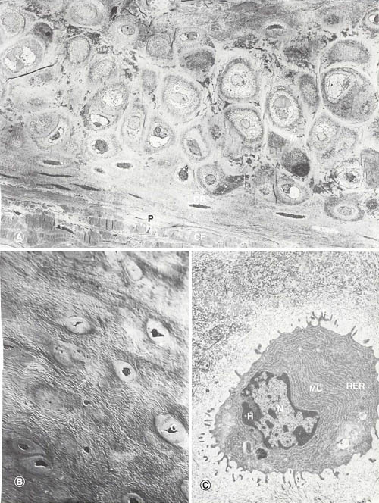

Slide 53
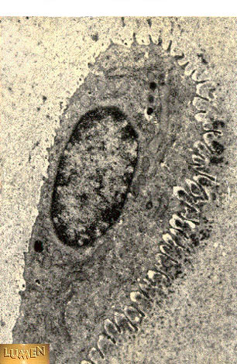
Kondrosit, TEM

Slide 54
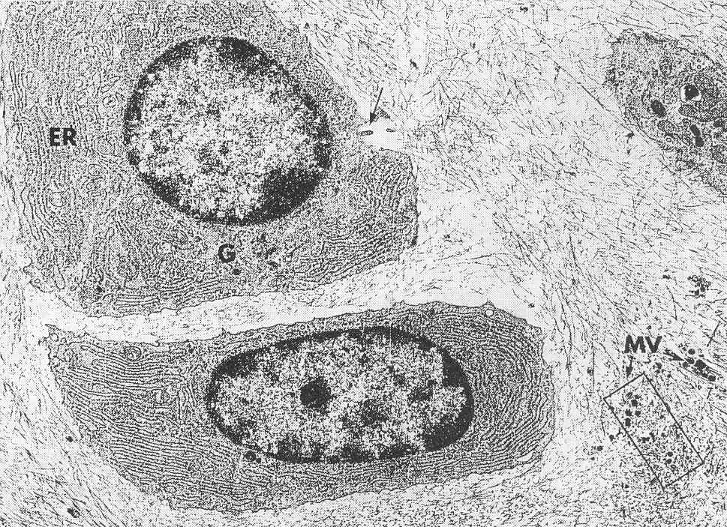
Telli kıkırdak. ER.Endoplazmik retikulum, G.Golgi, Mv.Matriks vezikülleri ve matriksde kollagen teller (TEM, x5.600)

Slide 56
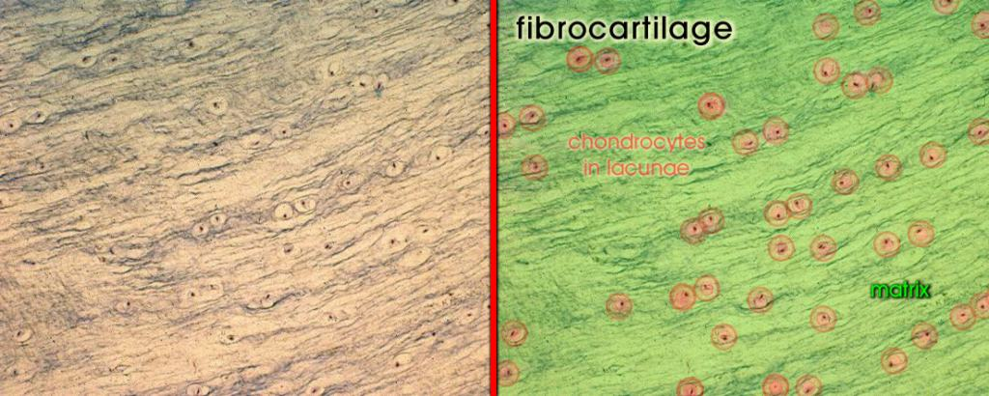
science.tjc.edu/images/ histology/epithelium.htm

Slide 57
Fibrocartilage collagen fibers and chondrocytes

Slide 58
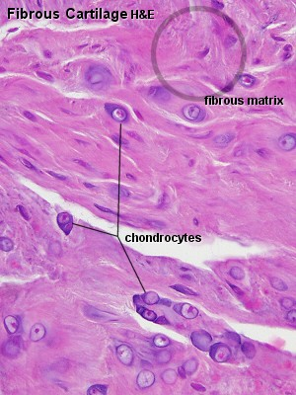

Slide 59
Articular cartilage
Articular cartilage function is based upon its composition of hyaline cartilage, molecular composition of the extracellular matrix(ECM).
The ECM consists mainly of proteoglycan and collagens
The main proteoglycan in cartilage is aggrecan, which, as its name suggests, forms large aggregates with hyaluronan.
These aggregates are negatively charged and hold water in the tissue.
The collagen, mostly collagen type II, constrains the proteoglycans.

Slide 60
The ECM responds to tensile and compressive forces that are experienced by the cartilage.
Cartilage growth thus refers to the matrix deposition, but can also refer to both the growth and remodeling of the extracellular matrix.
Due to the great stress on the patellofemoral joint during resisted knee extension, the articular cartilage of the patella is among the thickest in the human body.

Slide 61
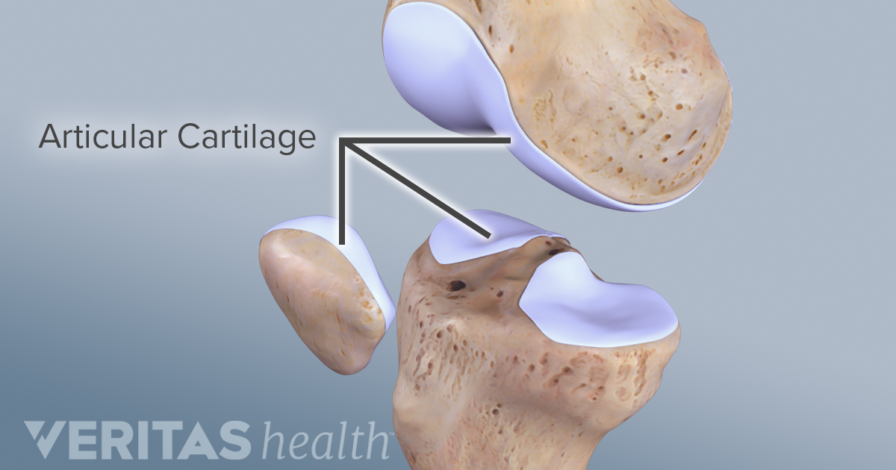

Slide 62
Function
Mechanical properties
The mechanical properties of articular cartilage in load bearing joints such as knee and hip have been studied extensively at macro, micro and nano-scales.
These mechanical properties include the response of cartilage in frictional, compressive, shear and tensile loading.
Cartilage is resilient and displays viscoelastic properties.

Slide 63
Frictional properties
Lubricin, a glycoprotein abundant in cartilage and synovial fluid, plays a major role in bio-lubrication and wear protection of cartilage.

Slide 64
Repair
Cartilage has limited repair capabilities:
Because chondrocytes are bound in lacunae, they cannot migrate to damaged areas.
Therefore, cartilage damage is difficult to heal.
Also, because hyaline cartilage does not have a blood supply, the deposition of new matrix is slow.
Damaged hyaline cartilage is usually replaced by fibrocartilage scar tissue.
If hyaline cartilage is torn all the way down to the bone, the blood supply from inside the bone is sometimes enough to start some healing inside the lesion.

Slide 65
In cases like this, the body will form a scar in the area using fibrocartilage.
Over the last years, surgeons and scientists have elaborated a series of cartilage repair procedures that help to postpone the need for joint replacement.
Bioengineering techniques are being developed to generate new cartilage, using a cellular "scaffolding" material and cultured cells to grow artificial cartilage.

Slide 66
Disease
Chondrodystrophies are a group of diseases, characterized by the disturbance of growth and subsequent ossification of cartilage.
Some common diseases that affect the cartilage are;
Osteoarthritis: Osteoarthritis is a disease of the whole joint, however one of the most affected tissues is the articular cartilage.
The cartilage covering bones is thinned, eventually completely wearing away, resulting in a "bone against bone" within the joint, leading to reduced motion, and pain.

Slide 67
Osteoarthritis affects the joints exposed to high stress and is therefore considered the result of "wear and tear" rather than a true disease.
It is treated by arthroplasty, the replacement of the joint by a synthetic joint often made of a stainless steel alloy (cobalt chromoly) and ultra high molecular weight polyethylene .
Chondroitin sulfate or glucosamine sulfate supplements, have been claimed to reduce the symptoms of osteoarthritis but there is little good evidence to support this claim.

Slide 68
Traumatic rupture or detachment: The cartilage in the knee is frequently damaged, and can be partially repaired through knee cartilage replacement therapy.
Often when athletes talk of damaged "cartilage" in their knee, they are referring to a damaged meniscus (a fibrocartilage structure) and not the articular cartilage.
Achondroplasia: Reduced proliferation of chondrocytes in the epiphyseal plate of long bones during infancy and childhood, resulting in dwarfism.

Slide 69
Costochondritis: Inflammation of cartilage in the ribs, causing chest pain.
Spinal disc herniation : Asymmetrical compression of an intervertebral disc ruptures the sac-like disc, causing a herniation of its soft content.
The hernia often compresses the adjacent nerves and causes back pain.
Relapsing polychondritis: a destruction, probably autoimmune, of cartilage, especially of the nose and ears, causing disfiguration.
Death occurs by suffocation as the larynx loses its rigidity and collapses.

Slide 70
Tumors made up of cartilage tissue, either benign or malignant, can occur.
They usually appear in bone, rarely in pre-existing cartilage.
The benign tumors are called chondroma, the malignant ones chondrosarcoma.

Slide 71
Tumors arising from other tissues may also produce a cartilage-like matrix, the best known being pleomorphic adenoma of the salivary glands.
The matrix of cartilage acts as a barrier, preventing the entry of lymphocytes or diffusion of immunoglobulins.
This property allows for the transplantation of cartilage from one individual to another without fear of tissue rejection.

