Slide 1
COM337 Computer Graphics
Geometric Transformations
2/2

Slide 2
3D Transformations.
Use homogeneous coordinates, just as in 2D case.
Transformations are now 4x4 matrices.
We will use a right-handed (world) coordinate system - ( z out of page ).
y
Note:
Convenient to think of display as
Being left-handed !!
( z into the screen )
x
z (out of page)

Slide 3
Simple extension to the 3D case:

Slide 4
Scale in 3D.
Simple extension to the 3D case:

Slide 5
Rotation in 3D
Need to specify which axis the rotation is about.
z-axis rotation is the same as the 2D case.

Slide 6
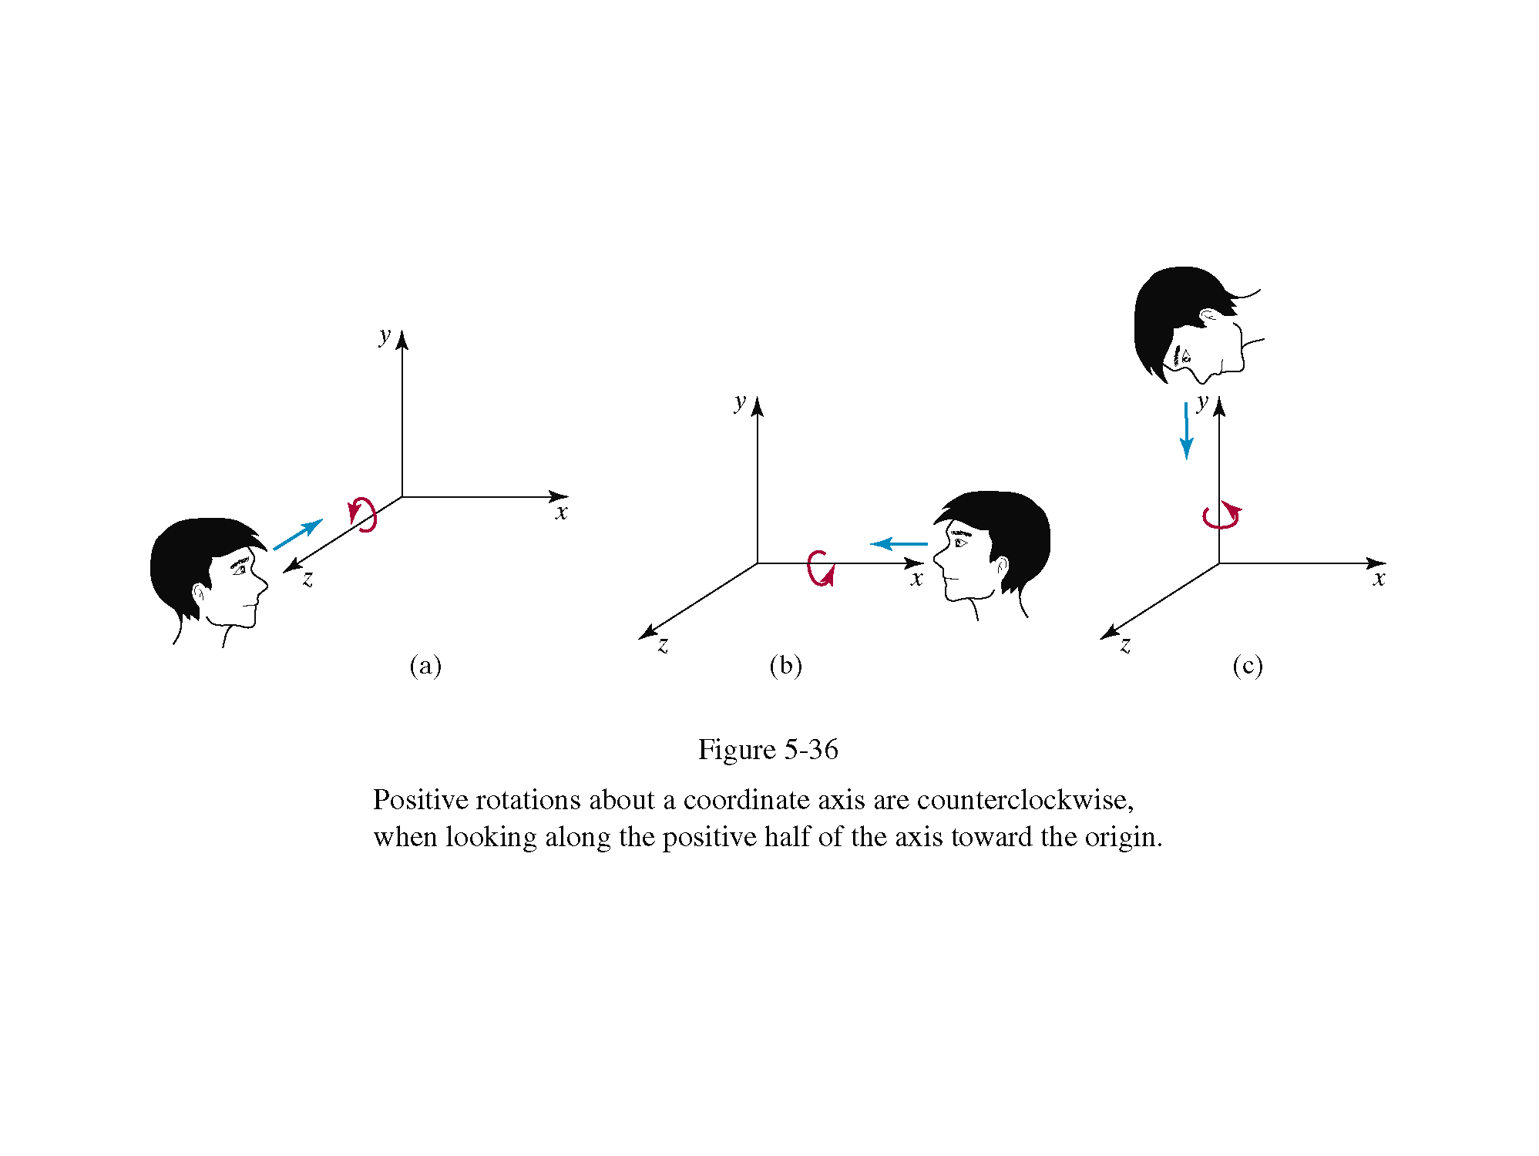

Slide 9
Rotation around an axis parallel to x-axis

Slide 13
α

Slide 15
H&B p271

Slide 16
Rows of upper-left 3x3 submatrix, when rotated by R lie on the x,y and z axes

Slide 18
Scaling an object with this transformation will also move its position relative to the origin - so move it to the origin, scale it, then move it back...

Slide 23
Common Coordinate Systems
6 coordinate systems were used in order in the fixed-function pipeline (older OpenGL style)
Modelling/object coordinates
World/scene coordinates
Camera/eye/viewing coordinates
Clip/clipping coordinates
Normalized device coordinates
Window/screen coordinates
With programmable shaders, we have greater flexibility
We can add other systems or avoid using some traditional ones

Slide 24
Model-view transformation
Changing from one coordinate system to another can be done with a 4x4 matrix
One such matrix can represent the change from modelling coordinates to world coordinates
Another can represent the change from world coordinates to camera coordinates
These 2 matrices can be concatenated together into the model-view transformation, which is specified by the model-view matrix

Slide 25
Projection transformation
Once objects are in camera coordinates, WebGL needs to check whether they lie within the view volume
To do this, it carries out a projection transformation that brings all potentially visible objects into a cube centered at the origin in clip coordinates
Next topic in the course

Slide 26
WebGL transformations
In WebGL, we are not required to use a model-view matrix
But it is useful in most applications, so we will use it in our examples
We can specify a transformation in the application code or
We can define parameters for it in the application code and send these parameters to the shaders and let the GPU carry out the transformations

Slide 27
WebGL transformations
We can set a model-view matrix by sending an array of 16 elements (elements of the 4x4 matrix) to the vertex shader
MV.js includes 3x3 and 4x4 matrix types we can use
var d = mat4(); // create a mat4 identity matrix
var e = mat3(0, 1, 2,
3, 4, 5,
6, 7, 8); // create a mat3 from 9 elements
var f = mat3(e); //create the mat3 ’f’ by copying mat3 ’e’

Slide 28
WebGL transformations
Because JavaScript does not support operator overloading like C++, we use functions to perform the basic matrix–vector operations.
a = add(b,c); // adds vectors ’b’ and ’c’
// and puts result in ’a’
d = transpose(e); // sets ’d’ to the transpose of ’e’
f = mult(e, d); // sets ’f’ to the product of ’e’ and ’d’
Other functions in the package compute matrix inverses, dot and cross products, etc.

Slide 29
Row- and Column-Major Orders
Consider the matrix
var m = mat3( 0, 1, 2, 3, 4, 5, 6, 7, 8 );
Most people would equate this specification with the matrix
$$M=\left[\begin{matrix}0 & 1 & 2 \\ 3 & 4 & 5 \\ 6 & 7 & 8\end{matrix}\right]$$
This is specifying our matrix in row major order;
We can just as well say that m corresponds to the matrix
$$M=\left[\begin{matrix}0 & 3 & 6 \\ 1 & 4 & 7 \\ 2 & 5 & 8\end{matrix}\right]$$
which would be specifying M in column major order.
WebGL and all versions of OpenGL are based on column major form.
MV.js uses the more familiar row major form
The flatten function automatically transposes a matrix to change the array from row major order to column major order when it is sent to the GPU.

Slide 30
Modeling a Colored Cube
var vertices = [vec3(-0.5, -0.5, 0.5),
vec3(-0.5, 0.5, 0.5),
vec3(0.5, 0.5, 0.5),
vec3(0.5, -0.5, 0.5),
vec3(-0.5, -0.5, -0.5),
vec3(-0.5, 0.5, -0.5),
vec3(0.5, 0.5, -0.5),
vec3(0.5, -0.5, -0.5) ];
and
var vertexColors = [[ 0.0, 0.0, 0.0, 1.0 ], // black
[ 1.0, 0.0, 0.0, 1.0 ], // red
[ 1.0, 1.0, 0.0, 1.0 ], // yellow
[ 0.0, 1.0, 0.0, 1.0 ], // green
[ 0.0, 0.0, 1.0, 1.0 ], // blue
[ 1.0, 0.0, 1.0, 1.0 ], // magenta
[ 1.0, 1.0, 1.0, 1.0 ], // white
[ 0.0, 1.0, 1.0, 1.0 ] // cyan ];

Slide 31
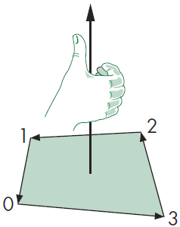
Specifying Faces of the Cube
We need to specify which points create a side of the cube
E.g. vertices at indices 0, 3, 2, 1 form one face
! The order is actually important. 0, 1, 2, 3 is different. We need to consider
inward/outward pointing faces, or
front/back of polygons

Slide 32
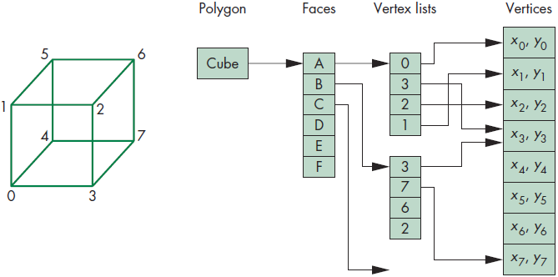
Data Structures for Object Representation
A cube has 6 faces and each of its 8 vertices are used by exactly 3 faces (so, we specify six faces using 24 ordered vertex indices)
We can put all these indices in a single array, but there is a better and preferable method
We want to separate topology (what a cube is, regardless of exact coordinates) from geometry (coordinates)

Slide 33
Data Structures for Object Representation
var indices = [ 1, 0, 3,
3, 2, 1,
2, 3, 7,
7, 6, 2,
3, 0, 4,
4, 7, 3,
6, 5, 1,
1, 2, 6,
4, 5, 6,
6, 7, 4,
5, 4, 0,
0, 1, 5 ];
Indices of 12 triangles that form the cube
WebGL has an alternative to drawArrays which is drawElements
Couples an array of indices with an array of vertices and other attributes

Slide 34
Modeling a Colored Cube
Send vertices and vertexColors to GPU as before (as in the last 3D Sierpinski code)
For the indices
var iBuffer = gl.createBuffer();
gl.bindBuffer(gl.ELEMENT_ARRAY_BUFFER, iBuffer);
gl.bufferData(gl.ELEMENT_ARRAY_BUFFER,
new Uint8Array(indices),gl.STATIC_DRAW);
And to draw, inside the render function
gl.drawElements(gl.TRIANGLES, numVertices,
gl.UNSIGNED_BYTE, 0);

Slide 35
Transformations in WebGL
The two transformations (4x4 matrices) commonly used are called model-view transformation and projection transformation
Model-view transformation takes us from modelling, or world coordinates to camera coordinates
Projection transformation applies the desired projection and produces coordinates in clip coordinates (unit cube or similar)
Model-view transformation normally uses the affine (line-preserving) transformations we talked about
Projection transformation is also a 4x4 matrix that we will discuss as the next topic in the course

Slide 36
Transformations in WebGL
We can create matrices for transformations using the following six functions
var a = rotate(angle, direction);
var b = rotateX(angle);
var c = rotateY(angle);
var d = rotateZ(angle);
var e = scale(scaleVector);
var f = translate(translateVector);
Angles are specified in degrees

Slide 37
Transformations in WebGL Example
Rotating 45 degrees around vector (1,2,3) with fixed point (4,5,6)
var R = mat4();
var ctm = mat4();
var alpha = Math.acos(3.0/Math.sqrt(14.0));
var beta = Math.sqrt(13.0/14.0);
var d = vec3(4.0, 5.0, 6.0);
R = mult(R, rotateX(alpha));
R = mult(R, rotateY(beta));
R = mult(R, rotateZ(-45.0));
R = mult(R, rotateY(-alpha));
R = mult(R, rotateX(-beta));
ctm = translate(ctm, d);
ctm = mult(ctm, R);
ctm = translate(ctm, negate(d));

Slide 38
Transformations in WebGL
Remember: order is reversed
The transformation you want to do first is applied last (because coordinates will be multiplied from the right)
We again have many ways to apply transformations we want
Do all in the application code
Requires a lot of data transfer between main memory and CPU
We are doing the transformations in the CPU
Calculate the matrices in application but send it to shader to multiply with coordinates
Less data sending
We are still doing some calculations (calculating matrices and perhaps multiplying them) in the CPU

Slide 39
Transformations in WebGL
Send transformation parameters (translation amounts, rotation degrees and reference axes, scaling factors, etc.) to shader and both compute and apply the matrix there
Minimum amount of data sending
Will be the most efficient in many real cases (depends on the transformation and number of vertices to apply it to, may be less efficient in some cases)
TRY DOING THESE ON YOUR OWN WITH THE HELP OF SECTION 4.12 IN THE TEXTBOOK!..

