Slide 1
Horticultural Pests
Objective: Discuss the anatomy and life cycle of pests.

Slide 2
Mind Binder
Insect
Head
Thorax
Abdomen
Chewing mouthpart
Piercing-sucking mouthpart
Rasping-sucking mouthpart
Siphoning mouthpart
Sponging mouthpart
Egg
Larva
Pupa
Nymph
Complete metamorphosis
Incomplete metamorphosis

Slide 3
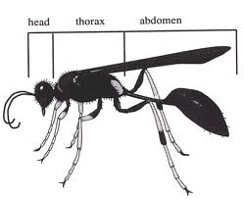
Anatomy of Insects
Small animals that have three body regions and three pairs or six legs.
Body regions are head, thorax, and abdomen.

Slide 4
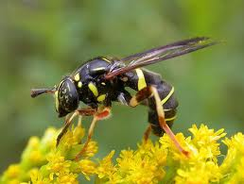
Mouthparts
Five types of mouthparts are important when identifying insects
Chewing
Piercing-sucking
Rasping-sucking
Siphoning
Sponging

Slide 5
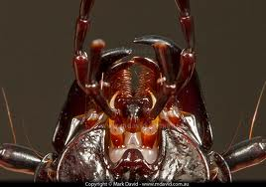
Chewing
Chewing insects chew or grind food
Damage by chewing insects includes tearing, chewing or grinding all parts of the plant
Examples: Beetles, cutworms, caterpillars and grasshoppers

Slide 6
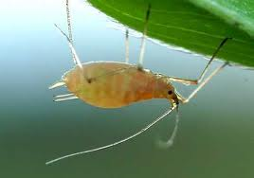
Piercing-Sucking
Puncture plant and suck sap usually from the underside of the leaves or on the stem
Damage cause yellow spotted leaves which result in stunted growth
Examples: Aphids, mealy bugs, mites, scale and whiteflies

Slide 7
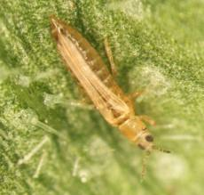
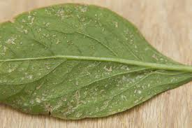
Rasping-Sucking
Rasps or breaks the leaf surface and suck sap
Damage plant tissue becomes speckled and white
Example: Thrip

Slide 8
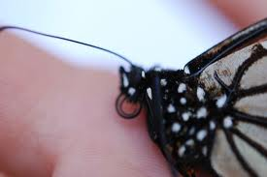
Siphoning
Dip a coiled tube into a liquid food such as nectar and draw (or siphon) it in.
Siphoning insects do little or no damage to the plant.
Examples: Butterflies and flies

Slide 9
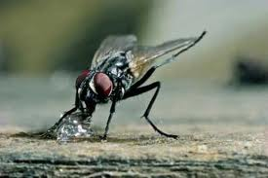
Sponging
Have two sponge-like structures that collect liquid food and move it into the food canal.
Sponging insects can carry germs or diseases that can damage the plant.
Example: Housefly

Slide 10
Life Cycle of Insects
Complete Metamorphosis
Incomplete Metamorphosis
Has FOUR stages
Egg
Larva (worms or caterpillars)
Pupa (resting stage)
Adult (flies, beetles)
Has THREE stages
Egg
Nymph (baby insect)
Adult
Insects must be killed when they are actively feeding or moving on the plant.

Slide 11
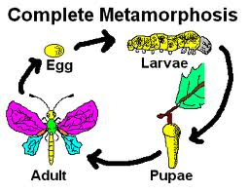
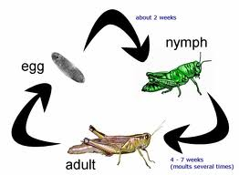
Life Cycle of Insects
Complete
Incomplete

Slide 12
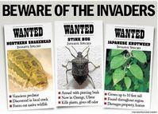
Most Wanted…Horticultural Pests
Choose a pest from the following list and create a WANTED poster!
In your poster you need to include the…
Damage the pest is causing
A description of the pest
The life cycle of the pest
A photograph of the pest
Control methods, if the pest is seen

Slide 13
Common Pests WANTED!
Beetle
Cutworm
Caterpillar
Grasshopper
Aphid
Mealy Bugs
Mites
Scale Flies
Whiteflies
Thrip
Butterflies
Housefly

