Slide 1
Diversity And Classification of Flowering Plants: Eudicots ca. 75% of all angiosperms!

Slide 2
Eudicots

Slide 3
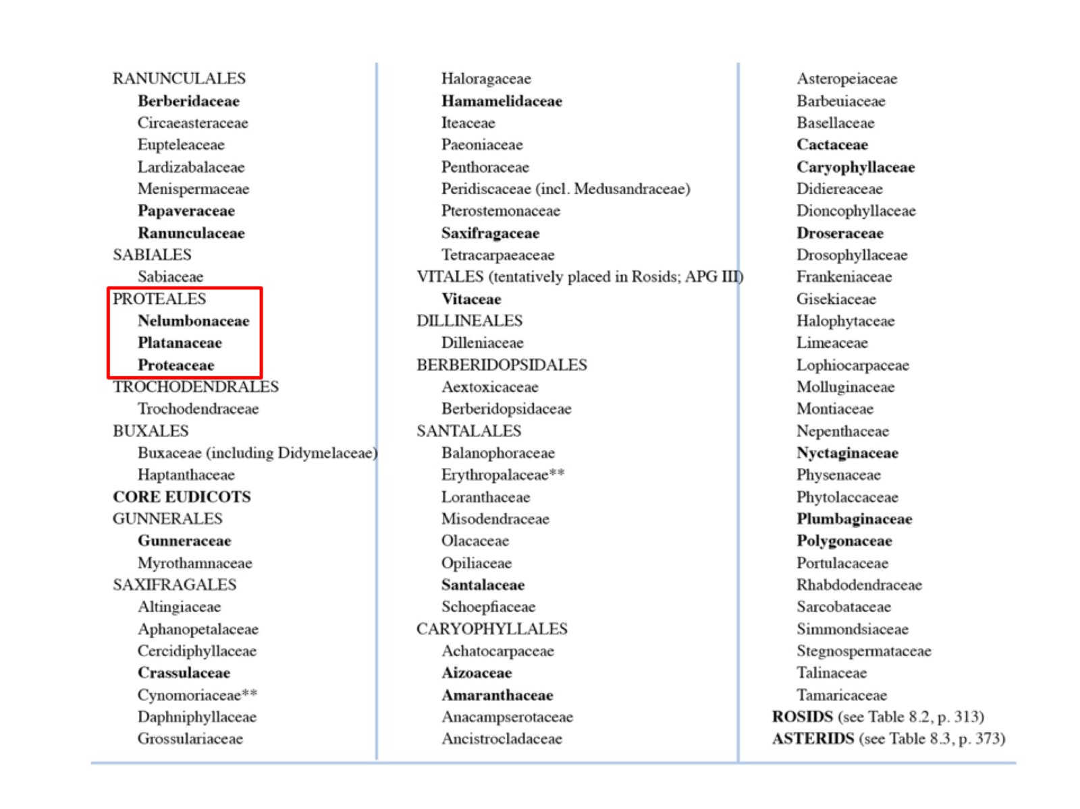

Slide 4
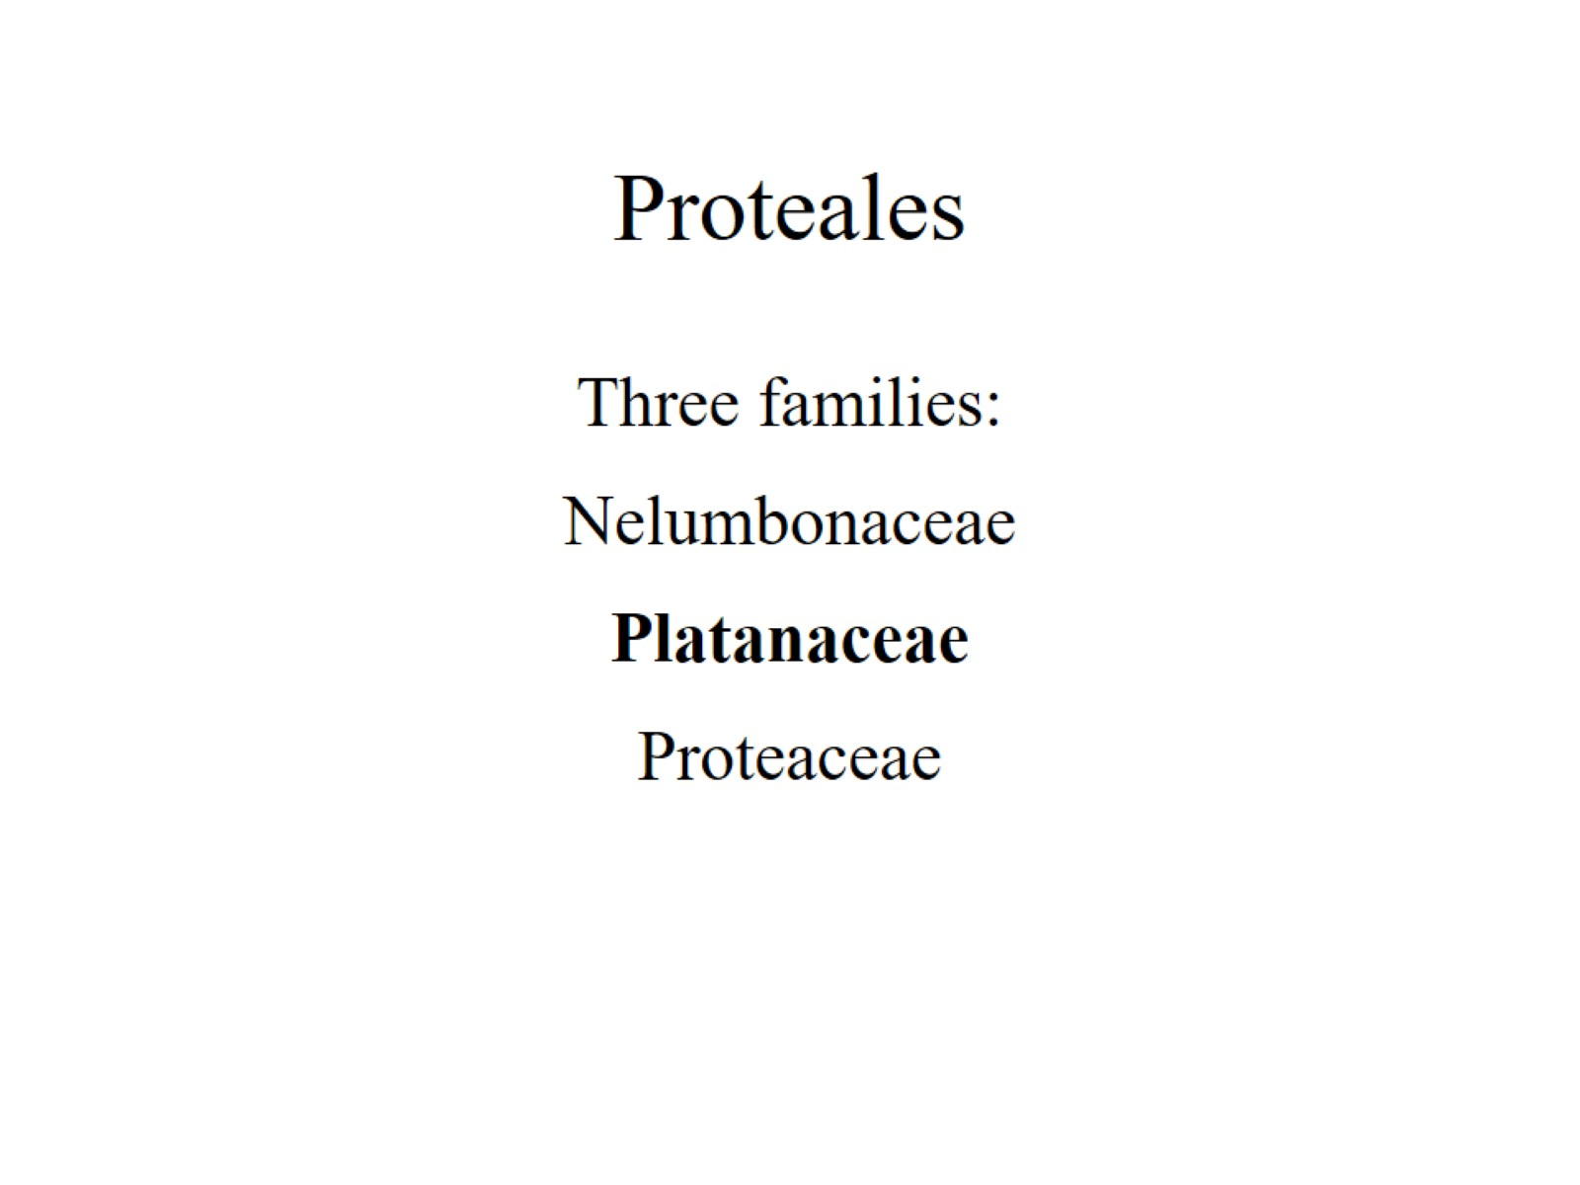
Proteales

Slide 5
Platanaceae Plane Tree / Sycamore family (Greek Platanus, broad leaf). 1 genus (Platanus) / 7 species.

Slide 6
encircling stipules

Slide 7
infrapetiolar buds

Slide 8
palmately lobed and veined

Slide 10
RANUNCULALES

Slide 11
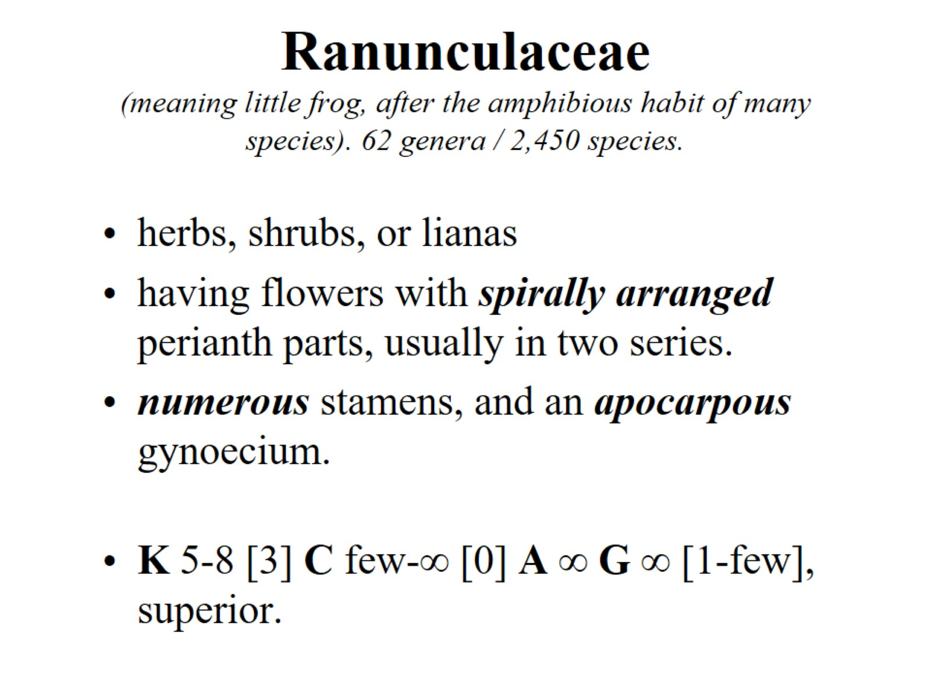
Ranunculaceae (meaning little frog, after the amphibious habit of many species). 62 genera / 2,450 species.

Slide 12
Flower in longitudinal section

Slide 13
Follicles

Slide 14
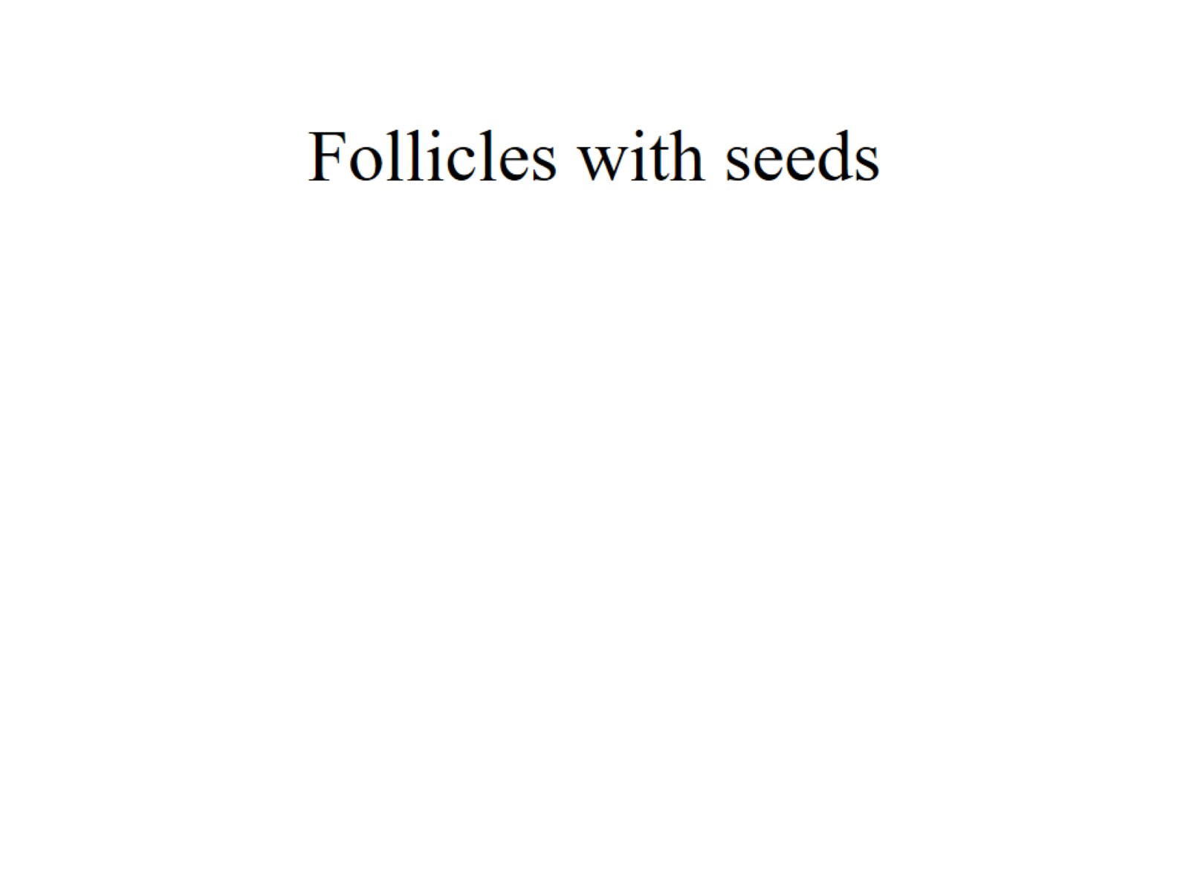
Follicles with seeds

Slide 15
Ranunculus trichophyllus

Slide 16
Clematis sp.

Slide 17
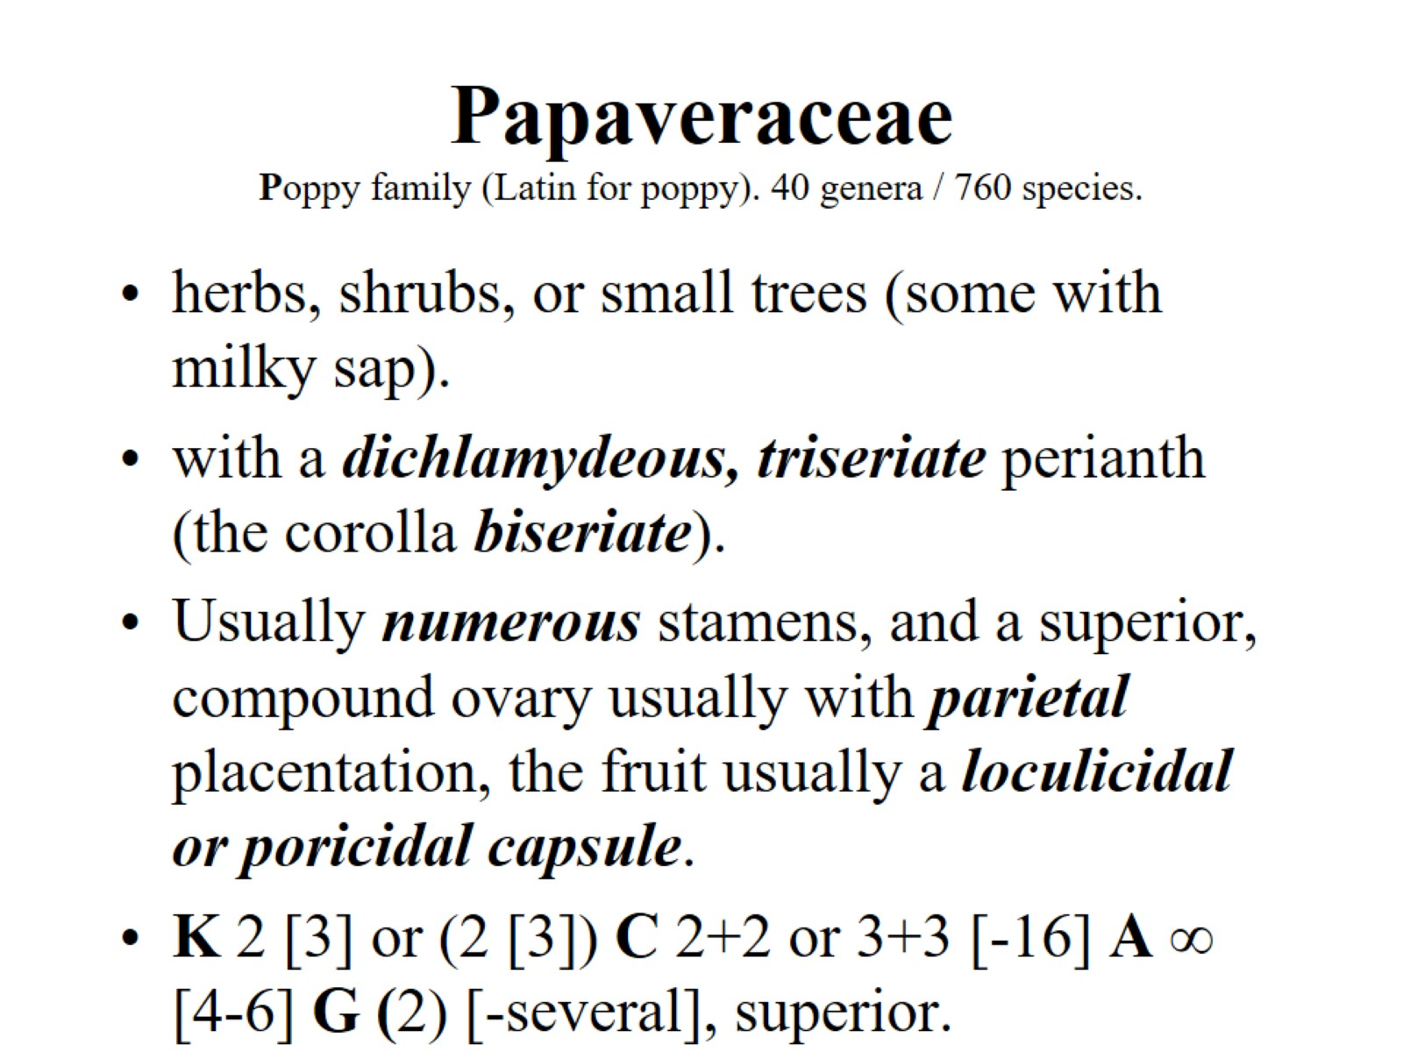
Papaveraceae Poppy family (Latin for poppy). 40 genera / 760 species.

Slide 18
poricidal capsule

Slide 19
parietal placentae

Slide 20
Papaver somniferum

Slide 21
Hypecoum sp.

Slide 22
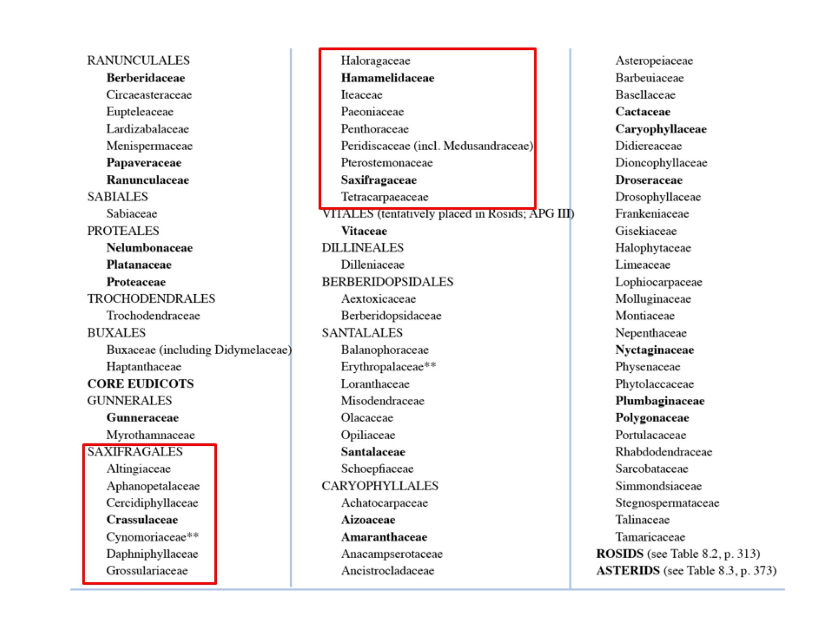

Slide 23
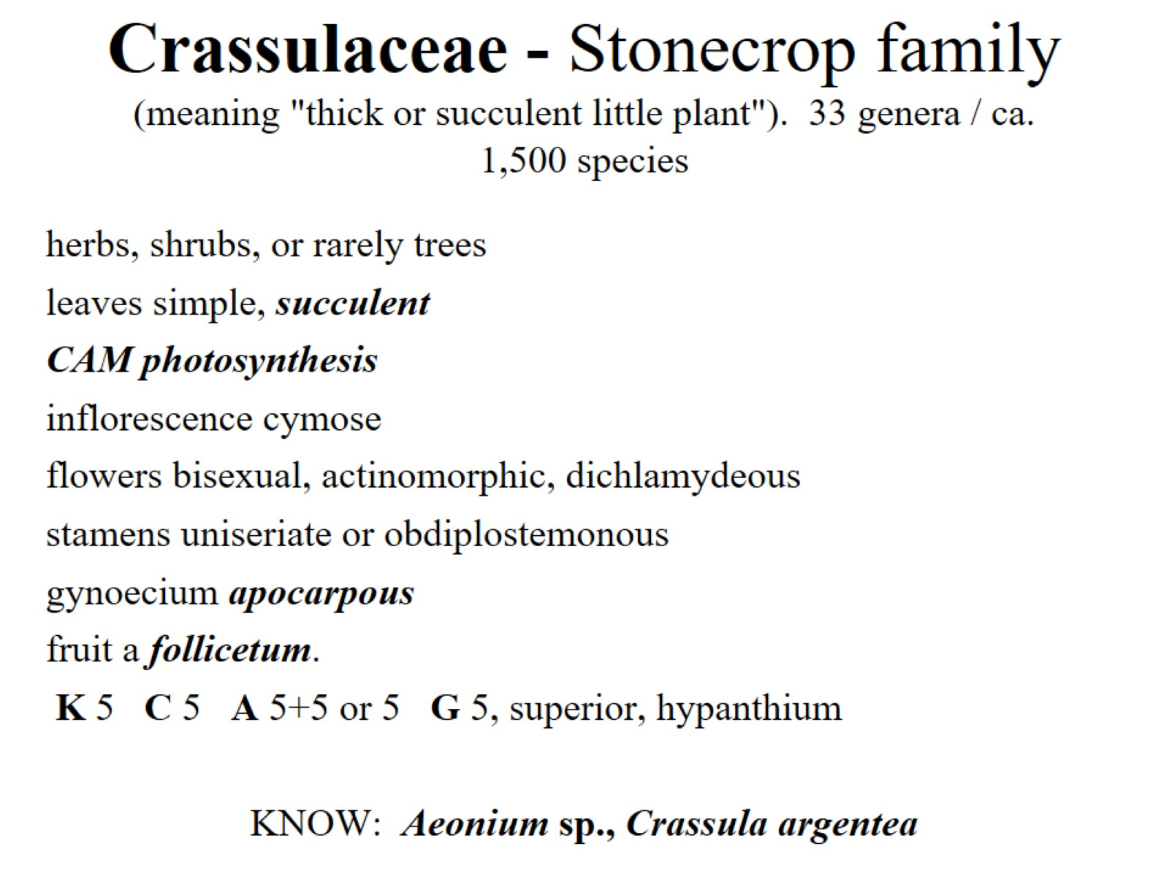
Crassulaceae - Stonecrop family (meaning "thick or succulent little plant"). 33 genera / ca. 1,500 species

Slide 24
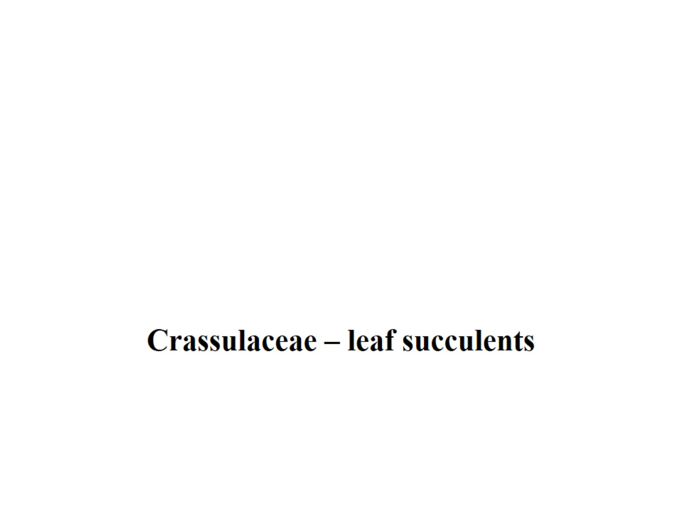

Slide 25
fruit a follicetum.

Slide 27
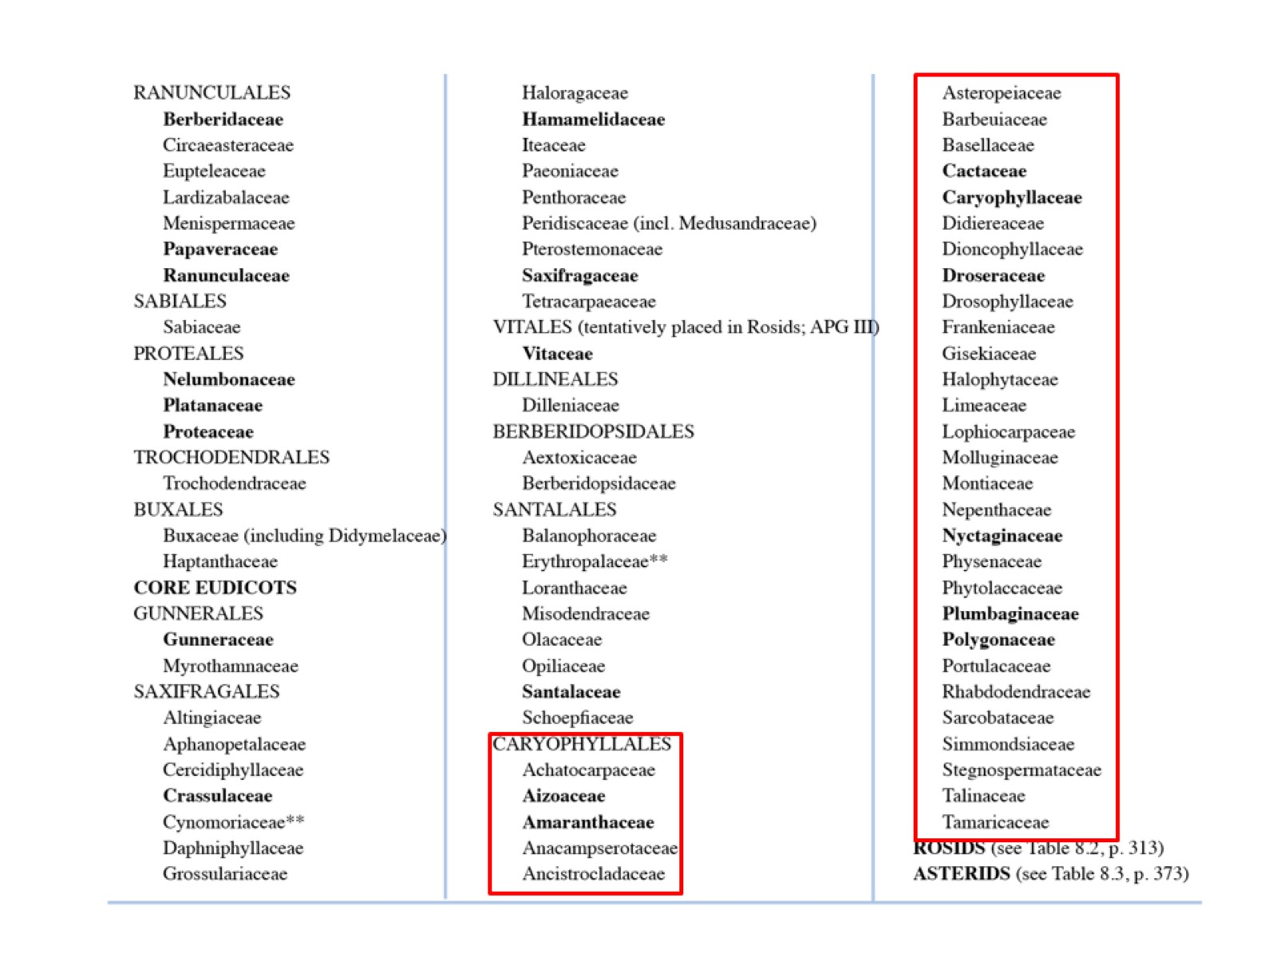

Slide 28
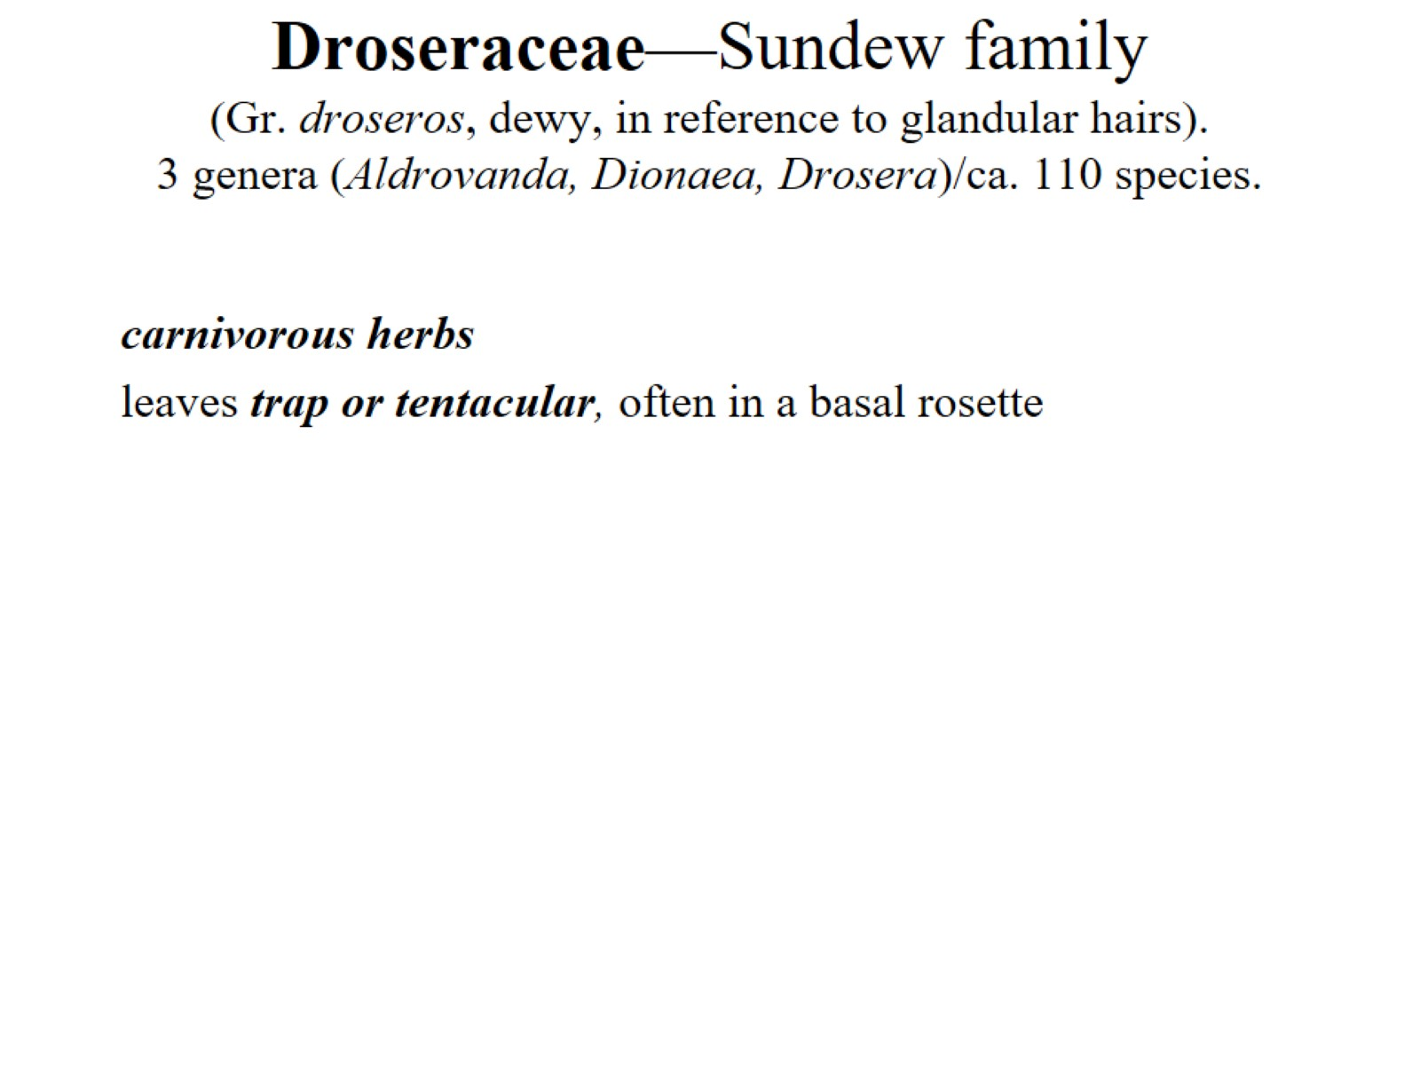
Droseraceae—Sundew family (Gr. droseros, dewy, in reference to glandular hairs). 3 genera (Aldrovanda, Dionaea, Drosera)/ca. 110 species.

Slide 29
Droseraceae—Sundew family (Gr. droseros, dewy, in reference to glandular hairs). 3 genera (Aldrovanda, Dionaea, Drosera)/ca. 110 species.

Slide 30
Core Caryophyllales

Slide 35
Amaranthaceae (including Chenopodiaceae) 174 genera / 2050 species

Slide 36
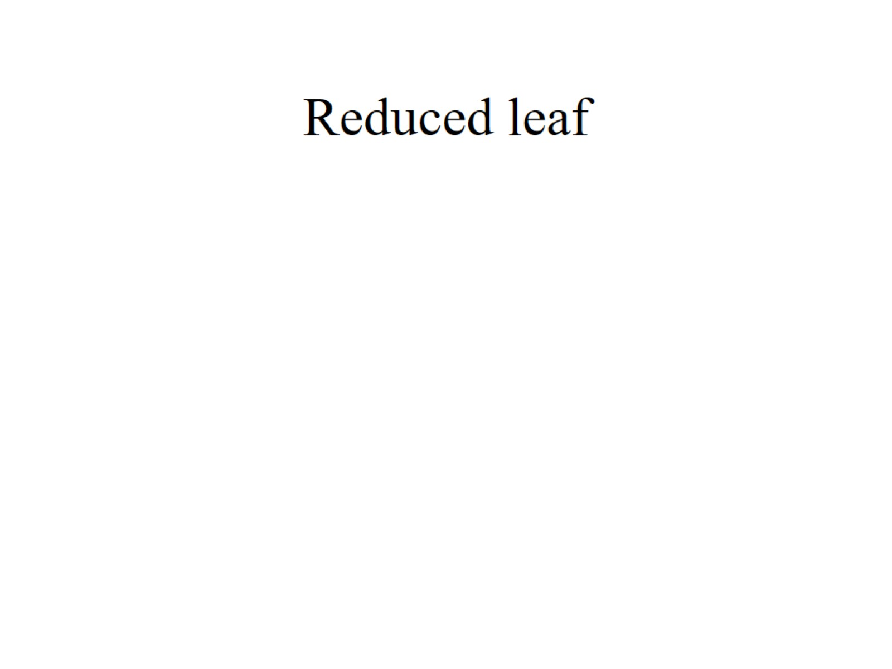
Reduced leaf

Slide 37
Succulent leaves

Slide 38
uniseriate perianth of mostly sepals

Slide 39
periant

Slide 40
Curved embryo

Slide 41
Microcnemum sp.

Slide 42
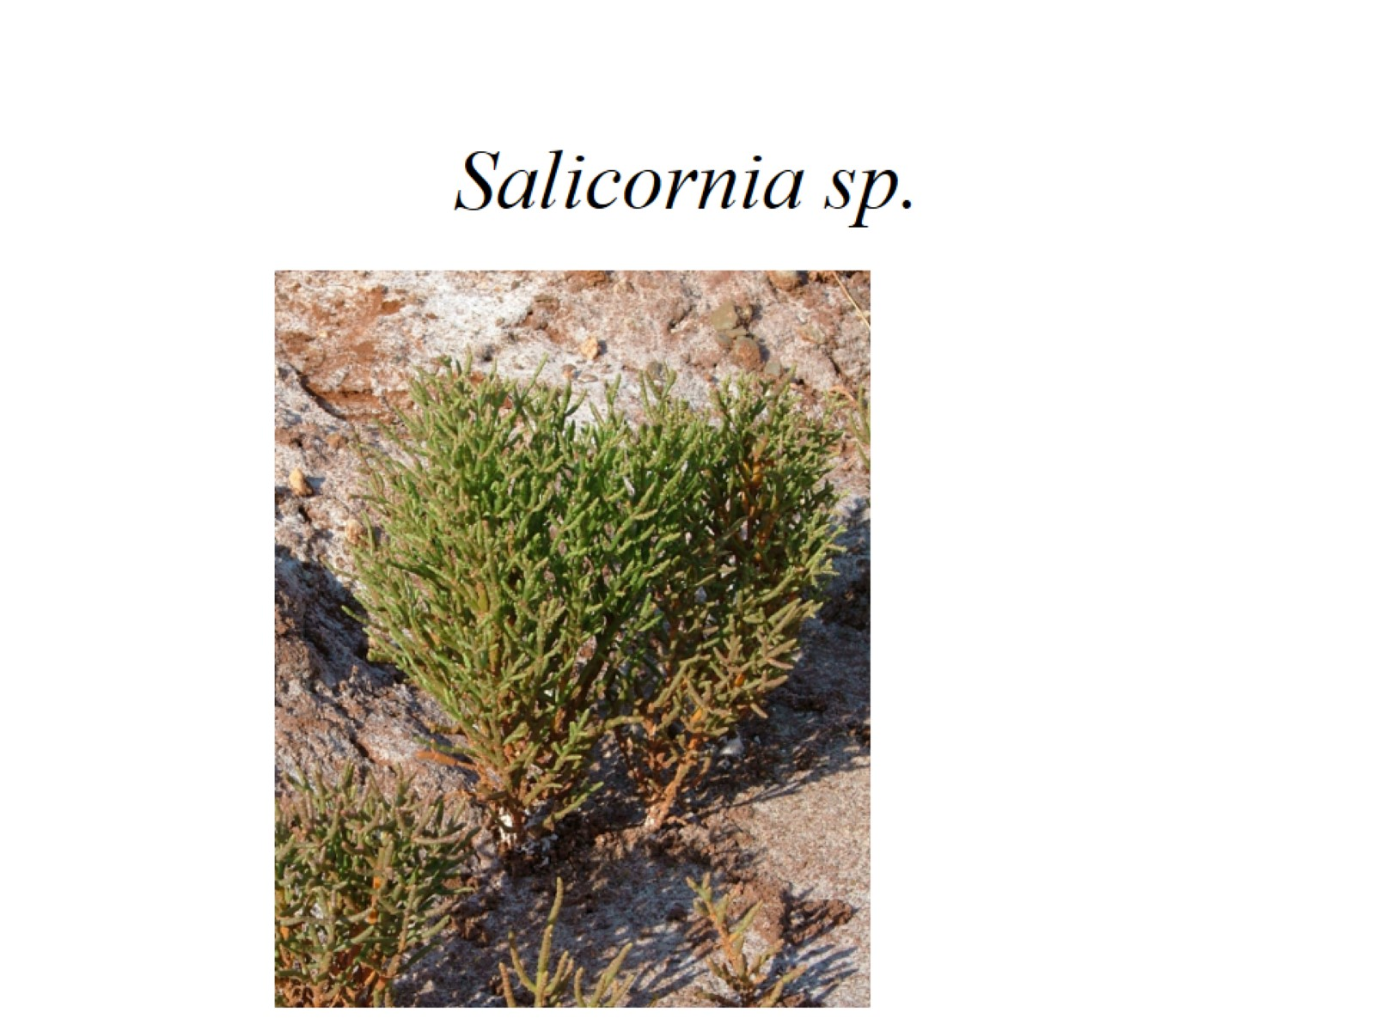
Salicornia sp.

Slide 43
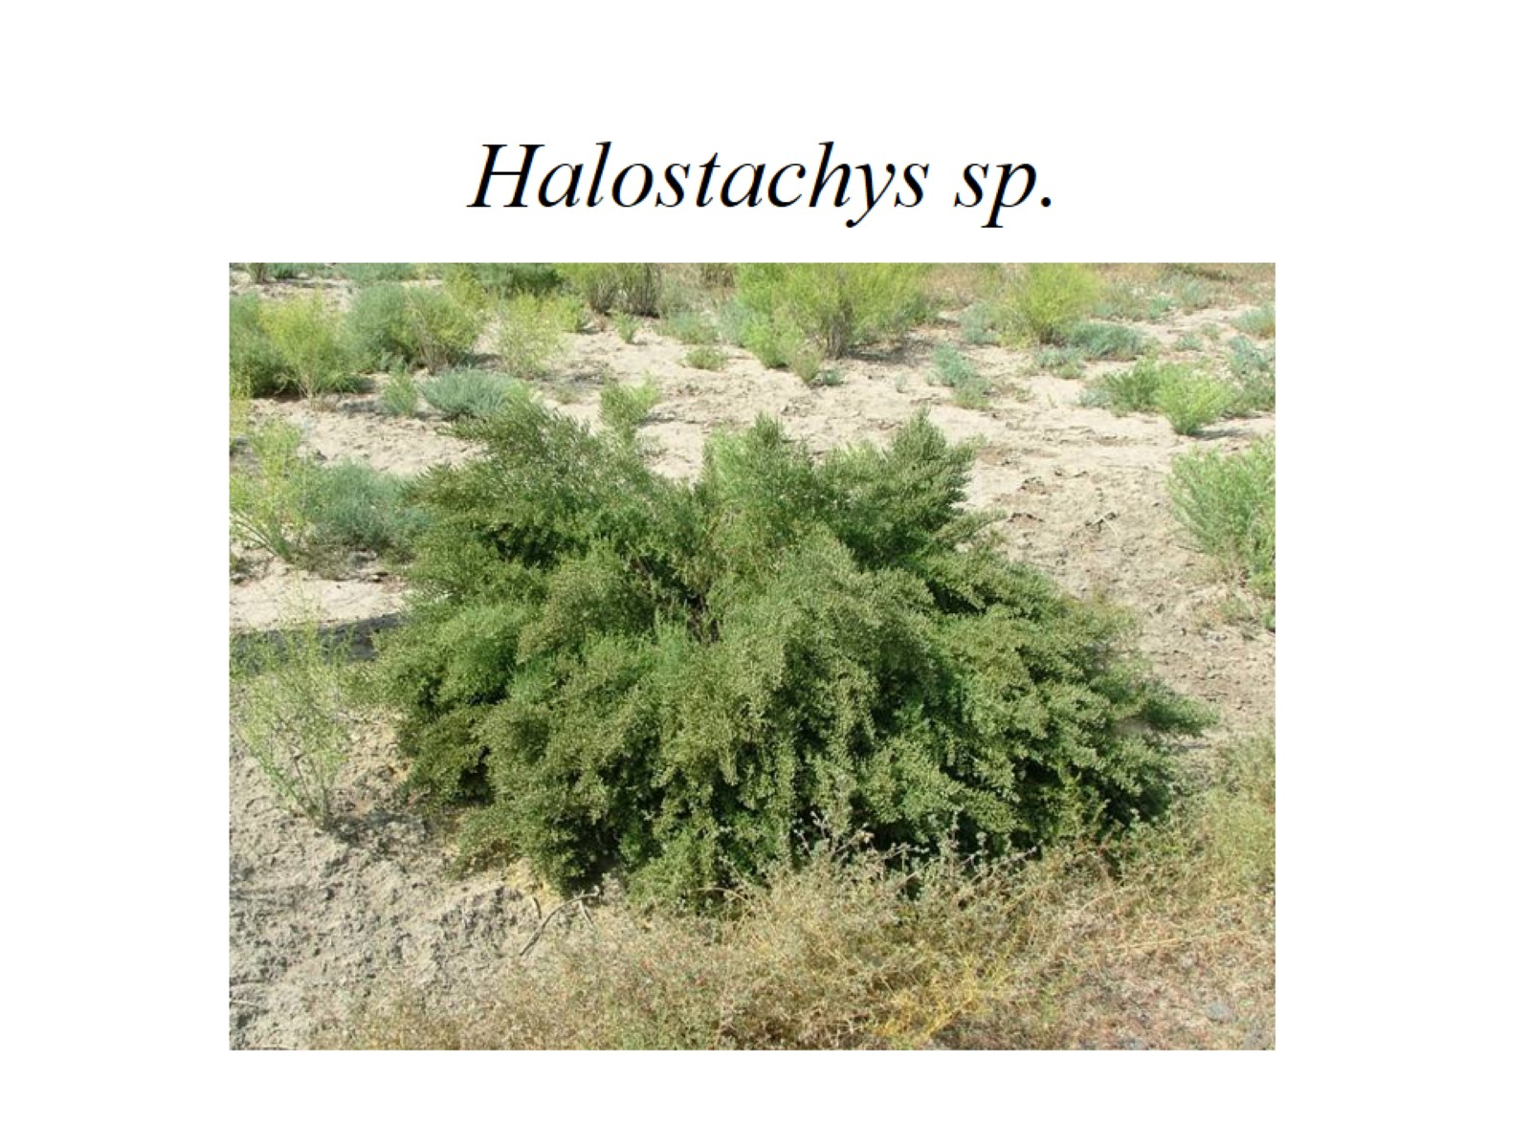
Halostachys sp.

Slide 44
Salsola grandis

Slide 45
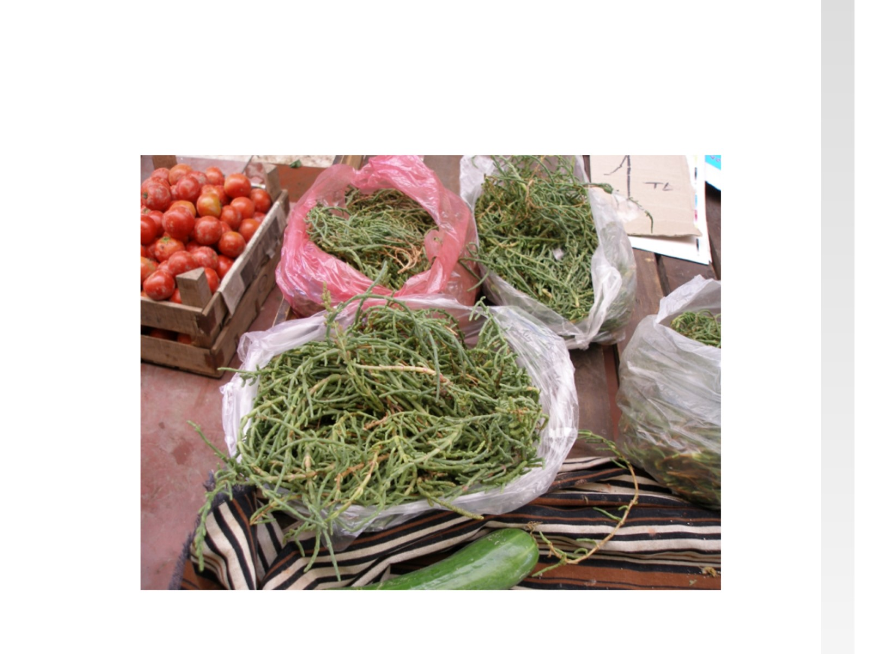

Slide 46
Caryophyllaceae 87 genera / 2300 species

Slide 47
Swollen nodes

Slide 48
Cyme inflorescence

Slide 49
flower in longitudinal section

Slide 50
flower in exploded view

Slide 51
Denticidal capsule

Slide 52
free-central placentation

Slide 53
curved (peripheral) embryo around the perisperm.

Slide 54
Stellaria

Slide 55
Silene sp.

Slide 56
Dianthus sp.

Slide 57
Cactaceae - Cactus family (Greek for a spiny plant). 97 genera / 1,400 species

