Slide 1
Crime and Social Policy
Dr. Boran A. Mercan

Slide 2
the family as a site of criminality and thus interference; the relationship between families and crime.
Is it possible to do an early intervention?
Perhaps a risk-focused prevention can be put to resolve problem families according to risk categories

Slide 3
Problem Families and Policy Responses
Family-centred crime policy
‘problem families’,
‘cycle of deprivation’,
and ‘pro-family policies’

Slide 5
Bowlby (1944) pointed out family dynamics and its link with delinquency.
An empirical study with ‘Forty-Four Juvenile Thieves’ at the London Child Guidance Clinic.
Influenced by Sigmund Freud and psychoanalysis
Most juvenile delinquents tend to display ‘affectionless character’.
The starking result: those who had suffered from a prolonged separation from mothers were more likely to involve in delinquency than non-delinquents
the trauma of separation during the first five years of life.
There is an intimate relation btw family milieu and the possibility of delinquency in later periods of the life.

Slide 6
The concept of problem families
Interventions became possible with that notion.
carried out by various public authorities such as public health officials, social workers and housing managers.
This also mobilised many civil society initiatives: the Eugenics Society, Family Service Units, and local Medical Officers of Health
These started investigations on problem families in the 1940s and 1950s

Slide 7
What is problem family indeed?
Those parents who lack of attention to the education of their children,
keep disordered and dirty homes,
bred too many children to foster and care.
The importance of media representations and tabloids
What takes hold of the truth?

Slide 8
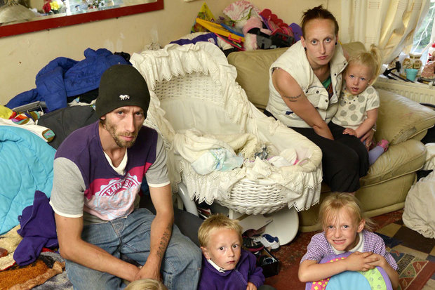
https://www.express.co.uk/news/uk/415236/Super-fertile-jobless-parents-of-six-on-27-000-benefits-demand-a-bigger-council-house (accessed 14 May 2018)

Slide 9
Farrington (1995; 2002; 2007) and Kolvin et al. (1988) made use of many indices of disgrace and deprivation that refer to the importance of social relationships and social conditions, and possible social policy responses to problem families. Some points are as such:
• marital disruption and separation from biological parents;
• parental illness;
• poor domestic care of the child and the home;
• dependence on social services;
• overcrowding in the home;
• living in social housing in an inner-city area;
• socially disorganised communities;
• poor parental supervision and child-rearing techniques involving harsh and erratic discipline (Rodger, 2008: 102).

Slide 10
The Cycle of Deprivation (Sir Keith Joseph - Secretary of State for Social Services)
social deprivation is a ‘home-made’ problem.
a ‘cycle of deprivation’ indicates that deprivation might be transmitted from one generation to the next
In that, the responsibility belongs to weak household management and the problem of broken family
However, this is a biased-essentialist and culturally reductionist approach to poverty and poor household!

Slide 11
Pro-family policies
Tony Blair, New Labour, The Third Way,
A particular attention paid to community, family and crime.
For crime reduction: Changes in the family structure are directly to do with crime and deviance.
Broken families, single parenting, problem families and so forth cannot be separately dealt with from the issue of crime.
Necessity of a solution to both family dissolution and crime.

Slide 12
The Social Exclusion Unit by Blair government in1997
The government-led various programmes in the scope of Children, Families and Schools.
Sure Start, Support for Parents, Literacy and Numeracy Strategies, Teenage Pregnancy Strategy, and Access to Childcare, among others (Young and Matthews, 2003).
The Third Way approach to the renewal of transmitted deprivation like the transmission of cultural codes.
‘intergenerational cycle of deprivation’ and ‘transmission’ of disadvantage (Social Exclusion Unit, 2004; also Knepper, 2007).

