Slide 1
iPS Cells
Notes:
Normal development starts as soon as the sperm fertilizes the egg. Then it develops into an embryo and finally to a fully functional organism. The fertilized egg is at the undifferentiated stage and as the embryo develops you end up with fully differentiated cells such as fibroblasts/neurons/cardiomyocytes...
For this reason, the long--‐standing predominant view was that cells in the somatic lineage were permanently in a locked state, such that the journey back to a highly undifferentiated state was impossible.
Conrad Hal Waddington proposed an epigenetic landscape of mountains and valleys as a metaphor for development. It nicely visualizes the unidirectional developmental porcess of normal development. Cells do not normally move back towards the top of the mountain or cross into the other valleys..

Slide 2
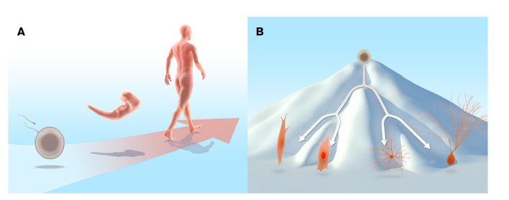
Introduction
- What was known? -
Normal development
Waddington’s Epigenetic Landscape
Undifferentiated cell
Adult
Fully differentited stage
Embryo
Fertilized egg
Undifferentiated stage
Differentiated cell
Until 1960s, the view: “the journey back to a highly undifferentiated state was impossible”
Notes:
Normal development starts as soon as the sperm fertilizes the egg. Then it develops into an embryo and finally to a fully functional organism. The fertilized egg is at the undifferentiated stage and as the embryo develops you end up with fully differentiated cells such as fibroblasts/neurons/cardiomyocytes...
For this reason, the long--‐standing predominant view was that cells in the somatic lineage were permanently in a locked state, such that the journey back to a highly undifferentiated state was impossible.
Conrad Hal Waddington proposed an epigenetic landscape of mountains and valleys as a metaphor for development. It nicely visualizes the unidirectional developmental porcess of normal development. Cells do not normally move back towards the top of the mountain or cross into the other valleys..

Slide 3
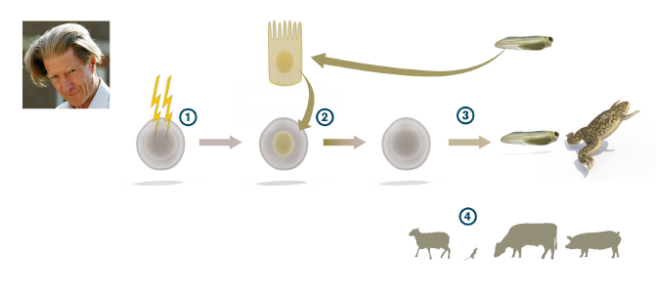
1962, Gurdon : “the nucleus from a differentiated frog intestinal epithelial cell was capable of generating a fully functional tadpole upon transplantation to an enucleated egg”
Intestinal cells
J.Gurdon
Tadpole
Frog egg
1997:Birth of doly
Differentiated somatic cell nuclei had the potential to revert to pluripotency!

Slide 4
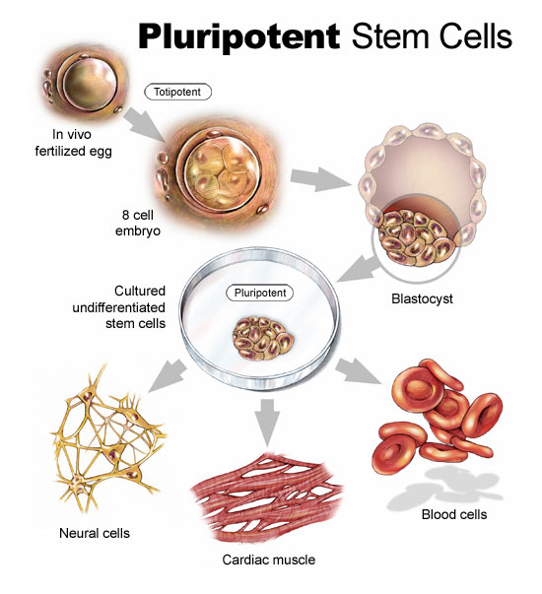
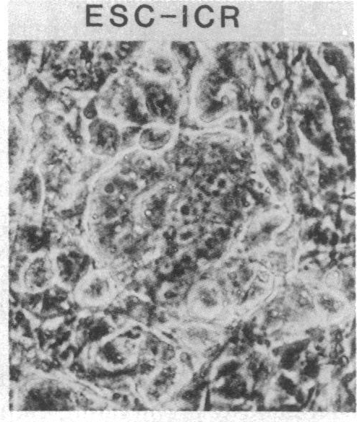
Generation of embryonic stem cells.....
Fertilized egg
1981, Evans & Martin : mESCs
1998, Thomson: hESCs
Differentiated cells

Slide 5
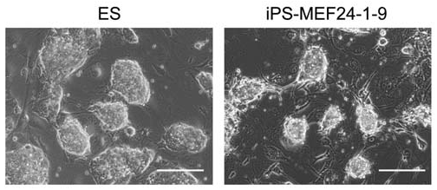
S. Yamanaka
2006, Yamanaka: “introduction of a small set of transcription factors into a differentiated cell was sufficient to revert the cell to a pluripotent state”
Adult fibroblasts
Cocktail of transcription factors
Oct3/4
Sox2
Klf4
cMyc
Induced Pluripotent Stem Cells (iPS Cells)
Pluripotent cell

Slide 6
2012 Nobel Prize in Physiology or Medicine
Until mid 20th century.....
Cellular differentiation is unidirectional
Pluripotent Cell
Somatic Cell
Dr Gurdon and Dr Yamanaka’s discoveries: “differentiated cells can be reprogrammed to a pluripotent stem cell state!”
This represents a paradigm shift in our understanding of our cellular differentiation and plasticity of the differentiated state.
Waddington’s landscape

Slide 7
What do iPS cells offer?
iPS Cells
Somatic Cells
Patient
Neurons
Cardiomyocytes
Hepatocytes
Regenerative medicine
Disease modelling
Drug-screening

Slide 8
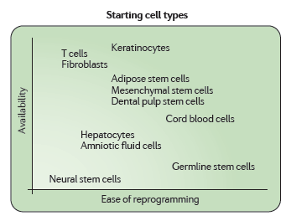
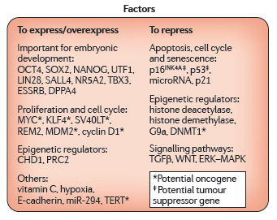
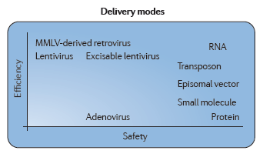
The Reprograming Menu
Gonzalez et al., 2011

Slide 9
Limitations
Main obstacles for clinical translation of reprogrammed somatic cells to a pluripotent state by the forced expression of specific transcription factors are:
the limited efficiency of reprogramming methodologies
long-term culture conditions
the safety of induced pluripotent stem (iPS) cells that may lead to spontaneous formation of teratomas on implantation

