Slide 1
Role of fats in the organisms
Necessary amount of fats support body functions
Fats provide an efficient way to store energy over long periods of time
Fats play an important role in the absorption of fat-soluble vitamins by the body

Slide 2
Lipids
Lipids are defined as a large and diverse group of naturally occuring organic compounds such as
Fats
Oils
Fatty acids
Phospholipids
Waxes
Unsaponifiables (sterols, squalene, terpenic alcohols, aliphatic alcohols, hydrocarbons)

Slide 3
Fats and oils
Animal fats and oils
Mammal depot fat (lard and tallow)
Milk fat
Marine oils (fish and whale oil)
Vegetable oils and fats
Seed oil (soybean, canola)
Fruit coat oils (palm and olive oil)
Kernel oils (coconut and palm kernel)

Slide 4
Fatty acids
Few fatty acids occur free in foods, but most of them are found to be incorporated into triglycerides.
They consist of an carboxylic acid group (-COOH) on one end and a methyl group (-CH₃) on the other end.
Carboxylic acid group
Methyl group
Hydrocarbon chain

Slide 5
What is cis and trans form?
The terms cis and trans describe the geometric shape of the fatty acid.
A cis fatty acid has the hydrogens on the same side as the double bond.
A trans fatty acid has the hydrogens on either side of the double bond.
Most of the fatty acids in nature are in the cis configuration, whereas trans fatty acids are found in ruminant milk fats and often result from hydrogenation.

Slide 6
Fatty acids
Saturation degree of fatty acids affects the physical form of the fats or oils such as melting properties at a specific temperature
For example at room temperature;
The animal fats are solid, since they have more saturated fatty acids
The vegetable oils are liquid, since they have more unsaturated fatty acids

Slide 7
Main sources of fatty acids
Fatty acids
Saturated (mainly animal origin)
Monounsaturated (mainly plant origin)
Polyunsaturated (mainly plant origin)
Animal
Meat
Poultry
Milk
Butter
Cheese
Egg yolk
Lard
Plants
Chocolate
Coconut
Coconut oil
Palm oil
Plants
Olives
Olive oil
Peanut
Avocado
Plants
Vegetable oils (corn, sunflower, canola etc…
Certain nuts (almond, pecan, walnut)
Animal
Fish

Slide 8
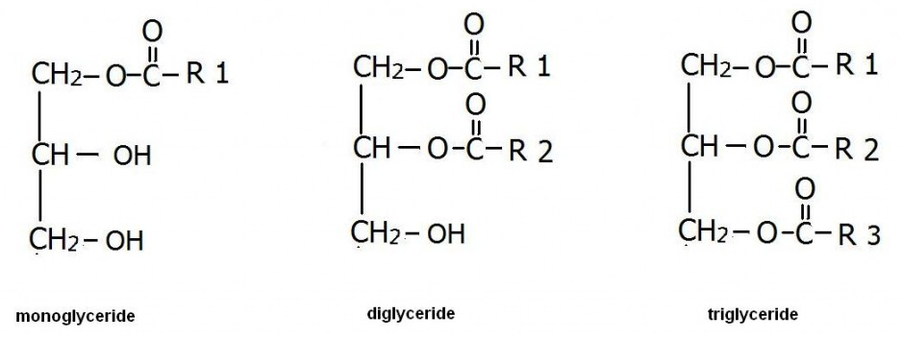
Triglycerides
Triglycerides consist of three fatty acids attached to glycerol molecule.
If there is two fatty acids or one fatty acid linked to glycerol in the structure, we can call diglyceride or monoglyceride, respectively.
Fatty acids

Slide 9
Phospholipids
Phospholipids consist of glycerol molecule attached with two fatty acids and a compound containing phosphorus.
The best known phospholipid is lecithin, which is found in egg yolk.

Slide 10
Unsaponifiable fraction of lipids
Sterols
Hydrocarbons
Terpenic alcohols
Squalene
Aliphatic alcohols

Slide 11
References
deMan, J.M. (1999) Principles of food chemistry. (3rd ed.) Pages 33-54. An aspen publication, Maryland, USA.
Brown, A. (2008) Understanding food principles and preparation. (3rd ed.) Pages 37-41. Thomson Wadsworth, California, USA.
Lipids. Web link : https://www.khanacademy.org/science/biology/macromolecules/lipids/a/lipids
Türk Gıda Kodeksi Gıda Etiketleme ve Tüketicileri Bilgilendirme Yönetmeliği. http://www.resmigazete.gov.tr/eskiler/2017/01/20170126M1-6.htm (in Turkish)

