Slide 1
Political Geography
Asst. Prof. Merve ALTUNDAL ÖNCÜ

Slide 2
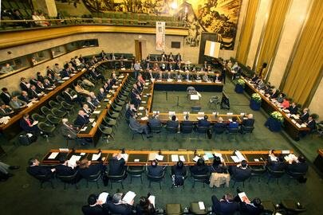
The United Nations and International Law
The UN Charter, charges the General Assembly with the responsibility for, among other things, “encouraging the progressive development of international law and its codification.’’
The Sixth Committee of the General Assembly is assigned the overall responsibility for legal matters, but the actual work is being done chiefly by the International Law Commission (ILC), established by the General Assembly in 1947.
The 34 members of the ILC are distinguished authorities drawn from all major legal traditions who do not represent governments but function in their personal capacities.

Slide 3
There always been conflicts and disputes among States; with different origins and shapes. Regardless of the dimensions of the conflicts, however, they can be resolved without resort to war if the parties involved are willing.
The most important method of settling a dispute is bilateral negotiations. The parties use diplomatic channels to begin with. Sometimes the normal diplomatic efforts will be supplemented or supplanted by negotiations between cabinet ministers and even heads of government.

Slide 4
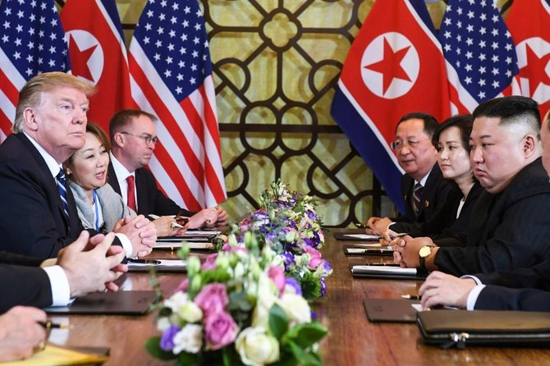
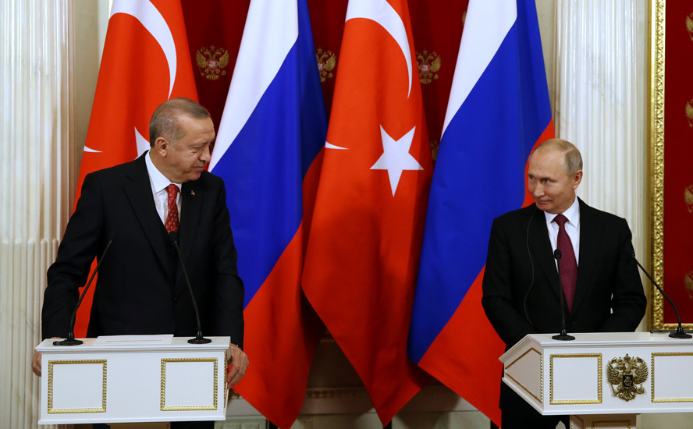
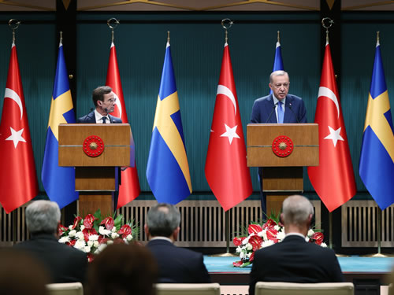

Slide 5
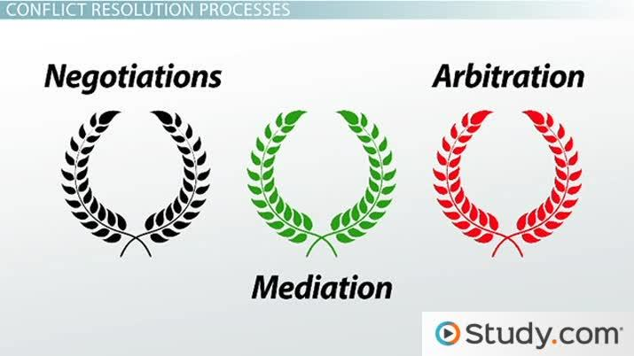
There are five standard types of third party participation: good offices, conciliation, mediation, arbitration, and judicial proceedings. The choice to be made any of one or more of these depends on the disputing parties.

Slide 6
Good offices are the simplest form of third-party participation. Is the one in which the third party is least directly involved in the dispute. The third party expedites bilateral negotiations by performing such services for the disputants as providing a neutral site for the negotiations; supplying interpreters, office space, secretarial services, and the like; transmitting messages between the parties; doing basic research and providing factual information to the parties; even providing entertainment and sight-seeing so as to create and maintain a relaxed and friendly atmosphere for the negotiations.

Slide 8
Conciliation in the negotiations a third party can intervene moderately. A conciliator will consider the positions of both sides and offer a compromise solution to the problem. He or she does not participate in the negotiations, undertake detailed studies, or pass judgment. The conciliator’s function is to facilitate the resolution of a dispute by offering a face-saving solution to the parties.

Slide 10
Mediation is very close to conciliation, but is more formal and active. A mediator studies the case in more detail, participates actively in the negotiations, and offers a formal proposal for solution of the problem.

Slide 11
Arbitration is a more formal, time-consuming, and expensive undertaking and , consequently, is less frequently utilized than any method discussed so far.
The disputants may resort to arbitration only if a dispute is more legal than political in nature, and it is frequently difficult to disentangle the two, and if it has been protracted and particularly trying for both parties.
Unlike good offices, conciliation, and mediation, arbitration aims at justice, not compromise. It still represents, however, the parties’ attempt to arrive at an amicable resolution of a problem under their own rules by arbitrators of their own choice.

Slide 12
Judicial proceedings are formal adversary proceedings before a permanent court following established rules.
They are typically the last resort, used after all other methods of pacific settlement of a dispute have been rejected or have failed.
The preceding may take place before a national court, a regional court such as the International Court of Justice.
Naturally, being sovereign States, one or both parties may ignore or reject either arbitral or judicial decisions, but generally they are respected.

