Slide 1
Yapay Zeka 802600715151
Doç. Dr. Mehmet Serdar GÜZEL
Slides are mainly adapted from the following course page:
at http://ai.berkeley.edu created by Dan Klein and Pieter Abbeel for CS188

Slide 2
Lecturer
Instructor: Assoc. Prof Dr. Mehmet S Güzel
Office hours: Tuesday, 1:30-2:30pm
Open door policy – don’t hesitate to stop by!
Watch the course website
Assignments, lab tutorials, lecture notes

Slide 3
Reinforcement Learning 2
Notes:
Please retain proper attribution, including the reference to ai.berkeley.edu. Thanks!

Slide 4
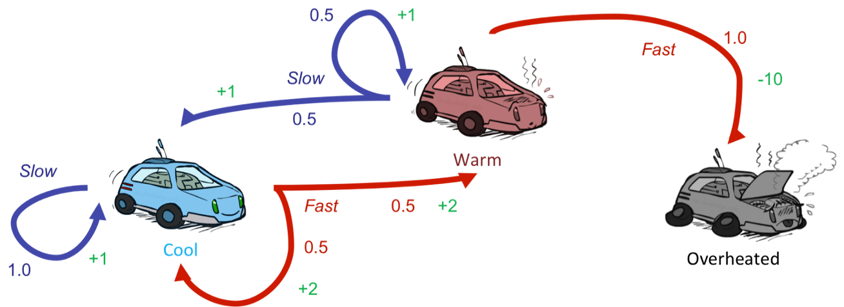
Reinforcement Learning
Still assume a Markov decision process (MDP):
A set of states s ∈ S
A set of actions (per state) A
A model T(s,a,s’)
A reward function R(s,a,s’)
Still looking for a policy π(s)
New twist: don’t know T or R
I.e. we don’t know which states are good or what the actions do
Must actually try actions and states out to learn

Slide 5
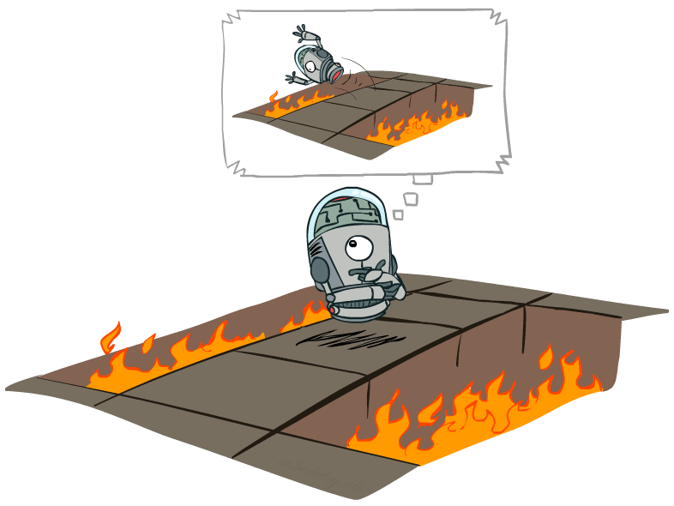
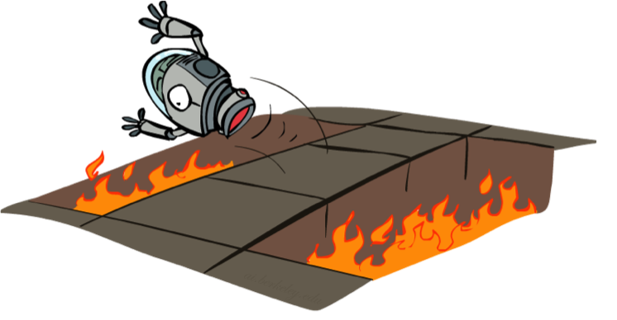
Offline (MDPs) vs. Online (RL)
Offline Solution
Online Learning

Slide 6
Model-Based Learning

Slide 7
Model-Based Learning
Model-Based Idea:
Learn an approximate model based on experiences
Solve for values as if the learned model were correct
Step 1: Learn empirical MDP model
Count outcomes s’ for each s, a
Normalize to give an estimate of
Discover each when we experience (s, a, s’)
Step 2: Solve the learned MDP
For example, use value iteration, as before

Slide 8
Example: Model-Based Learning
Input Policy π
Observed Episodes (Training)
Learned Model
Episode 1
Episode 2
T(s,a,s’).
T(B, east, C) = 1.00
T(C, east, D) = 0.75
T(C, east, A) = 0.25
…
R(s,a,s’).
R(B, east, C) = -1
R(C, east, D) = -1
R(D, exit, x) = +10
…
 | A
B | C | D
 | E
B, east, C, -1
C, east, D, -1
D, exit, x, +10
B, east, C, -1
C, east, D, -1
D, exit, x, +10
Episode 3
Episode 4
E, north, C, -1
C, east, D, -1
D, exit, x, +10
E, north, C, -1
C, east, A, -1
A, exit, x, -10
Assume: γ = 1

Slide 9
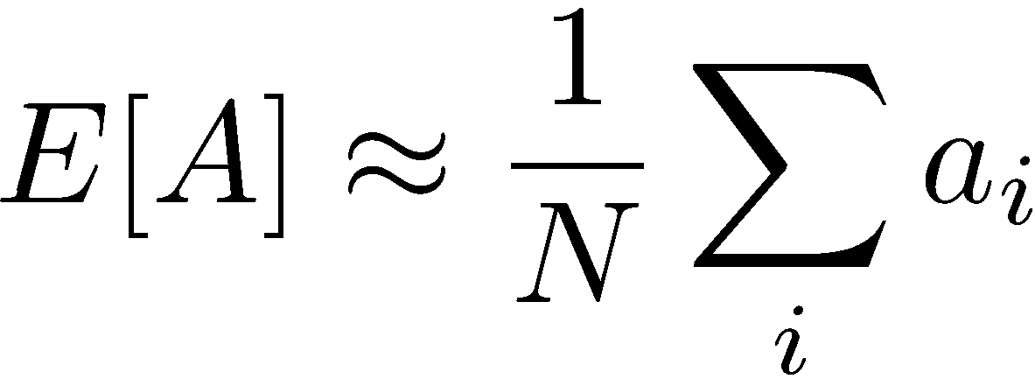
Example: Expected Age
Goal: Compute expected age of cs188 students
Known P(A)
Without P(A), instead collect samples [a₁, a₂, … a_{N}]
Unknown P(A): “Model Based”
Unknown P(A): “Model Free”
Why does this work? Because eventually you learn the right model.
Why does this work? Because samples appear with the right frequencies.

Slide 10
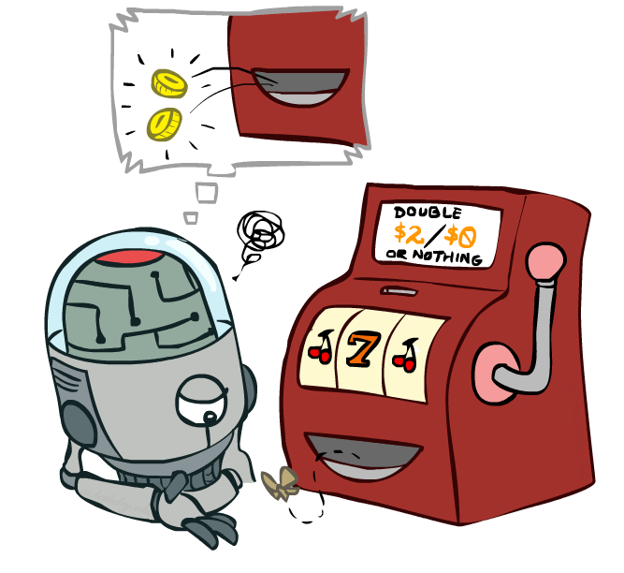
Model-Free Learning

Slide 11
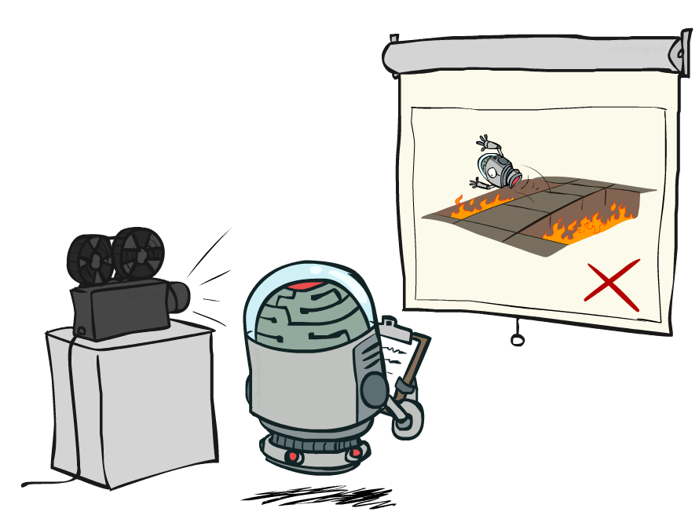
Passive Reinforcement Learning

Slide 12
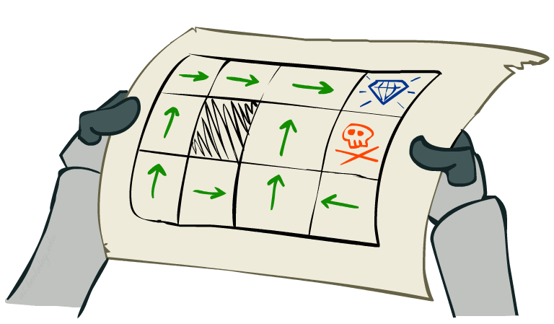
Passive Reinforcement Learning
Simplified task: policy evaluation
Input: a fixed policy π(s)
You don’t know the transitions T(s,a,s’)
You don’t know the rewards R(s,a,s’)
Goal: learn the state values
In this case:
Learner is “along for the ride”
No choice about what actions to take
Just execute the policy and learn from experience
This is NOT offline planning! You actually take actions in the world.

Slide 13
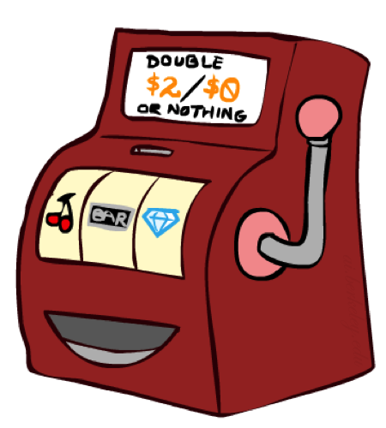
Direct Evaluation
Goal: Compute values for each state under π
Idea: Average together observed sample values
Act according to π
Every time you visit a state, write down what the sum of discounted rewards turned out to be
Average those samples
This is called direct evaluation

Slide 14
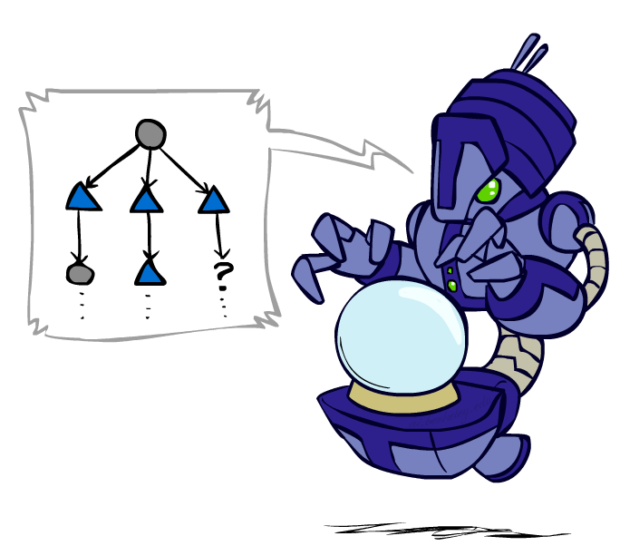
Sample-Based Policy Evaluation?
We want to improve our estimate of V by computing these averages:
Idea: Take samples of outcomes s’ (by doing the action!) and average
s
π(s)
s, π(s)
s, π(s),s’
s₁'
s₂'
s'
s₃'
Almost! But we can’t rewind time to get sample after sample from state s.

Slide 15
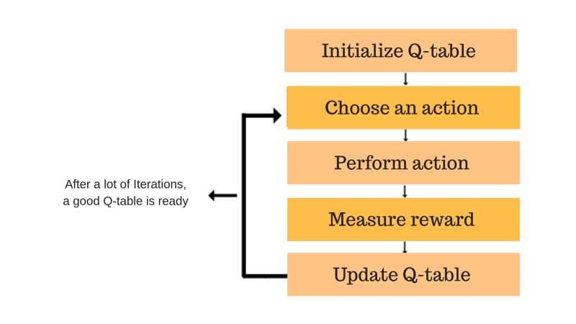
Q-Learning Properties
Q-learning is a values-based learning algorithm in reinforcement learning.
Introducing the Q-learning algorithm process

Slide 16
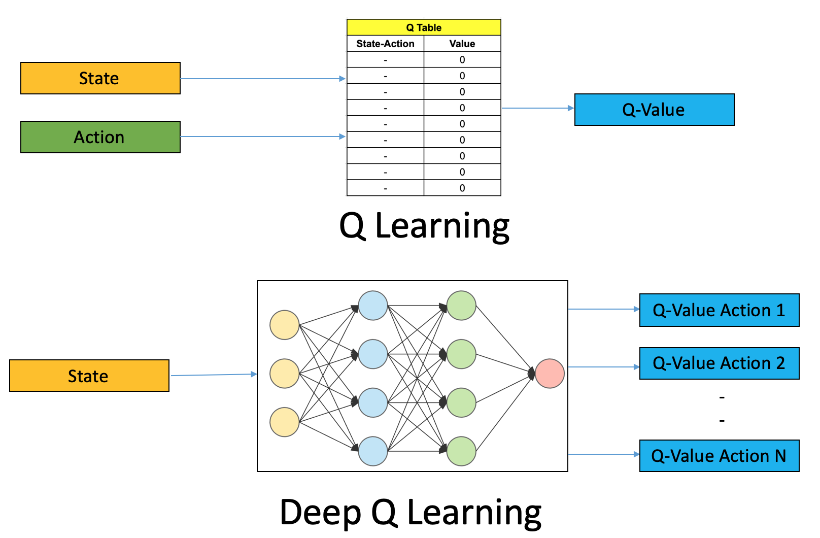
Deep Q-Learning

