Slide 1
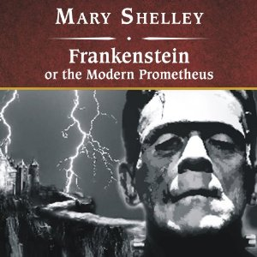
Monsters ın gothıc fıctıon:
mary shelley’s frankenstein

Slide 2
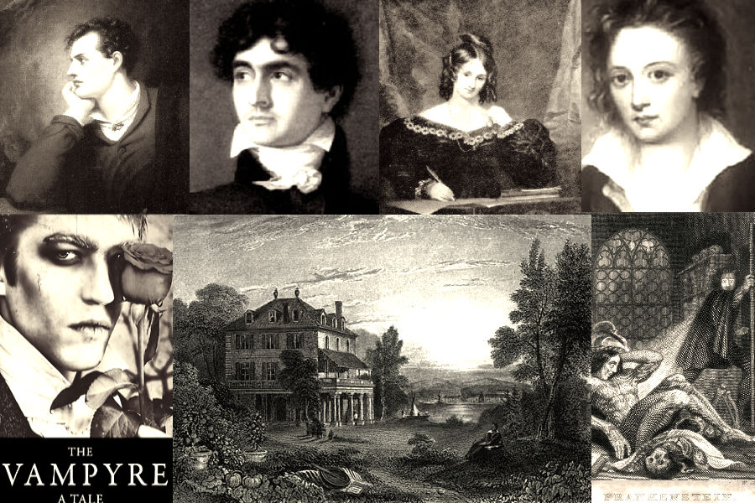

Slide 3
Three narrators
1) Robert Walton
2) Victor Frankenstein
3) The Monster

Slide 4
Gothic elements
A hideous monster with superhuman strength and stature. He has free will and individual consciousness.
Nature: thunderstorms, rain, a boat stuck in the North Pole.
Gloomy atmosphere, sense of terror
Murder and mystery
The hunt
Thirst for revenge
Suffering

Slide 5
themes
1) Fear of the unknown:
Electricity
Science
The Monster

Slide 6
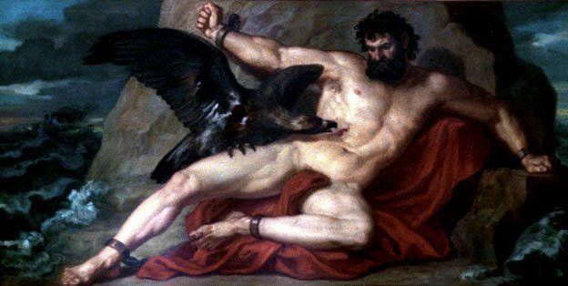
The modern prometheus

Slide 7
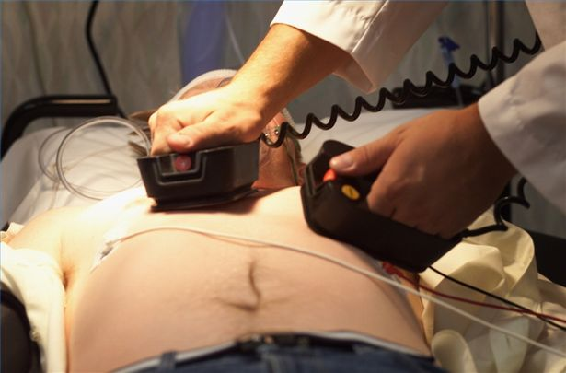
electricity
Luigi Galvani
Defibrillation

Slide 8
“It was the secrets of heaven and earth that I desired to learn; and whether it was the outward substance of things, or the inner spirit of nature and the mysterious soul of man that occupied me, still my enquiries were directed to the metaphysical, or in its highest sense, the physical secrets of the world.”

Slide 9
“A new species would bless me as its creator and source; many happy and excellent natures would owe their being to me. No father could claim the gratitude of his child so completely as I should deserve theirs.”

Slide 10
“Learn from me, if not by my precepts, at least by my example, how dangerous is the acquirement of knowledge and how much happier that man is who believes his native town to be the world, than he who aspires to become greater than his nature will allow.”

Slide 11
themes
2) Free Will
3) Alienation

Slide 12
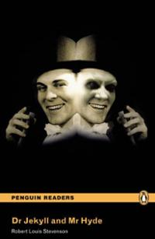

Slide 13
themes
4) Revenge
Victims: Brother William
Friend Henry Clerval
Wife Elizabeth
also indirectly:
Justine
Father

Slide 14
The doctor left him alone
He refused to create a female partner for him
By creating him and by leaving him alone, Victor caused all his sufferings.

Slide 15
Next sessıon:
Several monsters ın frankenstein
and
the concept of the other

