Slide 1
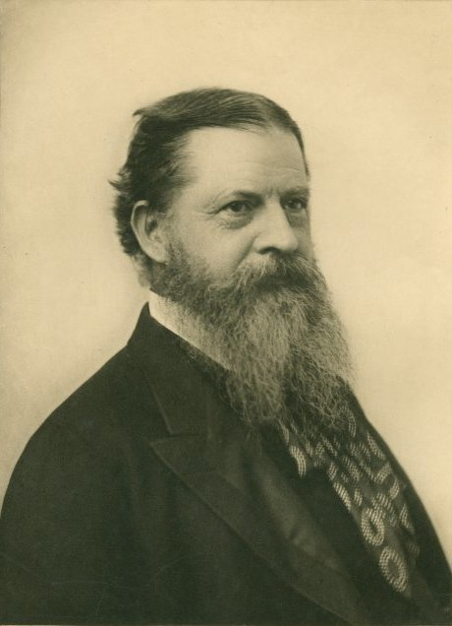
Charles Sanders Peirce
(1839-1914)

Slide 2
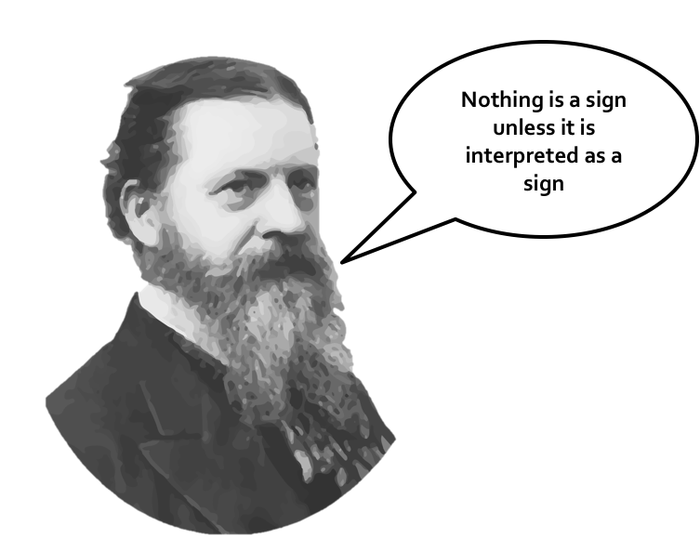

Slide 7
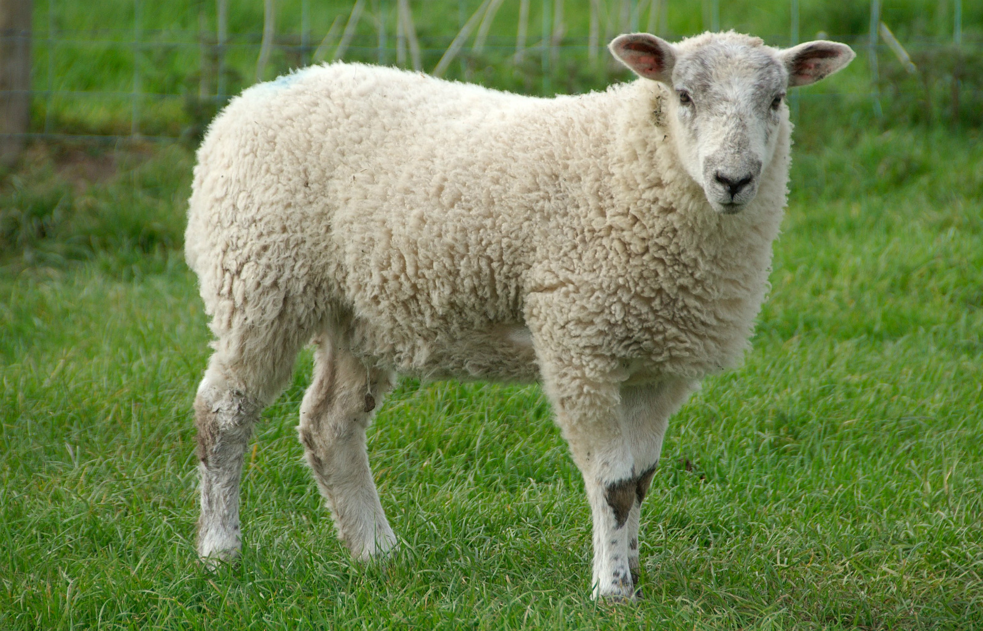
K – O – Y – U – N S – H – E – E – P M – O – U – T – O – N

Slide 8
Symbol/Symbolic (Simge/simgesel)
Icon/Iconic (Görüntü/görüntüsel, İkon/İkonik)
Index/Indexical (Belirti/Belirtisel)

Slide 9
