Slide 1
ELE427 COMMUNICATION THEORY – II
ANKARA UNIVERSITY
FACULTY OF ENGINEERING
ELECTRICAL AND ELECTRONICS ENGINEERING DEPARTMENT

Slide 2
ELE427 COMMUNICATION THEORY - II
LECTURE 1
INTRODUCTION TO INFORMATION AND CODING THEORY: ENTROPY AND INFORMATION RATE

Slide 3
Information Measure
Information is simply the commodity produced by the source for transfer to some user at the destination.
The less likely the message, the more information it conveys.
Information measures the freedom of choice exercised by the source in selecting a message.

Slide 4
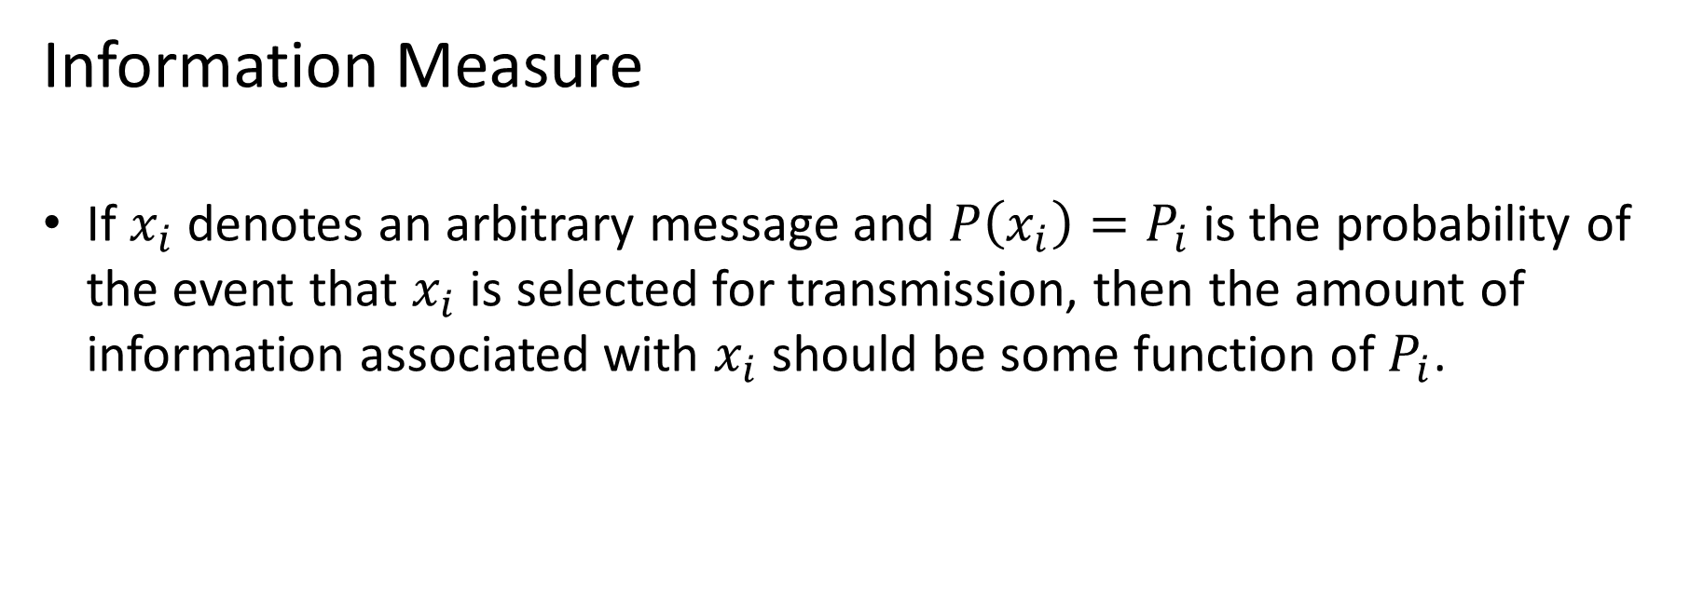
Information Measure
If $x_{i}$ denotes an arbitrary message and $P\left(x_{i}\right)=P_{i}$ is the probability of the event that $x_{i}$is selected for transmission, then the amount of information associated with $x_{i}$should be some function of $P_{i}$.

Slide 5
Information Measure
Shannon defined information measure by the logarithmic function
$I_{i}=−\log_{b}{P_{i}=}$ $\log_{b}\frac{1}{P_{i}}$
where b is the logarithmic base.
The quantity $I_{i}$is called the self-information of message $x_{i}$.

Slide 6
Information Measure
The definition of $I_{i}$ has several important and meaningful consequences, including
$$I_{i}≥0 for 0≤P_{i}≤1$$
$$I_{i}→0 for P_{i}→1$$
$I_{i}>I_{j} for P_{i}<$ $P_{j}$

Slide 7
Information Measure
Suppose a source produces two successive and independent messages, $x_{i}$ and $x_{j}$ with joint probability $P(x_{i}$ $x_{j})=P_{i}$ $P_{j}$then
$I_{ij}=\log_{b}{\frac{1}{P_{i}P_{j}}}=$ $\log_{b}{\frac{1}{P_{i}}}+\log_{b}{\frac{1}{P_{j}}}=$ $I_{i}+I_{j}$
so the total information equals the sum of the individual message contributions.

Slide 8
Entropy and Information Rate
Now consider an information source that emits a sequence of symbols selected from an alphabet of M different symbols, i.e., an M-ary alphabet.
Let X denote the entire set of symbols $x_{1},x_{2},…,x_{M}$.
We can treat each symbol as a message that occurs with probability $P_{i}$ and conveys the self-information $I_{i}$

Slide 9
Entropy and Information Rate
The set of symbol probabilities, of course, must satisfy
$$\sum_{i=1}^{M}{P_{Q}=1}$$

Slide 10
Entropy and Information Rate
We’ll also assume that successive symbols are statistically independent and come from the source at an average rate of r symbols per second.
These properties define the model of a discrete memoryless source.

Slide 11
Entropy and Information Rate
The expected information per symbol is then given by the statistical average
$H\left(X\right)=\sum_{i=1}^{M}{P_{i}I_{i}}=\sum_{i=1}^{M}{P_{i}}$ $\log_{2}{\frac{1}{P_{i}}} bits/symbol$
which is called the source entropy.

Slide 12
Entropy and Information Rate
We define the source information rate
$$R=rH\left(X\right)bits/sec$$
a critical quantity relative to transmission.

Slide 13
Entropy and Information Rate
The source entropy always falls within the limits
$$0≤H(X)≤\log_{2}{M}$$
The lower bound here corresponds to no uncertainty or freedom of choice, which occurs when one symbol has probability $P_{j}=1$ while $P_{i}=0$ for i $≠$j.
The upper bound corresponds to maximum uncertainty or freedom of choice, which occurs when $P_{i}=\frac{1}{M}$ for all i.

Slide 14
References
Communication Systems, An Introduction to Signal and Noise in Electrical Communication, 5th edition, A.B. Carlson, P.B. Crilly, J.C. Rutledge, Mc Graw Hill.
An Introduction to Analog and Digital Communications, 2nd edition, S. Haykin, M. Moher, Wiley.

