Slide 2
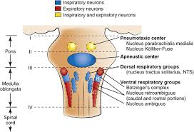
Control of Respiration
The rhythmic pattern of breathing and the adjustments are integrated within portions of the brainstem known as the respiratory center.
Four specific regions have been identified: (i) the dorsal respiratory group (DRG) in the dorsal medulla, (ii) the ventral respiratory group (VRG) in the ventral medulla, (iii) the pneumotaxic center (PC) in the rostral portion of the pons, and (iv) the apneustic center in the caudal pons.

Slide 3
Control of Respiration
Neurons of the DRG are associated with inspiratory activity and generate the basic rhythm of breathing.
Operates on «ramp signal». Begins weakly, increases steadily for about 2 sec,ceases abruptly for next 3 seconds –Pacemaker activity
Inspiration is initiated by a burst of action potentials in the nerves to the inspiratory muscles.
Then the action potentials cease, the inspiratory muscles relax, and expiration occurs as the elastic lungs recoil.
Output from the DRG is relayed via the phrenic nerve to the diaphragm to provide for its contraction
Input to the DRG is relayed via the vagal and glossopharyngeal nerves.
The vagal and glossopharyngeal nerves also relay information to the DRG from peripheral chemoreceptors (e.g., skin, muscle, joints).

Slide 4
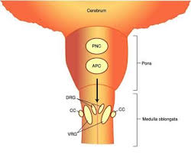
Control of Respiration
The VRG has neurons that are associated with both inspiratory and expiratory activity but it is primarily responsible for expiration.
If expiration is considered to be passive during normal quiet breathing, the expiratory neurons are not active; however, during exercise, when expiration becomes an active process, the expiratory neurons are active.
It is likely that the inspiratory neurons of the VRG are also more active during exercise.

Slide 5
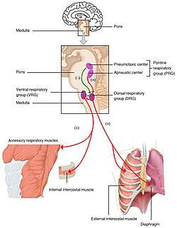
Control of Respiration
The PC inhibits inspiration and therefore regulates inspiratory volume and respiratory rate.
The primary function of the PC is to limit inspiration, thereby controlling the duration of the filling phase of the respiratory cycle.
The pneumotaxic signal that controls the filling phase may be strong or weak.
*The effect of a strong signal is to increase the respiratory rate whereby both inspiration and expiration are shortened and which are coupled with a lesser tidal volume. The converse is true for a weak PC signal.
The apneustic center is the least understood of all the regions of the respiratory center; consequently, there is no consensus as to its role. Whereas the PC is concerned with the termination of inspiration, the apneustic center is believed to be associated with deep inspirations (apneusis).
Perhaps complementary breaths (sighs) are manifestations of apneustic center activity

Slide 6
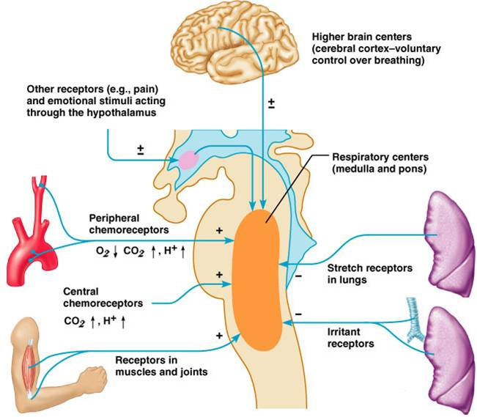
Neural control of ventilation
Hering–Breuer reflexes
The basic rhythm of respiration may be modified so that the breathing rate, depth, or both are changed.
The reason for the modification is to change the rate of ventilation in response to body needs.
Afferent impulses to the respiratory center from several receptor sources have been identified.
The most noteworthy of these among many of the animals are the Hering–Breuer reflexes.
The receptors for these reflexes are located in the lung and particularly in the bronchi and bronchioles.

Slide 7
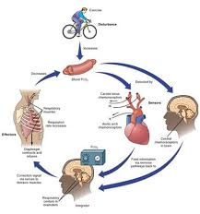
Neural control of ventilation
There are two components to the Hering–Breuer reflexes:
(i) the inspiratory‐inhibitory or inflation reflex and
(ii) the inspiratory or deflation reflex.
The nerve impulses generated by the receptors of the Hering–Breuer reflexes are transmitted by fibers in the vagus nerves to the respiratory center.
The effect of inflation‐receptor stimulation is to inhibit further inspiration (stimulation of neurons in the DRG) and to stimulate expiratory nerves in the VRG. The inspiratory or deflation reflex component is activated at some particular point of deflation.
Deflation reflex receptor stimulation can be elicited in anesthetized dogs by manual compression of the thorax, which is followed immediately by inspiration.
Practical use of this reflex is appropriate for respiratory depressed or unresponsive animals to promote more adequate ventilation in the former or to initiate ventilation in the latter.
During exercise when tidal volume and frequency are increased, it would appear that the deflation reflex is more active in order to hasten the beginning of the next inspiration.

Slide 8
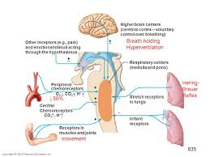
Neural control of ventilation
There are other peripherally located receptors that assist in modifying the basic rhythm.
Stimulation of receptors in the skin is excitatory to the respiratory center.
Advantage is taken of these receptors when stimulation of breathing is desired in newborn animals. Rubbing the skin with a rough cloth often starts the breathing cycles.
An assist to ventilation needed during muscle activity is obtained from receptors located in tendons and joints.
They will be stimulated when muscle contraction causes movement.
It is also believed that when impulses are directed to skeletal muscles from the cerebral cortex, collateral impulses go to the brainstem and stimulate the respiratory center to increase alveolar ventilation.
This mechanism might account for increases in ventilation that are not explainable by mere observation of changes in carbon dioxide, oxygen, and hydrogen ion concentration in the blood.

Slide 9
Upper air passage reflexes
Stimulation of the mucous membrane in these regions causes reflex inhibition of respiration.
A striking example of this reflex is the inhibition of respiration that occurs during swallowing.
Stimulation of the mucous membrane of the larynx in the unanesthetized animal causes not only inhibition of respiration but, usually, also powerful expiratory efforts (coughing).
Similarly, stimulation of the nasal mucous membrane frequently leads to sneezing. Obviously the function of all these reflexes is to protect the delicate respiratory passages and the depths of the lungs from harmful substances (irritating gases, dust, food particles) that otherwise might be inspired.

Slide 10
Baroreceptor modification of respiration
The principal function of afferent impulses from baroreceptors in the carotid and aortic sinuses is to regulate the circulation.
However, the same receptors are also able to modify respiration.
The receptors are constantly generating impulses that increase in frequency when blood pressure increases and which decrease in frequency when blood pressure decreases.
These impulses to the respiratory center are inhibitory in nature, and respiratory frequency decreases when impulse frequency increases.
It is believed that the function of this response is to modify the return of blood to the heart.
For example, when blood pressure is reduced, respiration increases and flow of blood to the heart is facilitated.

Slide 11
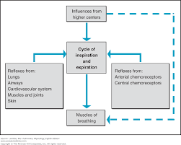
Voluntary control of respiration
Ordinary respirations proceed quite involuntarily.
However, it is a matter of everyday experience that they may be altered voluntarily within wide limits; they may be hastened, slowed, or stopped altogether for a while.
If respirations are entirely inhibited voluntarily, there soon comes a time when one must breathe again; the cells of the respiratory center escape from the inhibition.

Slide 12
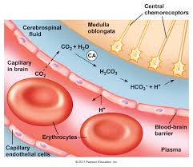
Central chemoreception
Chemosensitive areas near the ventral surface of the medulla are highly sensitive to changes in hydrogen ion concentration of the interstitial fluid of the brain. T
he chemoreceptors in these areas are excitatory to the respiratory center, causing increases in tidal volume and in frequency.
Whereas hydrogen ions diffuse poorly through the blood–cerebrospinal fluid barrier and the blood–brain barrier, carbon dioxide is freely diffusible and indirectly exerts its influence on ventilation through the intermediary of hydrogen ions after hydration.
Therefore, whenever the PaCO2 increases, the PCO2 of both the interstitial fluid of the medulla and the cerebrospinal fluid increases, forming hydrogen ions through hydration.
Because of the barriers to hydrogen ion diffusion, the respiratory center response to respiratory acidosis (increased Paco2) is greater than the response to metabolic acidosis (increased hydrogen ion concentration).

Slide 13
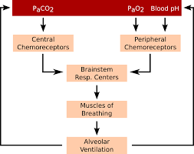
Peripheral chemoreception
The anatomical entities known as the carotid and aortic bodies, found in the region of the bifurcation of the carotid arteries and the arch of the aorta, respectively, are chemoreceptors.
They detect changes in the partial pressures of carbon dioxide and oxygen and hydrogen ion concentration and affect the respiratory center by transmission of impulses in afferent nerve fibers of the glossopharyngeal nerves (from the carotid bodies) and vagus nerves (from the aortic arch).
Although the medulla is the principal location for detection of changes in carbon dioxide and hydrogen ion concentrations, it has been shown that the carotid and aortic body chemoreceptors supply about 50% of the ventilator drive in response to changes in PaCO2.
Carotid and aortic body chemoreceptors, however, are the only places where the partial pressure of oxygen is detected.
These small organs are highly perfused with blood, and the oxygen needed for baseline activity is obtained from the oxygen in solution.

Slide 14
Peripheral chemoreception
Nerve impulse transmission by the carotid and aortic bodies to the respiratory center varies with the Po2 perfusing them, as mentioned above.
The impulse discharge rate is increased most significantly in the Po2 range 20–60 mmHg and declines rapidly after 60 mmHg.
The oxygen–hemoglobin dissociation curve shows that hemoglobin is still about 90% saturated with oxygen at a partial pressure of 60 mmHg.
Therefore, no serious oxygen lack is present and little change in ventilation occurs.

