Slide 1
Phase Diagrams

Slide 2
Interpretation of Phase Diagram
Nomenclature
For metallic alloys, Greek letters ($α,β, γ$) are used for solid solutions
Liquidus line; line between L and $α$+L
Solidus line; line between $α$ and $α$+L (below which only $α$ exists)
Phases Present
Determination of Phase Compositions
Tie Line connects the phases in equilibrium with each other and is drawn across the two-phase region at specified T
The intersections of the tie line and the phase boundaries are recorded for both sites
Composition of each phases from the horizontal composition axis can be read.

Slide 3
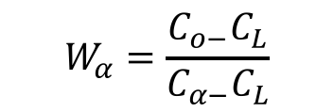
Interpretation of Phase Diagram
Determination of Phase Amounts
The lever rule
Tie line is drawn across the two-phase region at T
The overall composition is located on the tie line
Mass fraction of one phase is determined by taking the tie line from the overall composition to the phase boundary for the other phase and dividing the total tie line length
$$W_{L}=\frac{C_{α−}C_{o}}{C_{α−}C_{L}}$$
$$W_{α}=\frac{C_{o−}C_{L}}{C_{α−}C_{L}}$$
C_{o}; overall composition
W_{L}; mass fraction of liquid phase
$W_{α}$; mass fraction of ${}_{α}$ phase

Slide 4
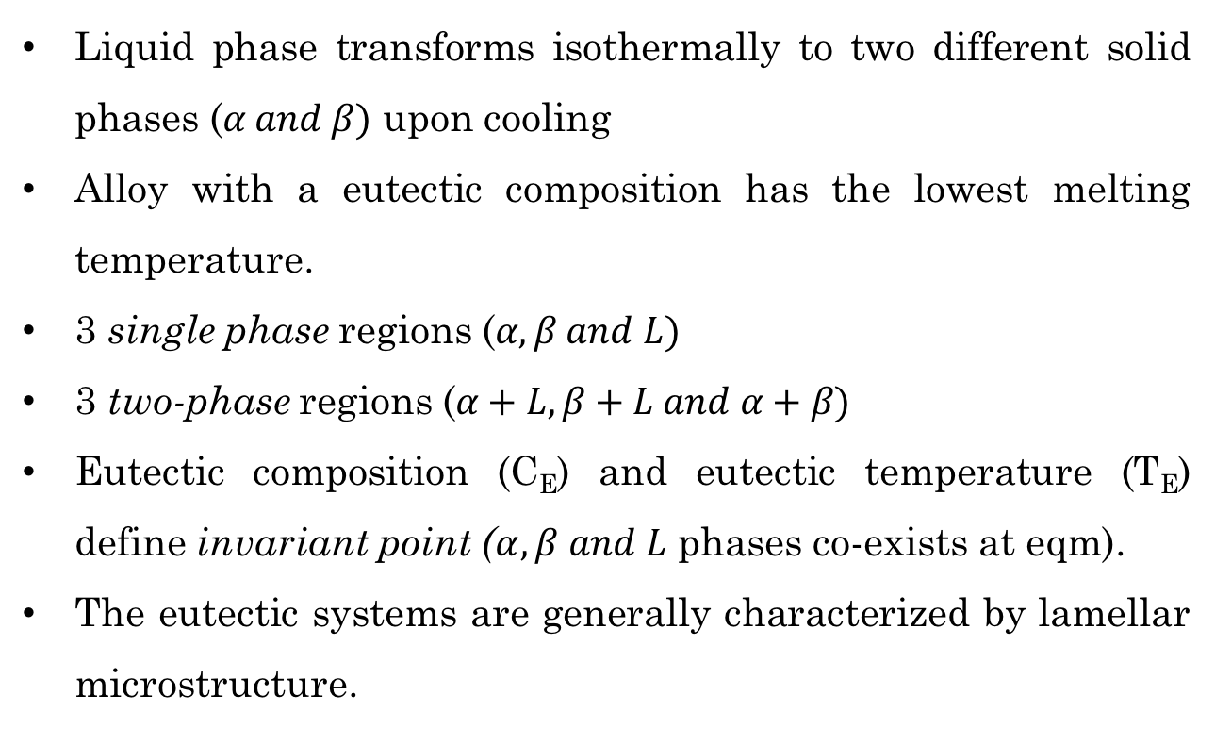
Binary-Eutectic Systems (Limited solid solubility)
• Eutectic reaction
L(C_{E}) $α$ (C$α$_{E}) + $β$ (C$β$_{E})
Easily melted
Example: Cu-Ag System
Pb-Sn System
Liquid phase transforms isothermally to two different solid phases ($α and β)$ upon cooling
Alloy with a eutectic composition has the lowest melting temperature.
3 single phase regions ($α,β and L)$
3 two-phase regions ($α+L, β+L and α+β)$
Eutectic composition (C_{E}) and eutectic temperature (T_{E}) define invariant point ($α,β and L$ phases co-exists at eqm).
The eutectic systems are generally characterized by lamellar microstructure.

Slide 5
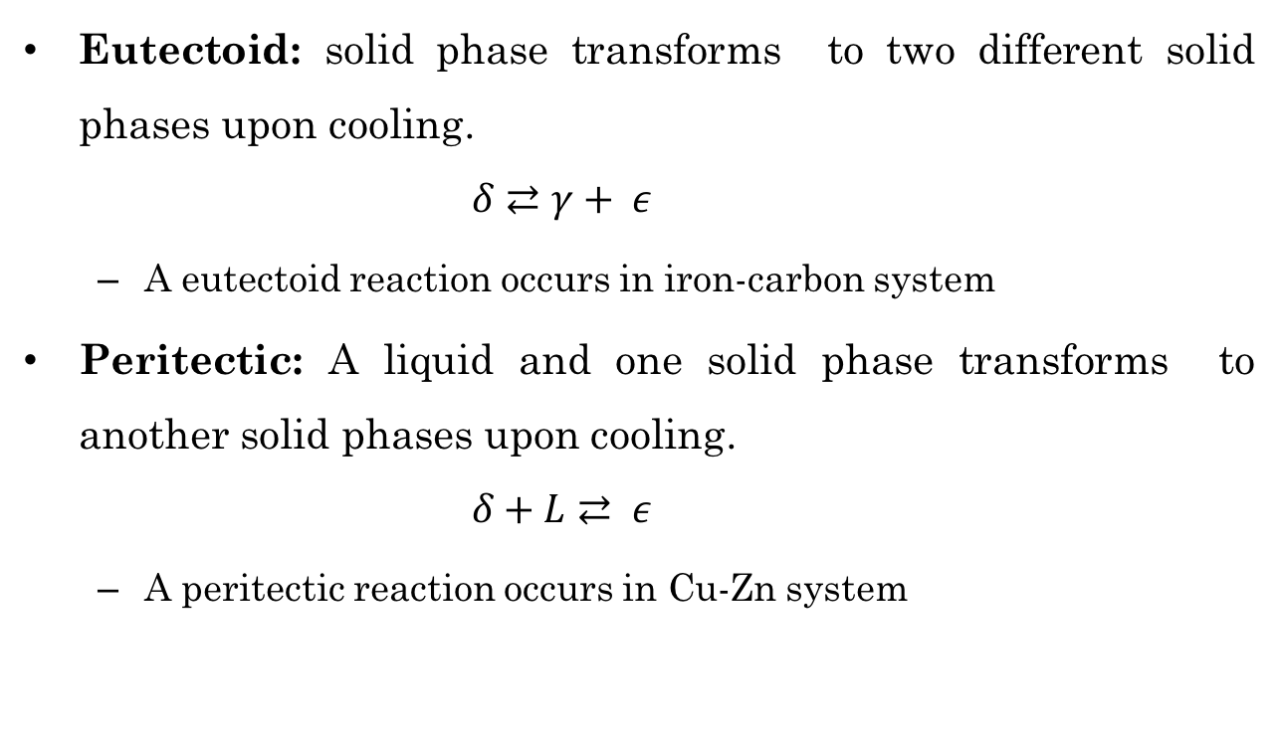
Eutectoid and Peritectic
Eutectoid: solid phase transforms to two different solid phases upon cooling.
$$δ⇄γ+ ε$$
A eutectoid reaction occurs in iron-carbon system
Peritectic: A liquid and one solid phase transforms to another solid phases upon cooling.
$$δ+L⇄ ε$$
A peritectic reaction occurs in Cu-Zn system

Slide 6
The Gibbs Phase Rule
Number of phases in a system at equilibrium relates with the number of degrees of freedom, the number of components and the number of noncompositional variables.
P + F = C+N
P: The number of phases
F: The number of degrees of freedom
# of externally controlled variables (T, P, composition)
C: The number of components
N: The number of noncompositional variables

Slide 7
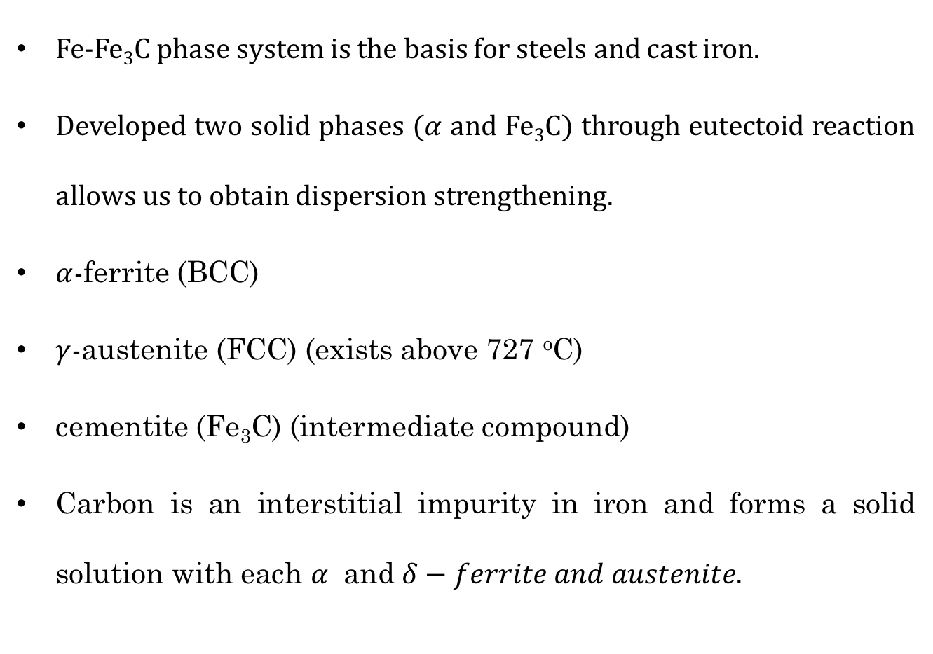
The Iron (Fe)-Iron Carbide (Fe₃C) Phase Diagram
Fe-Fe₃C phase system is the basis for steels and cast iron.
Developed two solid phases ($α$ and Fe₃C) through eutectoid reaction allows us to obtain dispersion strengthening.
$α$-ferrite (BCC)
$γ$-austenite (FCC) (exists above 727 ºC)
cementite (Fe₃C) (intermediate compound)
Carbon is an interstitial impurity in iron and forms a solid solution with each $α$ and $δ−ferrite and austenite.$

Slide 8
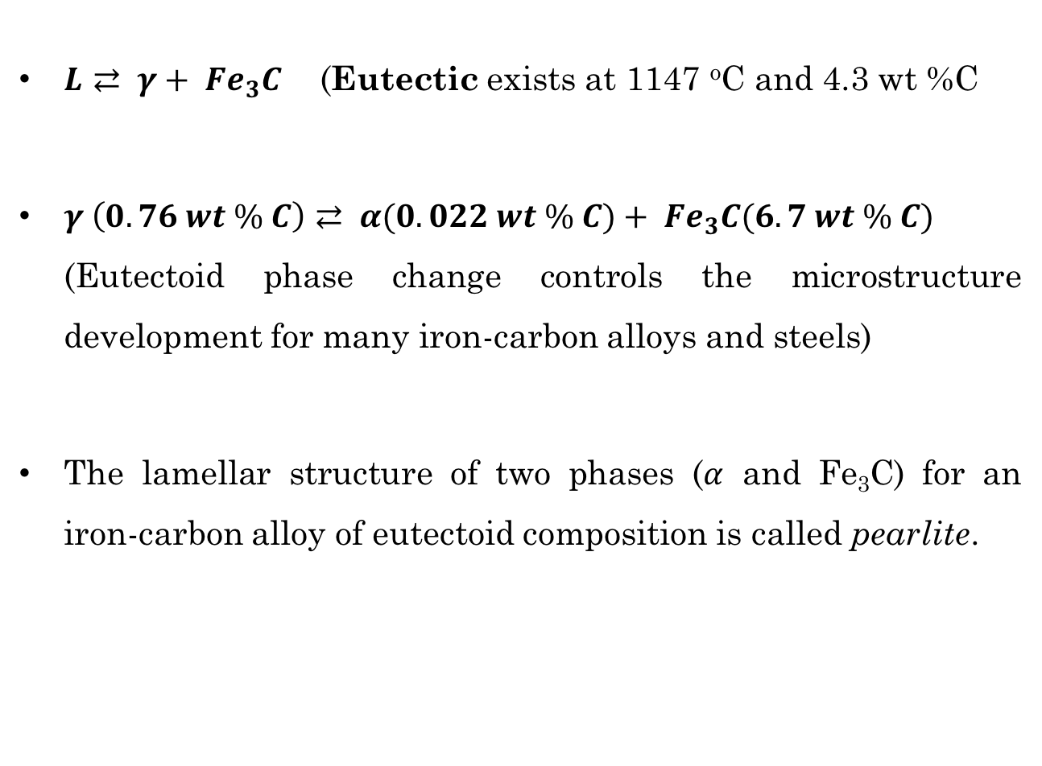
The Iron (Fe)-Iron Carbide (Fe₃C) Phase Diagram
$L⇄ γ+ {Fe}_{3}C$ (Eutectic exists at 1147 ºC and 4.3 wt %C
$γ \left(0.76 wt \% C\right)⇄ α(0.022 wt \% C)+ {Fe}_{3}C(6.7 wt \% C)$ (Eutectoid phase change controls the microstructure development for many iron-carbon alloys and steels)
The lamellar structure of two phases ($α$ and Fe₃C) for an iron-carbon alloy of eutectoid composition is called pearlite.

Slide 9
References
Donald R. Askeland, Pradeep P. Fulay, Wendelin J. Wright, The Science and Engineering of Materials, Sixth Edition
William D. Callister, David G. Rethwisch, Materials Science and Engineering, Eighth Edition, Wiley, 2011.

