Slide 1
ANKARA UNIVERSITY DEPARTMENT OF ENERGY ENGINEERING NUMERICAL METHODS
INSTRUCTOR
DR. ÖZGÜR SELİMOĞLU

Slide 2
CONTENTS
Finding roots of equations
a) Methods Based on Linear Interpolation
b) Newton-Raphson Method
Notes:
This week we will continue to cover the topic «Finding roots of equations». Finding the roots are equvilant to soliving the problem most of the cases. Therefore understanding the use of techniques to solve the equations by finding the roots of simulatenious equations are important.
Today we wil firstly discuss the Linear Interpolation method which can be used successfully for many applications. The second method is Newton Raphson Method. Which gives better estimates by also considering the curvatures of the functions.

Slide 3
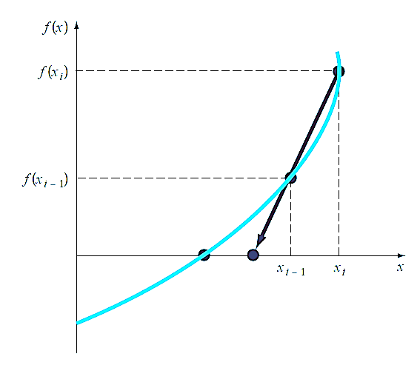
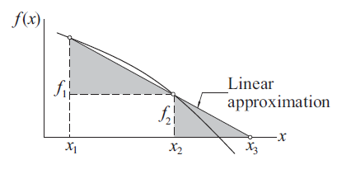
METHODS BASED ON LINEAR INTERPOLATION
Secant and False Position Methods
The secant and the false position methods are closely related. Both methods require two starting estimates of the root, say, x₁ and x₂. The function f (x) is assumed to be approximately linear near the root, so that the improved value x₃ of the root can be estimated by linear interpolation between x₁ and x₂.
There are certain functions whose derivatives may be extremely difficult or inconvenient to evaluate. For these cases, the derivative can be approximated by a backward finite divided difference, as in (Figure 2).Referring to Figure 1, the similar triangles (shaded in the figure) yield the relationship.
This approximation can be substituted to yield the following iterative equation:
Referring to Figure 1, the similar triangles (shaded in the figure) yield the relationship
where we used the notation f_{i} = f (x_{i}). Thus the improved estimate of the root is
Figure 2: Graphical depiction of the secant method. The secant method uses a difference rather than a derivative to estimate the slope.
Figure 1: Linear interpolation.

Slide 4
Example 1: Use the secant method to estimate the root of f(x) = e^{−x} − x . Start with initial estimates of x₋₁ = 0 and x₀ = 1.0.
Solution: Recall that the true root is 0.56714329. . . .
First iteration:
Second iteration:
(Note that both estimates are now on the same side of the root.)
Third iteration:

Slide 5
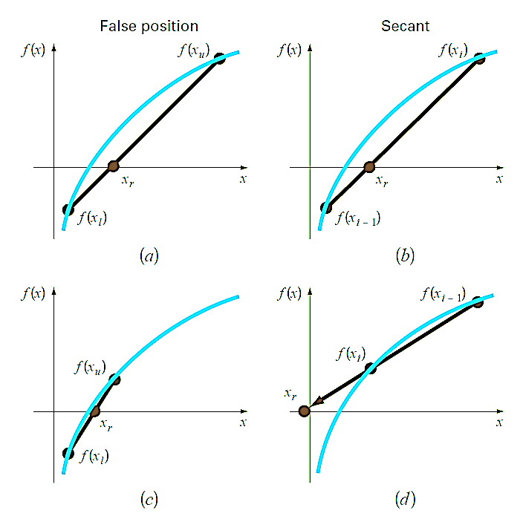
The Difference Between the Secant and False-Position Methods
Note the similarity between the secant method and the false-position method. Both use two initial estimates to compute an approximation of the slope of the function that is used to project to the x axis for a new estimate of the root. However, a critical difference between the methods is how one of the initial values is replaced by the new estimate. Recall that in the false-position method the latest estimate of the root replaces whichever of the original values yielded a function value with the same sign as f (x_{r}). Consequently, the two estimates always bracket the root. Therefore, for all practical purposes, the method always converges because the root is kept within the bracket. In contrast, the secant method replaces the values in strict sequence, with the new value x_{i+1} replacing x_{i} and x_{i} replacing x_{i−1}. As a result, the two values can sometimes lie on the same side of the root. For certain cases, this can lead to divergence.
Figure 3: Comparison of the false-position and the secant methods. The first iterations (a) and (b) for both techniques are identical. However, for the second iterations (c) and (d), the points used differ. As a consequence, the secant method can diverge, as indicated in (d ).

Slide 6
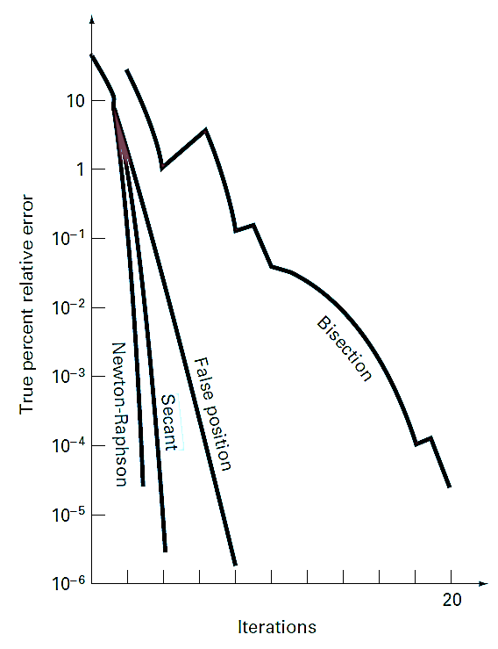
Example 2 : Use the false-position and secant methods to estimate the root of f (x) = ln x. Start the computation with values of
x_{l} = x_{i−1} = 0.5 and x_{u} = x_{i} = 5.0.
Solution: For the false-position method, the use of Eq. (a) and the bracketing criterion for replacing estimates results in the following iterations:
(a)
As can be seen (Fig. 3 a and c), the estimates are converging on the true root which is equal to 1.
For the secant method, using Eq. (b) and the sequential criterion for replacing estimates results in
(b)
As in Fig. 3 d, the approach is divergent.
Although the secant method may be divergent, when it converges it usually does so at a quicker rate than the false-position method. For instance, Fig. 4 demonstrates the superiority of the secant method in this regard. The inferiority of the false-position method is due to one end staying fixed to maintain the bracketing of the root. This property, which is an advantage in that it prevents divergence, is a shortcoming with regard to the rate of convergence; it makes the finite-difference estimate a less-accurate approximation of the derivative.
Figure 4: Comparison of the true percent relative errors ε_{t} for the methods to determine the roots of f (x) = e^{−x} − x.

Slide 7
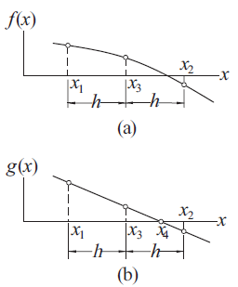
Ridder’s Method
Ridder’s method is a clever modification of the false position method. Assuming that the root is bracketed in (x₁, x₂), we first compute f₃ = f (x₃), where x₃ is the midpoint of the bracket, as indicated in Figure 5 (a). Next we the introduce the function
(1)
where the constant Q is determined by requiring the points (x₁, g₁), (x₂, g₂) and (x₃, g₃) to lie on a straight line, as shown in Figure 5 (b). As before, the notation we use is g _{i} = g(x_{i} ). The improved value of the root is then obtained by linear interpolation of g(x) rather than f (x).
Let us now look at the details. From Eq. (1) we obtain
(2)
where h = (x₂ − x₁)/2. The requirement that the three points in Figure 5 b lie on a straight line is
g₃ = (g₁ + g₂)/2, or
which is a quadratic equation in e^{hQ}. The solution is
(3)
Figure 5: Mapping used in Ridder’s method.
Notes:
The requirement here is after applying the transformation from f(x) to g(x), the three points should lay on the same straight line. This assumption will give us the solution of unknown Q and corresponding e(hQ)

Slide 8
Linear interpolation based on points (x₁, g₁) and (x₃, g₃) now yields for the improved root
where in the last step we used Eqs. (2). As the final step, we substitute for e ^{hQ} from Eq. (3), and obtain after some algebra
(4)
It can be shown that the correct result is obtained by choosing the plus sign if f₁ − f₂ > 0, and the minus sign if f₁ − f₂ < 0. After the computation of x₄, new brackets are determined for the root and Eq. (4) is applied again. The procedure is repeated until the difference between two successive values of x₄ becomes negligible.
Ridder’s iterative formula in Eq. (4) has a very useful property: If x₁ and x₂ braketing the root, then x₄ is always within the interval (x₁, x₂). In other words, once the root is bracketed, it stays bracketed, making the method very reliable. The downside is that each iteration requires two function evaluations.

Slide 9
Example 3: Determine the root of f (x) = x³ − 10x² + 5 = 0 that lies in (0.6, 0.8) with Ridder’s method.
Solution: The starting points are
First Iteration: Bisection yields the point
The improved estimate of the root can now be computed with Ridder’s formula:
Because f₁ > f₂ we must use the plus sign. Therefore,
As the root clearly lies in the interval (x₃, x₄), we let
which are the starting points for the next iteration.

Slide 10
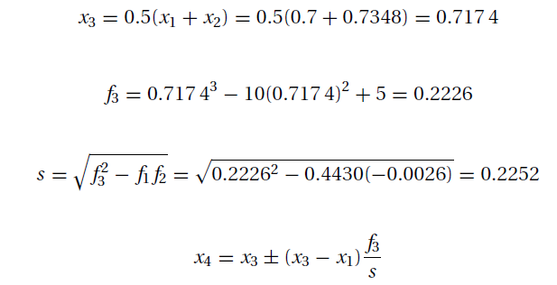
Second Iteration
Since f₁ > f₂, we again use the plus sign, so that
Thus the root is x = 0.7346, accurate to at least four decimal places.

Slide 11
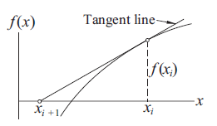
NEWTON-RAPHSON METHOD
The Newton-Raphson algorithm is the best known method of finding roots for a good reason: It is simple and fast. The only drawback of the method is that it uses the derivative f‘(x) of the function as well as the function f (x) itself. Therefore, the Newton-Raphson method is usable only in problems where f‘(x) can be readily computed.
The Newton-Raphson formula can be derived from the Taylor series expansion of f (x) about x:
(5)
If x_{i+1} is a root of f (x) = 0, Eq. (5) becomes
(6)
Assuming that x_{i} is a close to x_{i+1}, we can drop the last term in Eq. (6) and solve for x_{i+1}. The result is the Newton-Raphson formula:
(7)
The graphical description of the Newton-Raphson formula is shown in Figure 6. The formula approximates f(x) by the straight line that is tangent to the curve at x_{i} . Thus x_{i+1} is at the intersection of the x-axis and the tangent line.
Figure 6: Graphical interpretation of the Newton-Raphsonformula.

Slide 12
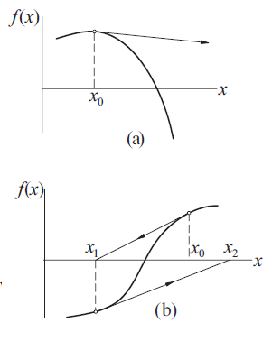
The algorithm for the Newton-Raphson method is simple: It repeatedly applies Eq. (7), starting with an initial value x₀, until the convergence criterion
is reached, ε being the error tolerance. Only the latest value of x has to be stored. Here is the algorithm:
The truncation error E in the Newton-Raphson formula can be shown to behave as
where x is the root. This indicates that the method converges quadratically (the error is the square of the error in the previous step). Consequently, the number of significant figures is roughly doubled in every iteration.
Although the Newton-Raphson method converges fast near the root, its global convergence characteristics are poor. The reason is that the tangent line is not always an acceptable approximation of the function, as illustrated in the two examples in Figure 7. However, the method can be made nearly fail-safe by combining it with bisection.
Figure 7: Examples where the Newton-Raphson method diverges.

Slide 13
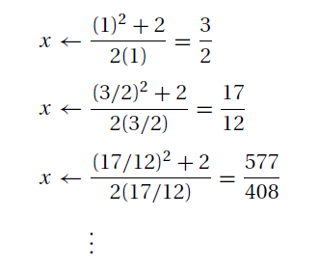
Example 4: Use the Newton-Raphson method to obtain successive approximations of $\sqrt{2}$ as the ratio of two integers.
Solution: The problem is equivalent to finding the root of f (x) = x² − 2 = 0. Here the Newton-Raphson formula is
Starting with x = 1, successive iterations yield
Note that x = 577/408 = 1.1414216 is already very close to $\sqrt{2 }$= 1.1414214.
The results are dependent on the starting value of x. For example, x = 2 would produce a different sequence of ratios.

Slide 14
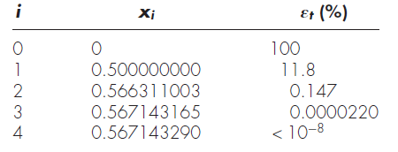
Example 5: Use the Newton-Raphson method to estimate the root of « f (x) = e^{−x} − x », employing an initial guess of x₀ = 0.
Solution: The first derivative of the function can be evaluated as
which can be substituted along with the original function into Eq. (7) to give
Starting with an initial guess of x₀ = 0, this iterative equation can be applied to compute
Thus, the approach rapidly converges on the true root. Notice that the true percent relative error at each iteration decreases much faster than it does in simple fixed-point iteration.

Slide 15
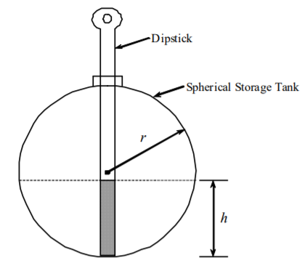
Example 7: You have a spherical storage tank containing oil. The tank has a diameter of 6ft. You are asked to calculate the height h to which a dipstick 8 ft long would be wet with oil when immersed in the tank when it contains 6ft³ of oil.
The equation that gives the height h of the liquid in the spherical tank for the given volume and radius is given by
Use the Newton-Raphson method of finding roots of equations to find the height h to which the dipstick is wet with oil. Conduct three iterations to estimate the root of the above equation. Find the absolute relative approximate error at the end of each iteration and the number of significant digits at least correct at the end of each iteration.
Solution:
Let us take the initial guess of the root of f(h)=0 as h₀=1

Slide 16
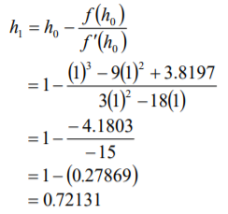
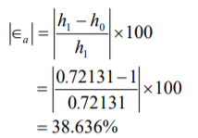
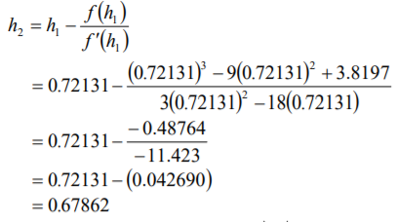
Iteration 1: The estimate of the root is
The absolute relative approximate error $\left|∈a\right|$at the end of Iteration 1 is
The number of significant digits at least correct is 0, as you need an absolute relative approximate error of %5 or less for one significant digit to be correct in your result.
Iteration 2: The estimate of the root is

Slide 17
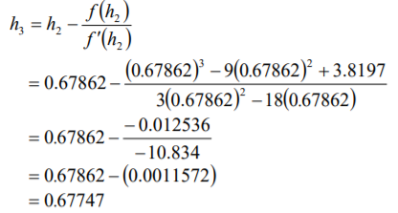
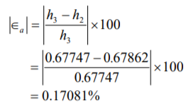
The absolute relative approximate error $\left|∈a\right|$at the end of Iteration 2 is
The number of significant digits at least correct is 0.
Iteration 3: The estimate of the root is
The absolute relative approximate error $\left|∈a\right|$at the end of Iteration 3 is

Slide 18
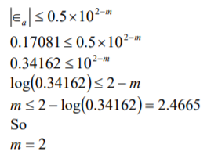
Hence the number of significant digits at least correct is given by the largest value of m for which
The number of significant digits at least correct in the estimated root 0.67747 is 2.

Slide 19
REFERENCES
Jaan Kiusalaas, “Numerical Methods in Engineering with Python 3”,3rd Edition, Cambridge, NY, 2013
S.C. Chapra and R.P. Canale, “Numerical Methods for Engineers”, 6th ed., McGraw-Hill,, NY, 2010

