Slide 1
Introduction of the Course
Meltem Kurt Yüksel MD Prof
Division of Internal Medicine
Adult Hematology Department and Stem Cell Transplantation Unit
AUMF
20 Dec 2021
In person& Virtual Education 2021-2022

Slide 4
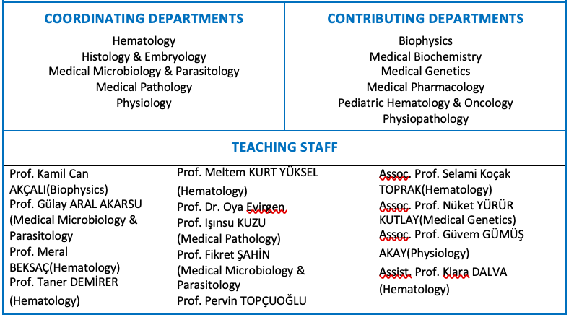
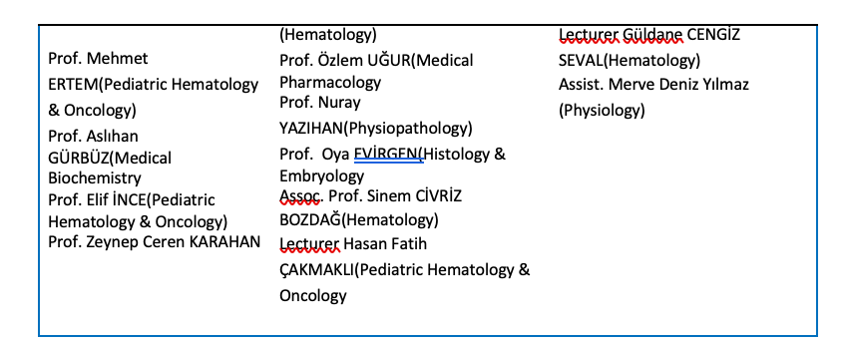

Slide 6
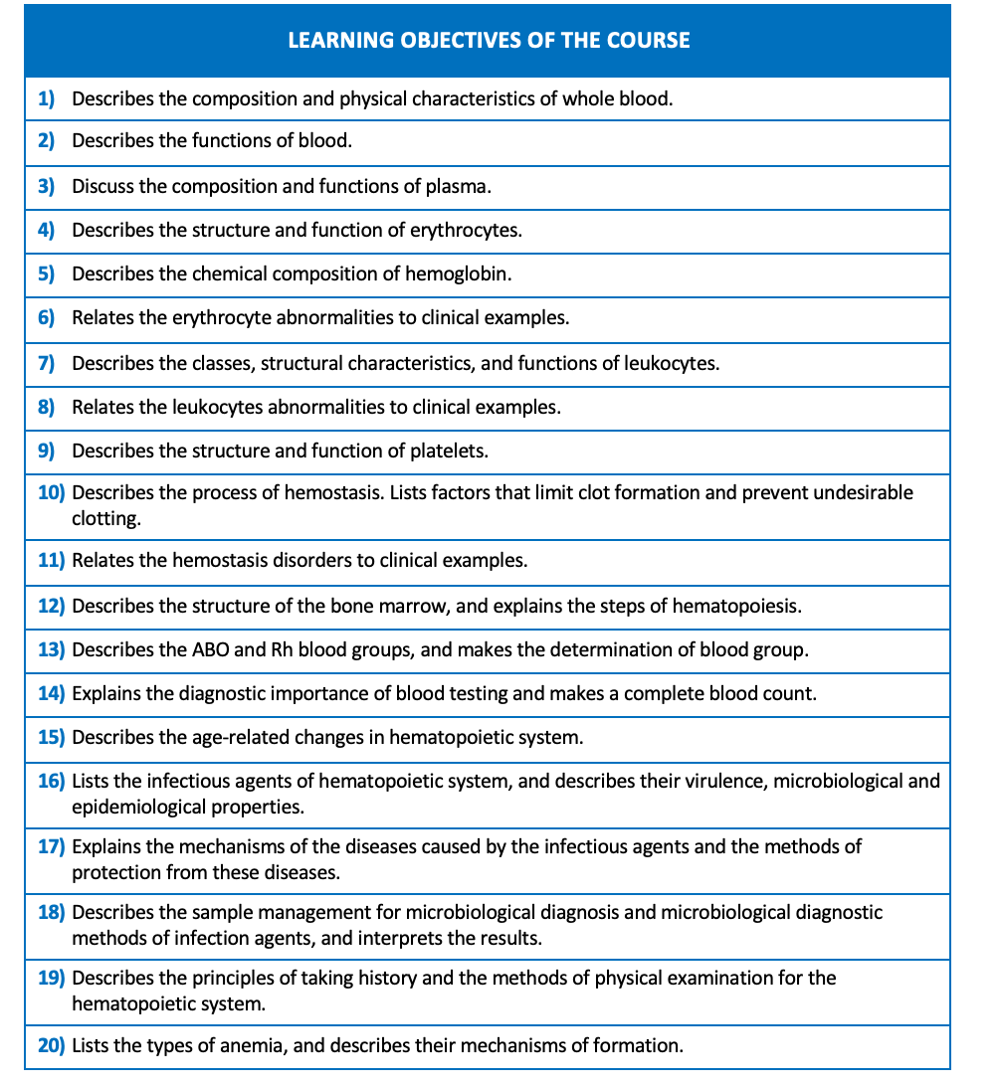

Slide 7
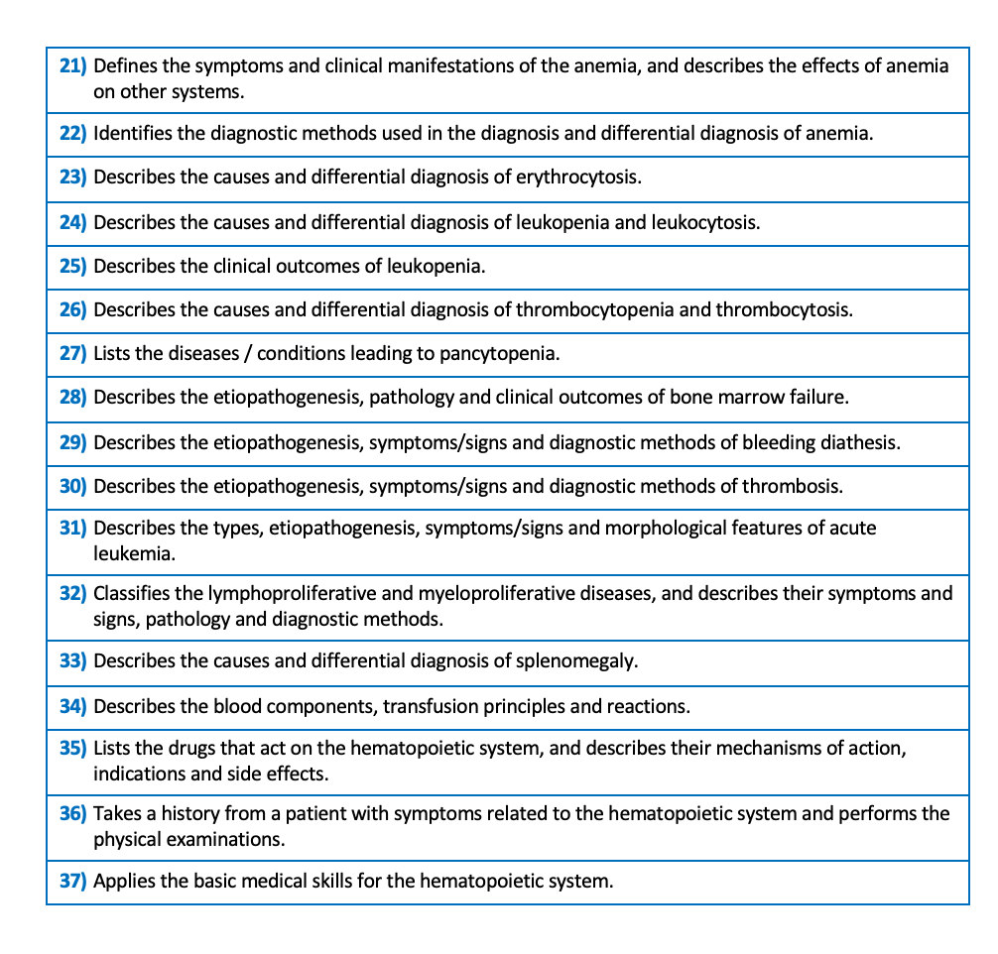

Slide 9
Thank you very much…

