Slide 1
1st GROUP OF CATIONS (Ag⁺,${Hg}_{2}^{2+}$ ve Pb²⁺)
This group contains Ag⁺,${Hg}_{2}^{2+}$ ve Pb²⁺ ions, and the main prominent feature of this group is that they precipitate as insoluble chloride salts in water in the presence of diluted HCl solution.
However, when the solubility products of this group are taken into consideration as presented in Table 1, the lead ion will not be able to precipitate in this group because the solubility of PbCl₂ in water (more soluble in hot water) is high. Pb²⁺ ions are still analyzed in the first group.
Table 1. Solubility products of 1st group of cations
Subtances | Solubility products (K_{sp})
AgCl | 1 x 10⁻¹⁰
PbCl₂ | 1.56 x 10⁻¹⁰
Hg₂Cl₂ | 2.0 x 10⁻¹⁸
The cations in this group can be easily analyzed as their chloride precipitations with 0.3 M HCl. When the acid concentration is increased, the precipitated salts in the medium re-soluble again. At this point, the concentration of the acid is highly important parameter.

Slide 2
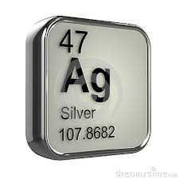
Ag⁺ ions assay
Amonnia solution (NH₃):
Ag⁺ ions (20 drop) precipitates as a white-coloured chloride forms when the 1 M HCl (4 drop) solution is added to the medium.
Ag⁺ + HCl AgCl_{(k)} + H⁺
(White)
The resulting white-coloured solution is centrifuged, and the precipitate is taken up from the media. The ammonia (6 M) solution is added to medium until the AgCl is dissolved. The AgCl precipitate is dissolved as the diammine complexed form wiht ammonia solution, indicating the presence of Ag⁺ ions in the sample.
AgCI + 2NH₃ Ag(NH₃)₂⁺ + Cl⁻

Slide 3
Potassium Iodide (KI):
Ag⁺ ions (20 drop) precipitate as a yellow creamy AgI when 1 M KI (4 drop) is added to solution.
Ag⁺ + KI AgI_{(k)} + K⁺
(Yellow)
Separate the filtrate from the resulting solution by centrifugation, and add the 1 M KCN solution to dissolve the remaining precipitate. These processes indicate the presence of Ag⁺ ions in the medium.
Potassium chromate (K₂CrO₄):
Ag⁺ ions (20 drop) precipitate as a brick-red coloured Ag₂CrO₄ when K₂CrO₄ (4 drop) is added to solution.
2Ag⁺ + CrO₄²⁻ Ag₂CrO_{4 (k)}
(Brick-red)
Sodium hydroxide (NaOH):
Ag⁺ ions (20 drop) precipitate as a darkish-brown coloured AgOH when 1M NaOH (4-5 drop) is added to solution. However, the compound immediately decomposes into silver oxide due to it’s unstable.
Ag⁺ + OH⁻ AgOH
(Darkish-brown)
2AgOH Ag₂O + H₂O
(Black)

Slide 4
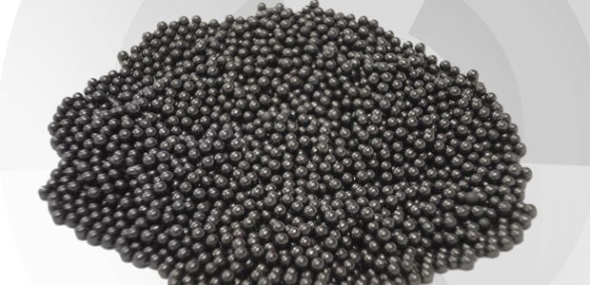
Pb²⁺ ions assay
Amonyak çözeltisi (NH₃):
Pb²⁺ ions (20 drop) precipitates as a white-coloured chloride forms when the 1 M HCl (4 drop) solution is added to the medium.
Pb²⁺ + 2HCl PbCl₂ + 2H⁺
(White)
The resulting white precipitate is separated from the solution by centrifugation, 2 mL of pure water is added, and the mixture is heated in the water bath for 5 minutes. If the precipitate dissolves, there are Pb²⁺ ions in the media.
Potasyum iyodür çözeltisi (KI):
The purified water (20 drop) is added to the Pb²⁺sample solution (20 drop), and then 1 M KI (3-4 drops) is added to resulting mixture. The yellow coloured PbI₂ precipitate is obtained after the experimental process.
Pb²⁺ + KI PbI₂ + K⁺
(Yellow)

Slide 5
Thioacetamide solution:
The purified water (20 drop) is added to the Pb²⁺ sample solution (20 drop), and thioacetamide solution (3-4 drops) is added to the mixture. Then, the solution is heated in the water bath for 5 minutes.
Pb²⁺ + H₂S PbS _{(k)}
(Black)
The resulting precipitate should dissolve in the 3M HNO₃ solution.
Potassium chromate (K₂CrO₄):
Pb²⁺ ions (20 drop) precipitate as a yellow coloured PbCrO₄ when K₂CrO₄ (3-4 drop) is added to solution.
Pb²⁺ + CrO₄²⁻ PbCrO_{4(k)}
(Sarı)

Slide 6
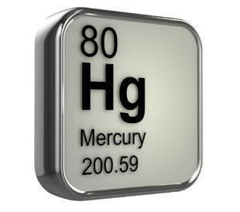
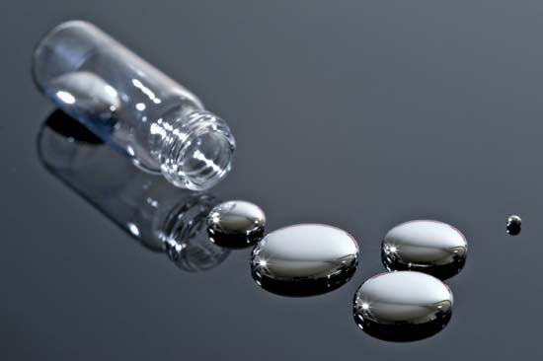
Hg₂²⁺ ions assay
Hg₂²⁺ ions (20 drop) precipitate as their white chloride salts when 3M HCl (3-4 drop) is added to solution. The resulting precipitate is insoluble in cold and hot water or diluted HNO₃ solution, however, is soluble in ammonia, concentrated HNO₃ or aqua regia solutions.
Potassium chromate (K₂CrO₄):
Hg₂²⁺ ions (20 drop) precipitate as a reddish-brown Hg₂CrO₄ salt when K₂CrO₄(3-4 drop) is added to solution.
Hg₂²⁺ + CrO₄²⁻ Hg₂CrO_{4 (k)}
(Reddish-brown)

Slide 7
Potassium iodide (KI):
The purified water (20 drop) is added to the Hg₂²⁺ sample solution (20 drop), and 1 M KI solution (4-5 drops) is added to the mixture. The yellow-green coloured Hg₂I₂ precipitate is obtained after this process. This precipitate is soluble when the excessive KI is added to the precipitate, however, insoluble in dilute acids.
Hg₂²⁺ + 2KI Hg₂I₂ + 2K⁺
Copper strip (Amalgam):
Firstly, the copper wire (strip) piece is cleaned with 8-10 drops of concentrated HNO₃ solution in the watch-glass. The copper strip is dried by filter paper and Hg₂²⁺ sample solution is added to the copper strip. The coating of Hg on the copper strip (bright gray colored) shows the presence of Hg₂²⁺ ions in the sample solution.

