Slide 1
RESTING MEMBRANE POTENTIAL ACTION POTENTIAL WEEK 4
Assoc. Prof. Dr. Yasemin SALGIRLI DEMİRBAŞ
Resident ECAWBM

Slide 2
SIdedness
The electrical charges on one side of the membrane (positive or negative) are different than on the other side.
Why does sidedness exist?
Different permeability
Pumps
Protein channels
How does a membrane become sided?
Primary and secondary active transport, or pores that allow only one particular solute to move.
These things make a higher concentration on one side.
Sidedness is caused by proteins.

Slide 3
The restıng membrane potentıal
Take two electrodes and place one on the outside and the other on the inside of the plasma membrane of a living cell.
You would measure an electrical potential difference, or voltage, between the electrodes.
This electrical potential difference is called the membrane potential.
For a cell’s membrane potential, the reference point is the outside of the cell.
The resting membrane potential is determined by the uneven distribution of ions (charged particles) between the inside and the outside the cell,
And by the different permeability of the membrane to different types of ions.
Notes:
Like distance, potential difference is measured relative to a reference point. In the case of distance, the reference point might be a city.

Slide 4
The restıng membrane potentıal
In neurons and their surrounding fluid, the most abundant ions are:
Positively charged (cations): Sodium and potassium
Negatively charged (anions): Chloride and organic anions
In most neurons, organic anions (such as those found in proteins and amino acids) are present at higher concentrations inside the cell than outside. In contrast, Na​+​​ and Cl​−​​ are usually present at higher concentrations outside the cell.
This means there are stable concentration gradients across the membrane for all of the most abundant ion types.

Slide 5
how IS the Membrane potentıal establıshed?
The membrane potential of a resting neuron is primarily determined by the movement of K​+​​ ions across the membrane
K+ at a higher concentration inside the cell just as for a regular neuron. (Other ions are also present, including anions that counterbalance the positive charge K​+​​but they will not be able to cross the membrane)
In a resting neuron, both Na​+ and K​+​​are able to cross the membrane.

Slide 6
how IS the Membrane potentıal establıshed?
Na​+ will try to drag the membrane potential toward its (positive) equilibrium potential.
K​+​​ will try to drag the membrane potential toward its (negative) equilibrium potential.
You can think of this as being like a tug-of-war. The real membrane potential will be in between the Na​+​​equilibrium potential and the K​+​​ equilibrium potential.
However, it will be closer to the equilibrium potential of the ion type with higher permeability (the one that can more readily cross the membrane).

Slide 7
how IS the Membrane potentıal establıshed?
In a neuron, the resting membrane potential is closer to the potassium equilibrium potential than it is to the sodium equilibrium potential.
That's because the resting membrane is much more permeable to K​+​​than to Na​+​​.
The electrical potential that counters net diffusion of K⁺ is called the K⁺ equilibrium potential (E_{K}).
So, if the membrane were permeable only to K+, Vm would be -94 mV
The electrical potential that counters net diffusion of Na+ is called the Na+ equilibrium potential (ENa).
So, if the membrane were permeable only to Na+, Vm would be +61 mV

Slide 8
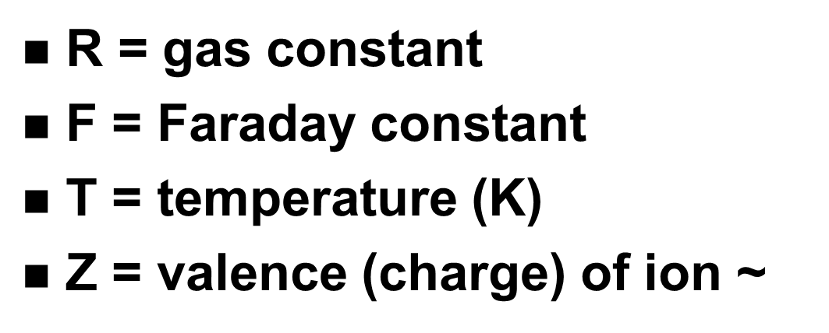
Nernst equılıbrıum
The Nernst potential (equilibrium potential) is the theoretical intracellular electrical potential that would be equal in magnitude but opposite in direction to the concentration force.
No net gain or loss. Cells with resting membrane potential are at minus 70mV.

Slide 9
Membrane PotentIal
Net bioelectric potential
for all ions
units = millivolts (mV)
Balance of both gradients
concentration & electrostatic
V_{m} = -70 mV
given by Goldman equation ~

Slide 10
Membrane restIng potentIal
Inside of the cell is negative due to :
Abundance of negatively charged proteins
Na+/K+ ATPase (net loss of positive charges~ 4mV)
Membrane is 100x more permeable (“leaky”) to K+

Slide 11
ACTION POTENTIAL
The inside of the cell is negative because there are K leak channels, that means there is greater permeability for K, so it will diffuse out of the cell down its concentration gradient.
The membrane potential (how negative or positive is) is a number that is a reflection of the ion with the greatest permeability.
If our cells are minus 70 mV, it’s because they are most permeable to K.
Therefore, K will diffuse out its concentration gradient, taking its positive charges with it, leaving the inside of the cell more negative.
What if the cell was more permeable to Na? Sodium would diffuse down its concentration gradient to the inside of the cell, taking its positive charges with it, making the inside of the cell more positive.

Slide 12
ACTION POTENTIAL
Are rapid, large alterations in the membrane potential during which time the membrane potential may change 100 mV, from -70 to +30 mV, and then repolarize to its resting membrane potential.
Nerve and muscle cells as well as some endocrine, immune, and reproductive cells have plasma membranes capable of producing action potentials.
These membranes are called excitable membranes, and their ability to generate action potentials is known as excitability

Slide 13
ACTION POTENTIAL
Are rapid, large alterations in the membrane potential during which time the membrane potential may change 100 mV, from -70 to +30 mV, and then repolarize to its resting membrane potential.
Nerve and muscle cells as well as some endocrine, immune, and reproductive cells have plasma membranes capable of producing action potentials.
These membranes are called excitable membranes, and their ability to generate action potentials is known as excitability

Slide 14
ACTION POTENTIAL
The action potential results from a transient change in membrane ion permeability, which allows selected ions to move down their concentration gradients.
In the resting state, the open channels in the plasma membrane are predominantly those that are permeable to potassium ions.
Very few sodium-ion channels are open,
the resting potential is close to the potassium equilibrium potential.

Slide 15
ACTION POTENTIAL
During an action potential, the membrane permeabilities to sodium and potassium ions are markedly altered.
The depolarizing phase of the action potential is due to the opening of voltage-gated sodium channels, which increases the membrane permeability to sodium ions several hundredfold.
This allows more sodium ions to move into the cell.
During this period more positive charge enters the cell in the form of sodium ions than leaves in the form of potassium ions, and the membrane depolarizes.
It may even overshoot, becoming positive on the inside and negative on the outside of the membrane.
In this phase, the membrane potential approaches but does not quite reach the sodium equilibrium potential (60 mV).

Slide 16
ACTION POTENTIAL
Action potentials in nerve cells last only about 1 ms and typically show an overshoot.
They may last much longer in certain types of muscle cells
The membrane potential returns so rapidly to its resting level because:
(1) the sodium channels that opened during the depolarization phase undergo inactivation near the peak of the action potential, which causes them to close; and
(2) voltage-gated potassium channels,which open more slowly than sodium channels, open in response to the depolarization.
Closure of the sodium channels alone would restore the membrane potential to its resting level since potassium flux out would then exceed sodium flux in.

Slide 17
ACTION POTENTIAL
the process is speeded up by the simultaneous increase in potassium permeability.
Potassium diffusion out of the cell is then much greater than the sodium diffusion in, rapidly returning the membrane potential to its resting level.
In fact, after the sodium channels have closed, some of the voltage-gated potassium channels are still open
in nerve cells there is generally a small hyperpolarization of the membrane potential beyond the resting level
cellular accumulation of sodium and loss of potassium are prevented by the continuous action of the membrane Na,K-ATPase pumps.

Slide 18
Mechanism of Ion-channel Changes
The potassium channels that open during an action potential are also voltage-gated.
In fact, their opening is triggered by the same depolarization that opens the sodium channels, but the potassium channel opening is slightly delayed.
What about the inactivation of the voltage-gated sodium channels that opened during the rising phase of the action potential?
This is the result of a voltage induced change in the conformation of the proteins that constitute the channel, which closes the channel after its brief opening.

