Slide 1
COM337 Computer Graphics
Viewing (Projections)

Slide 2
Classical and Computer Viewing
Viewing was an issue that existed before computers
Photography, animation, architectural drawings, mechanical designs, cartography
In perspective projection, all projection rays meet at a point called center of projection (COP)
This is the center of the lens in human eye or in a real camera
In computer viewing, this is the origin of our camera/viewing coordinate system
The projection surface is a plane and projection happens with straight lines

Slide 3
Classical and Computer Viewing
Viewer can be moved to an infinite distance away to produce another useful projection type
Projection lines become parallel to each other
Instead of a COP, we have a direction of projection (DOP)
This is called parallel projection
Used in technical drawings
Lengths and distances remain same even if objects’ distance to projection plane changes
The origin of the camera/viewing coordinate system is often the center of the projection plane

Slide 4
Classical Projections

Slide 5
Projection Classification
planar geometric projections
parallel
perspective
symmetric
oblique
multiview
orthographic
axonometric
oblique
isometric
dimetric
trimetric

Slide 6
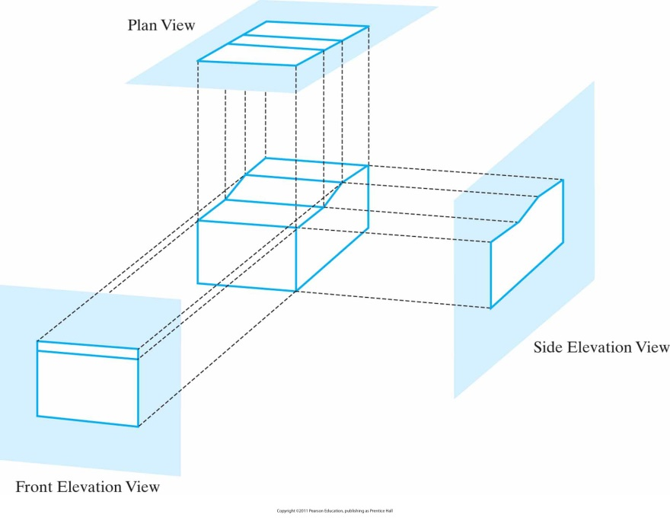
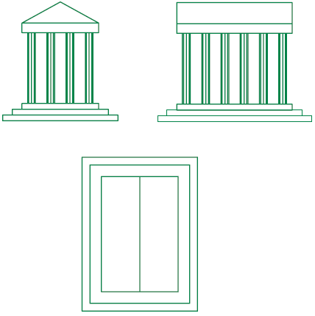
Orthographic (Orthogonal) Projections
A type of parallel projection in which direction of projection is perpendicular to the projection plane
Elevations (front, side), plan view (top)
This type of view preserves distances and angles (for planes parallel to view plane)

Slide 7
Orthogonal Projection Coordinates
If projection direction is parallel to z_{view}
x_{p}=x, y_{p}=y
z coordinate is kept for visibility detection procedures

Slide 8
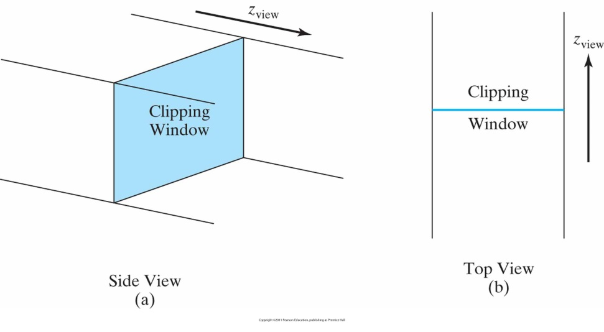
Clipping Window and Orthogonal Projection View Volume
Edges of the clipping window specify the x and y limits
These are used to form the top, bottom, and two sides of a clipping region called the orthogonal-projection view volume
Limit the volume in z_{view} direction by near-far (or front-back) clipping planes

Slide 9
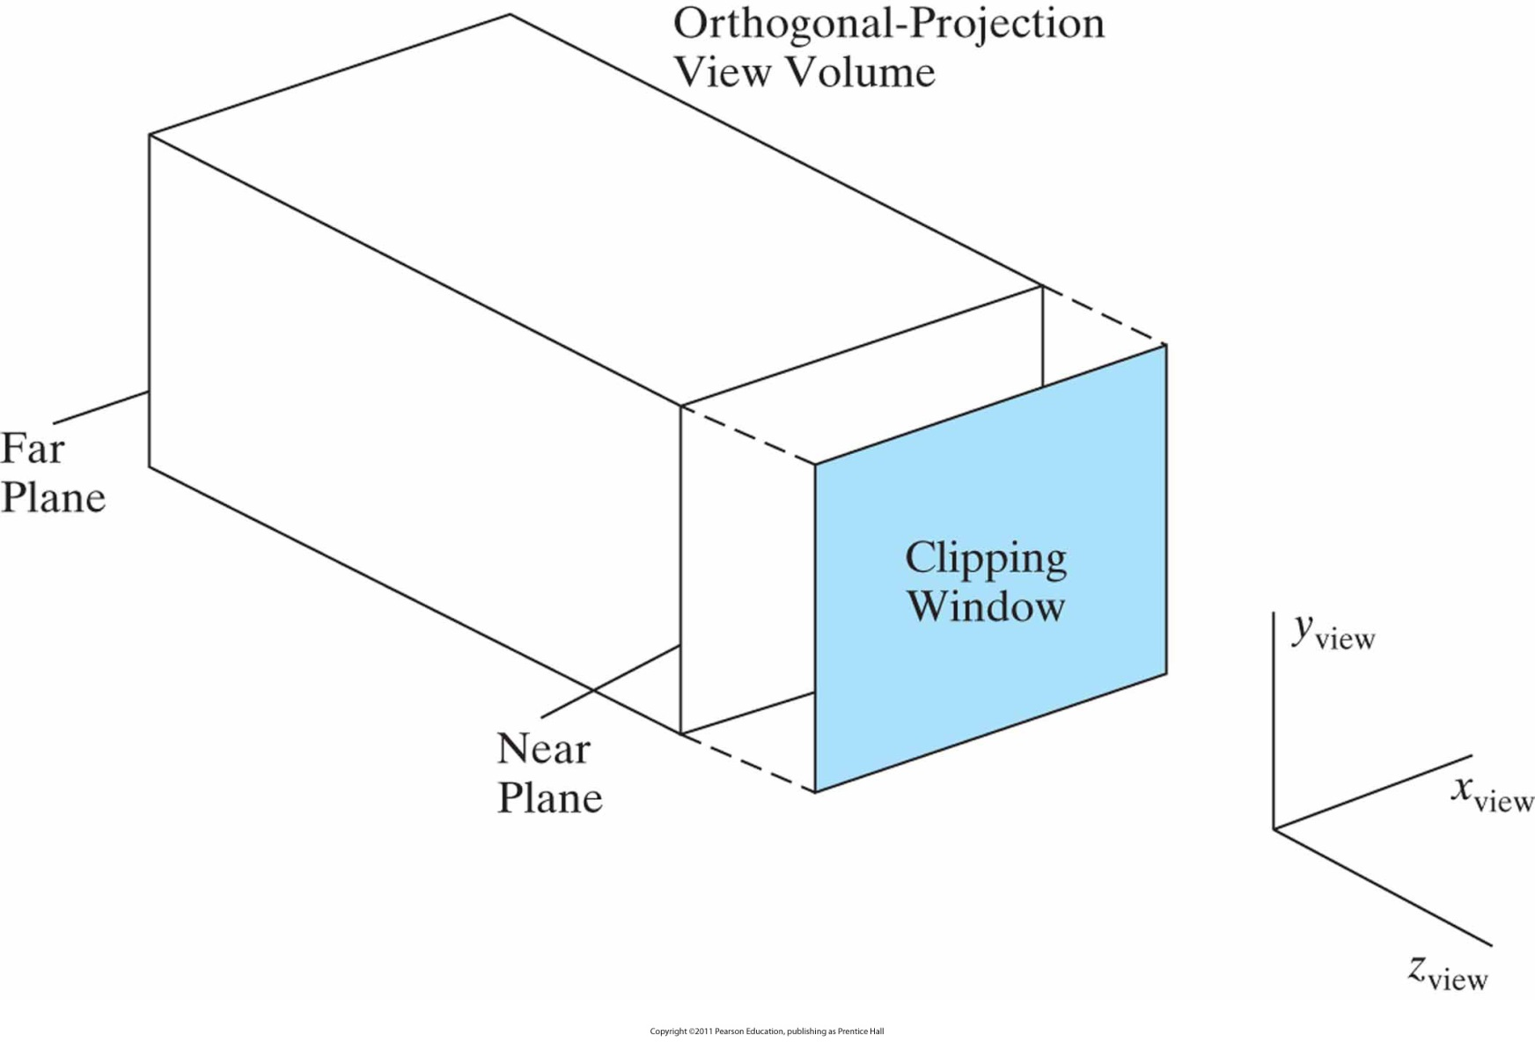

Slide 10
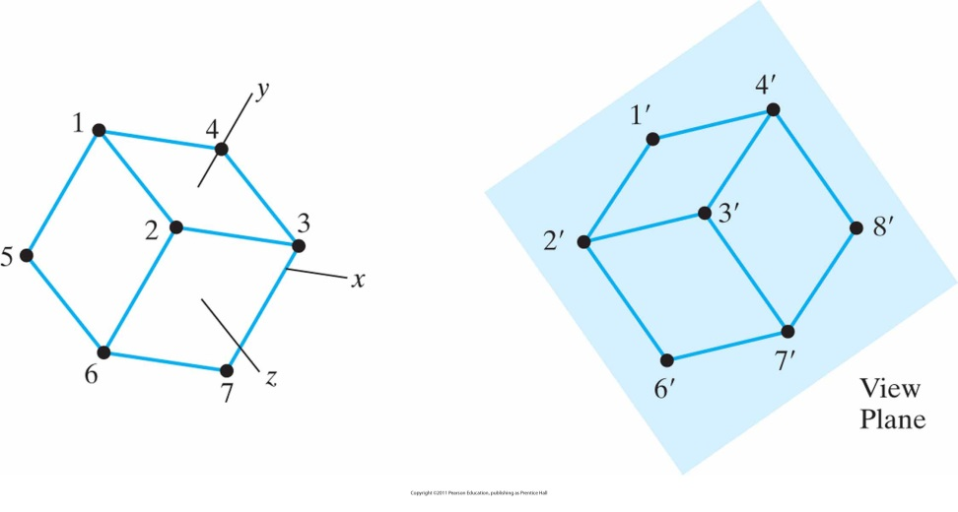
Axonometric Projections
When an orthogonal projection shows more than one face (i.e., when image plane is not parallel with one of the faces), we have an axonometric projection
classify by how many angles of
a corner of a projected cube are
the same
none: trimetric
two: dimetric
three: isometric
θ ₁
θ ₂
θ ₃

Slide 11
Axonometric Projections
Lines are scaled (foreshortened) but can find scaling factors
Lines preserved but angles are not
Projection of a circle in a plane not parallel to the projection plane is an ellipse
Can see three principal faces of a box-like object
Some optical illusions possible
Parallel lines appear to diverge
Does not look real because far objects are scaled the same as near objects
Used in CAD applications

Slide 12
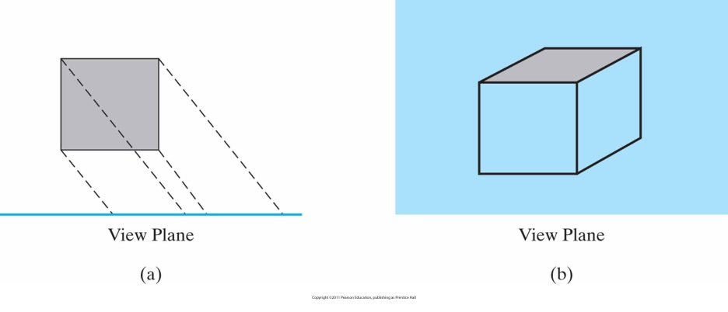
Oblique Projections
Projection lines are still parallel with each other but they are not perpendicular to the image plane

Slide 13
Oblique Projections
Angles in faces parallel to the image plane are preserved
The effect is same as z-axis shearing

Slide 14
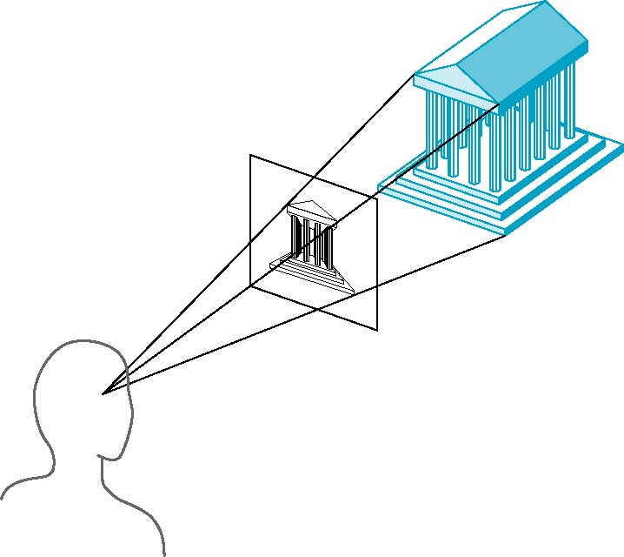
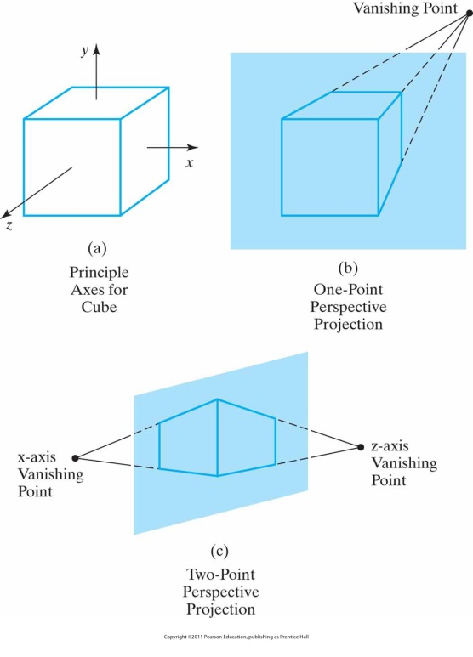
Perspective Projections
Projection lines converge at a point (center of projection)
Parallel lines on the object (not parallel to the projection plane) converge at a single point in the projection (the vanishing point)
Drawing simple perspectives by hand uses these vanishing point(s)

Slide 15
Perspective Projections

Slide 16
Perspective Projections
Objects further from viewer are projected smaller than the same sized objects closer to the viewer (diminution)
Looks realistic
Equal distances along a line are not projected into equal distances (nonuniform foreshortening)
Angles preserved only in planes parallel to the projection plane
More difficult to construct by hand than parallel projections (but not more difficult by computer)

Slide 17
Perspective Projection View Volume
An infinite pyramid of vision is chopped off by near and far clipping planes and we get a truncated pyramid (or frustum)

Slide 18
Symmetric Perspective Projection Frustum
If the line from perspective reference point through clipping window center (centerline) is perpendicular to view plane, we have a symmetric frustum
Clipping window can be specified by
width and height, or
field-of-view angle and aspect ratio
With a symmetric frustum, perspective transformation is a mapping to orthogonal coordinates (figure on next slide)

Slide 19
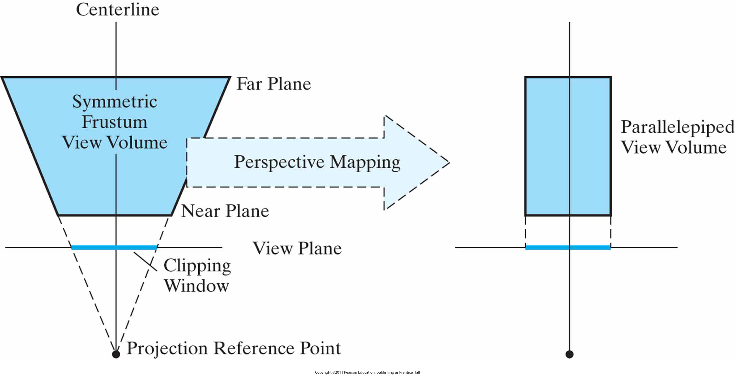

Slide 20
Oblique Perspective-Projection Frustum
Centerline not perpendicular to view plane
First, transform this into a symmetric frustum (z-axis shearing)
Then proceed as before

Slide 21
Arranging the Camera
By default, camera is at the origin, pointing towards negative z direction
We generally move the camera away from the origin (or equivalently, move the world coordinate system away from the camera)
These changes are done through the model-view (MV) matrix which is initially the identity matrix
Changes to the MV matrix affect the relative positions of camera and objects defined after the change
Be careful about where in your program primitives are defined w.r.t. the changes to the MV matrix

Slide 22
Arranging the Camera
One way is to use transformations just as we applied them to any other object
E.g., to get a side view from positive x direction
Rotate camera
Move away from origin
modelViewMatrix = mult(translate(0, 0, -d), rotateY(-90));

Slide 23
Arranging the Camera
Another way is to specify the position and orientation of the camera
m = lookAt(eye, at, up)
A transformation matrix can be calculated from this information.
eye vector will be used for translation
$n=at−eye$ is a vector in the direction that camera is looking at (z direction for the camera system)
Normalize $n$
$u=\frac{up×n}{\left|up×n\right|}$
$v=\frac{n×u}{\left|n×u\right|}$
These u, v, and n vectors are the x, y, and z directions for the camera and can be used to create the rotation matrix
Most APIs have a lookAt function

Slide 24
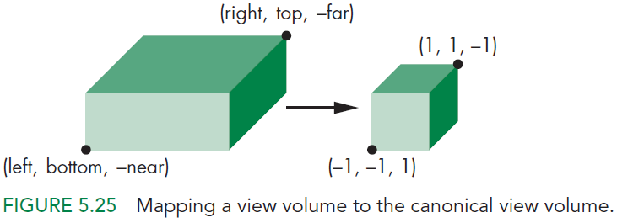
Orthogonal Projection in WebGL
The default projection is an orthogonal projection defined with the cube centered at origin that has a side length of 2
var N = ortho(-1.0, 1.0,
-1.0, 1.0,
-1.0, 1.0);
We can set a different view volume with
var N = ortho(left, right,
bottom, top,
near, far);
WebGL actually creates the transformation matrix that transforms this volume to the default cube (the canonical view volume)

Slide 25
Orthogonal Projection in WebGL
We can calculate the required transformation matrix easily
First, we need to translate so that the center of our volume is at the center of the cube (origin)
Then, we need to scale the box to get the cube with side length 2

Slide 26
Orthogonal Projection in WebGL
Translation
$$T=T\left(−\frac{\text{right}+\text{left}}{2},−\frac{\text{top}+\text{bottom}}{2},\frac{\text{far}+\text{near}}{2}\right)$$
Scale
$$S=S\left(\frac{2}{\text{right}−\text{left}},\frac{2}{\text{top}−\text{bottom}},\frac{2}{\text{near}−\text{far}}\right)$$
Together
$$ST=\left[\begin{matrix}\frac{2}{\text{r}\text{ight}−\text{l}\text{eft}} & 0 & 0 & −\frac{\text{left}+\text{right}}{\text{right}−\text{left}} \\ 0 & \frac{2}{\text{t}\text{op}−\text{b}\text{ottom}} & 0 & −\frac{\text{top}+\text{bottom}}{\text{top}−\text{bottom}} \\ 0 & 0 & −\frac{2}{\text{f}\text{ar}−\text{n}\text{ear}} & −\frac{\text{far}+\text{near}}{\text{far}−\text{near}} \\ 0 & 0 & 0 & 1\end{matrix}\right]$$

Slide 27
Perspective Projection in WebGL
Camera placement can be done with lookAt same as before
Assume it is at origin
And the projection plane is at $z=d$ where $d<0$
Projection coordinates of point (x,y,z) will be
x_{p} =
y_{p} =
z_{p} = d

Slide 28
Perspective Projection in WebGL
Again, we can view this as a transformation
We will have 4x4 matrices but last row will be used, so the w value of the homogeneous coordinate can be different than 1
We can always normalize w.r.t. w to get the actual coordinates
Consider
$$M=\left[\begin{matrix}1 & 0 & 0 & 0 \\ 0 & 1 & 0 & 0 \\ 0 & 0 & 1 & 0 \\ 0 & 0 & 1/d & 0\end{matrix}\right]$$
This will transform a point (x,y,z,1) to (x,y,z,z/d)
When we divide all coordinates with the value of w, we get
(x/z/d, y/z/d, d, 1)
which is the projection point

Slide 29
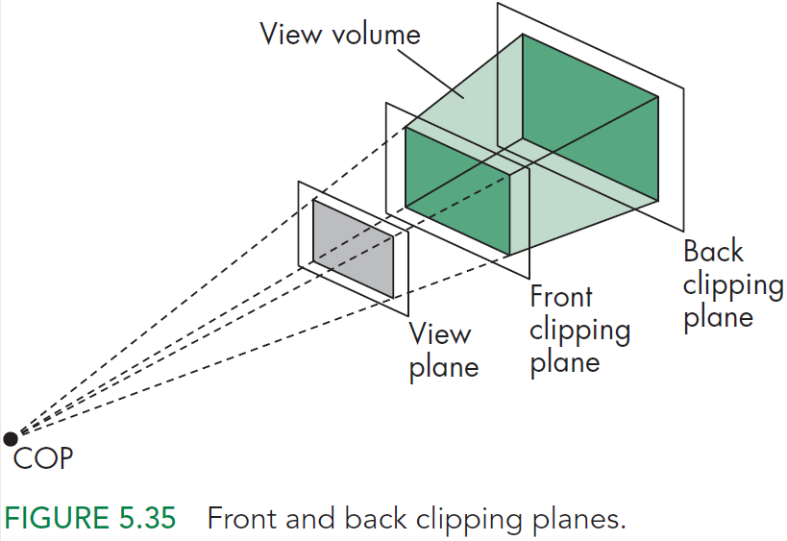
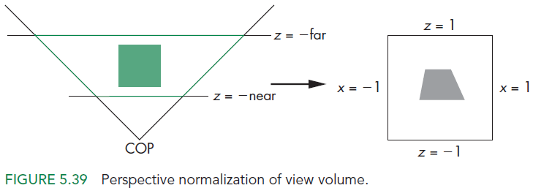
Perspective Projection in WebGL
We haven’t considered all variables
Our camera can see a wider or more narrow area
Not everything will be projected
frustum(left,right,
bottom,top,near,far)
or
perpective(fovy, aspect,
near, far)

