Slide 1
Atomic and Ionic Arrangements
OBJECTIVES
classification of materials based on atomic arrangements
Crystalline
Amorphous
arrangements in crystalline solids based on lattice, basis, unit cell and crystal structures

Slide 2
Order
Short-range order (SRO) - The regular arrangement of the atoms over a short distance (No periodicity in the structure)
AMORPHOUS MATERIALS
H₂O, silicate glass, polyethylene……….
Long-range order (LRO) - A regular repetitive arrangement of atoms which extends over a very large distance.
CRYSTALLINE MATERIALS (Metals, Alloys, Most Ceramics)
Single Crystal (Si, GaAs)
Polycrystalline
Mixed SRO and LRO -

Slide 3
Lattice, Basis, Unit Cell and Crystal Structures
A lattice is a collection of lattice points, which are arranged in a periodic pattern.
3D array of points coinciding with atom positions
Basis + Lattice = Crystal structure
🔴⚫️ + . . . . = 🔴⚫️🔴⚫️🔴⚫️🔴⚫️ . . . . 🔴⚫️🔴⚫️🔴⚫️🔴⚫️ . . . . 🔴⚫️🔴⚫️🔴⚫️🔴⚫️
Basis can be atoms or group of atoms and molecules.
Unit cell is the simplest repeating unit in the crystal
Opposite faces in the unit cell are parallel
The edge of the unit cell connects equivalent points

Slide 4
Crystal Systems
Crystal systems represent the 3D building blocks .
Crystal systems are characterized by a unit cell (UC)
The lattice parameters are the axial lengths and dimensions of UC and represented by lattice constants of a, b, and c .
14 unique case to arrange points in 3D (Bravais Lattices)
14 Bravais lattices are grouped into seven crystal systems of Cubic, Hexagonal, Tetragonal, Rhombohedral, Orthorhombic, Monoclinic, Triclinic.
3 lattice constants, a, b, and c
3 lattice angles, alpha/beta/ gamma

Slide 5
Crystal Systems, Bravais Lattices
Cubic
Simple cubic
Face centered cubic
Body centered cubic
Tetragonal
Simple tetragonal
Body centerd tetragonal
Hexagonal
Orthorhombic
Simple orthorhombic
Body centered orthorhombic
Base centered orthorhombic
Face centered orthorhombic
Rhombohedral (Trigonal)
Monoclinic
Simple monoclinic
Base centered monoclinic
Triclinic

Slide 6
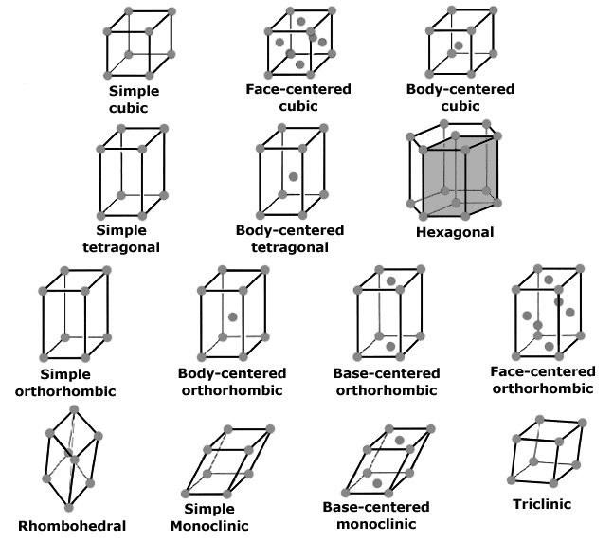
Bravais Lattices
http://www.seas.upenn.edu/~chem101/sschem/solidstatechem.html#bravais

Slide 7
Crystal Systems
Lattice Parameter Relationships
Crystal System | Axial Relationships | Interaxial Angles
Cubic | a = b = c | $α$ = $β$ = $γ$ = 90⁰
Hexagonal | a = b $≠$ c | $α$ = $β$ = 90⁰ $γ$ = 120⁰
Tetragonal | a = b $≠$ c | $α$ = $β$ = $γ$ = 90⁰
Rhombohedral | a = b = c | $α$ = $β$ = $γ$ $≠$ 90⁰
Orthorhombic | a $≠$ b $≠$ c | $α$ = $β$ = $γ$ = 90⁰
Monoclinic | a $≠$ b $≠$ c | $α$ = $γ$ = 90⁰$≠β$
Triclinic | a $≠$ b $≠$ c | $α$ $≠$ $β$ $≠$ $γ$ $≠$ 90⁰
William D. Callister, David G. Rethwisch, Materials Science and Engineering, Eighth Edition, Wiley, 2011.

Slide 8
References
Donald R. Askeland, Pradeep P. Fulay, Wendelin J. Wright, The Science and Engineering of Materials, Sixth Edition
William D. Callister, David G. Rethwisch, Materials Science and Engineering, Eighth Edition, Wiley, 2011.

