Slide 1
Brainstorming techniques
Prof.Dr.Barbaros Özer

Slide 2
Brainstroming techniques
1. Brainwriting
2. Rapid ideation
3. Figure storming
4. Eidetic image method
5. Online brainstorming, aka brain netting
6. Round-robin brainstorming
7. Step-ladder technique
8. Mind mapping
9. Starbursting
10. Change of scenery

Slide 3
Basic principles
Quantity instead of quality: Ideas ultimately yield the quality during development, combining and further harmonising proıcesses…
Do not criticize: Team members should be fully free to express their thoughts and ideas

Slide 4
7 principles of brainstroming
Defer judgment. Creative spaces don't judge. ...
Encourage wild ideas. Wild ideas can often give rise to creative leaps. ...
Build on the ideas of others. ...
Stay focused on the topic. ...
One conversation at a time. ...
Be visual. ...
Go for quantity.

Slide 5
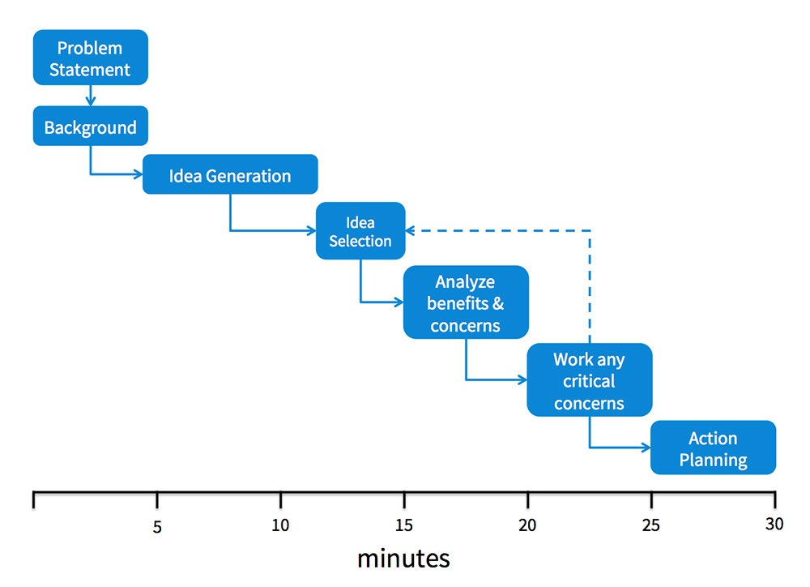

Slide 6
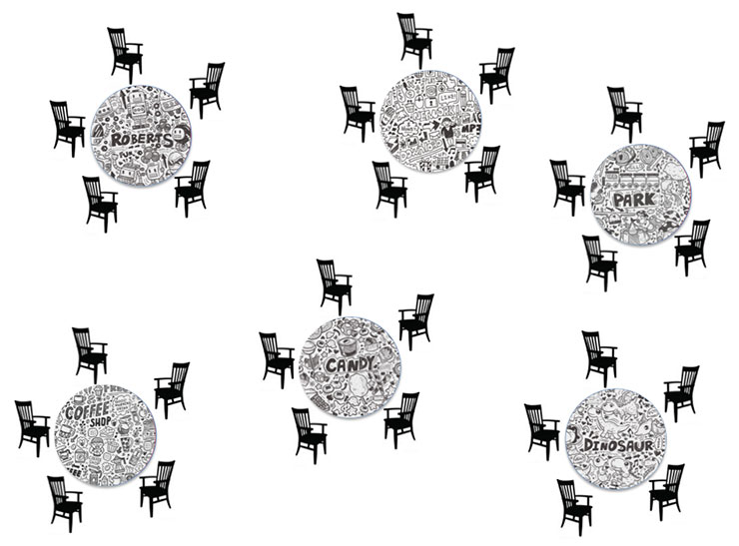

Slide 7
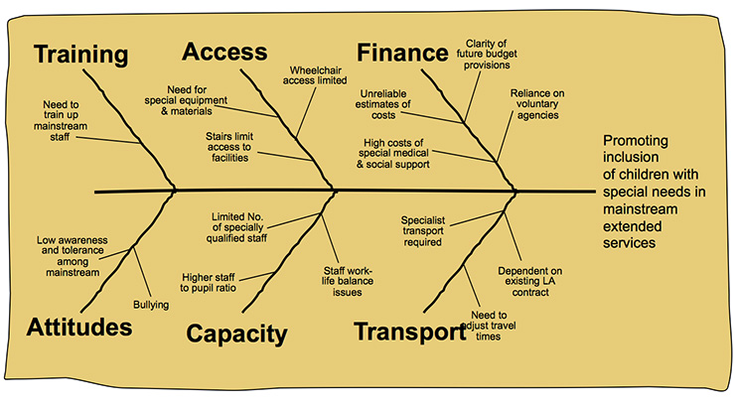

Slide 8
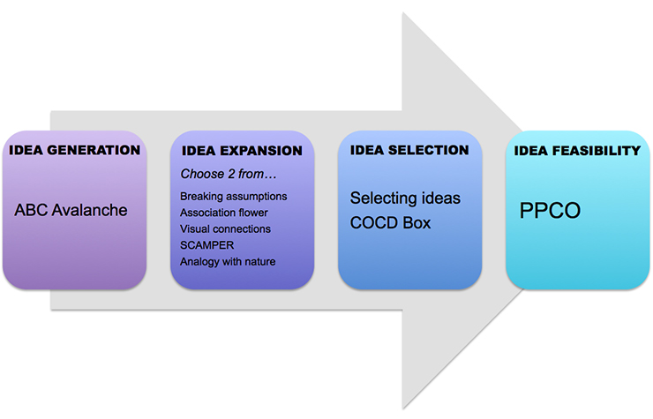

Slide 9
