Slide 1
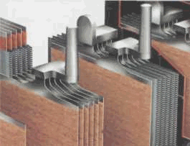
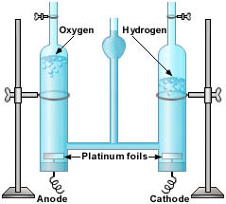
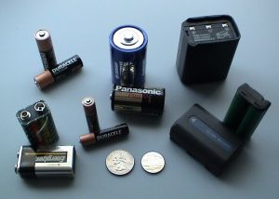
BÖLÜM 11
ELEKTROLİTİK ENDÜSTRİLERİ
2H₂O(l) → 2H₂(g) + O₂(g)

Slide 2
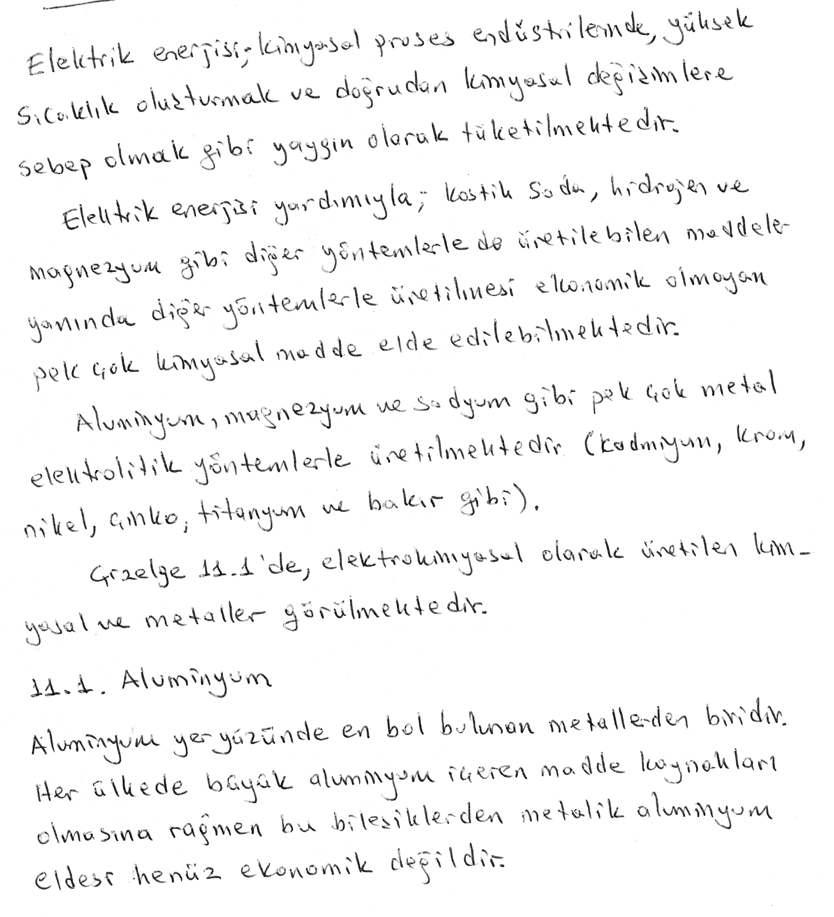

Slide 3
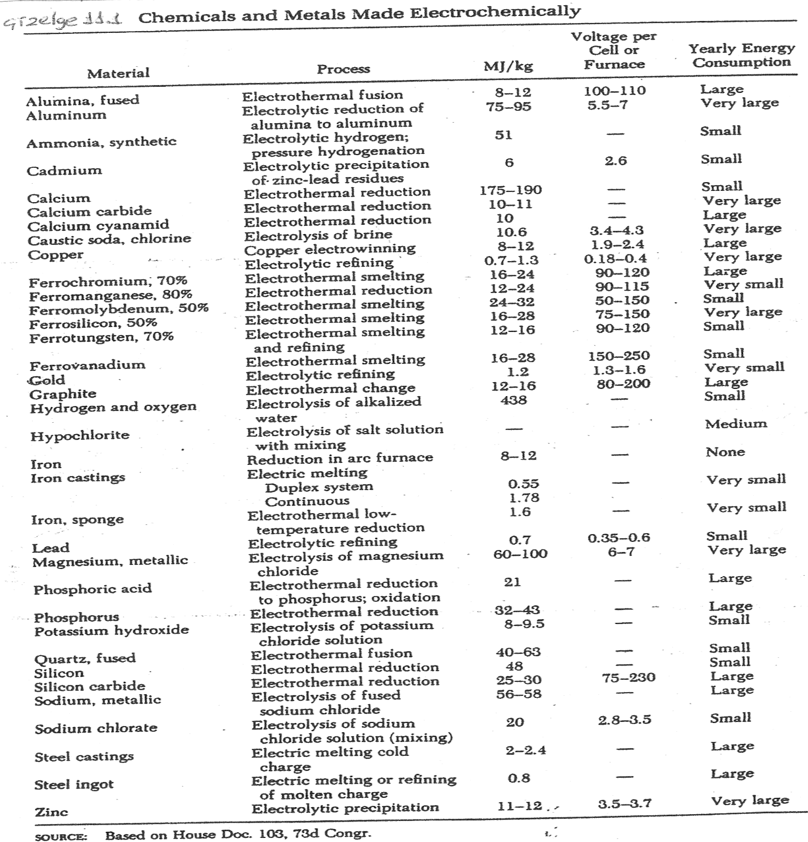

Slide 4
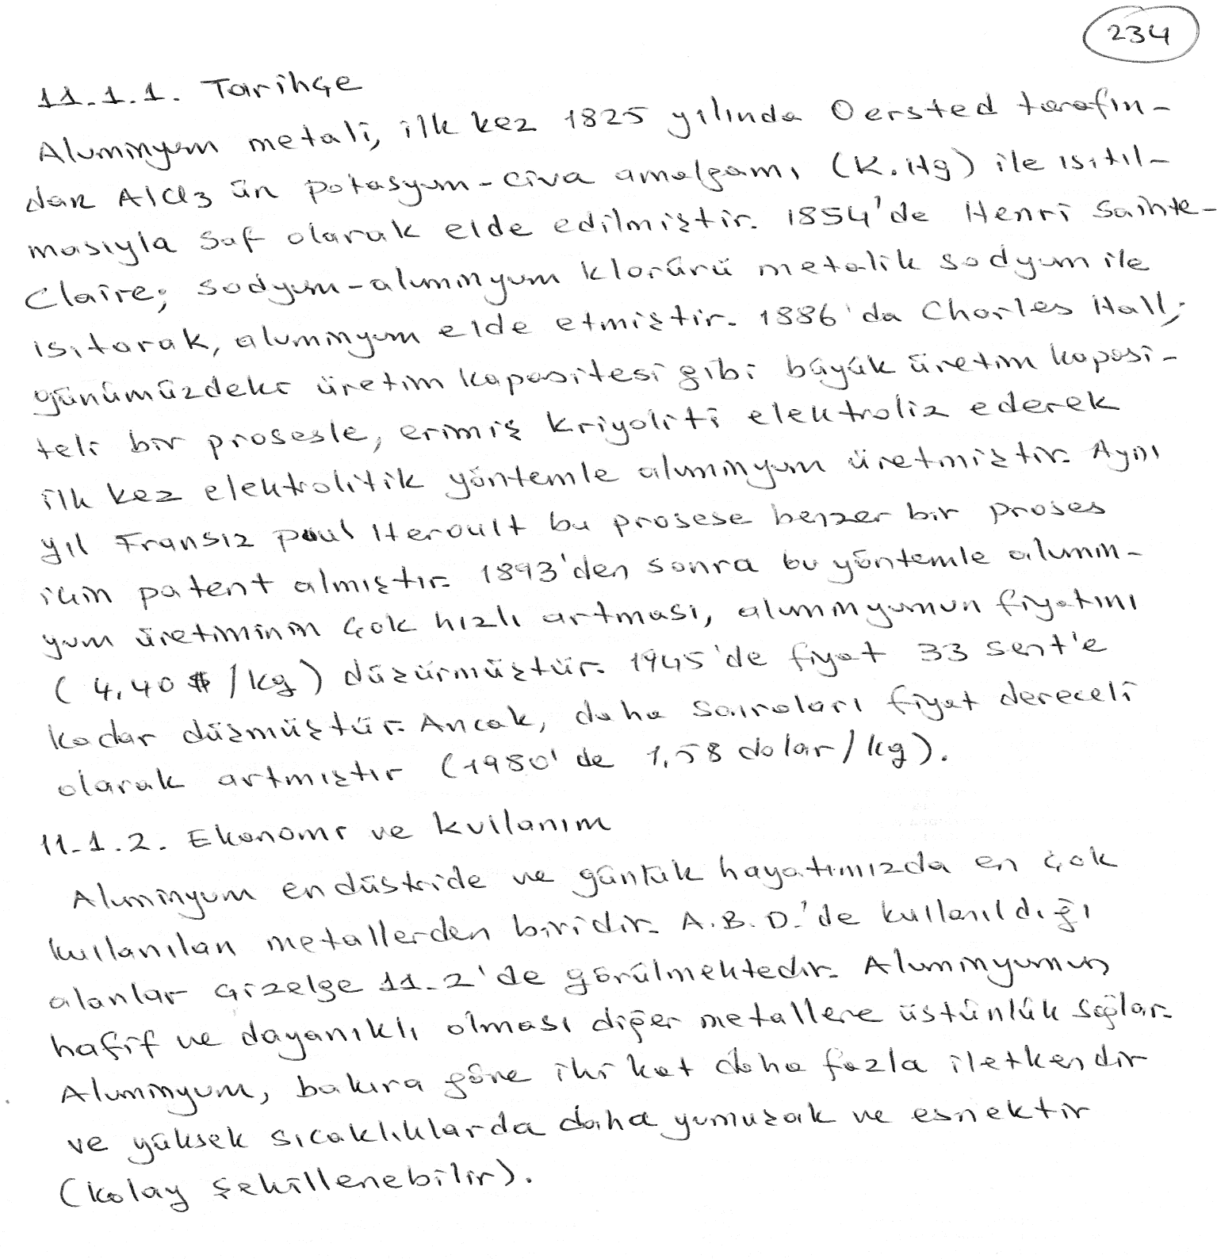

Slide 5
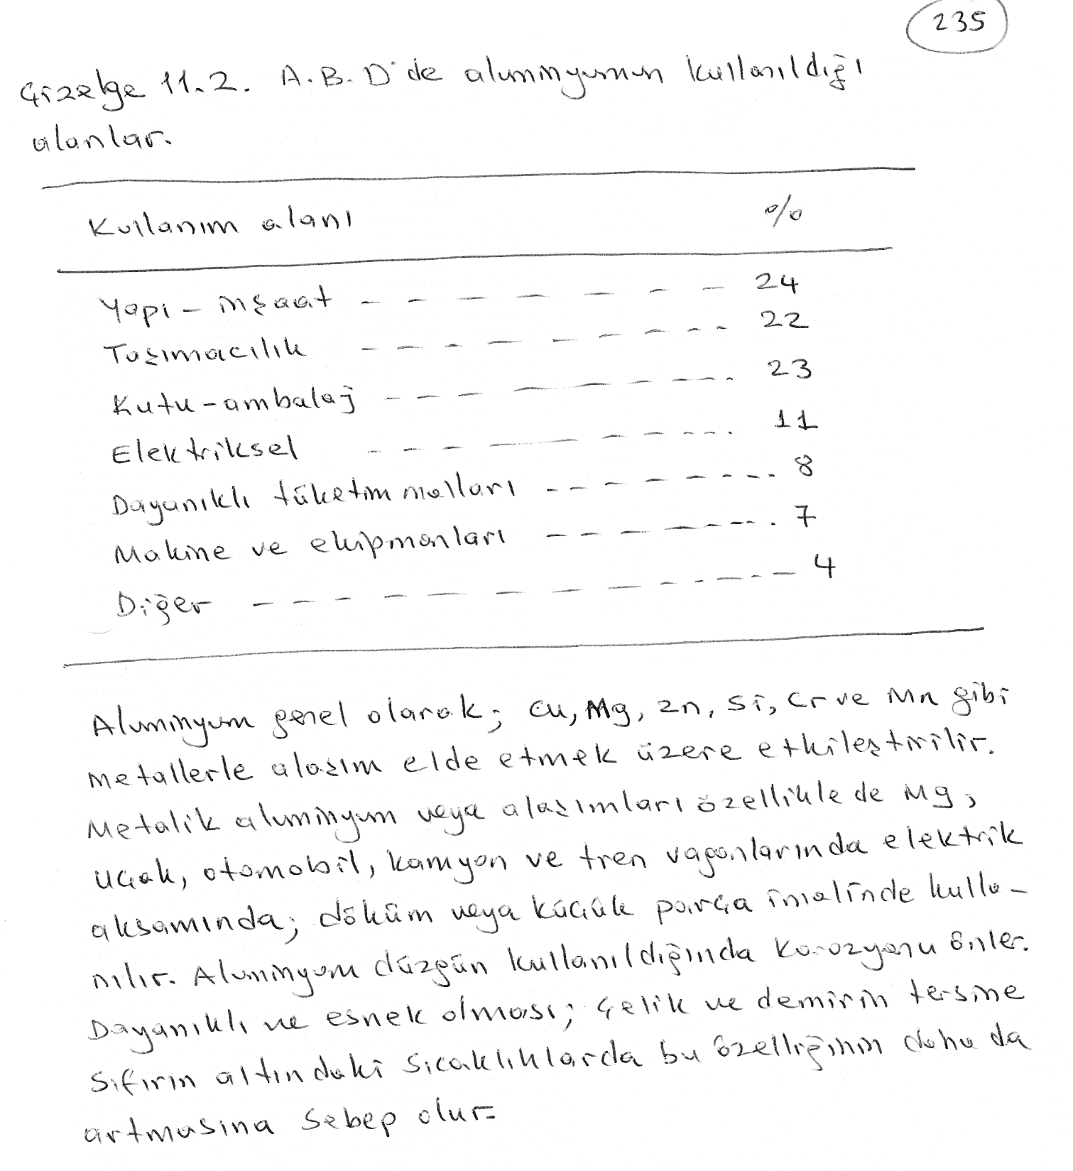

Slide 6
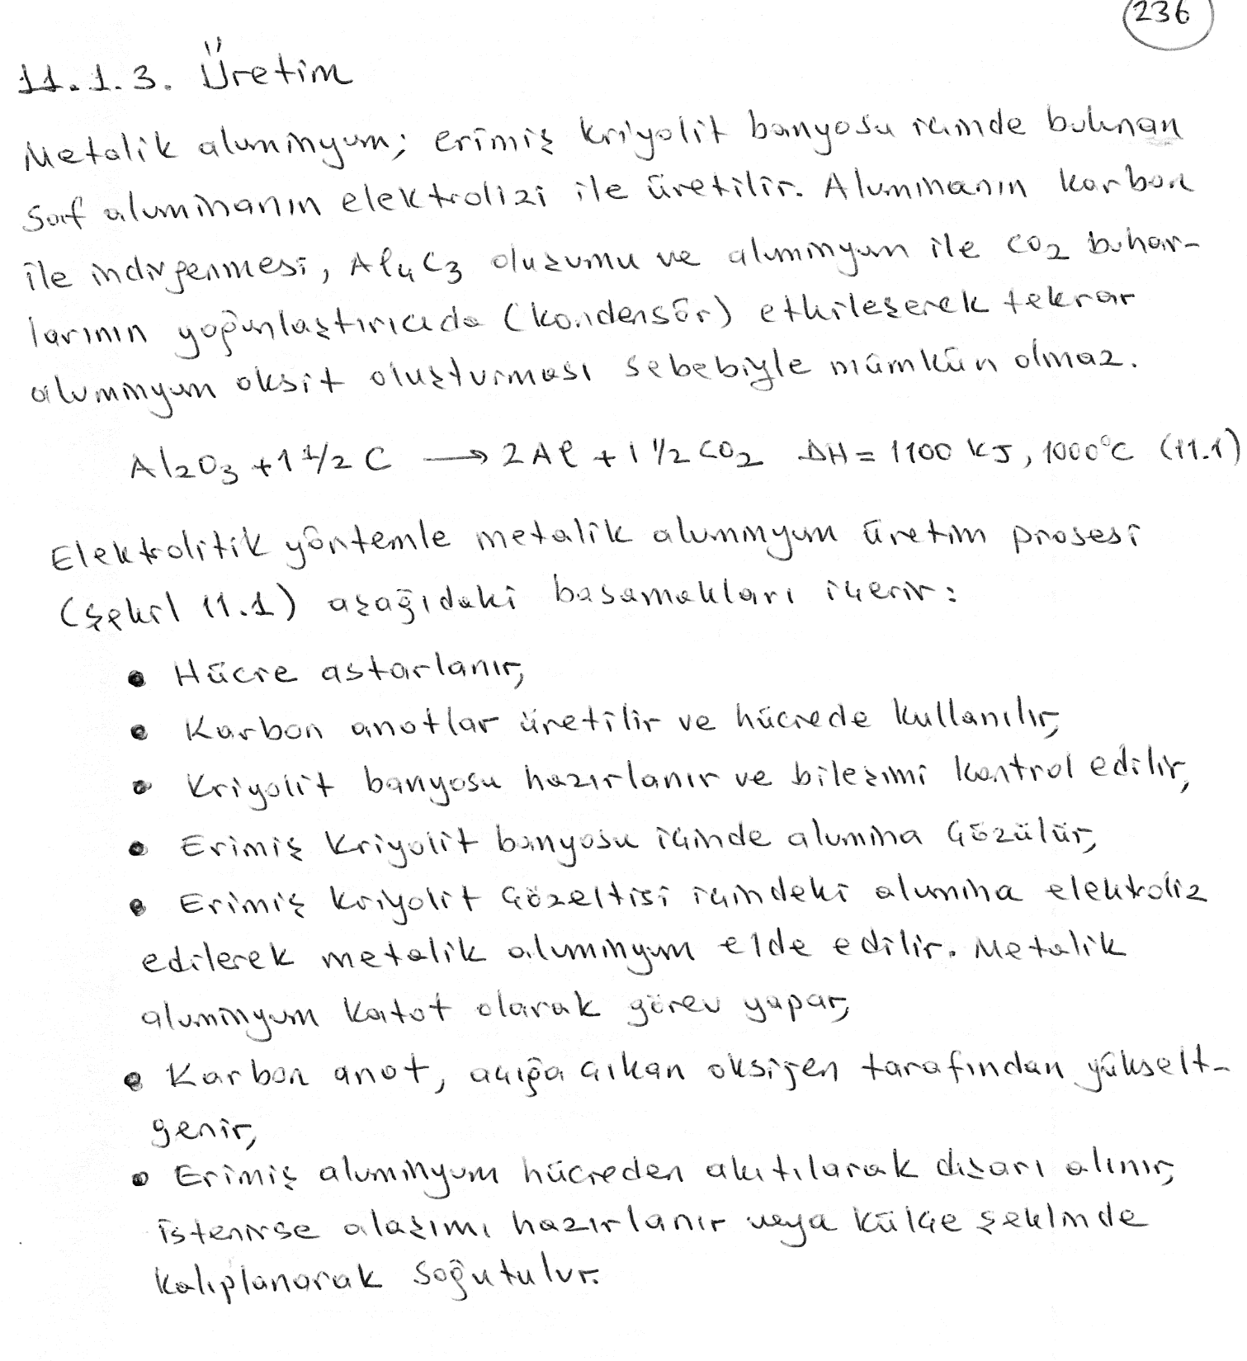

Slide 7
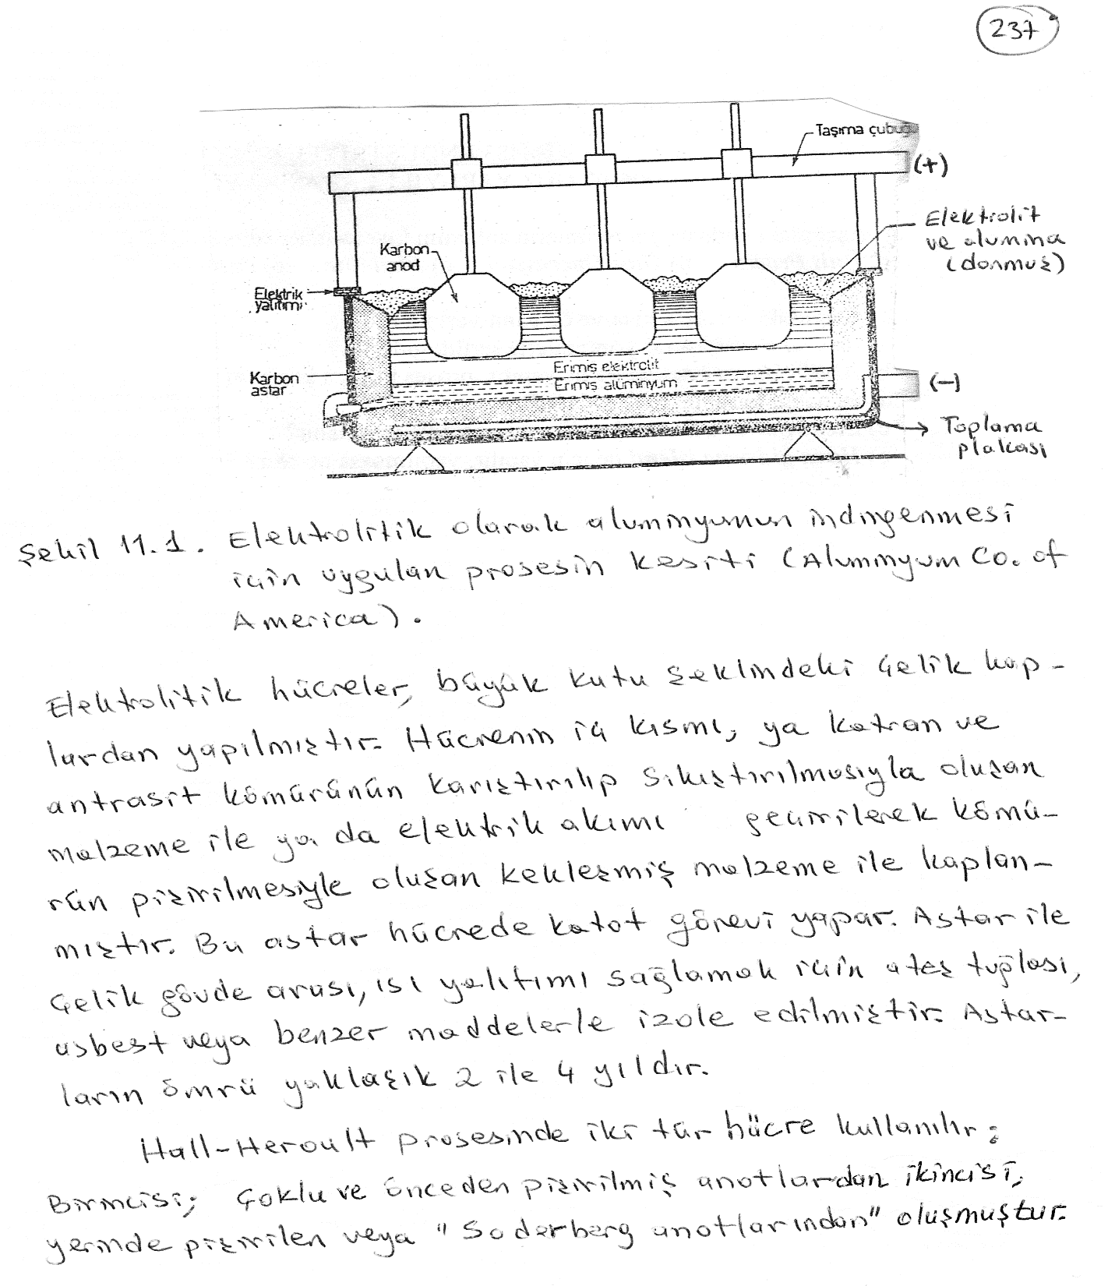

Slide 8
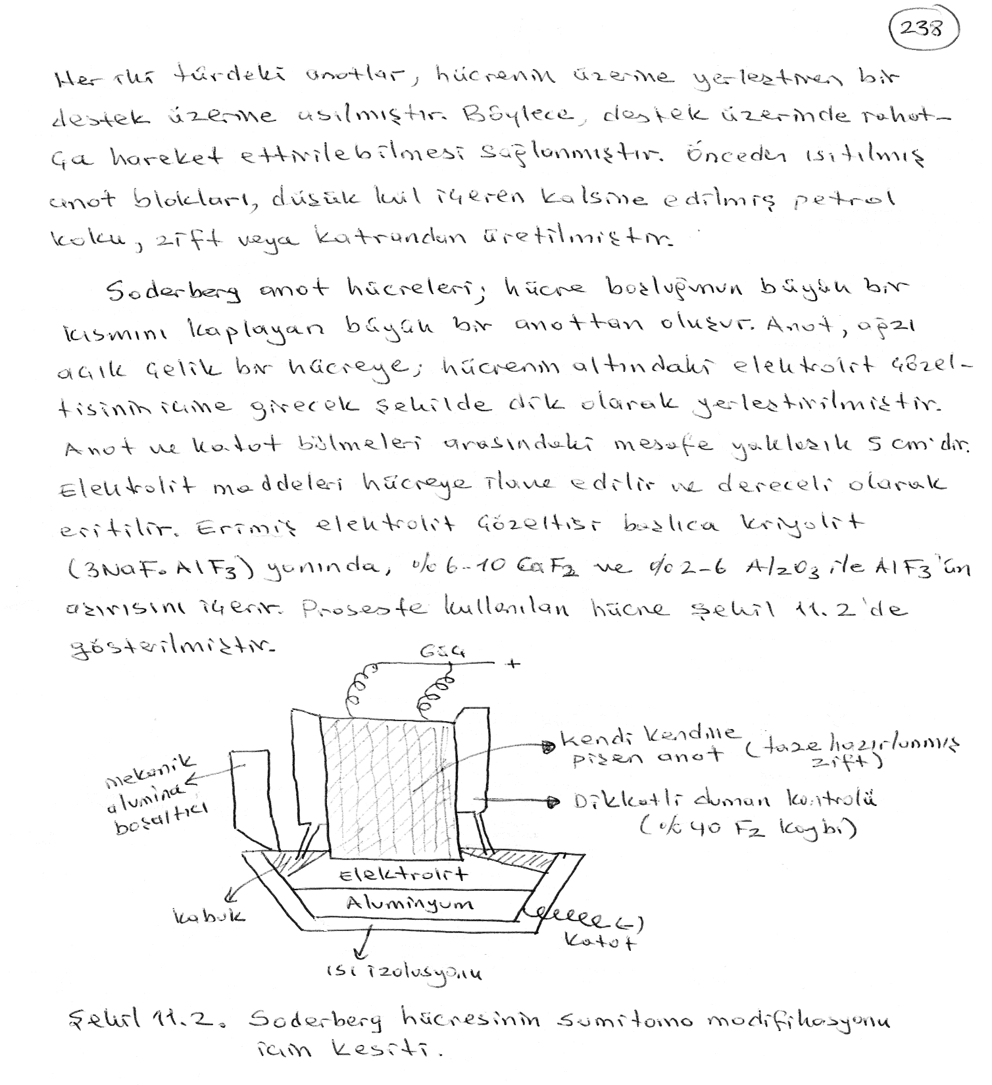

Slide 9
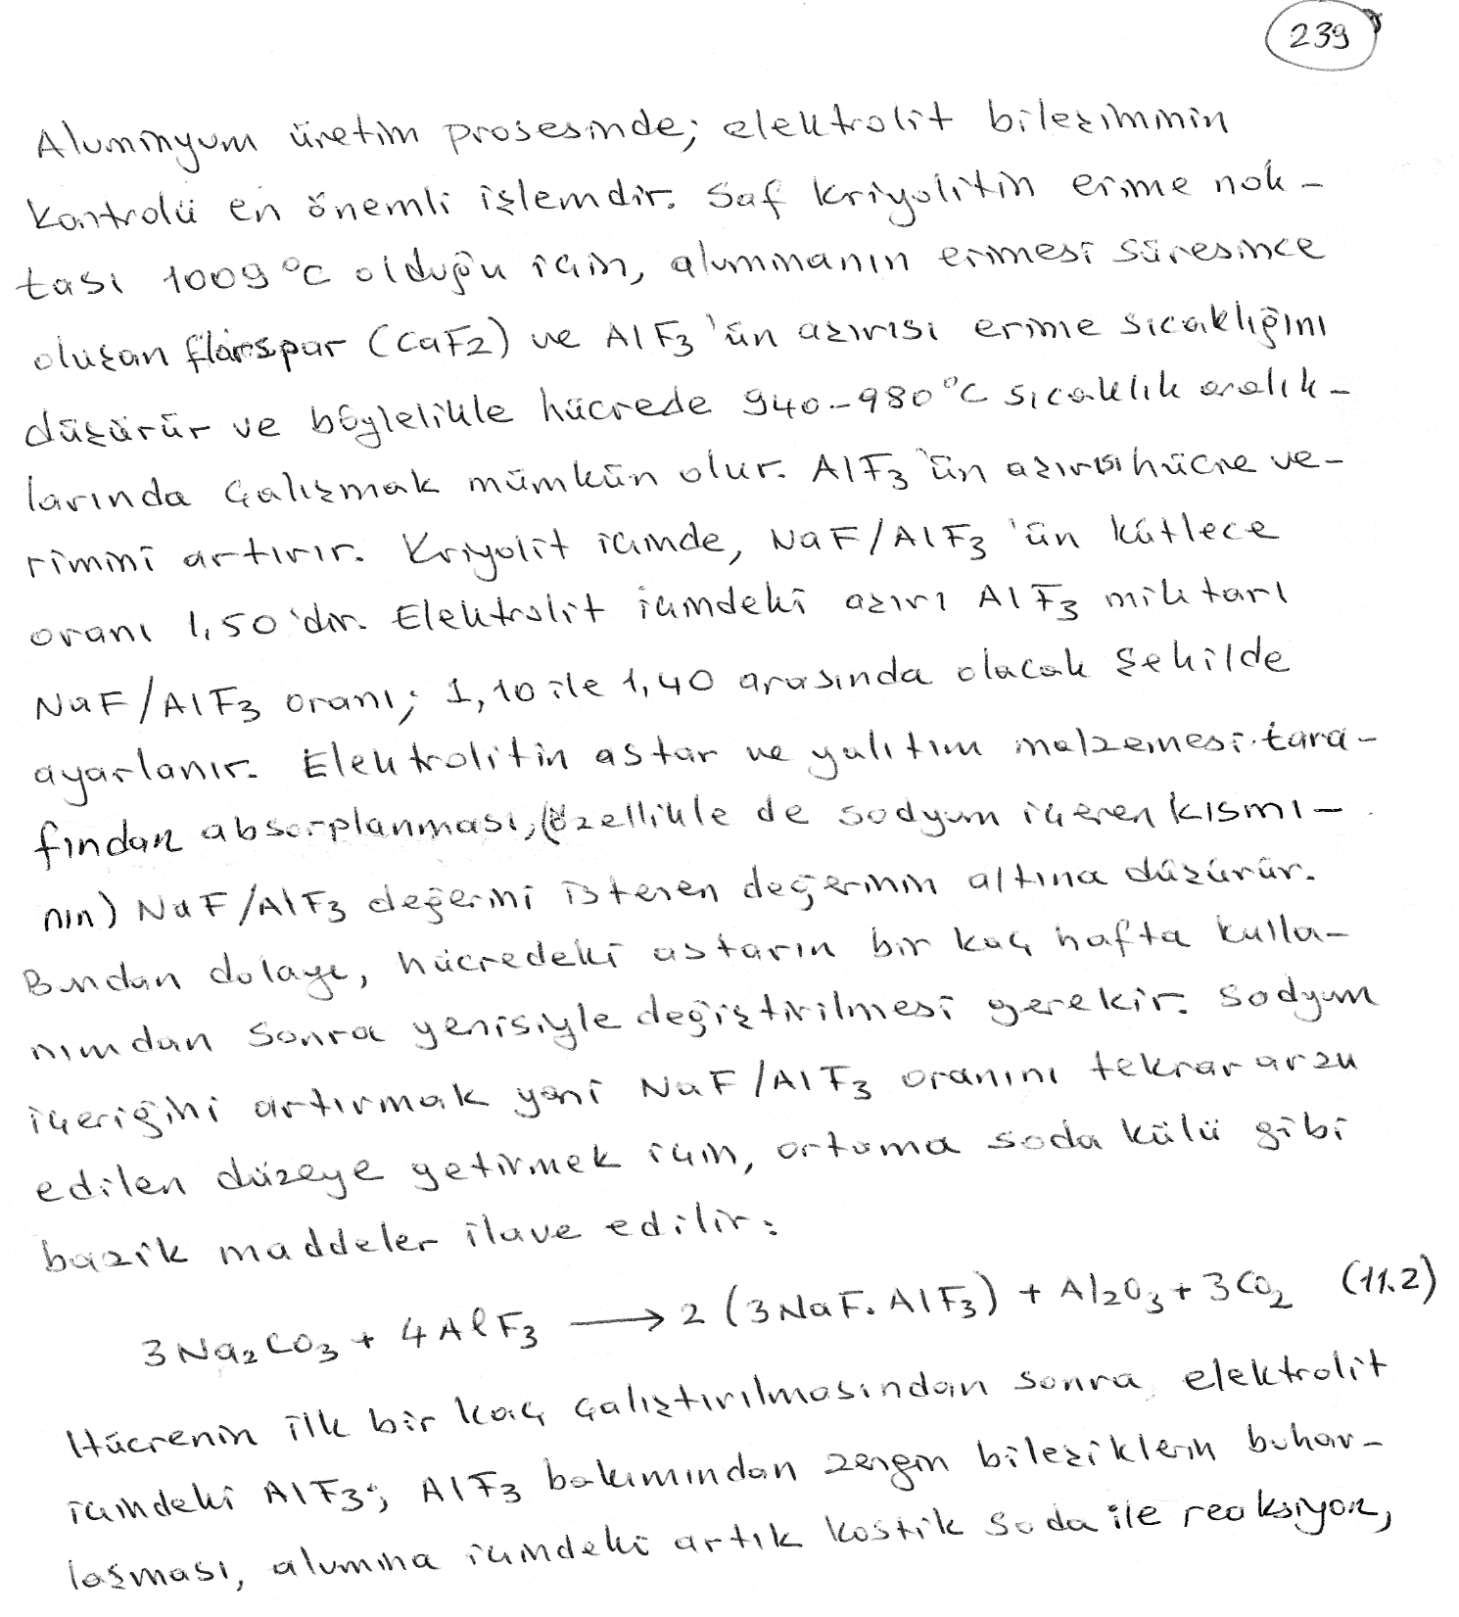

Slide 10
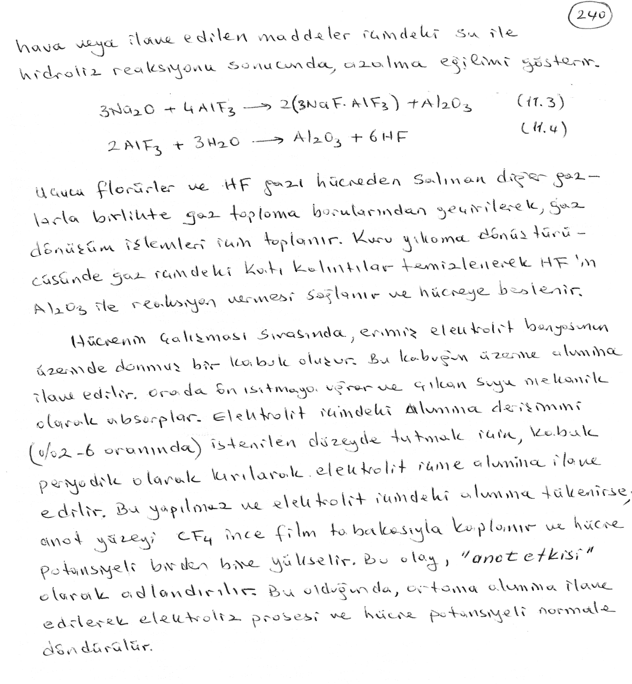

Slide 11
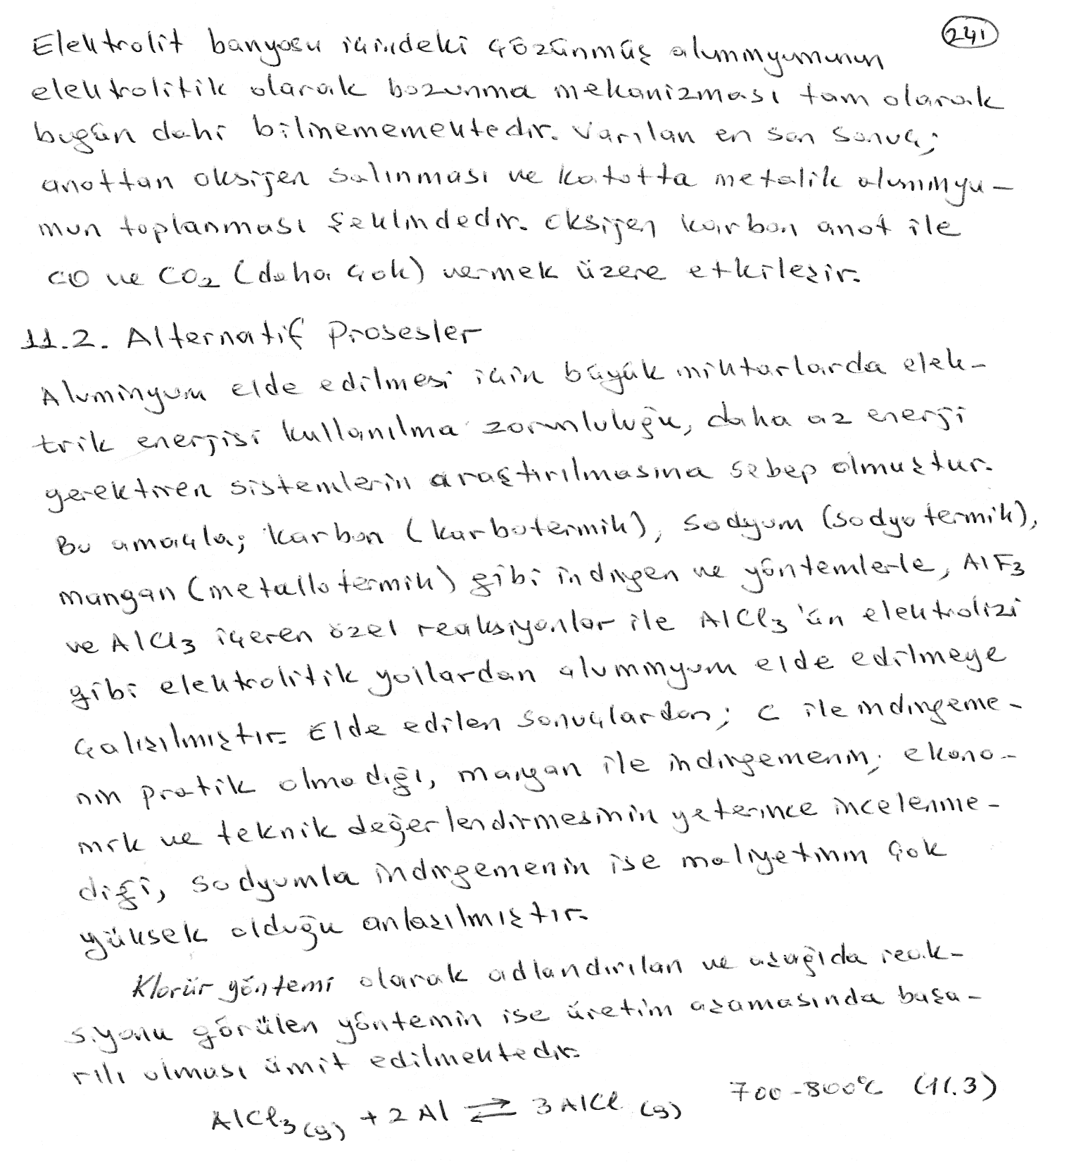

Slide 12
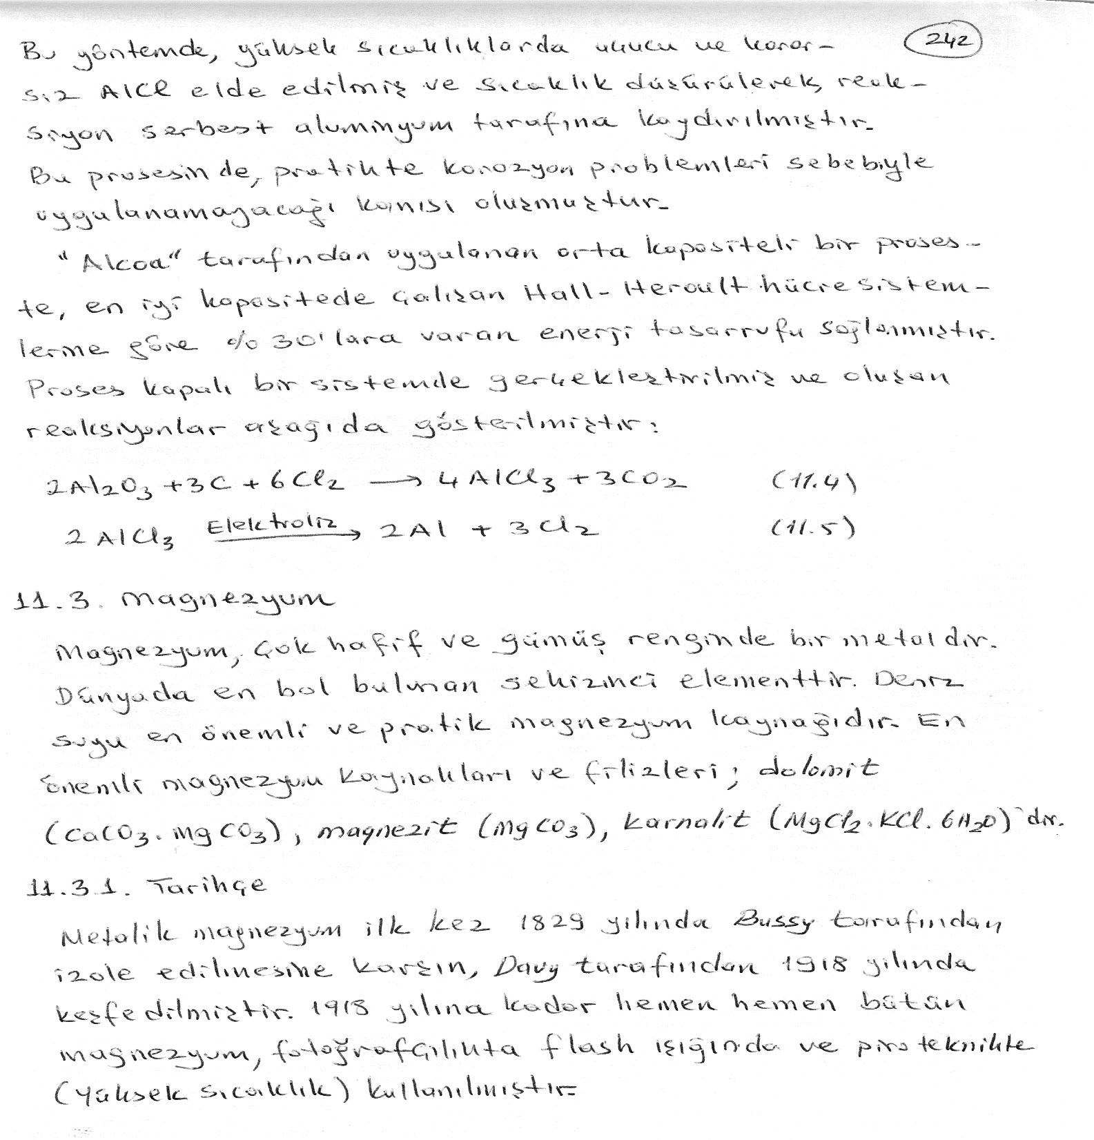

Slide 13
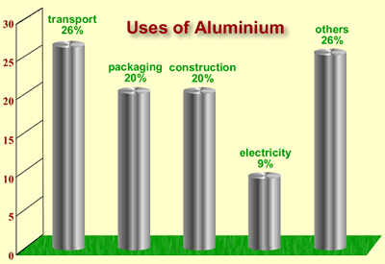
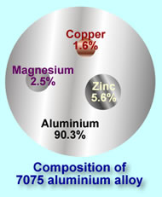
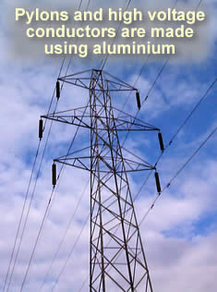
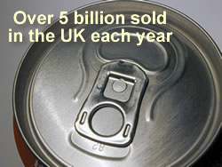

Slide 14
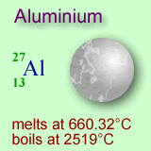
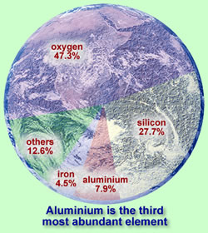
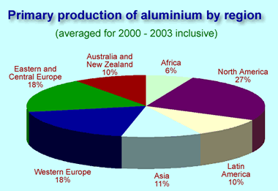

Slide 15
Early Production
The earliest production methods used very reactive metals in a mercury amalgam to displace aluminium from its compounds. Only small quantities could be produced by this method, and so aluminium was an expensive luxury metal.
Two significant developments were:
The discovery of the electrolytic method of extraction
The development of an efficient process to produce aluminium oxide for electrolysis

Slide 16
A short history of aluminium production
1855 | Production from aluminium chloride using a potassium/mercury amalgam. Expensive and small scale
1886 | Paul Heroult (France) and Charles Hall (US), working independently, successfully make metallic aluminium from aluminium oxide ("alumina") using electricity
1888 | Karl Bayer (Germany) develops an improved method for aluminium oxide production from bauxite oreCommercial aluminium production by "Hall-Heroult" process begins
1900 | Production at 1,000 tonnes
2000 | Hall-Heroult process still in use. Production exceeds 30 million tonnes

Slide 17
Making Cryolite
During electrolysis the aluminium oxide is dissolved in "cryolite", which is sodium aluminium fluoride (Na₃AlF₆). Cryolite is made using sodium aluminate and hydrogen fluoride, which is manufactured from the mineral fluorspar using sulphuric acid.

Slide 18
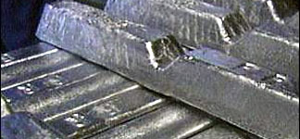
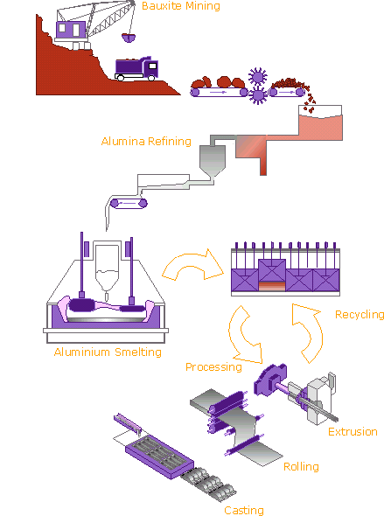
Aluminium ore, most commonly bauxite, is plentiful and occurs mainly in tropical and sub-tropical areas: Africa, West Indies, South America and Australia. There are also some deposits in Europe. Bauxite is refined into aluminium oxide trihydrate (alumina) and then electrolytically reduced into metallic aluminium. Primary aluminium production facilities are located all over the world, often in areas where there are abundant supplies of inexpensive energy, such as hydro-electric power.

Slide 19
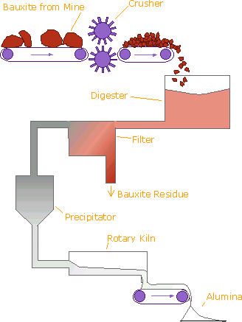
The Bayer Process
The aluminium industry relies on the Bayer process to produce alumina from bauxite. It remains the most economic means of obtaining alumina, which in turn is vital for the production of aluminium metal - some two tonnes of alumina are required to produce on tonne of aluminium

Slide 20
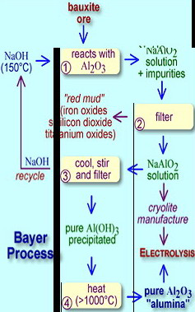
Aluminium Oxide
The chemistry used to obtain pure aluminium oxide ("alumina") from bauxite was first developed by the German chemist Karl Bayer in 1888, and the process is still referred to as the "Bayer Process".

Slide 21
Bayer Process Chemistry
Extraction
Gibbsite: Al(OH)₃ + Na⁺ + OH⁻ ---> Al(OH)₄⁻ + Na+ Böhmite and Diaspore: AlO(OH) + Na+ + OH - + H₂O ---> Al(OH)₄⁻ + Na+
Precipitation
Al(OH)₄⁻ + Na⁺ ---> Al(OH)₃ + Na⁺ + OH⁻
Calcination
2Al(OH)₃ ---> Al₂O₃ + 3H₂O

Slide 22
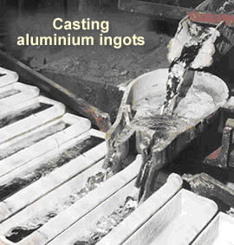
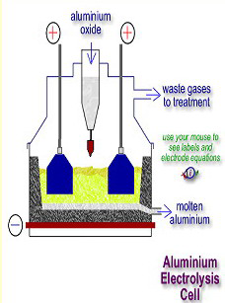
The cell voltage is in the region of 4v, but the current can be as much as 300,000 amps in each cell. The heating effect of the electric current is responsible for maintaining the temperature of the cell.

Slide 23
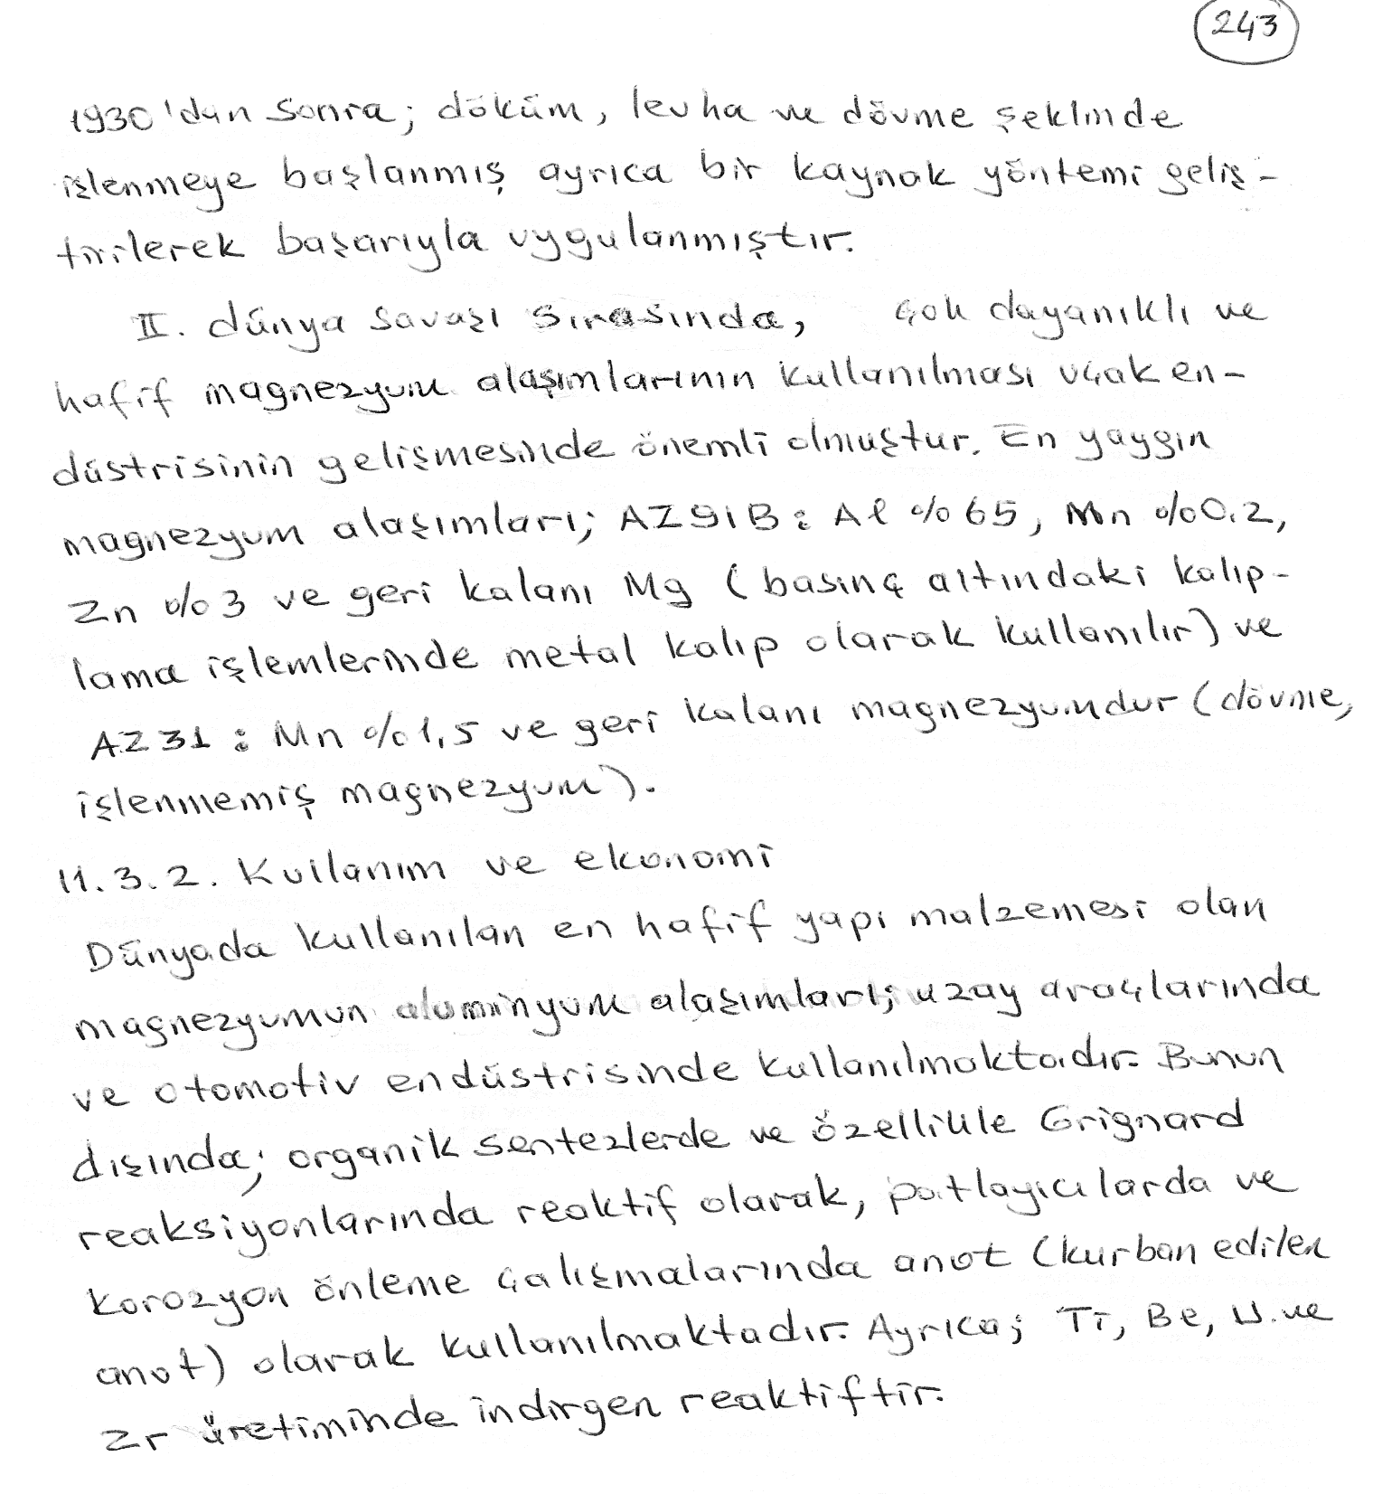

Slide 24
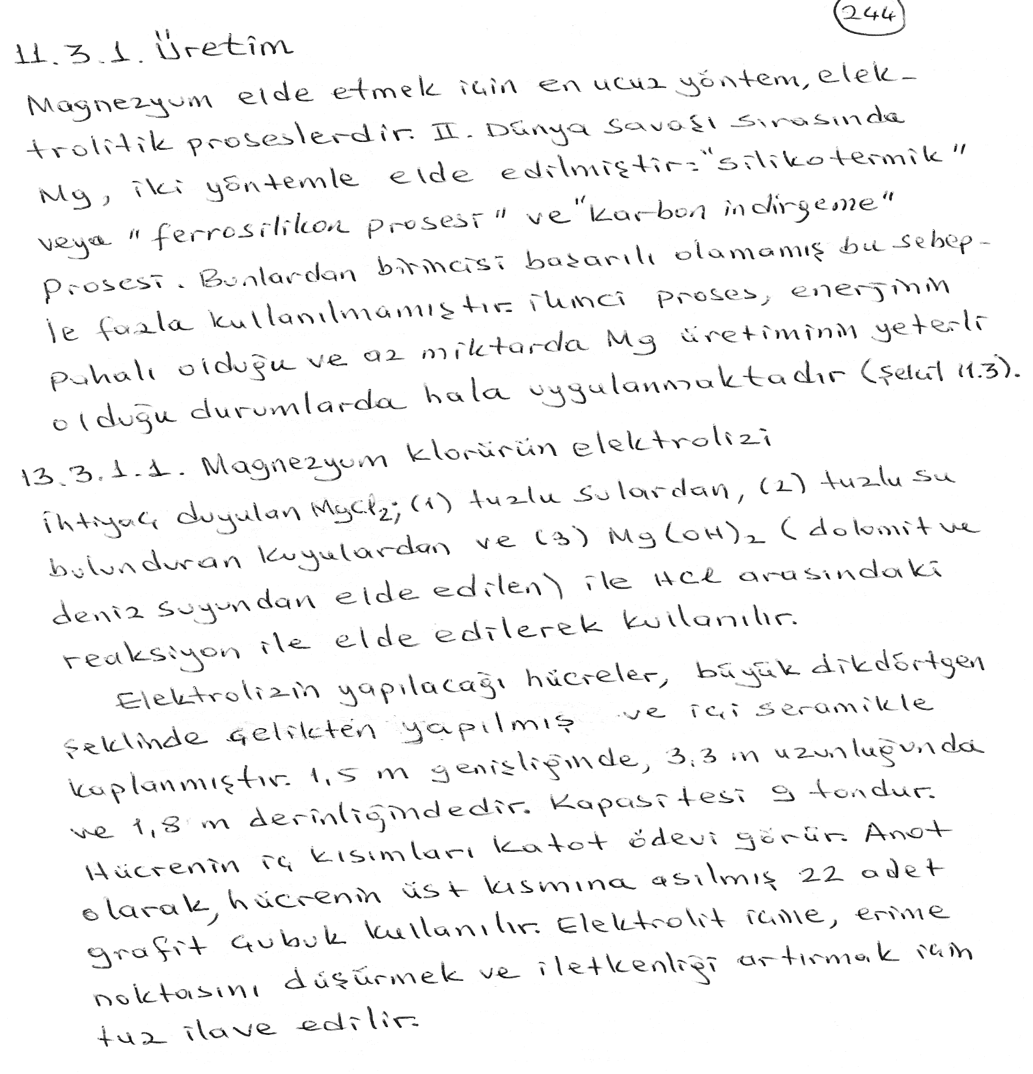

Slide 25
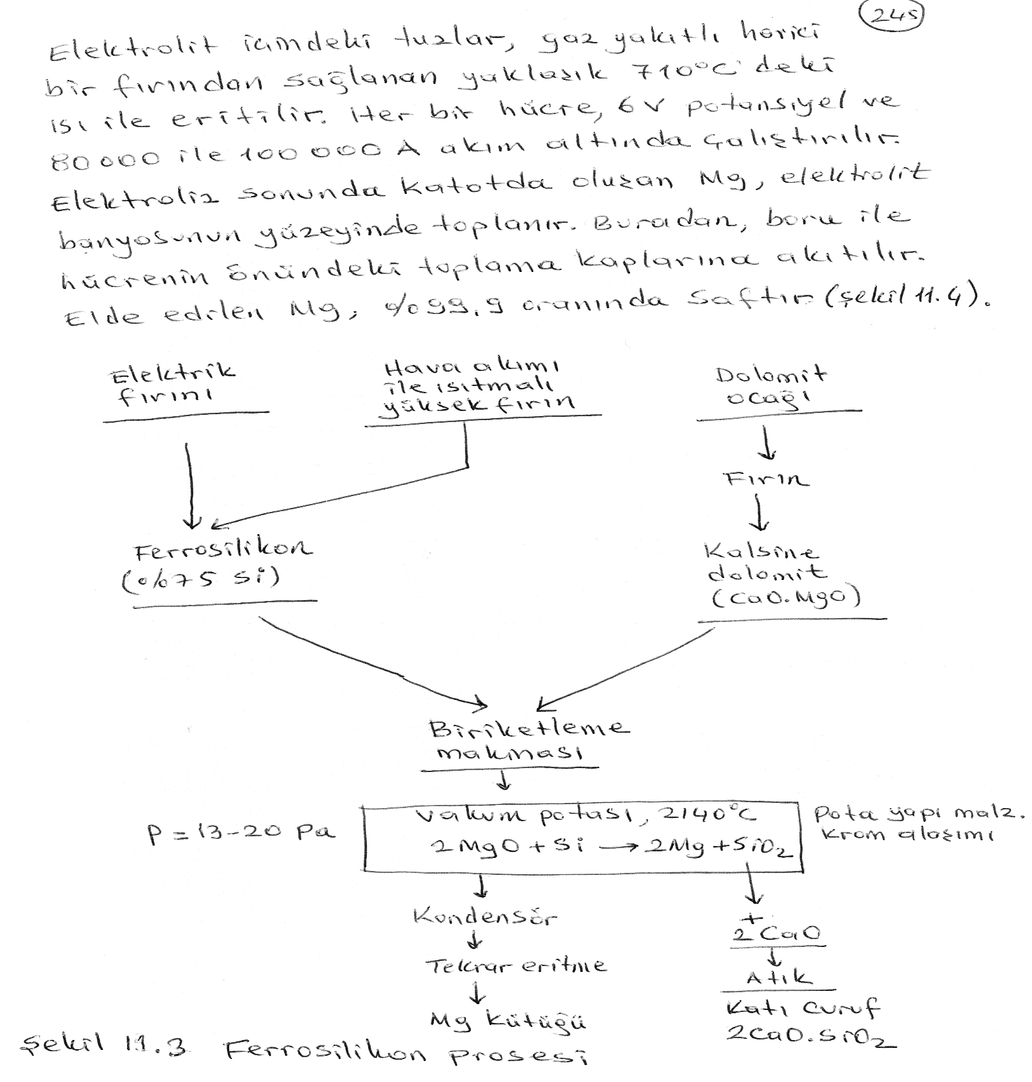

Slide 26
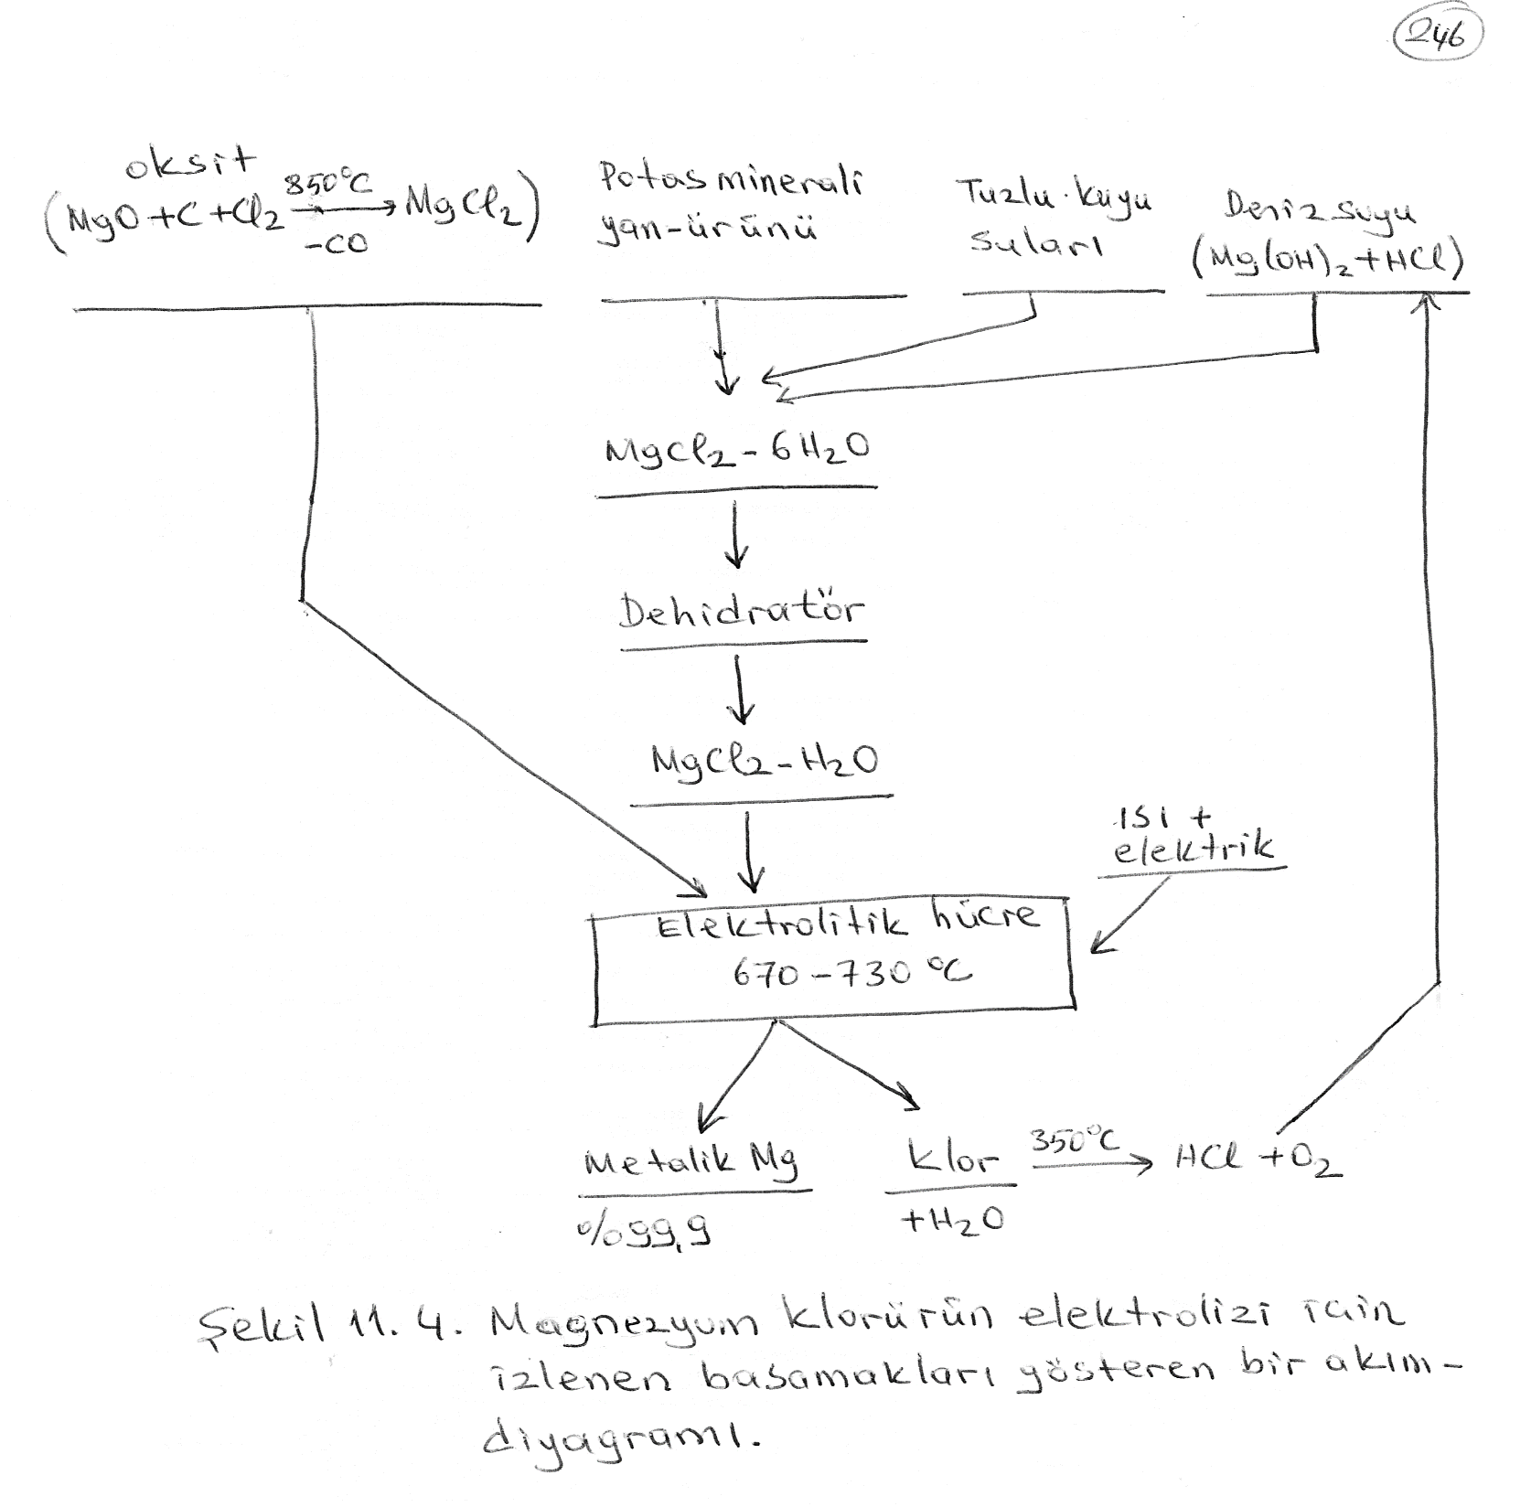

Slide 27
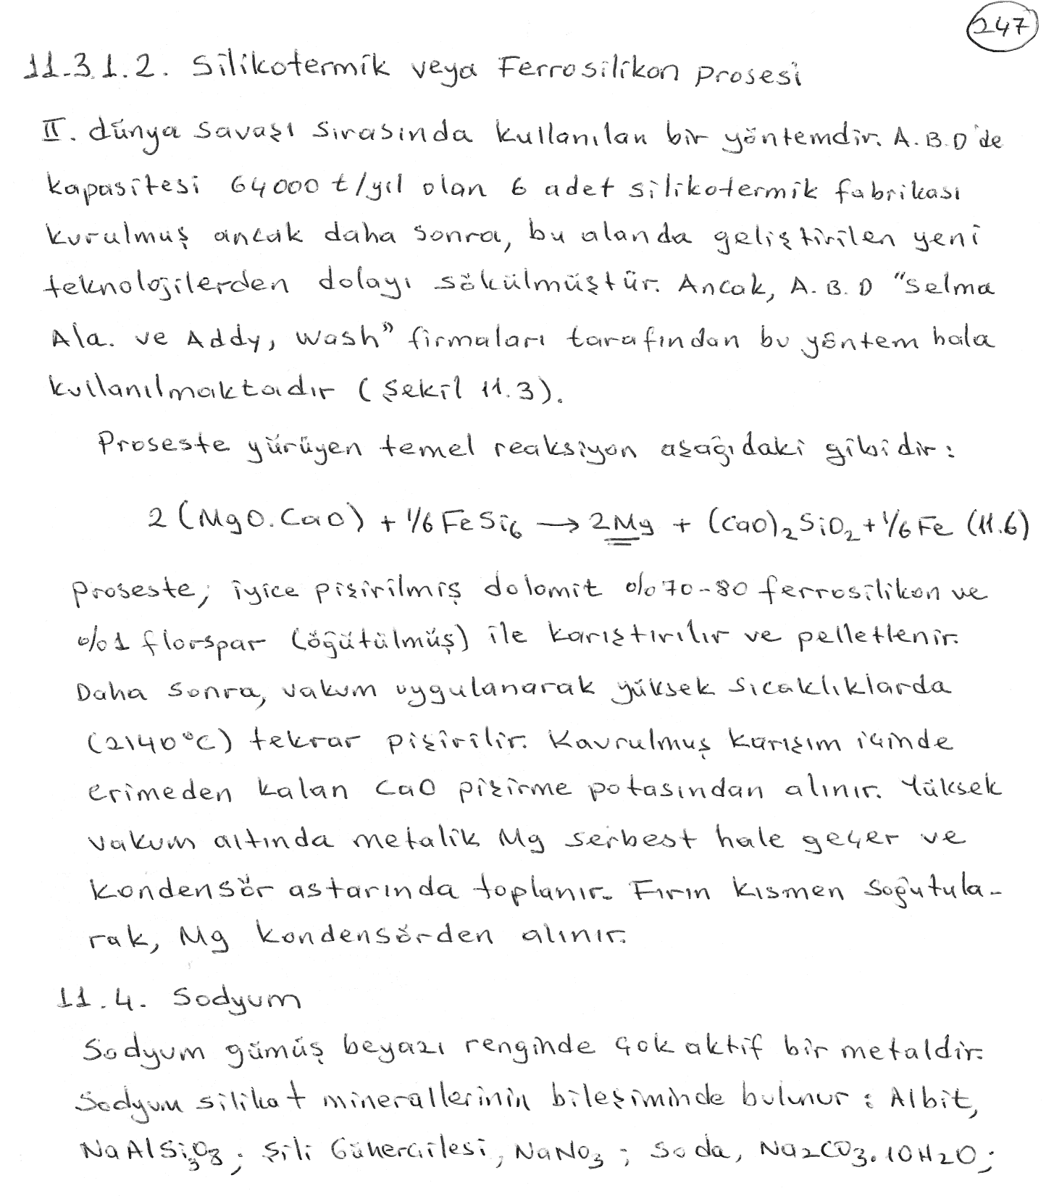

Slide 28
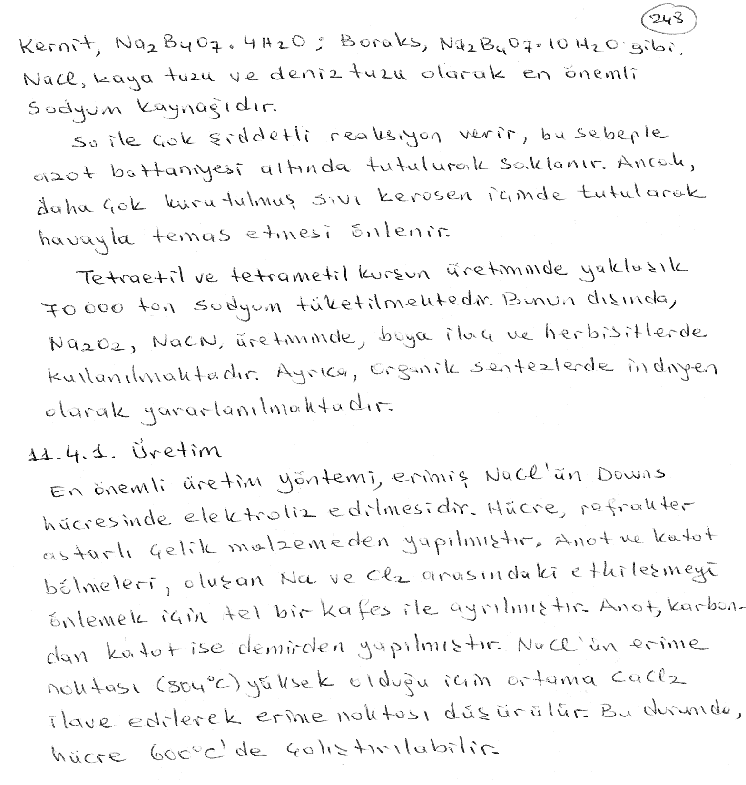

Slide 29
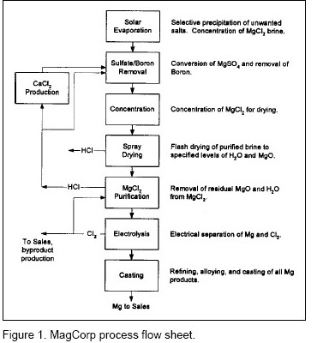

Slide 30
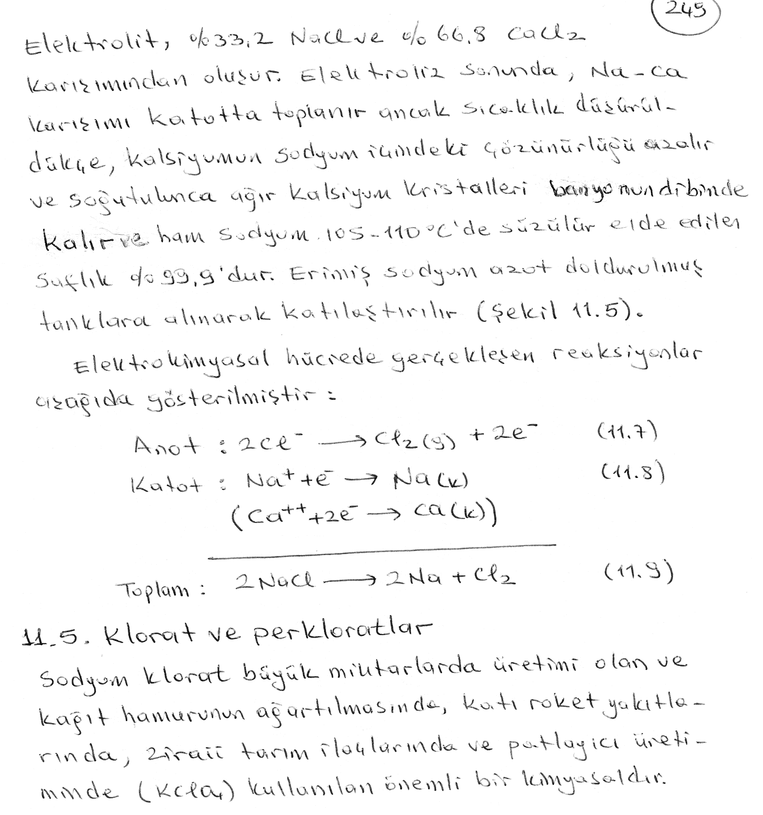
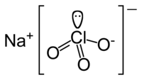

Slide 31
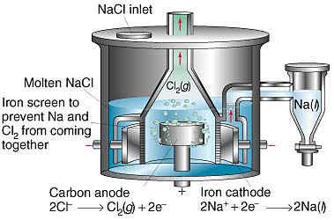
Şekil 11.5. Tuzlu sudan elektrolizle sodyum elde edilmesi için kullanılan Downs Hücresinin şematik gösterimi.

Slide 32
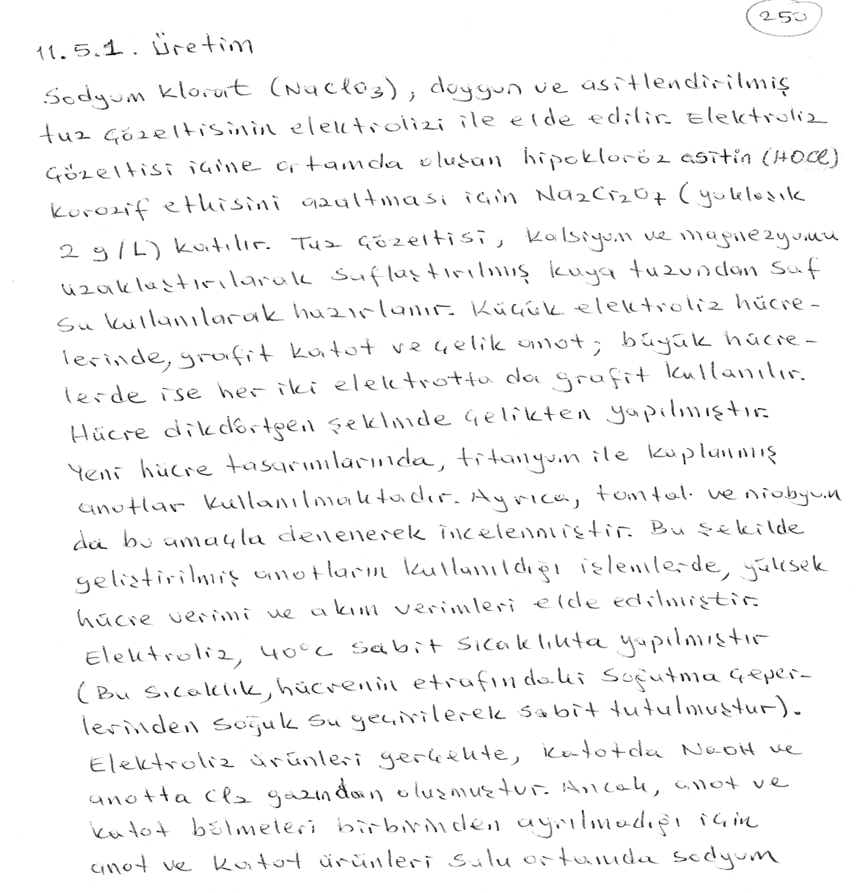

Slide 33
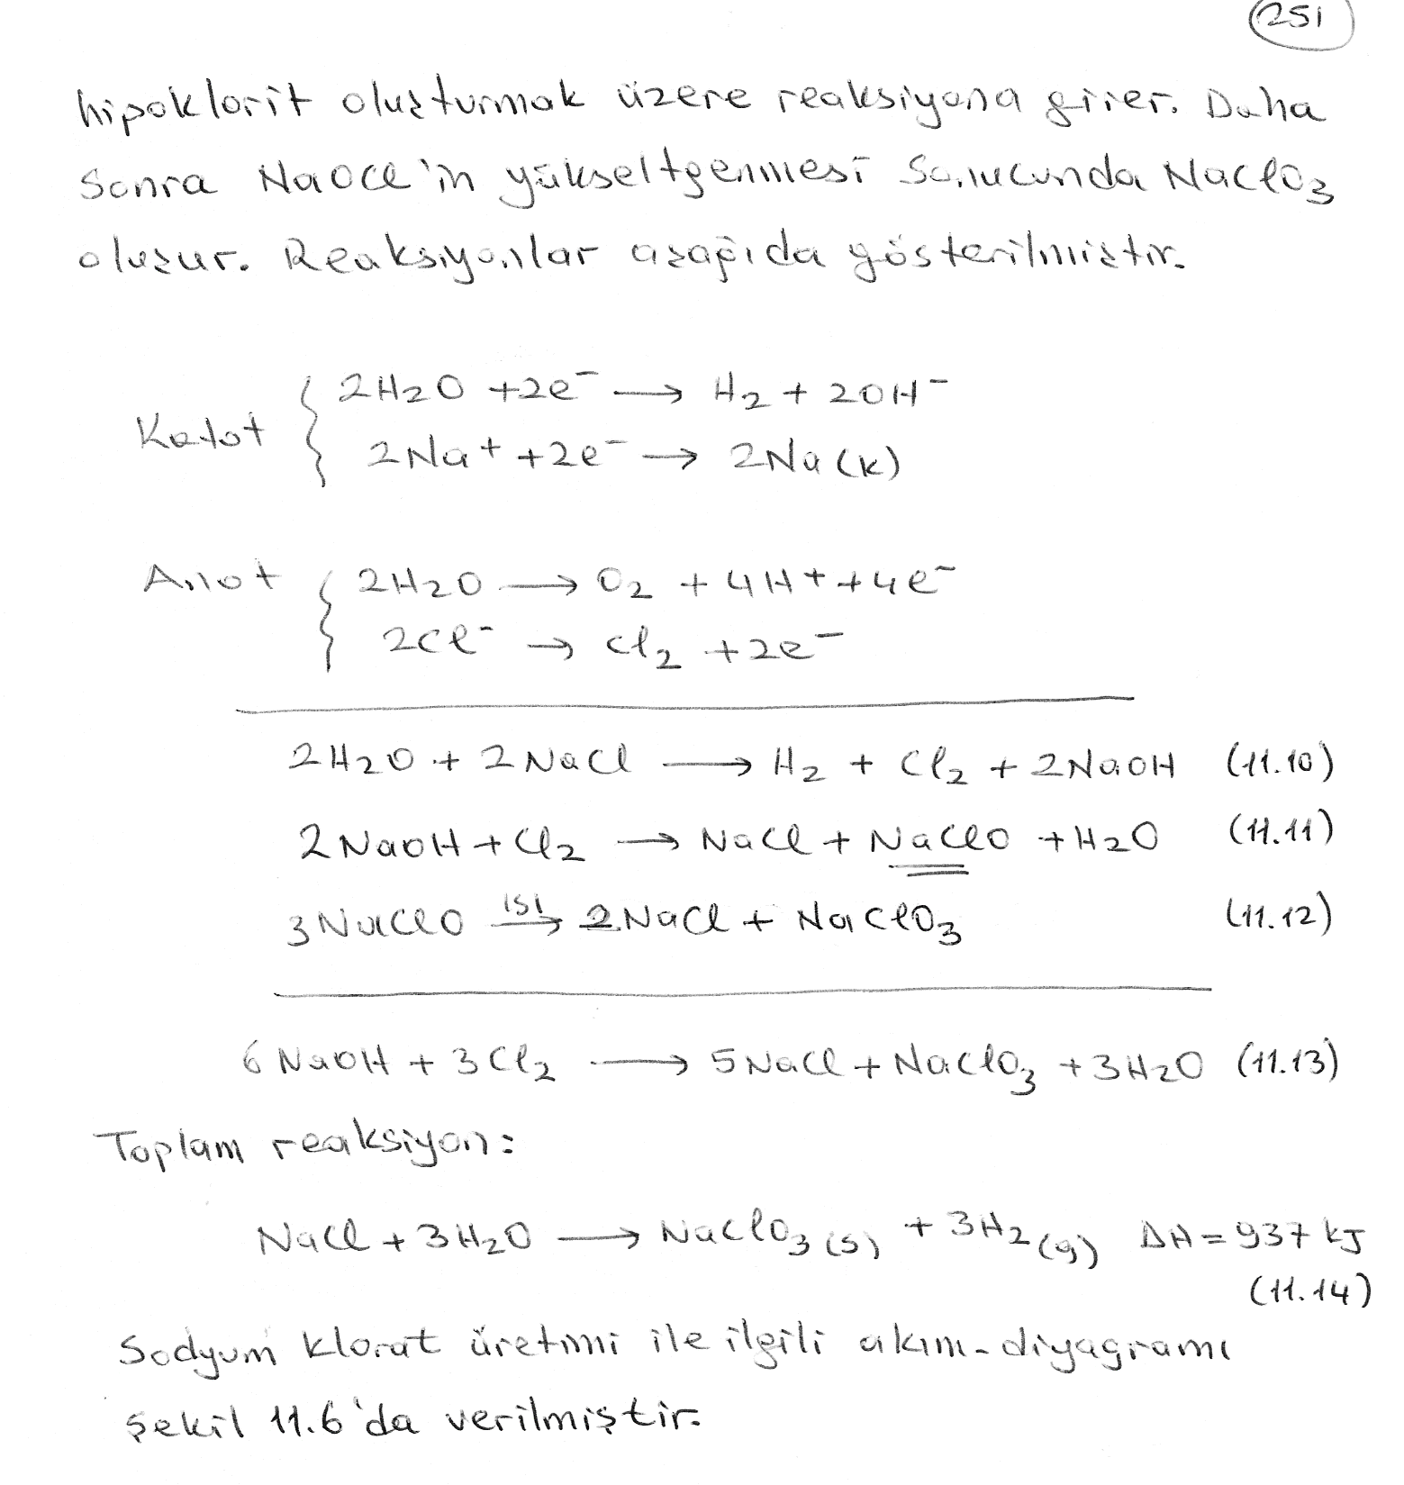

Slide 34
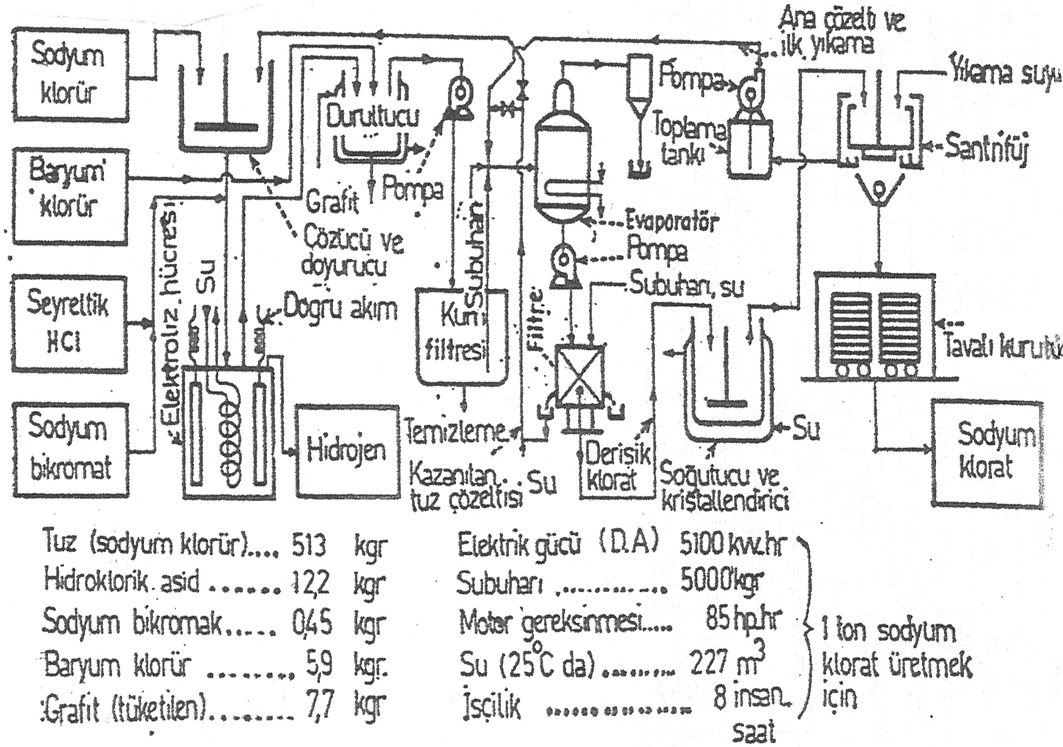
Şekil 11.6. Sodyum klorat üretimi için akım-diyagramı.

Slide 35
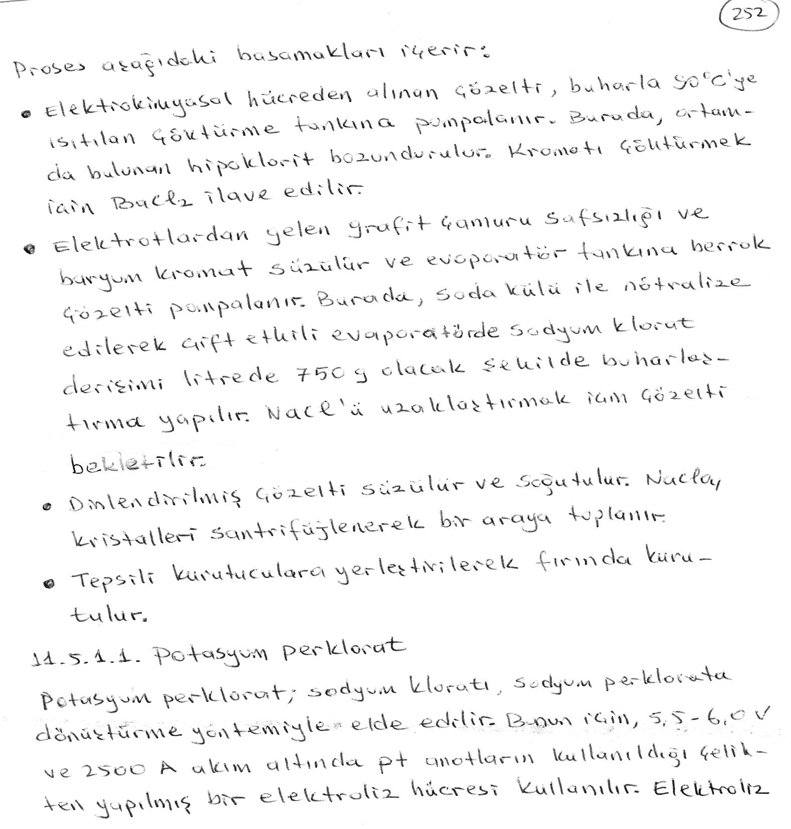

Slide 36
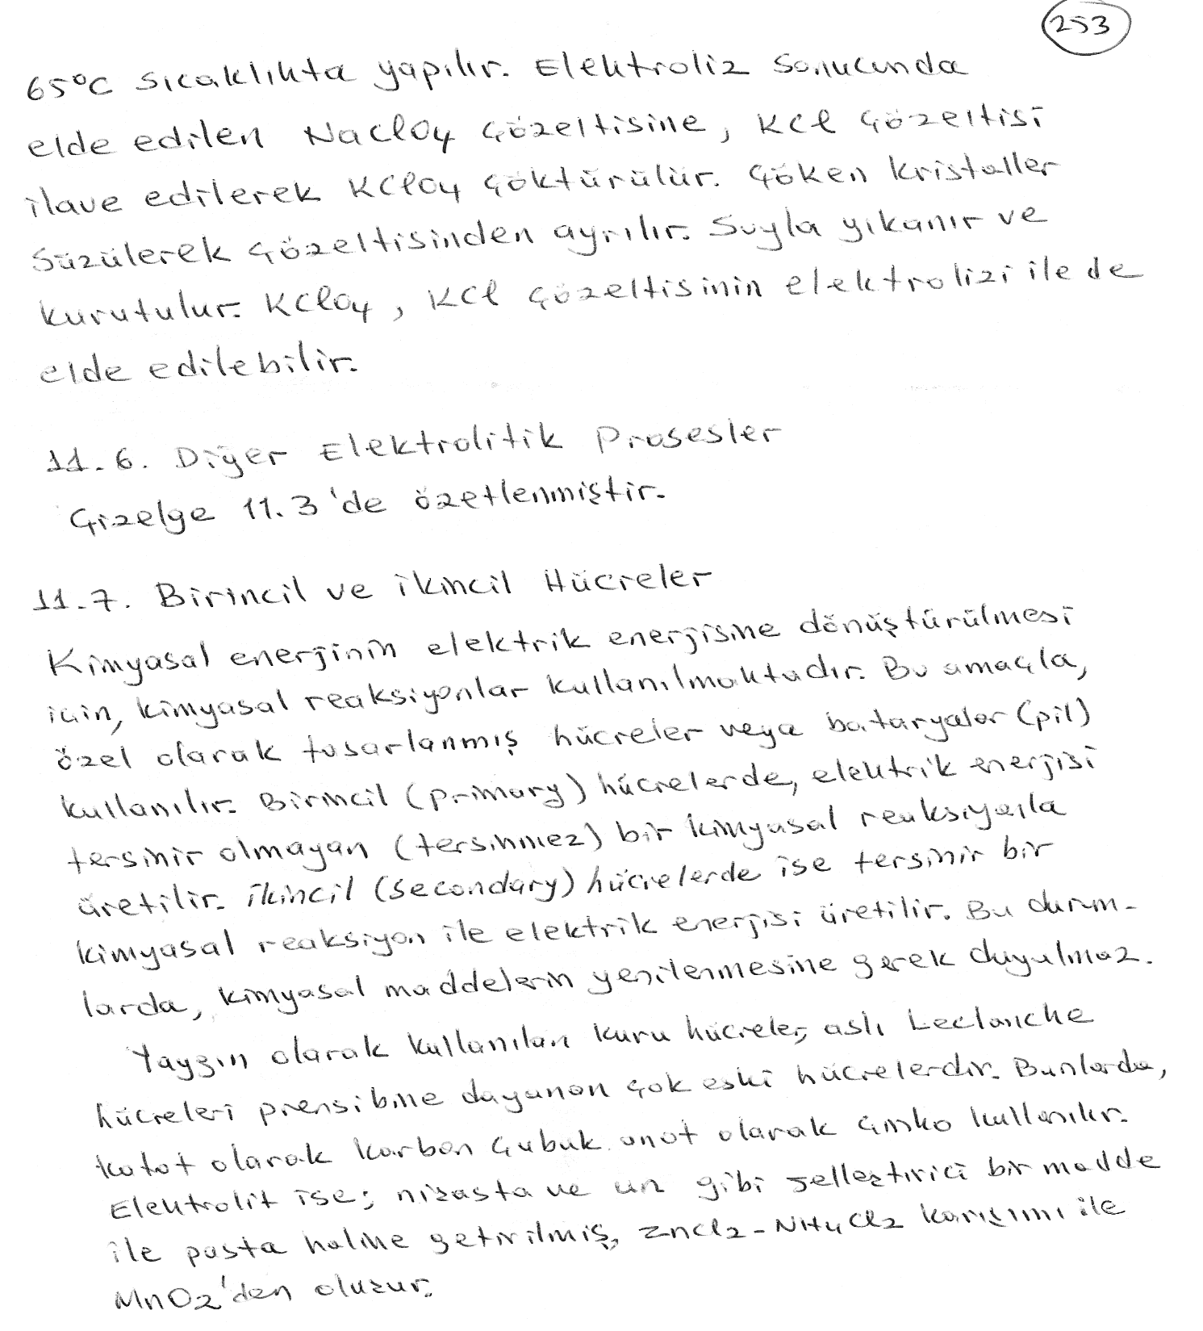

Slide 37
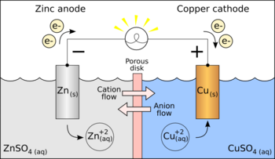
Scheme of a galvanic cell
Cu²+ + 2e− → Cu (E = +0.34 V)
Zn²+ + 2e− → Zn (E = −0.76 V)
Thus the reaction that is going on is really
Cu²+ + Zn → Cu + Zn²+
The electric potential is then +0.34 V −(−0.76 V) = 1.10 V

Slide 38
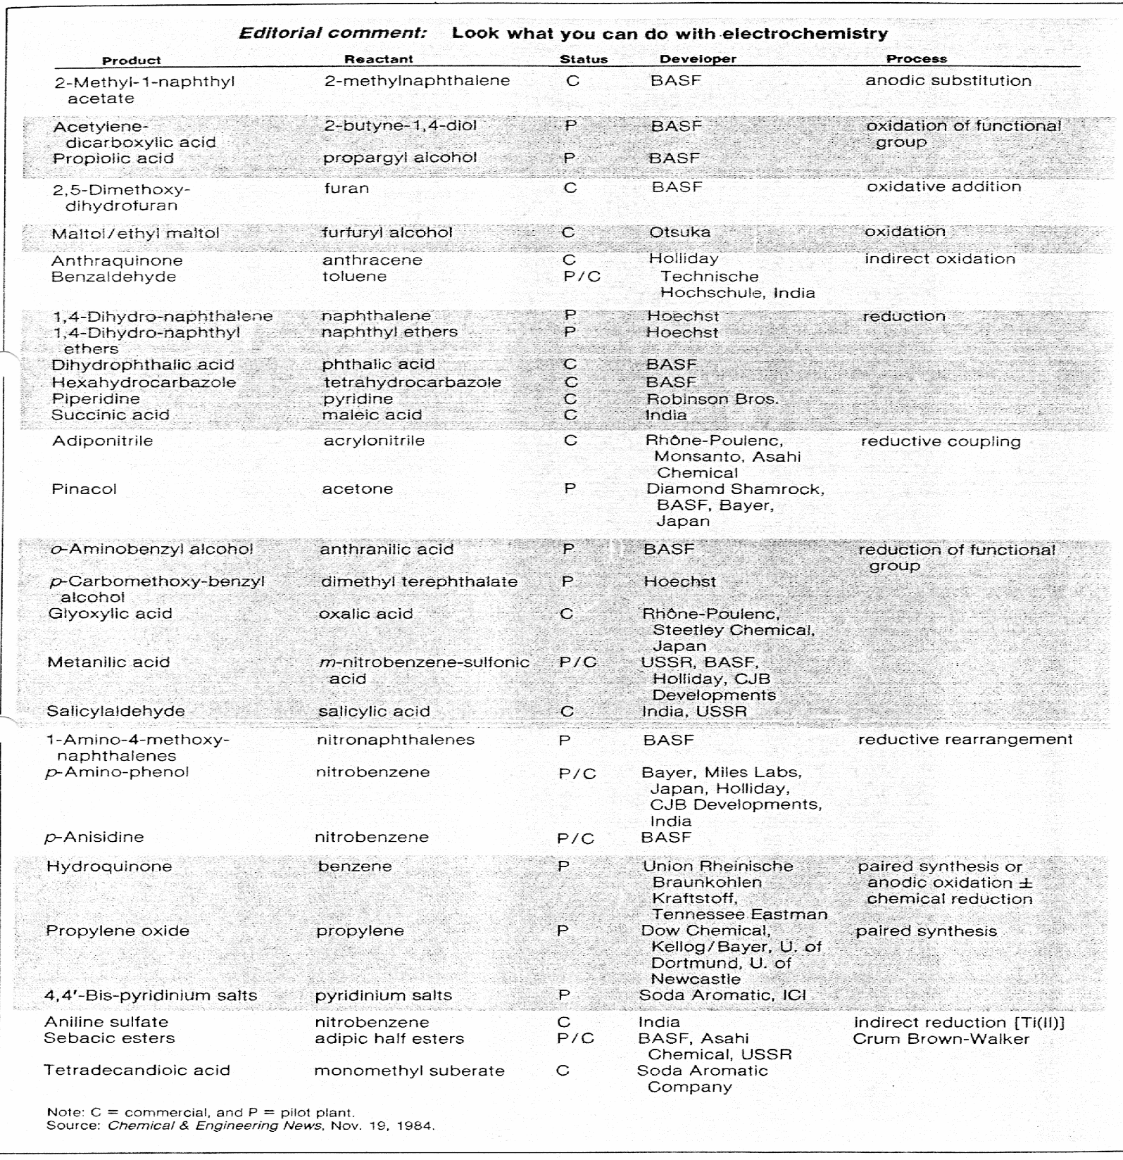
Çizelge 11.3. Diğer önemli elektrolitik prosesler

Slide 39
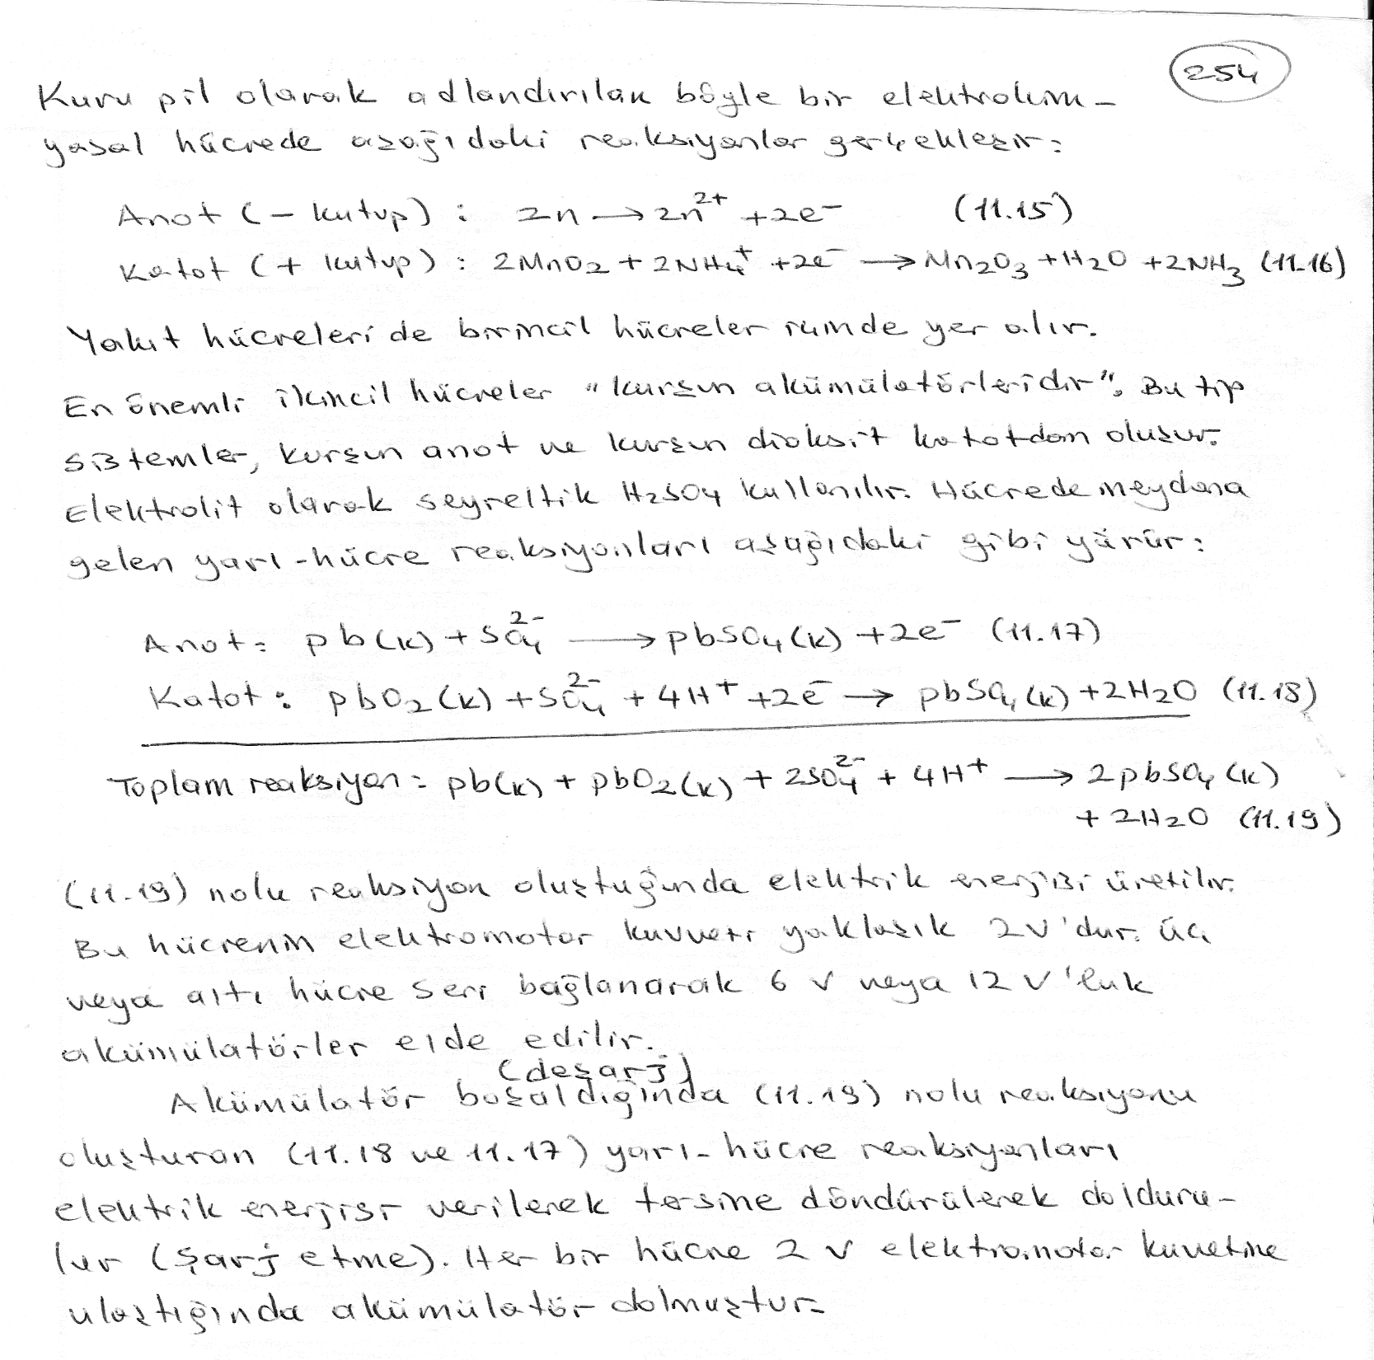

Slide 40
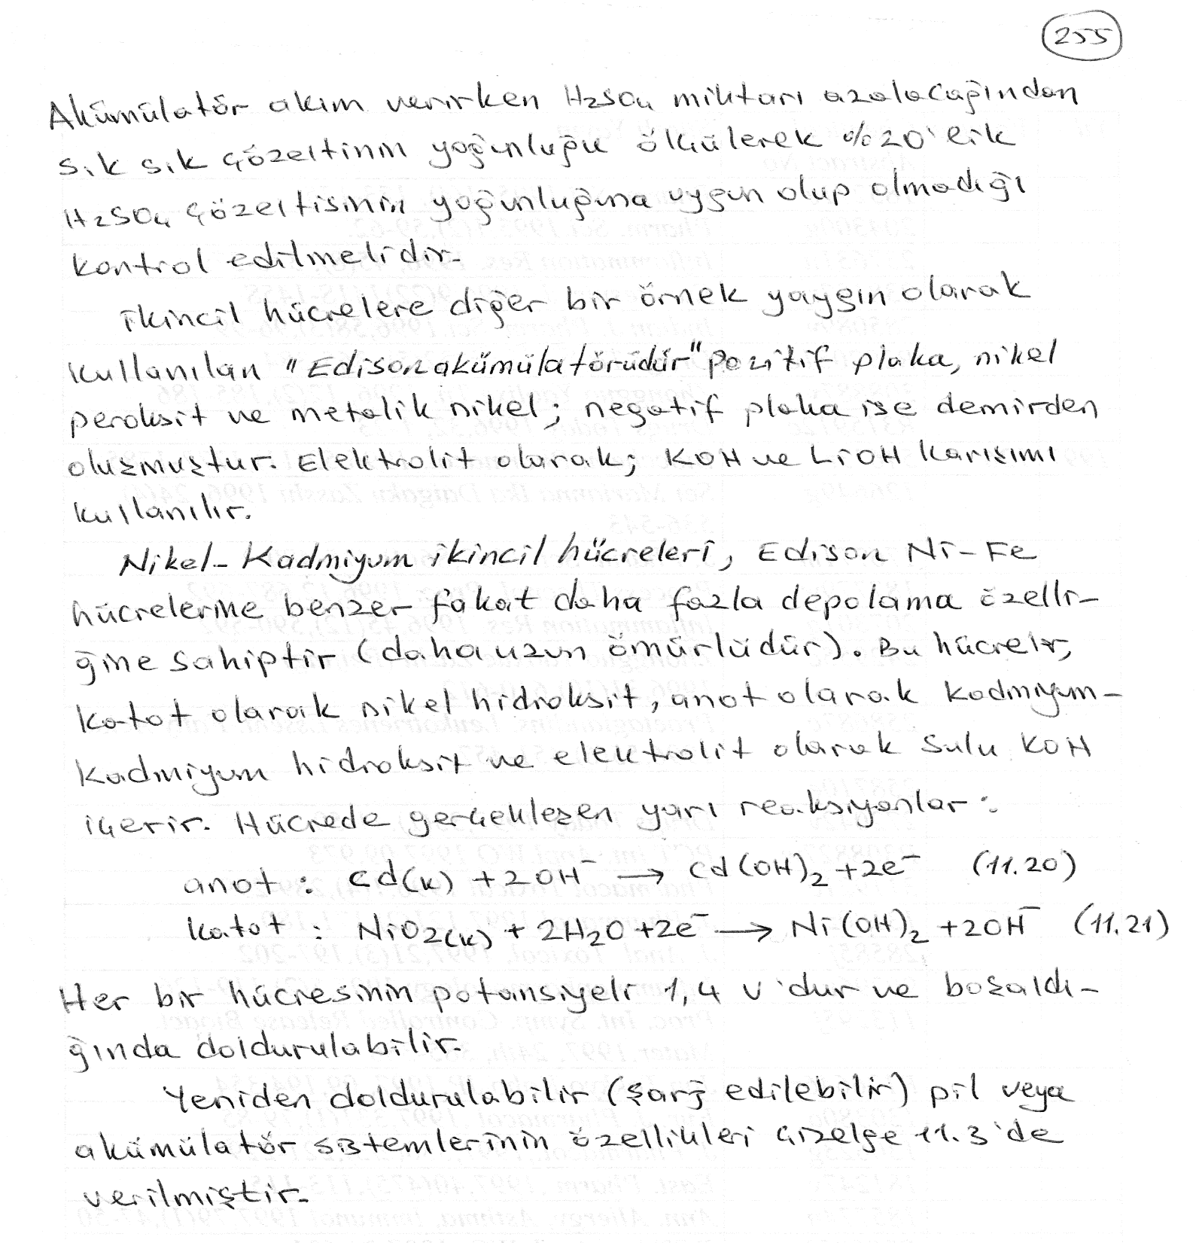

Slide 41
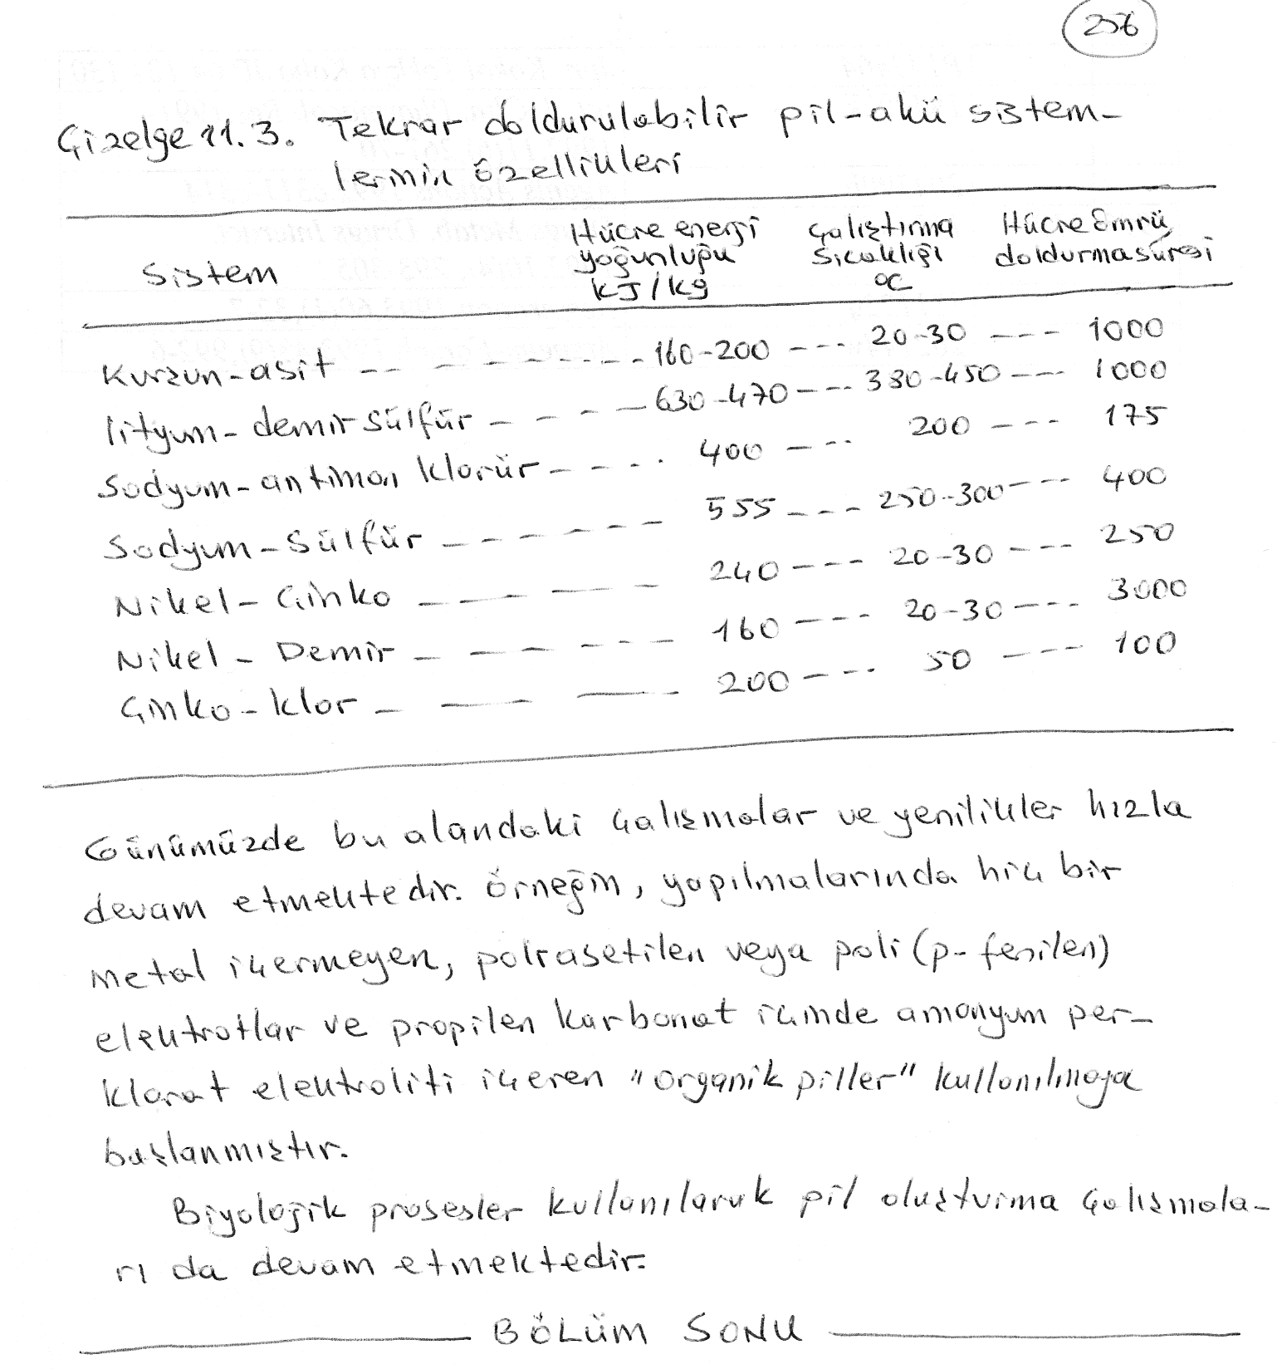

Slide 42
DÖNEM SONU

