Slide 1
EME 201 Materials Science
Grain Boundaries and Microscopy

Slide 2
Material Surface - External Surfaces
One of the most prominent boundaries is the outer surface of the crystal structure.
Surface atoms are not tied to the nearest neighbor number and therefore are in a higher energy state than the atoms in the inner state.
The bonds of these unsatisfied surface atoms cause a surface energy expressed in units of energy per unit area (J / m2).
To reduce this energy, materials tend to reduce the total surface area to the minimum if possible.
Surface imperfections are boundaries or planes that divide a material into zones; each region has the same crystal structure but with different orientations.
These defects include outer surfaces, grain boundaries, phase boundaries, twin boundaries, and stacking faults.

Slide 3
Grain Boundaries
The microstructure of many engineering materials, ceramics and metalls, are composed of many grains.
The grain is a piece of crystalline material in which the order of the atoms is almost the same.
However, the direction of the crystal structure or of the atomic order is different in each adjacent sequence.
A grain boundary separating individual grains is a narrow zone where the atoms are not uniformly spaced.
In other words, the atoms cause a compression zone because they are very close to each other in some places on the grain boundary, and they cause a tension zone because they are too far away from other areas.

Slide 4
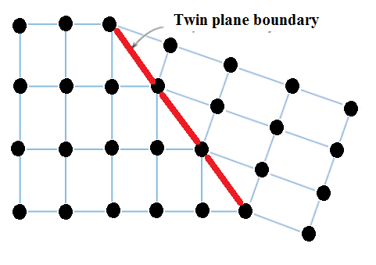
Twin Boundaries
The twin boundary is a special grain boundary type in which a particular mirror lattice symmetry is found; that is, the atoms on one side of the boundary are placed in the same image locations of the atoms on the other side.
The zone of material between these borders is called twin.
Twins arises from atomic displacements generated from applied mechanical shear forces and/or annealing heat treatments.
Figure 1. Schematic illustration exhibiting a twin plane boundary

Slide 5
ATOMIC VIBRATIONS
Every atom within the solid material vibrates very quickly around the lattice position in the crystal.
In a manner of speaking, these atomic vibrations can be thought of as imperfections.
At any given moment, all atoms do not oscillate with the same frequency and amplitude or with the same energy.
At a given temperature, there is an energy distribution for the constituent atoms about an average energy.
If we rise the temperature, this average energy also grows up.
Actually, a solid temperature is only a measure of the average vibrational activity of atoms and molecules.
For example, melting occurs when vibrations are large enough to pull off atomic bonds.

Slide 6
MICROSCOPIC TECHNIQUES
Optical microscopy is a simple image analysis technique to investigate the sample surfaces.
Optical microscopy is a technique used to bring to light the microstructural features like grain boundaries requiring less than about 2000 magnifications.
For visible light opaque materials (all metallic materials, many ceramic materials and polymeric materials) only the surface is observed and the light microscope should be used in a reflective mode.
The process of preparing a metallic sample for image analysis, and observing or recording the metal structure is called metallography.
The material sample is sanded and turned into a mirror-like lacquer.

Slide 7
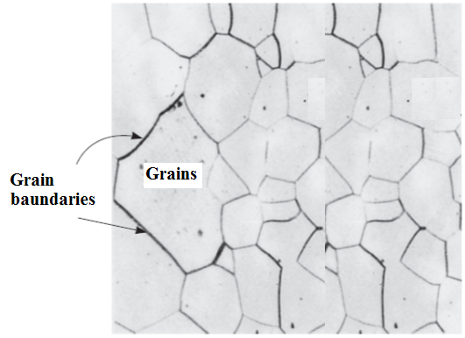
MICROSCOPIC TECHNIQUES
The surface of the material will be exposed to chemical etching.
The grain boundaries are more aggressively attacked than the rest of the grain.
The light from the optical microscope reflects or scatters from the surface of the sample depending on how the surface is patterned.
As more light is scattered from deeply patterned features such as grain boundaries, this part of the material surface will be more darker in color.
Figure 2. Microstructure of a sample surface (palladium (x100))

Slide 8
Electron Microscopy
The upper limit for possible magnification with an optical microscope is about 2000x.
As a result, some structural items are too thin or too small to allow observation using optical microscopy.
In such cases, an electron microscope with higher magnification capacity can be used.
An image of the studied structure was created using electron beams instead of light radiation.
The high magnification and resolution of these microscopes are the result of the short wave lengths of the electron beams.
The geometry of the microscope components is the same as in optical systems.

Slide 9
Electron Microscopy
Both reflection and transmission beam modes of operation are possible in electron microscopes.
There are two types of microscopy techniques depending on the operation modes.
Transmission Electron Microscopy Technique
The image obtained by a transmission electron microscope (TEM) is created by an electron beam passing the sample.
Scanning Electron Microscopy Technique
The surface of a sample to be investigated is scanned by an electron beam and the reflected electron beam is collected and then shown on a cathode ray tube.
The picture taken on the screen shows the surface properties of the sample.

Slide 10
REFERENCES
William D. Callister, ‘Materials Science and Engineering: An Introduction’, Seventh edition, John Wiley & Sons, Inc., U.S.A.
Brian S. Mitchell, ‘AN INTRODUCTION TO MATERIALS ENGINEERING AND SCIENCE FOR CHEMICAL AND MATERIALS ENGINEERS’, John Wiley & Sons, Inc., U.S.A, 2004.
J. W. Martin, ‘Materials for Engineering’, Third Edition, WOODHEAD PUBLISHING LIMITED, Cambridge, England.
Donald R. Askeland & Pradeep P. Fulay, ‘Essentials of Materials Science and Engineering’, Second Edition, Cengage Learning, Toronto, Canada.
G. S. Brady, H. R. Clauser, J. A. Vaccari, ‘Materials Handbook’, Fifteenth Edition, McGraw-Hill Handbooks.

