Slide 1
POXVIRIDAE

Slide 2
Poxviruses produce skin pocks.
Poxviruses occur naturally in most veterinary species except the dog. Pox viruses spread by contact in dirty unhygienic conditions which are now returning to environmentally -enriched pig and poultry housing.
Most are zoonotic and cause skin pox.

Slide 3
Schematic diagram of the structure of poxvirus virion.
Viral DNA and several viral proteins within the core form the nucleosome (N).
the core is covered with a 9 nm thick core membrane (CM) and assumes a dumbbell shape because of two lateral bodies (LB), which is eventually enclosed within a protein shell of 12 nm thickness (outer membrane) containing irregular surface tubules (T).
The virion is enclosed in a lipid bilayer envelope containing virus-specific proteins. (Reproduced with permission from Willey JM: Prescott, Harley, & Klein’s Microbiology, 7th edition. McGraw-Hill, 2008.)
Electron microscopic appearance of a poxvirus (vaccinia). (Negative stain; original magnification ×60000.) (Courtesy of Dr Claire M. Payne.)

Slide 4
dsDNA
Huge, up to 450 nm long with a complex capsid symmetry.
The poxviruses are subdivided into genera which differ in external structure by EM.
Most poxviruses grow in host cell lines and on the external surface of chick chorioallantoic membrane in-ovo, (ectoderm for pox compared to endoderm for myxoviruses), where they produce nodular lesions, "pocks".
Infected cells enlarge with vesicles and very large eosinophilic intracytoplasmic inclusion bodies (ballooning).
Smallpox = variola, eradicated
Vaccinia is the smallpox vaccine and is a recombinant of cowpox and variola
Orf

Slide 5
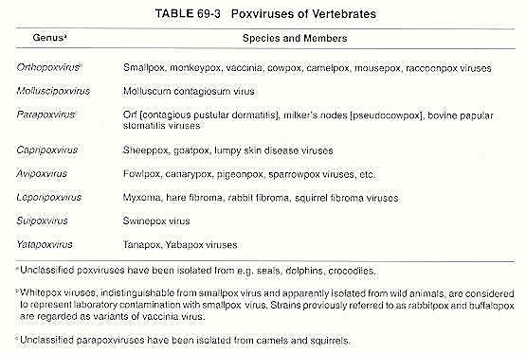
Classification
Baron S, (1996) Medical Microbiology. 4th edition. Chapter 69, University of Texas Medical Branch at Galveston;.

Slide 6
Pathogenesis
Primary replication in abraded squamous epithelium.
Viraemia then multiple infections of skin epidermis.
Ballooning then necrosis of the epidermal cells of the skin with a proliferation of the adjacent epidermal cells in response to epidermal growth factor encoded by the virus. This proliferation provides the virus with new host cells.
The proliferation, ballooning, and final necrosis (hydropic degeneration) of infected cells gives rise to the classical sequence of lesions seen as
papule,
vesicle,
pustule,
scab.
The centre of the pock can become secondly infected. Resolution in 3-4 weeks.
Other poxviruses spread to the upper respiratory tract eg fowlpox and cat pox. More rarely virus will replicate in the viscera giving rise to multiple focal lesions which are often fatal, e.g. sheep pox.

Slide 7
Lezyonlar 5 dönem gösterir.
Std.Eritematosum-eritem oluşumu (1-3 cm çapında)
Std.Papullosum- proliferasyon ve subepidermal papül oluşumu(deride kırmızı renkli mercimek büyüklüğünde sert düğümcük oluşumu)
Std.vesiculosum:Papülün 4.gününden itibaren içleri berrak sıvı ile dolu,etraflarnda hiperemik alan bulunan veziküller oluşur.Veziküllere 10 günde olgunlaşır.
Std.pustulosum: papüllerin içi fibrin ve nötrofil ile doludur. Püstüllü dönem 8-10 gün sürer.. Bu lezyonlar cowpoxvirusla oluşan enfeksiyonda daha koyudur.
Std. Crustosum: Kabuklaşma dönemidir.

Slide 8
https://emedicine.medscape.com/article/237229-clinical

Slide 9
Cowpox
In this mild, eruptive disease of dairy cows, lesions are seen on the udder and teats. Although once common, cowpox is now extremely rare and reported only in western Europe.
The contagious virus responsible for Cowpox in cattle can also affect other species including humans, small wild mammals and cats.
There is only one reported case of cowpox affecting a dog.
Signs of the disease include skin lesions (nodules, scabs and ulcers), eye problems (conjunctivitis) and respiratory signs (pneumonia). Cowpox in cats occurs mainly in Europe and Asia.

Slide 10
Cowpox virus can be transmitted to humans, and so this disease is a zoonosis.
Proper hygienic precautions such as washing hands thoroughly should be taken after contact with animals which could be carrying the disease, especially children and people with impaired immune function. Gloves must be worn when handling infected animals.

Slide 11
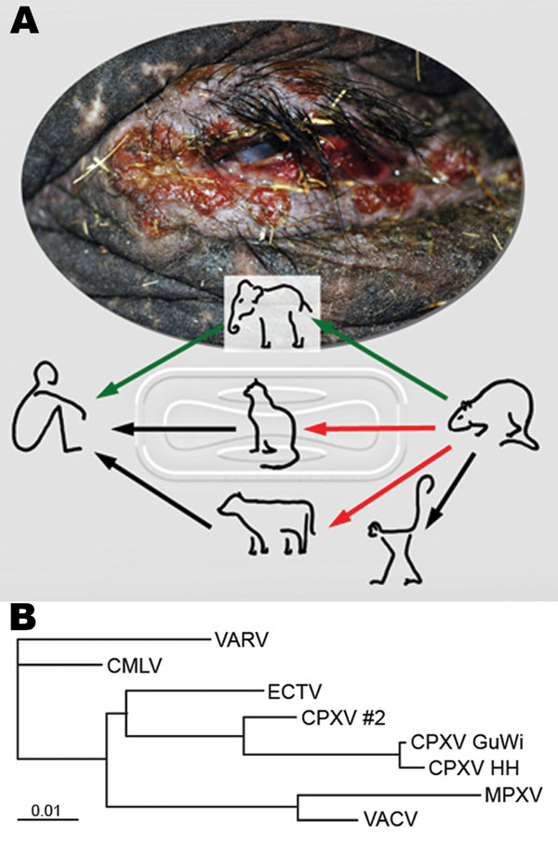
Etiology
The cause of Cowpox is an orthopoxvirus.
It is transmitted through a bite or skin wound and usually causes skin lesions, although respiratory and ocular signs may occur following viraemia.
Cats are usually infected having caught infected rodents but direct transmission from cat to cat, or human to human can occur.
In cattle transmission is via milkers hands or teat clusters on automated milking machines.
The virus is resistant in the environment surviving many months under dry conditions.
Kurth A, Wibbelt G, Gerber H, et al. Rat-to-Elephant-to-Human Transmission of Cowpox Virus. Emerging Infectious Diseases. 2008;14(4):670-671. doi:10.3201/eid1404.070817.

Slide 12
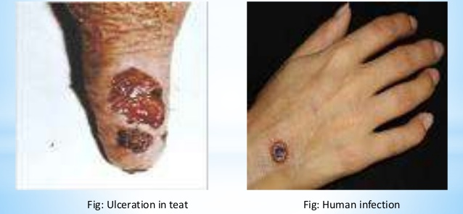
The virus of cowpox is closely related antigenically to vaccinia and smallpox viruses.
Indeed, the first two can be differentiated only by sophisticated laboratory techniques.
Before vaccination of the general population against smallpox was discontinued, some outbreaks of cowpox in cows in North America and Europe were due to infection with vaccinia from recently vaccinated persons.
Vaccinia-related viruses continue to cause occasional outbreaks of teat infections in dairy cattle in South America and buffalo in the Indian subcontinent. These viruses often spread to people in contact with cattle.
The epidemiology of these viruses is unknown, but it has been suggested that they are vaccine viruses that spread to animals during the smallpox vaccination campaigns.

Slide 13
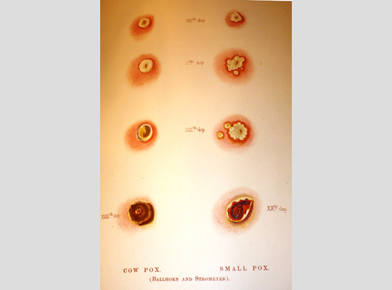
Vaccinia Cowpoxvirus
- ECE CAM necrosis - these lesions are hemorrhagic and proliferative
- a large number of small granular -big and homogen intracytoplasmic inclusion bodies
intracytoplasmic inclusion bodies
- Doesn’t infect mice - Infect mice
- 3-4 days after infection it causes pock lesion - Doesn’t infect chicken

Slide 14
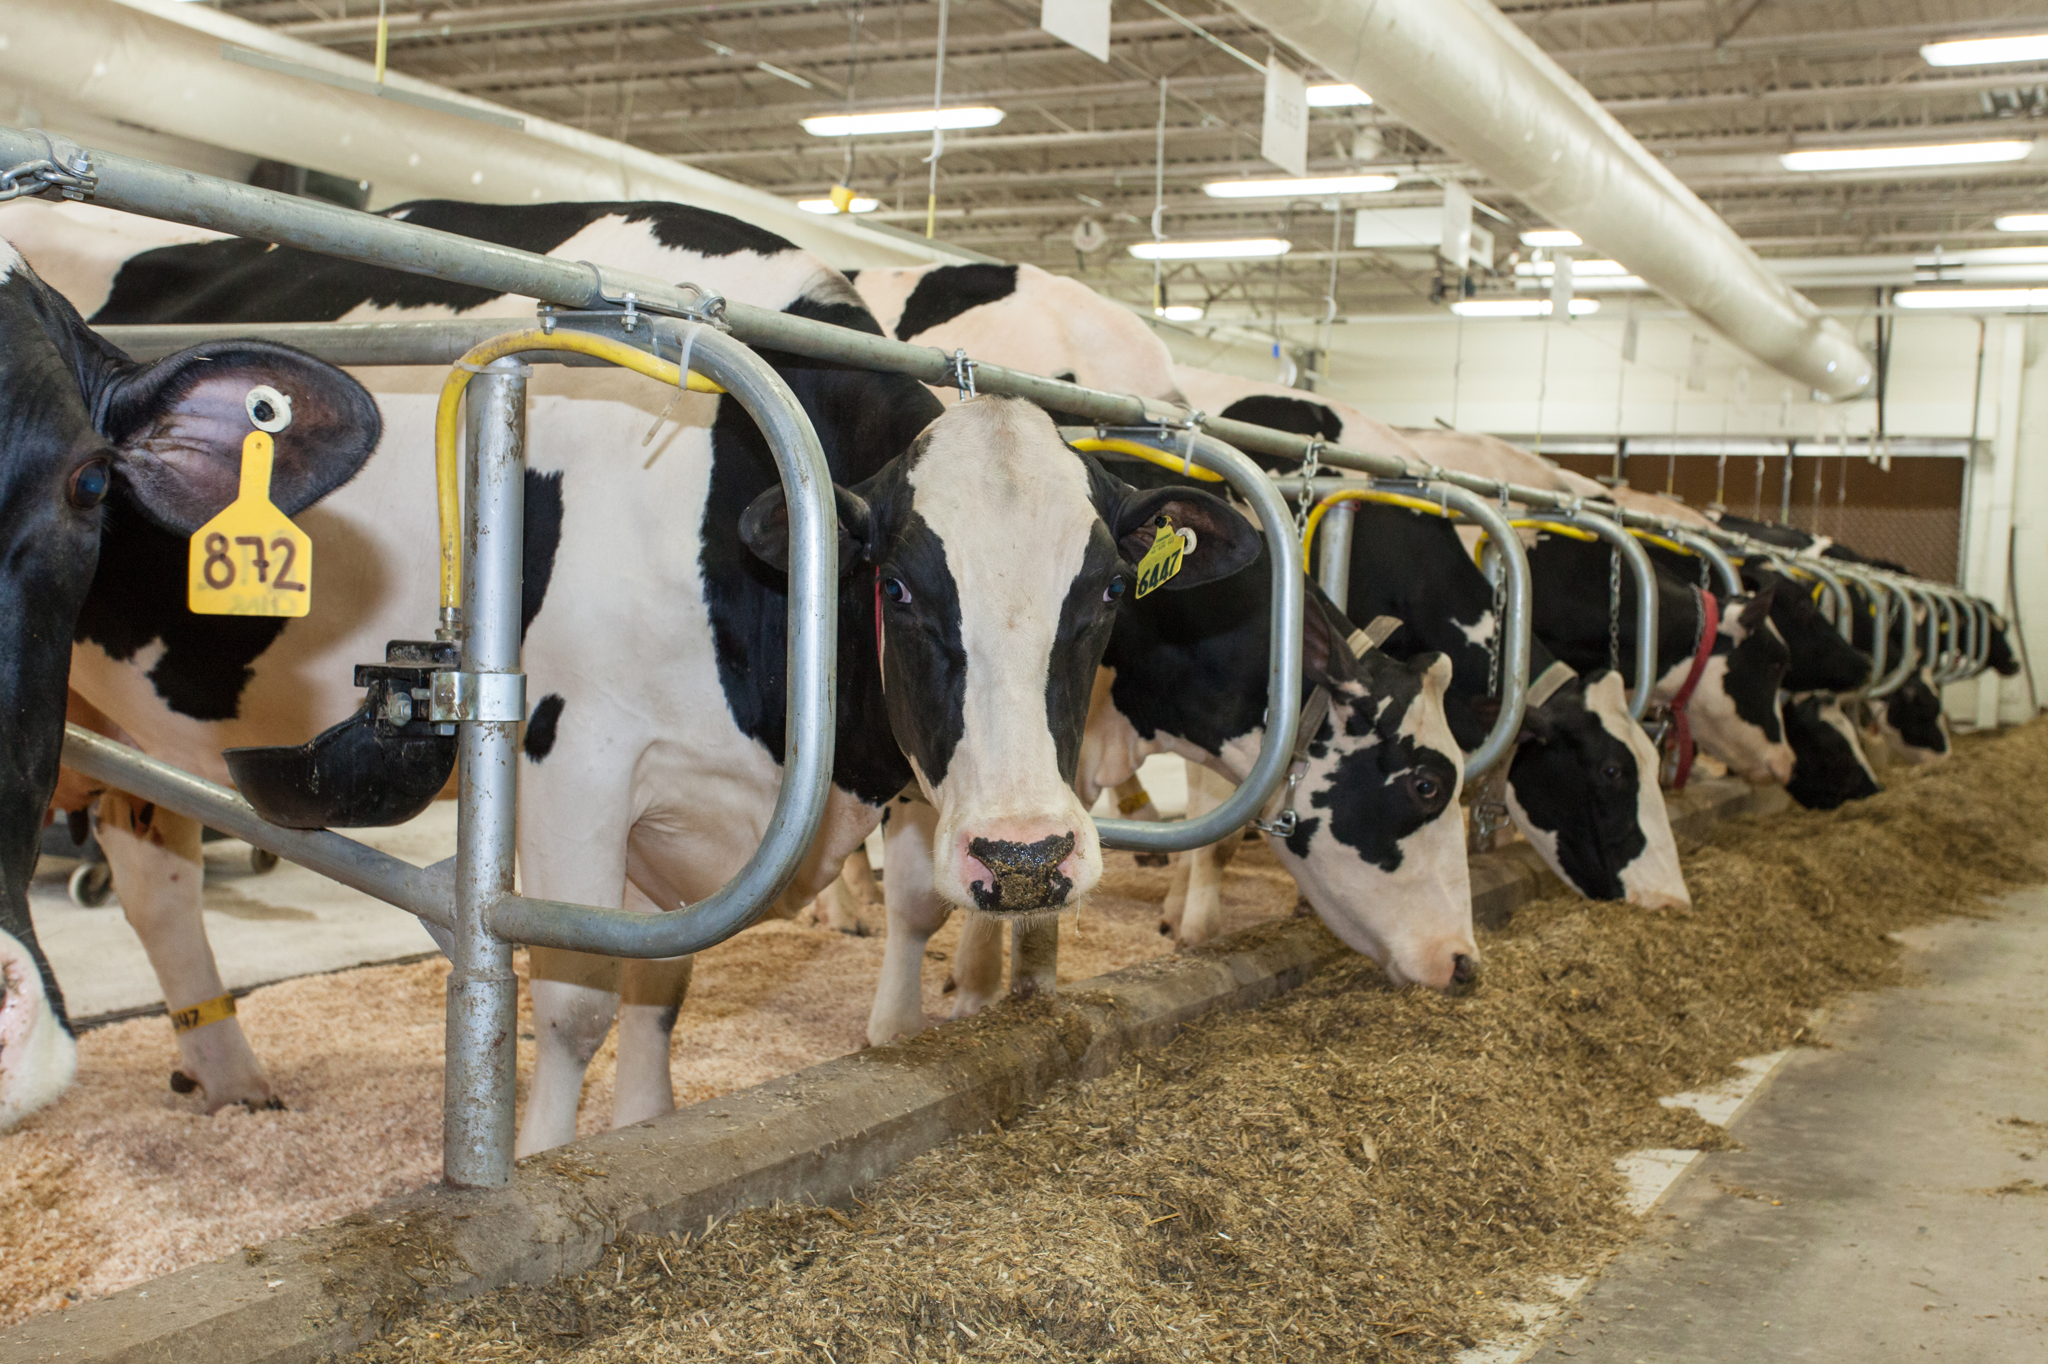
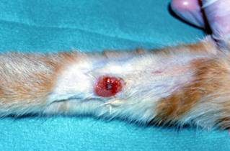
Dairy cattle are at greater risk than others.
In cats there is no breed predisposition to infection, but predators (eg cats) that catch infected small wild animals (especially gerbils, ground squirrels, voles, wood mice) which act as a reservoir for the disease are at greater risk of contracting the disease.
https://icatcare.org/advice/cat-health/cowpox-virus-infection-cats

Slide 15
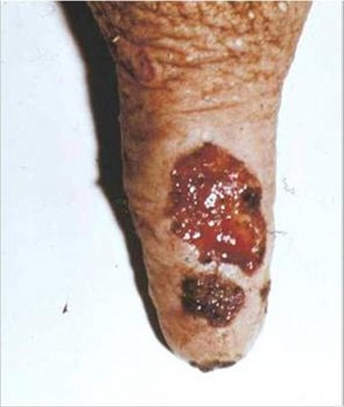
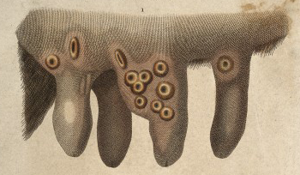
Clinical Signs
Cattle
Incubation period about 3-6 days
Typical pox lesions on the teats and udder.
Erythema, papules with a zone of hyperemia around
the base, vesiculation, pustular stage and scab
Scabby pox lesions (1-2 cm) and ulcers
on the teats and udder
Most cows in a herd will be infected
Secondary mastitis develops in some cases
Calves - get lesions in the mouth
Bulls - get lesions on the scrotum

Slide 16
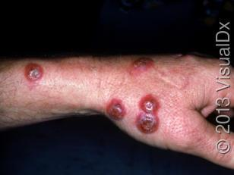
Human Cowpox is rare (1-2 cases are reported per year in the UK).
Cats are thought to be a main source of infection but direct contact with infected cattle is also a common source of infection. Signs in humans are most likely to occur in people with poor immunity or pre-existing skin disease and they include :
Painful skin with scabby lesions –usually on the hands or face
General malaise - if they are viraemic
Fever
Death - very rare

Slide 17
Diagnosis
Diagnosis can be made by :
Isolating Cowpox virus from scabs collected from skin lesions.
Measuring blood antibodies (fluorescent antibody test)
PCR
Differential Diagnosis
Pseudocowpox
Bovine ulcerative mammillitis associated with bovine herpesvirus-2 and bovine herpesvirus-4
Vesicular stomatitis, and foot and mouth disease
Udder impetigo
Teat chaps and frostbite

Slide 18
Control
Prevention of spread is difficult, since the virus responsible for the disease is readily transmitted by direct or indirect contact.
Udder cloths, milking machines and hands should be disinfected after contact with infected animals.
Dipping of the teats in an alcoholic tincture of a suitable disinfectant, such as quaternary ammonium compounds, is usually satisfactory in preventing immediate spread.
The prevalence and significance of the disease in cattle is too low to warrant the development of vaccines.

Slide 19
References
http://www.msdvetmanual.com/integumentary-system/pox-diseases/cowpox
http://www.provet.co.uk/health/diseases/cowpox.htm
http://www.vetbook.in/viral-disease-cow-pox.html

Slide 20
SHEEP POX AND GOAT POXVIRUS
Sheep pox and goat pox are contagious viral diseases of small ruminants.
These diseases may be mild in indigenous breeds living in endemic areas, but they are often fatal in newly introduced animals.
Economic losses result from decreased milk production, damage to the quality of hides and wool, and other production losses.
Sheep pox and goat pox can limit trade, inhibit the development of intensive livestock production, and prevent new breeds of sheep or goats from being imported into endemic regions.
NOTIFABLE DISAESE

Slide 21
Etiology
Poxviridae, genus Capripoxvirus
Sheep pox virus (SPPV) and goat pox virus (GTPV) were once believed to be strains of the same virus, but genetic sequencing has now demonstrated them to be separate viruses.
Sheep pox and goat pox result from infection by sheeppox virus (SPPV) or goatpox virus (GTPV),
SPPV is mainly thought to affect sheep and GTPV primarily to affect goats, but some isolates can cause mild to serious disease in both species. SPPV and GTPV can be distinguished by a few specialized genetic tests.

Slide 22
SPPV and GTPV cannot be distinguished from each other with serological techniques, including viral neutralisation.
PPPV and GTPV are also closely related to lumpy skin disease virus in cattle (LSDV), but there is no evidence LSDV causes disease in sheep and goats. It has a different transmission mechanism (insects) and partially different geographic distribution.

Slide 23
SPPV and GTPV only appear to affect sheep and goats.
It seems plausible that these viruses could cause disease in wild relatives of small ruminants, but there are no reports of any infections in free-living or captive wild species.
Zoonotic potential
SPPV and GTPV are not thought to infect humans.
Two published cases suggested that capripoxviruses might be transmitted to people, but these reports are considered doubtful.
Morbidity rate: Endemic areas 70–90%
Mortality rate: Endemic areas 5–10%, although can approach 100% in imported animals

Slide 24
Geographic Distribution
Sheep pox and goat pox are endemic in north and central Africa, parts of the Middle East, Turkey, and some parts of Asia including the Indian subcontinent.
Frequent outbreaks in Greece and occasional outbreaks in Bulgaria are thought to be caused by viruses that enter these countries during outbreaks in Turkey.

Slide 25
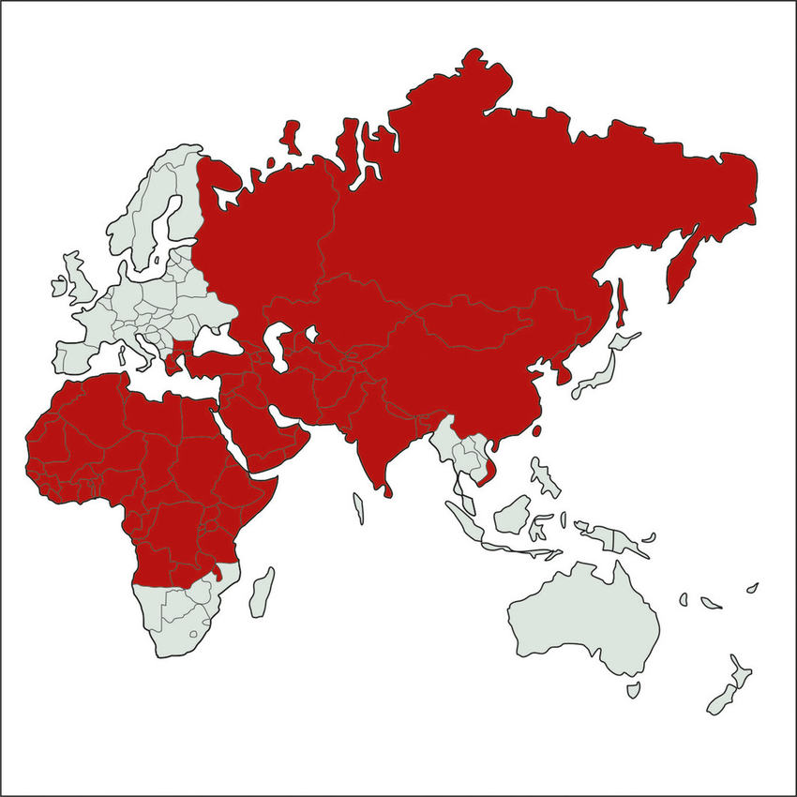
Tuppurainen, E. S. M., Venter, E. H., Shisler, J. L., Gari, G., Mekonnen, G. A., Juleff, N., ... & Babiuk, S. (2017). Capripoxvirus Diseases: Current Status and Opportunities for Control. Transboundary and emerging diseases, 64(3), 729-745.

Slide 26
Transmission
SPPV and GTPV appear to be transmitted mainly during close contact, but also occur in contaminated environments.
Aerosols are thought to be important in transmission.
These viruses may also enter the body through other mucous membranes or abraded skin.
Mechanical transmission by insects appears possible, although it is not thought to be important in the epidemiology of sheep pox or goat pox.
Sheep and goats do not become chronically infected carriers.

Slide 27
Sources of virus
Ulcerated papules on mucous membranes prior to necrosis
Skin lesions with scabs: contain large amounts of virus in association with antibody but infectivity is not known
Saliva, nasal and ocular secretions
Milk, urine, faeces
Semen or embryos: transmission not yet established

Slide 28
Clinical Signs
Estimates of the incubation period in the field differ between sources, but are generally in the range of 1-2 weeks.
Clinical signs would be expected to appear sooner when the virus is inoculated by insects than when it is transmitted in aerosols.

Slide 29
Sheep pox and goat pox appear similar, with clinical signs that
typically include fever,
enlarged superficial lymph nodes,
oculonasal discharge, and
poxviral lesions that may affect the skin, (Skin lesions: congestion, haemorrhage, oedema, vasculitis and necrosis. All the layers of epidermis, dermis and sometimes musculature are involved) mucous membranes and internal organs.
Some animals develop numerous lesions and become severely ill; others have mild or no clinical signs.
Yune, N., & Abdela, N. (2017). Epidemiology and Economic Importance of Sheep and Goat Pox: A Review on Past and Current Aspects. J Vet Sci Technol, 8(430), 2.

Slide 30
Pox lesions
Skin lesions tend to be more frequent and visible on sparsely wooled/ haired skin such as
mouth,
nose,
pharynx,
epiglottis,
trachea,
on the rumenal and abomasal mucosae,
vulva, prepuce, testicles, udder, and teats
but in more severe cases, they may cover the entire body.
In animals with heavy wool, lesions can be easier to find by palpation than visual inspection. Some animals may have only a few lesions, often around the ears or the tail.
the axillae,
muzzle,
eyelids,
ears,
mammary gland and
inguinal area,
http://www.wikiwand.com/en/Sheeppox

Slide 31
Skin lesions typically begin as erythematous macules and develop into 0.5-1.5 cm hard papules.
The centers of the papules become depressed, whitish gray and necrotic, and are surrounded by an area of hyperemia.
They eventually develop dark, hard, sharply demarcated scabs.
Vesicles might be seen during the intermediate stage, but are uncommon
Goat Pox lesions showing necrotic (see glossary) areas on skin.
http://www2.gsu.edu/~mstnrhx/EnviroBio%20Projects/bioweapons/SGP.htm

Slide 32
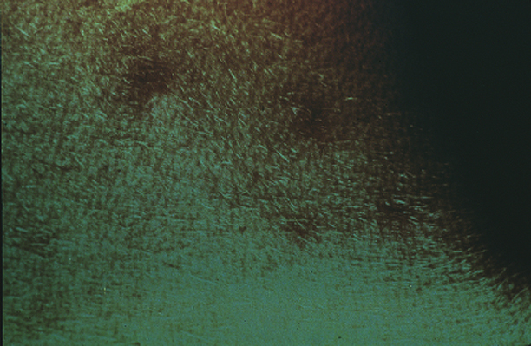
Std. papullosum

Slide 33
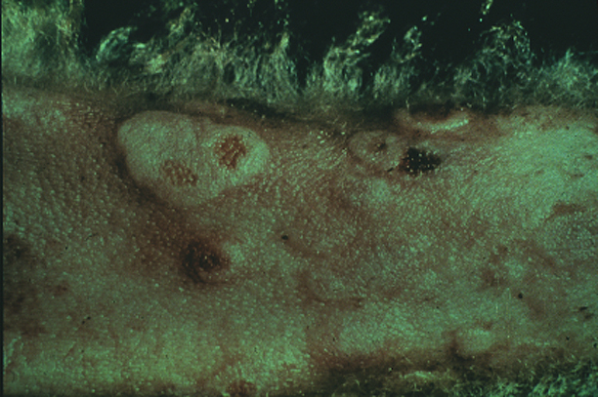
Std. vesiculosum

Slide 34
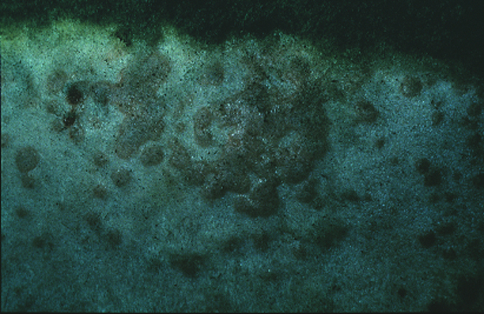
Std. pustulosum

Slide 35
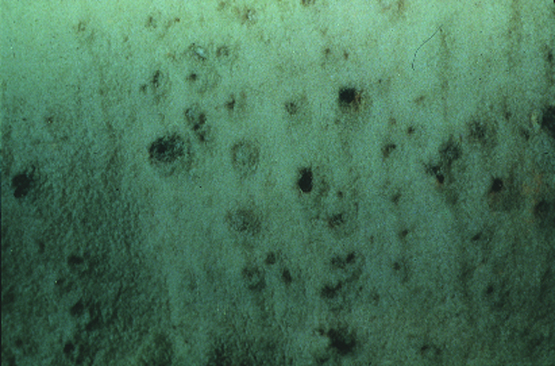
Std. crustosum

Slide 36
http://vet.uga.edu/ivcvm/courses/afip/conf05/wsc18/WSC18%20c04_fig01.jpg
Lung of sheep pox case (photograph Colin Scrivener)
Pox lesions in the omentum and wall of the rumen (photograph Colin Scrivener)
Sheep pox lesions in the renal cortex (photograph Colin Scrivener)
Bruce Watt (2014) SHEEP AND GOAT POX The Official Newsletter of the Australian Sheep Veterinarians, pp 6-9

Slide 37
Oral and nasal lesions can cause inappetence, rhinitis and excessive salivation, with discharges that eventually become mucopurulent.
Papules on the eyelids and ocular lesions can result in blepharitis and conjunctivitis.
Other signs vary, depending on the internal organs affected, but can include depression, as well as coughing and dyspnea (lesions affecting the lungs), diarrhea (lesions in the intestinal tract), and emaciation. Some animals may abort.

Slide 38
Diagnosis
Samples
Live animals: Full skin thickness biopsies; vesicular fluid if available; scabs; skin scrapings; lymph node aspirates; whole blood collected into heparin or EDTA; paired sera
Animals at necropsy: skin lesions; lymph nodes; lung lesions;

Slide 39
PCR can identify viral RNA directly in tissue samples, blood and secretions.
Antigen-detection tests cannot distinguish SPPV, GTPV and LSDV, but they can identify these viruses to the genus level.
Tests to detect capripoxvirus antigens include ELISAs, immunostaining methods and agar gel immunodiffusion (AGID).
SPPV and GTPV can be isolated in various bovine, caprine or ovine cell cultures.
They are reported to grow best in lamb testis or small ruminant kidney cell cultures, but other cells can be used.
Virus neutralization

Slide 40
Prevention and Control
Notifable Disease
If culling is not possible, isolation of infected herds and sick animals for at least 45 days after recovery
Slaughtering of infected herd if possible
Proper disposal of cadavers and products - burning or burial is often used
Stringent cleaning and disinfection of farms and equipment
Quarantine of new animals before introduction into herds
Animal and vehicle movement controls within infected areas
Vaccination may be considered when the disease has spread more widely

Slide 41
Live and inactivated vaccines have been used for the control of capripox. All strains of capripoxvirus so far examined share a major neutralisation site and will cross protect.
There are several attenuated virus vaccines delivered by subcutaneous or intradermal route; conferred immunity lasts up to 2 years
Inactivated vaccines give, at best, only short-term immunity
In Turkey, “İSTANBUL PENDİK VETERİNER KONTROL ENSTİTÜSÜ” produces the poxvirus vaccine.

Slide 42
Vaccine in Turkey
Vaccine does not apply to animals smaller than 6 weeks
The last 6 weeks of your pregnancy in the sheep and 1 month after giving birth, the protective vaccine are not implemented.
The vaccine is administered in the axillary region as Subcutan.

Slide 43
REFERENCES
http://www.cfsph.iastate.edu/Factsheets/pdfs/sheep_and_goat_pox.pdf
http://www.oie.int/fileadmin/Home/eng/Animal_Health_in_the_World/docs/pdf/Disease_cards/SHEEP_GOAT_POX.pdf
http://www.msdvetmanual.com/integumentary-system/pox-diseases/sheeppox-and-goatpox#v4737733

Slide 44
Poxviridae, subfamily Chordopoxvirinae, and include 4 virus species that cause nonsystemic, proliferative skin disease in domestic and wild ruminants:
the prototype Orf virus (ORFV),
Bovine papular stomatitis virus (BPSV),
Pseudocowpox virus (PCPV),
Parapoxvirus of red deer in New Zealand.

