Slide 1
streptococcı

Slide 2
It is found on skin and mucosal surfaces
Causes purulent infections
Mastitis, metritis, polyarthritis, meningitis

Slide 3
Classification
Class: Bacilli
Team: Lactobacillales
Family: Streptococcaceae
Genus: Lactococcus
Genus: Streptococcus (More than 50 species)
Family: Enterococcaceae
Genus: Enterococcus

Slide 4
Family: Lactobacillaceae
Genus: Pediococcus
Family: Leuconostocaceae
Genus: Leuconostoc

Slide 5
Streptococci (classical classification)
1- Pyogenic (mostly β hemolytic)
2- Oral (mostly α hemolytic), opportunistic
3- Enterococci, opportunistic (Enterococcus)
4- Lactic (α and Gamma hemolytic), apathogen (Lactococcus)
5- Anaerobic (Gamma hemolytic), opportunistic
6- Other

Slide 6
Gram positive cocci (double or variable length chains)
Each cocci is approximately 1 (0.5-2) μm in diameter
Facultative anaerobic
Catalase and oxidase negative, fermentative
Asporous
Immotile (except for some enterococci)
Capsule (usually pathogens)

Slide 7
Locations
Everywhere in the world
Streptococci with veterinary prescription are found on the mucosal surfaces, in the upper respiratory tract and in the urogenital canal (except S. equi)
Sensitive to drying
They can not survive for a long time when they leave from host
Enterococci are opportunistic pathogens and are found in the digestive tract of most animal species

Slide 8
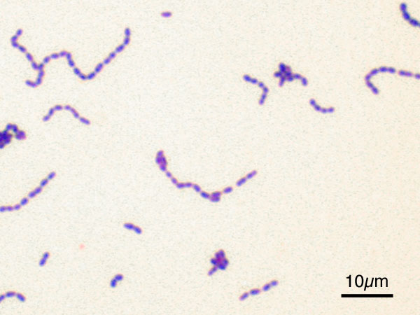
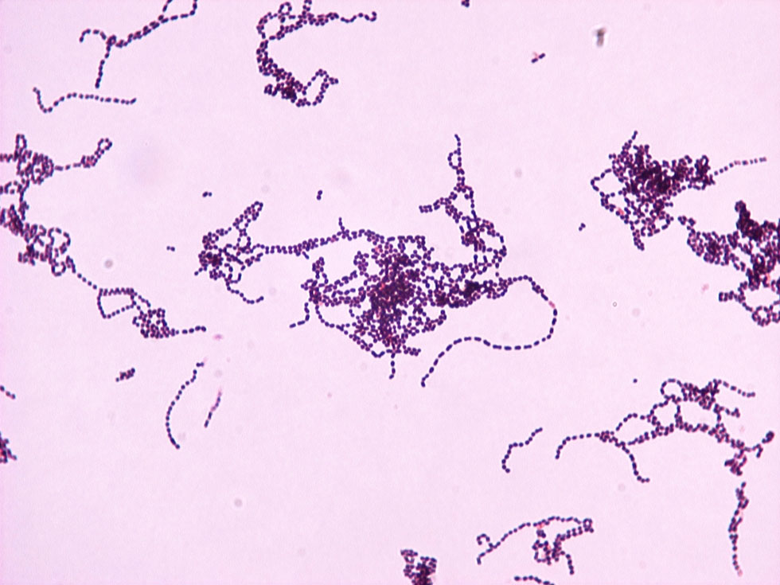
Bacterioscopy
Gram positive cocci (chain-like)

Slide 9
Culture
Proliferation of these bacteria are complex (blood or serum is required to be added to the medium)
Enterococci culture on MacConkey agar
Generally interested in blood cells
Proliferation temperature limits 25-45ºC, optimal 37ºC
They form a transparent, bright, S type colony
Sediment in liquid medium

Slide 10
Classification
According to hemolysis
According to its antigenic characteristic (serological feature)
According to biochemical characteristics
* There are those who lyse erythrocytes in the blood agar (hemolysis makers). The medium is prepared by placing 10% sheep blood in the agar

Slide 11
Beta Hemolytic; it becomes a completely colorless field around the colony (S. equi, S. agalactiae, S. pyogenes)
(chronic inflammation of the throat infection in humans S. pyogenes)
Alpha Hemolytic; around the colony is an area of unclear greenish hemolysis (H2O2 hemoglobin produced by bacteria to methemoglobin) (S. dysgalactiae, S. uberis, viridans group Streptococci)
Gamma hemolytic non-hemolytic Streptococcus (Enterococcus faecalis)

Slide 12
Beta Hemolysis Streptococci

Slide 13
Alpha Hemolysis Streptococci

Slide 14
Generally, β−hemolytic streptococci are pathogenic for most animal species
Lancefield Group C streptococci isolated from horses generally form a large β−hemolysis

Slide 15
Biochemical Tests
CATALASE
OXİDASE
OXIDATION / FERMANTATION TEST
SODIUM HYPOPURATE TEST
CAMP TEST

Slide 16
Gram positive Cocci
AGENTS | CATALASE | OXIDASE | O/F
Streptococci | - | - | F
Staphyloccus | + | - | F
Micrococcus | + | + | O

Slide 17
Streptococcos’ Catalase Test is negative

Slide 18
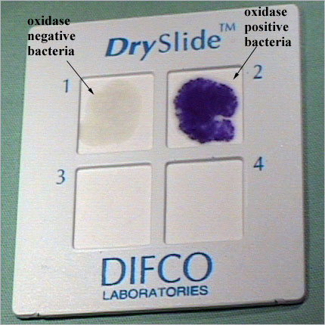
OXIDASE
The presence of cytochrome oxidase enzyme is detected

Slide 19
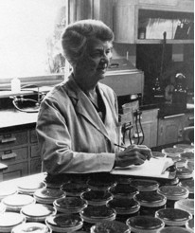
Serology
Lancefield Group
It is a serologic grouping based on the definition of C-substances which are group specific polysaccharides on cell walls of streptococci. Founded by Rebecca Lancefield in 1930. Streptococci are thus classified as A, B, C, D, E .. Grouping can be done in three ways:
Classical method
Precipitation test based on acid or autoclave extraction of C-substituents
Latex agglutination test
Test where latex particles are used
Coagulation test
Staphylococcus aureus (protein A) is used for the test

Slide 20
M Protein
Rebecca Lancefield found trying to classify S. pyogenes
Responsible for colonization and phagocytosis resistance
It is found on the cell surface of S. pyogenes
Inhibits complement to bind the peptidoglycan and opsonization
There are more than 50 different types
Some types are romatogenic (heart muscle-like epitopes)

Slide 21
Type name | Lancefield group | Host | Diseases
Str. pyogenes | A | Human, rodent Cow | Red, puerperal fever, apseler, rheumatic fever, nephritis, erisipelas mastitis
Str.agalactia | B | Cattle | Cronic mastitis
Str.equi | C | Horse | Gurm
Str.equisimilis | C | Horse and pig | purulent abscess
Str.zooepidemicus | C | Horse | Seconder pneumoni
Str.dysgalactia | C | Cattle | Acute mastitis
Str.uberis | No Lancefield antigen | Cattle | Mastitis
Str.canis | G | Carnivors | Lymphadenitis in dogs, irritable cases
Str.suis | D (Related to R,S,T ) | Pig | Neonatal infection, septicemia and pneumonia
Str.suis | Related to R | Human | Septicemia, arthritis, meningitis
Str.pneumoniae | No Lancefield antigen | Cattle, rats | Mastitis, calf septicemia, meningitis, pneumonia

Slide 22
Red fever (Scarlet fever)
Streptococcal pyrogenic exotoxin (A & C)
S. pyogenes agent
Toxin is transported by bacteriophage
In humans red spots in tongue, face, armpit, crotch
Tongue is in strawberry colour

Slide 23
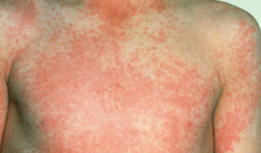
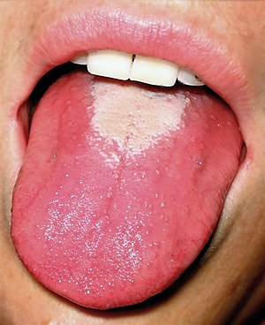
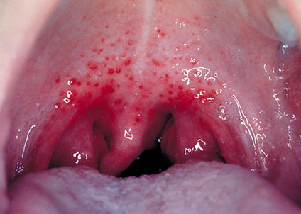
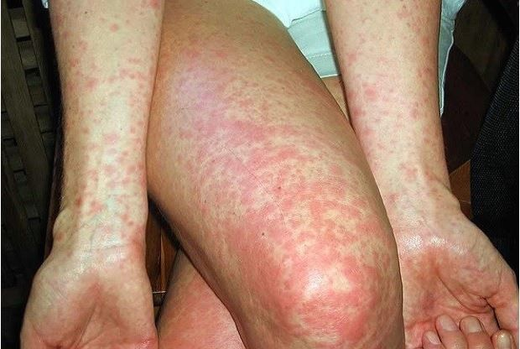
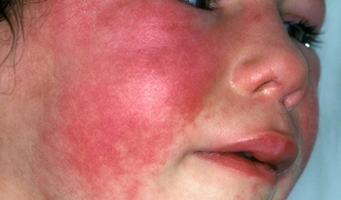

Slide 24
Virulence Factors
Streptococci are pyogenic bacteria and are mostly isolated from cases related to abscess formation and irritation.
Exotoxin
Streptolysin O and S (Hemolysin of B-hemolytic)
Hyalurinidaz
Streptodornase (DNase)
NADase
proteinase
Streptokinase (Fibrinolysis)
Phage-encoded pyrogenic toxin (red in humans)
Polysaccharide capsule
S. pyogenes, S. pneumoniae, some S. equi subsp. equi, S. agalactiae
M protein
In S. pyogenes and S. porcinus species, antifagocytic
S. equi subsp. equi adhesin

Slide 25
Streptococcal Causes Mastitis
Key factors
S. agalactiae
S. dysgalactiae
S. uberis
More rare factors
Enterococcus faecalis
S. pyogenes
S. zooepidemicus
S. agalactiae - Lancefield B, colonization in milk ducts, persistent chronic infection
S. dysgalactiae - Lancefield C, mouth cavity, genital organs, mammary gland, acute mastitis
S. uberis - Skin, tonsillar, vaginal mucosa flora effect, clinical mastitis without systemic symptoms

Slide 26
Diagnosis
Clinic symptoms
Inflammatory reactions in the mammary gland (somatic cell increase)
Milk coagulants (alkalization of pH due to Na and Cl ions)
Prevention of contamination in sampling
Culture on blood agar, Edward's medium and MacConkey agar , incubation at 37 ° C for 24-48 hours
Distinguishing agents that cause mastitis
Sugar fermentation tests

Slide 27
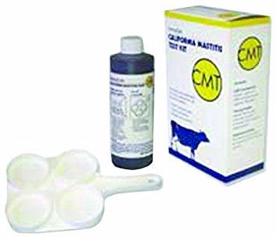
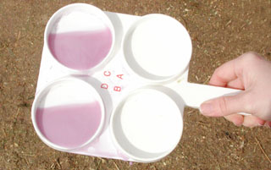
California Mastitis Test (CMT)
It is based on the principle of forming the gel of DNA released by disintegrating cell membrane.
Mixed with CMT separator and milk
CMT reagent is a a detergent with a pH indicator inside.
This detergent dissolves the cell membrane of the leukocytes if there is in the milk and releases the DNA.
3 grams of sodium lauryl sulfate is dissolved in 100 ml distilled water; Prepared by adding 1: 10,000 ratio of Brom Kreosol Purple to pH 8.0.

Slide 28
Tests that distinguish streptococci from mastitis;
Eskulin test
Na-hippurate
CAMP (Christie-Atkins-Munch Petersen) test

Slide 29
MASTITIS AGENTS
 | CAMP | Na-hippurat | Eskulin
S.agalactia | + | + | -
S.dysgalactia | - | - | -
S.uberis | - | + | +

Slide 30
GURM (Water scarf, Adenitis equorum, Strangles)
Definition: It is a feverish, contagious and acute infection characterized by the inflammation of the nasal, pharynx mucosa and regional lymph nodes.
Reported by Rivolta in 1873 and Sureyya Tahsin in 1940 Agent: S. equi subsp. equi (S. equi)

Slide 31
Etiological Features
The general characteristics of Streptococci
Creates long chains in nose currents and pus
They are encapsulated
Creates 1mm diameter colony and large hemolysis area in blood agar
Creates sediment in bottom of liquid media
Glucose, sucrose and salicin positive, lactose negative
Lancefield Group C

Slide 32
Epizootiyology
Widespread in the world
Foals are more sensitive
There is no disease in animals other than Equidae
Stress factors play an important role in the development of the disease
The disease is transmitted to the environment with nasal discharge and pus.
Contagion is caused by oral ingestion of the agent.
It is also possible to be infected by droplet infection and mating

Slide 33
Patogenesis
The duration of incubation is 5-10 days
Sudden high fever
In the nasal mucosa, pharyngeal and after the regional lymph nodules inflammation (pseudo-lymphadenitis) is formed
Rarely, abscess can be seen in other organs. Deaths are seen in this case (bastard gurm)
Two-sided nasal discharge. Initially clear then mucoprulent and irritable
Lymph nodules are hot, painful, edematous and abscessed (submandibular and retrofarengial). Fistula can be seen
Laryngitis and cough, high fever, depression, anorexia, rapid breathing

Slide 34
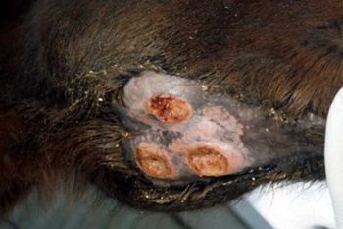
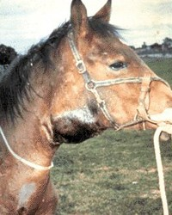
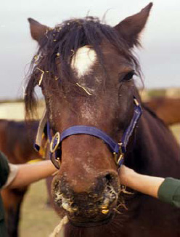
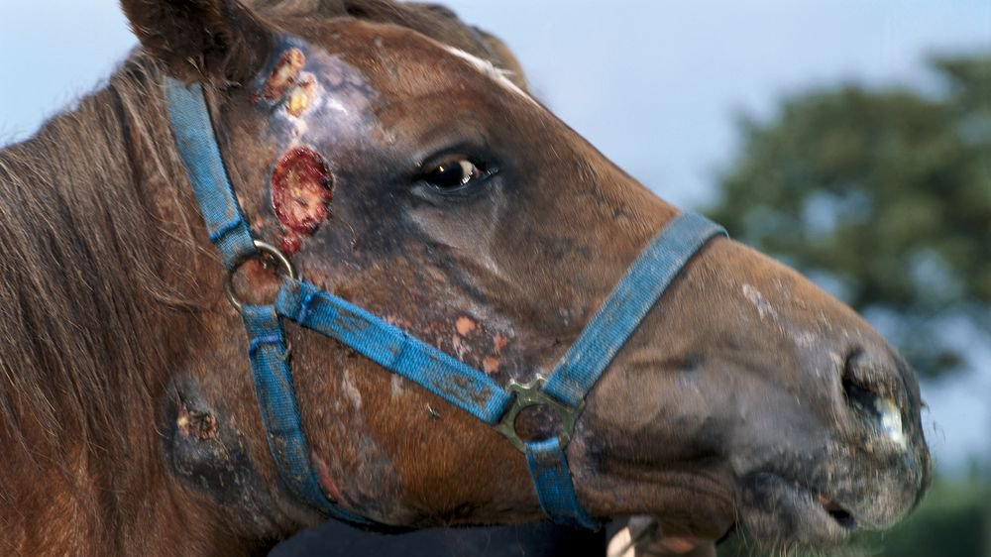
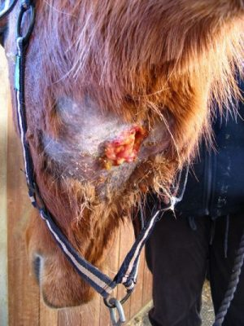
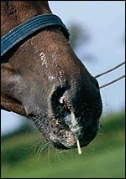
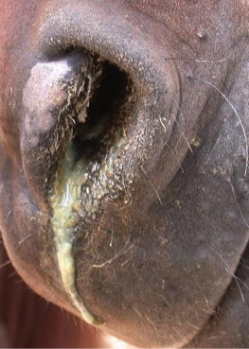
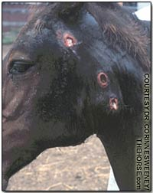

Slide 35
Diagnosis
Clinical diagnosis
Autopsy findings
Laboratory examination
-Bacterioscopy
Culture
Other agents in group C are separated from S. equisimilis and S. zooepidemicus by lactose, sorbitol and trehalose-negative
Animal experiment

Slide 36
Differential diagnosis
Malleus (Ruam)
Tuberculosis

Slide 37
Treatment
It is evaluated by performing an antibiogram test.
Penicillin derivatives, tetracyclines, sulfonamides
Protection
General hygiene
Separation of patients
Care and nursing care

