Slide 2
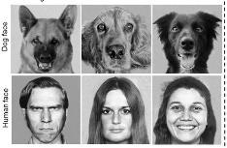
ANIMAL BEHAVIOR EMOTIONS & MOTIVATION

Slide 3
WE ANSWER:
What is emotion?
Do animals have emotion?
What is motivation?
WHY ARE EMOTIONS and MOTIVATION IMPORTANT for behaviors?

Slide 4
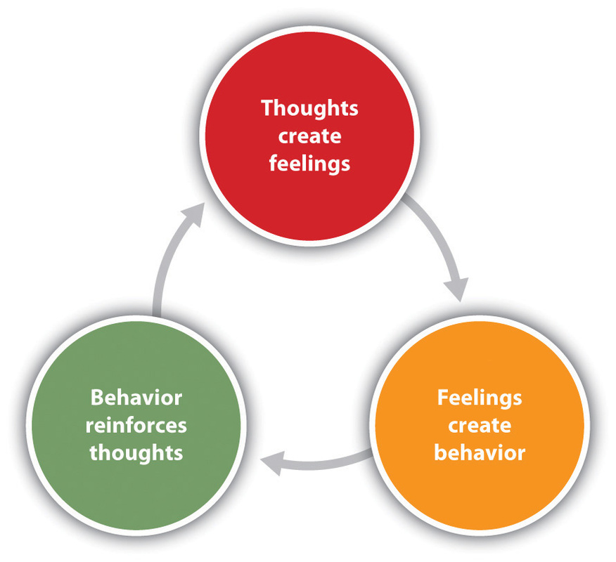
BEHAVIOR: Action performed in response to stimulus
EMOTION: We all have them, and yet most of us can't explain them !
MOTIVATION: Some «why» questions!
MOOD: « Time cools, time clarifies; no mood can be maintained quite unaltered through the course of hours » Mark Twain
ETHOLOGY: study of animal behavior

Slide 5
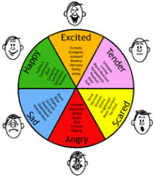
Use charts to explain your ideas
The concept of emotion emphasizes arousal, both physical and mental
The concept of motivation emphasizes how this arousal becomes action
mood is a general feeling not focusing on any particular item and persists for a long period of time

Slide 6
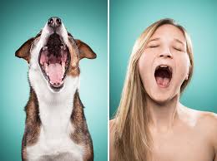
Emotion
is 4 part process consisting of physiological arousal, cognitive interpretation, subjective feelings, and behavioral expression.
Emotions help us respond to important situations and to convey our intentions to others.

Slide 7
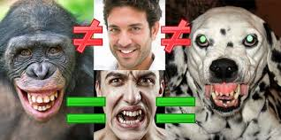
ORIGINS OF EMOTIONS

Slide 8
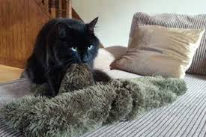
Emotions are the result of genetics and learning, especially early in life.
Emotions serve as arousal states that help organisms cope with important recurring situations.
Learned emotional responses, along with genetic predisposition are important components of many psychological disorders, including depression, panic attacks and phobias.

Slide 9
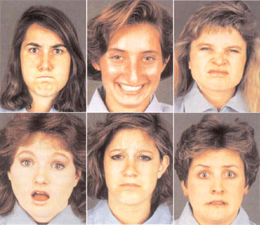
Paul Ekman, a leading psychologist in emotions, suggests humans everywhere can recognize seven basic emotions: sadness, fear, anger, disgust, contempt, happiness and surprise.
Place your screenshot here

Slide 10
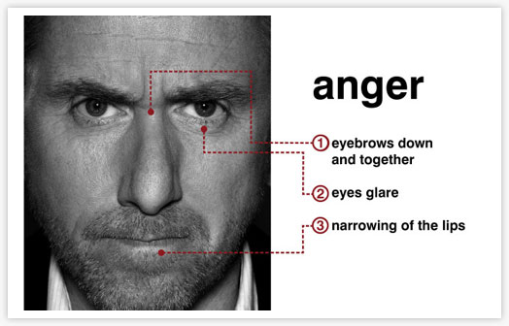

Slide 11
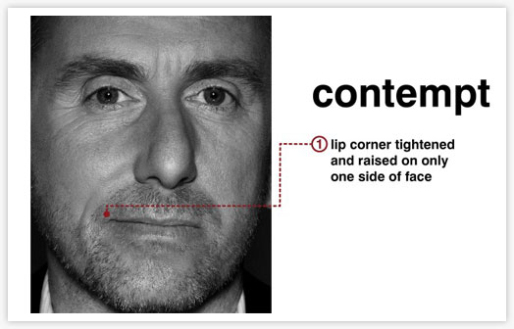

Slide 12
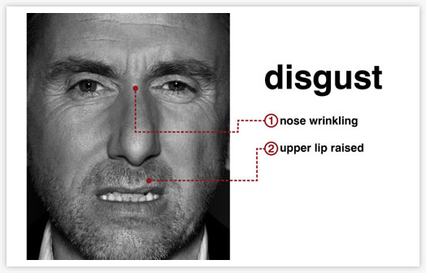

Slide 13
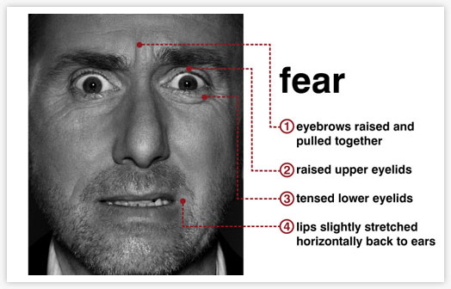

Slide 14
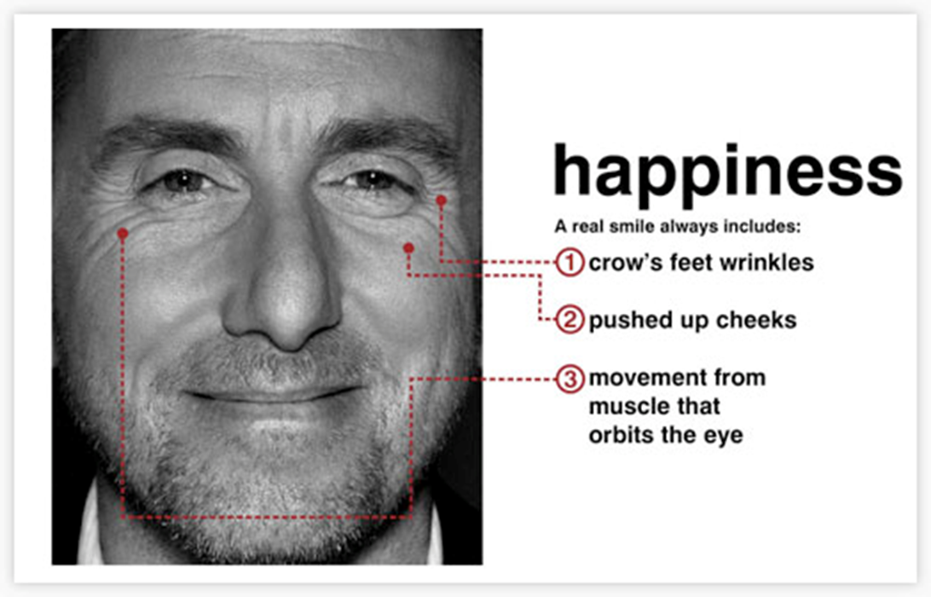

Slide 15
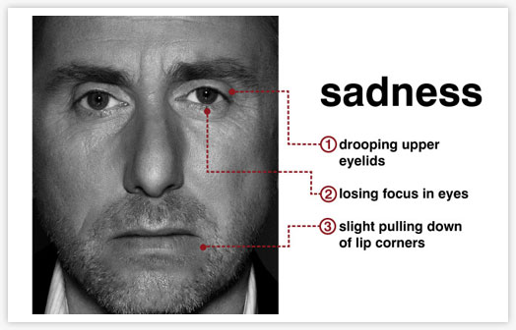

Slide 16
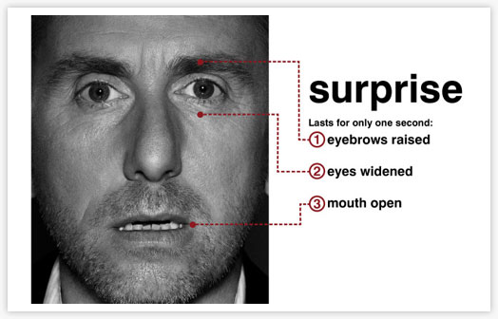

Slide 18
