Slide 1
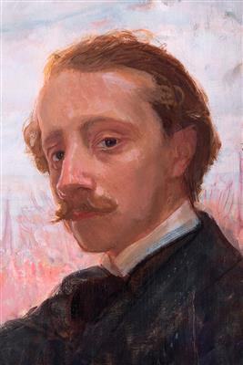
Wojciech Weiss (1875-1950)

Slide 2
Promienny zachód słońca

Slide 3
Pocałunek na trawie

Slide 4
Stanisław Ignacy Witkiewicz

Slide 5
Portret asymetryczny

Slide 6
Yaşamı ve eserleri
https://www.youtube.com/watch?v=gDpkDQj2AQA
https://www.youtube.com/watch?v=04vDLbG0dVQ
https://www.youtube.com/watch?v=6VhOCInGbME

Slide 7
Kaynaklar
https://www.youtube.com/watch?v=gDpkDQj2AQA
https://www.youtube.com/watch?v=04vDLbG0dVQ
https://www.youtube.com/watch?v=6VhOCInGbME

