Slide 1
Glycosaminoglycans
© 2009 W. H. Freeman and Company

Slide 2
Glycosaminoglycans
Linear polymers of repeating disaccharide units
One monomer is either
N-acetyl-glucosamine or
N-acetyl-galactosamine
Negatively charged
Uronic acids (C6 oxidation)
Sulfate esters
Extended hydrated molecule
Minimizes charge repulsion
Forms meshwork with fibrous proteins to form extracellular matrix
Connective tissue
Lubrication of joints

Slide 3
Heparin and Heparan Sulfate
Heparin is linear polymer, 3 – 40 kDa
Heparan sulfate is heparin-like polysaccharide but attached to proteins
Highest negative charge density biomolecules
Prevent blood clotting by activating protease inhibitor antithrombin
Binding to various cells regulates development and formation of blood vessels
Can also bind to viruses and bacteria and decrease their virulence

Slide 4
Glycoconjugates: Glycoprotein
A protein with small oligosaccharides attached
Carbohydrate attached via its anomeric carbon
About half of mammalian proteins are glycoproteins
Carbohydrates play role in protein-protein recognition
Only some bacteria glycosylate few of their proteins
Viral proteins heavily glycosylated; helps evade the immune system

Slide 5
Glycoconjugates: Glycolipids
A lipid with covalently bound oligosaccharide
Parts of plant and animal cell membranes
In vertebrates, ganglioside carbohydrate composition determines blood groups
In gram-negative bacteria, lipopolysaccharides cover the peptidoglycan layer

Slide 6
Glycoconjugates: Proteoglycans
Sulfated glucoseaminoglycans attached to a large rod-shaped protein in cell membrane
Syndecans: protein has a single transmembrane domain
Glypicans: protein is anchored to a lipid membrane
Interact with a variety of receptors from neighboring cells and regulate cell growth

Slide 7
Proteoglycans
Different glycosaminoglycans are linked to the core protein
Linkage from anomeric carbon of xylose to serine hydroxyl
Our tissues have many different core proteins; aggrecan is the best studied

Slide 8
Proteoglycan Aggregates
Hyaluronan and aggrecan form huge (M_{r} > 2•10⁸) non-covalent aggregates
Hold lots of water (1000 X its weight); provides lubrication
Very low friction material
Covers joint surfaces: articular cartilage
Reduced friction
Load balancing

Slide 9
Extracellular Matrix (ECM)
Material outside the cell
Strength, elasticity, and physical barrier in tissues
Main components:
Proteoglycan aggregates
Collagen fibers
Elastin (a fibrous protein)
ECM is a barrier for tumor cells seeking to invade new tissues
Some tumor cells secrete heparinase that degrades ECM

Slide 10
Interaction of the Cells with ECM
Some integral membrane proteins are proteoglycans
Syndecans
Other integral membrane proteins are receptors for extracellular proteoglycans
Integrins
These proteins link cellular cytoskeleton to the ECM and transmit signals into the cell to regulate
Cell growth
Cell mobility
Apoptosis
Wound healing

Slide 11
Oligosaccharides in Recognition

Slide 12
Review of Polysaccharides

Slide 13
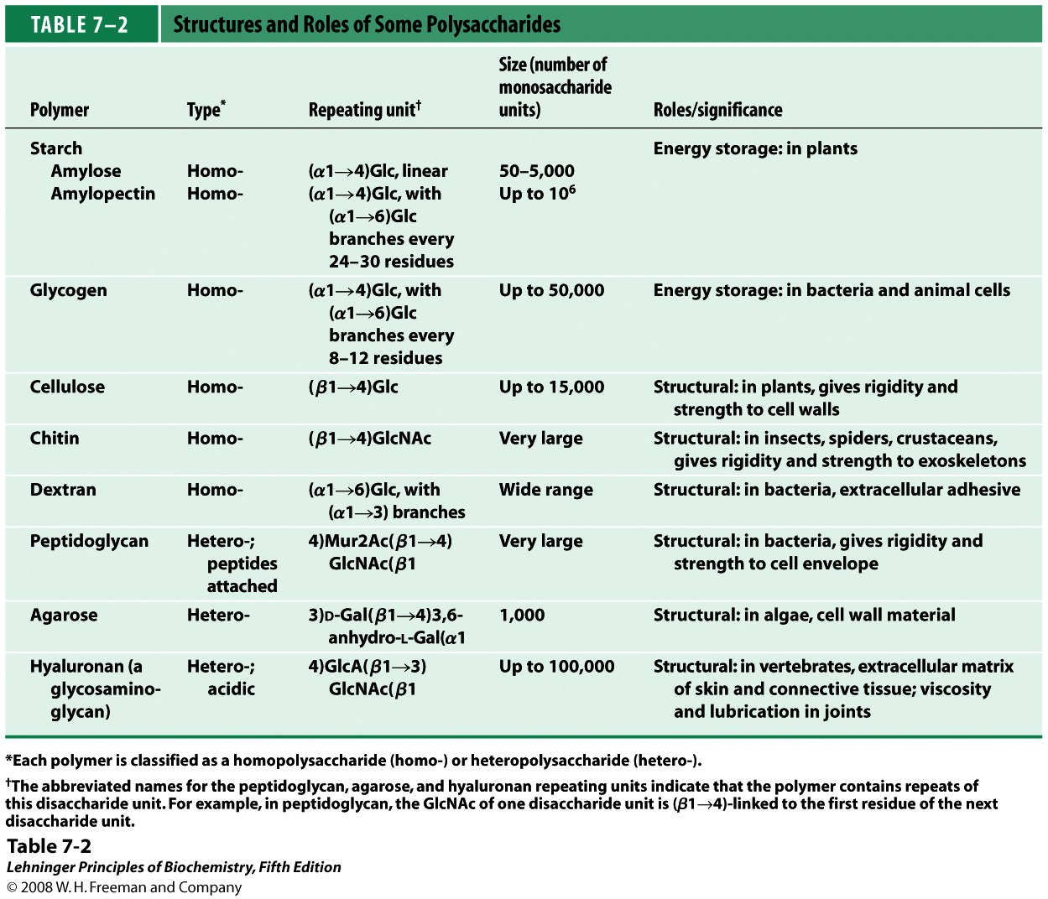

Slide 14
Chapter 7: Summary
In this chapter, we learned about:
structures of some important monosaccharides
structures and properties of disaccharides
structures and biological roles of polysaccharides
functions of glycosylaminoglycans as structural components of the extracellular matrix
functions glycoconjugates in regulating a variety of biological functions

