Slide 1
Capacity factor (k)
Theory of HPLC retention based on the adsorption from solutions can help to establish the relationships of measurable retention values (VR, tR, and k’) with the thermodynamic parameters, such as adsorption equilibrium constant (K), or free Gibbs energy ( ∆G ).

Slide 2
Capacity factor is the ratio of the reduced retention volume to the dead volume:

Slide 4
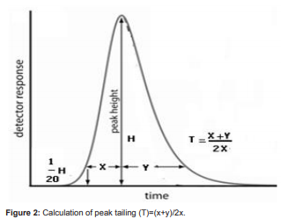

Slide 5
The retention volume can be defined as the volume of mobile phase required to elute a substance from the chromatography column.
Vr = Vm - KD Vs
where Vm = void volume and KD = distribution coefficient and Vs = stationary phase volume. Dead volume or void volume is the total volume of the liquid phase in the chromatographic column. Void Volume can be calculated as the following equation

Slide 6
where: r = radius of column [cm] = constant, ratio of circumference to diameter of a circle L = length of column [cm] f = fraction of column volume that is not taken up by stationary phase but available for mobile phase; default value for f = 0.7 (for Hypersil)

Slide 7
Resolution
Selectivity and resolution
Until now, retention and efficiency was discussed separately, but both of these parameters are affecting the separation of the mixture. Retention is developing the separation, and band broadening is destructing it. Selectivity is the ratio of the capacity factors of both peaks, or the ratio of its adjusted retention times. Selectivity represents the separation power of particular adsorbent to the mixture of these particular components (Figure 3).

Slide 8
This parameter is independent of the column efficiency; it only depends on the nature of the components, eluent type, eluent composition, and adsorbent surface chemistry. In general, if the selectivity of two components is equal to 1, then there is no way to separate them by improving the column efficiency. Resolution is the parameter describing the separation power of the complete chromatographic system relative to the particular components of the mixture. By convention, resolution (R) is expressed as the ratio of the distance between two peak maxima to the mean value of the peak width at the base line:

