Slide 1
What is a Material Safety Data Sheet (MSDS)?
A Material Safety Data Sheet (MSDS) is a document that
contains information on the potential hazards (health, fire,
reactivity and environmental) and how to work safely with
the chemical product.
It is an Essentials starting point for the development of a
complete health and safety program. It also contains information
on the use, storage, handling and emergency procedures all
related to the hazards of the material.
The MSDS contains much more information about the material
than the label. MSDSs are prepared by the supplier or
manufacturer of the material. It is intended to tell what the
hazards of the product are, how to use the product safely, what
to expect if the recommendations are not followed, what to do
if accidents occur, how to recognize symptoms of overexposure,
and what to do if such incidents occur.

Slide 3
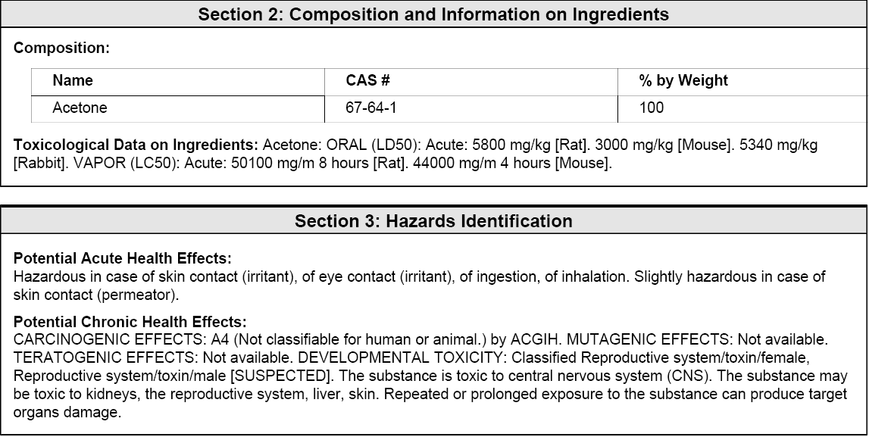

Slide 5
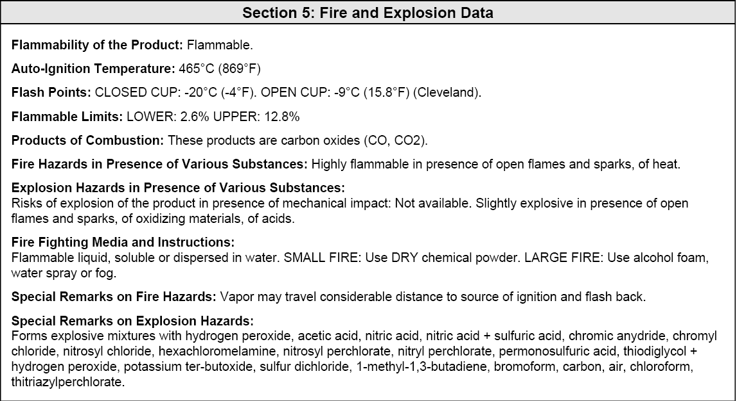

Slide 7
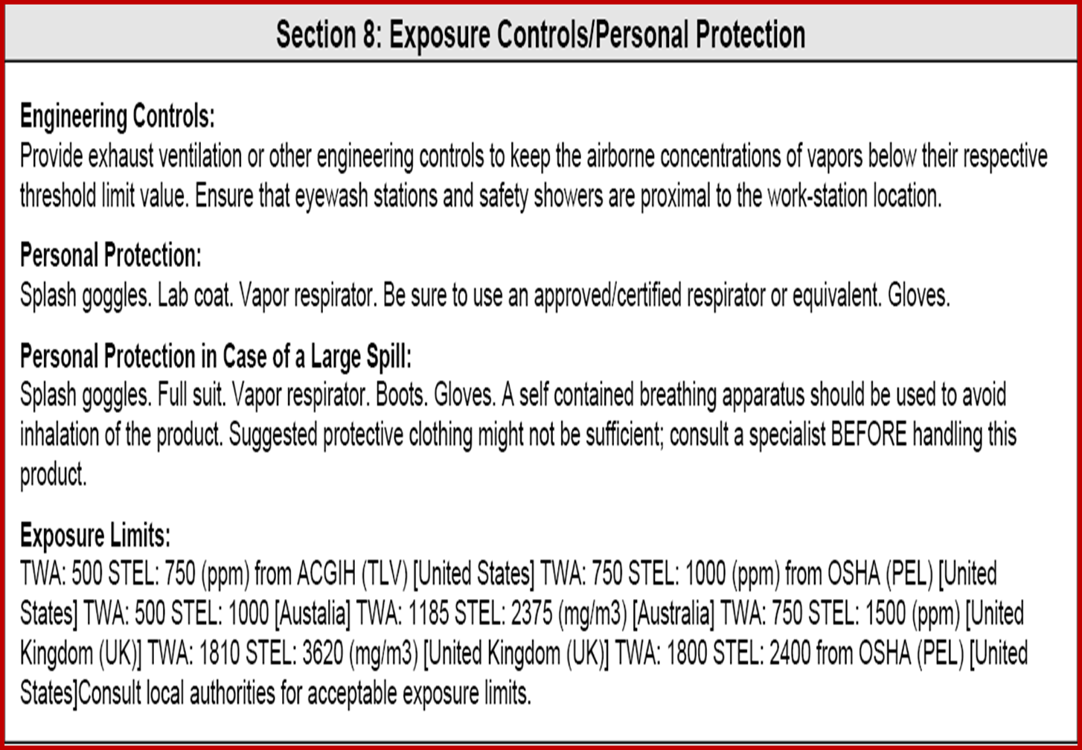

Slide 8
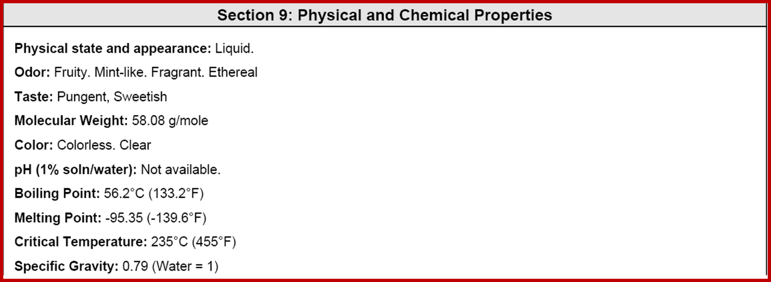

Slide 9
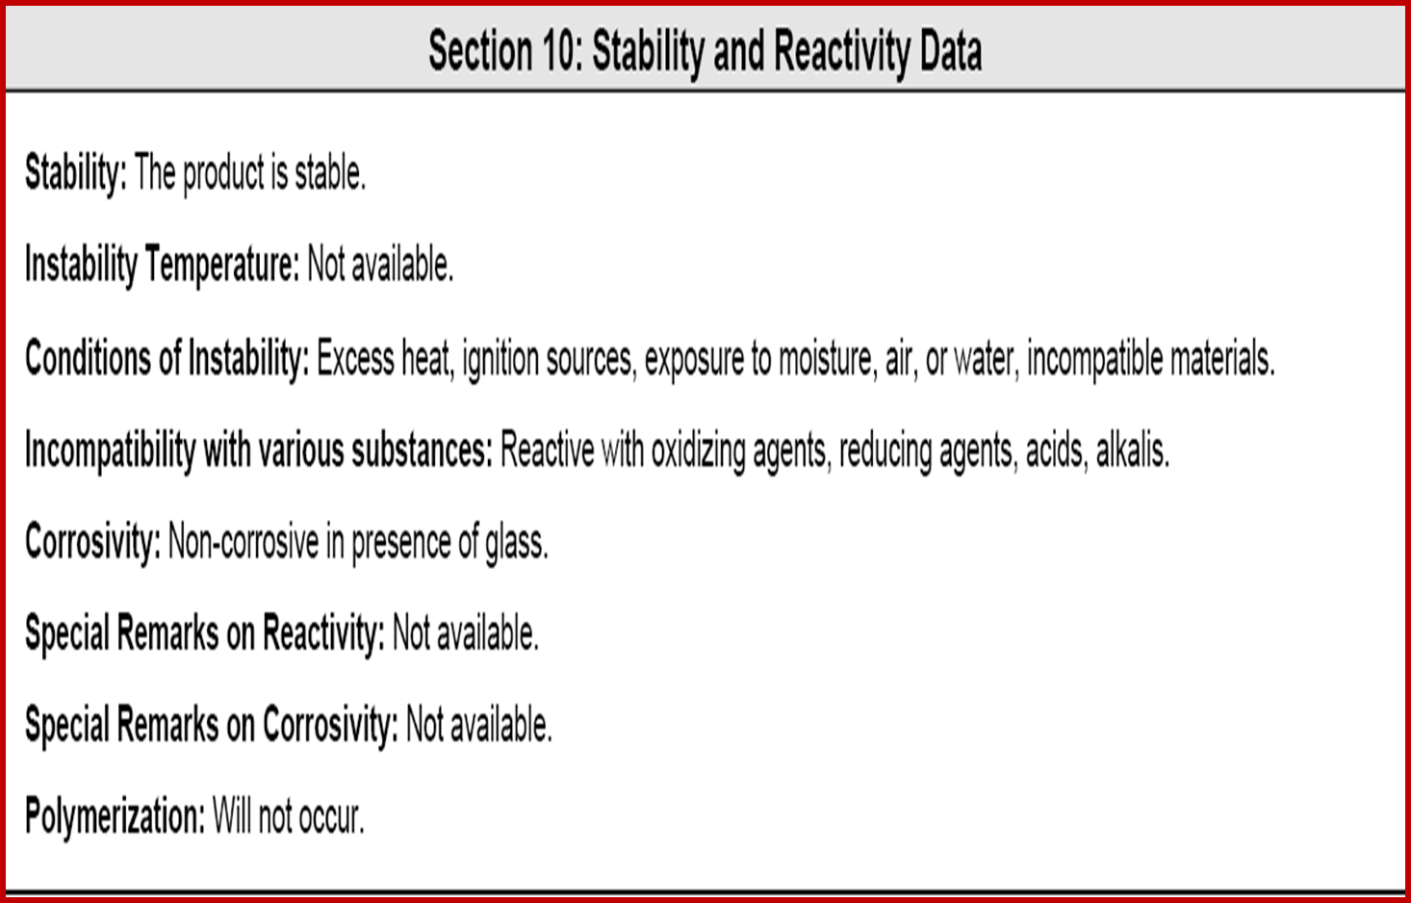

Slide 10
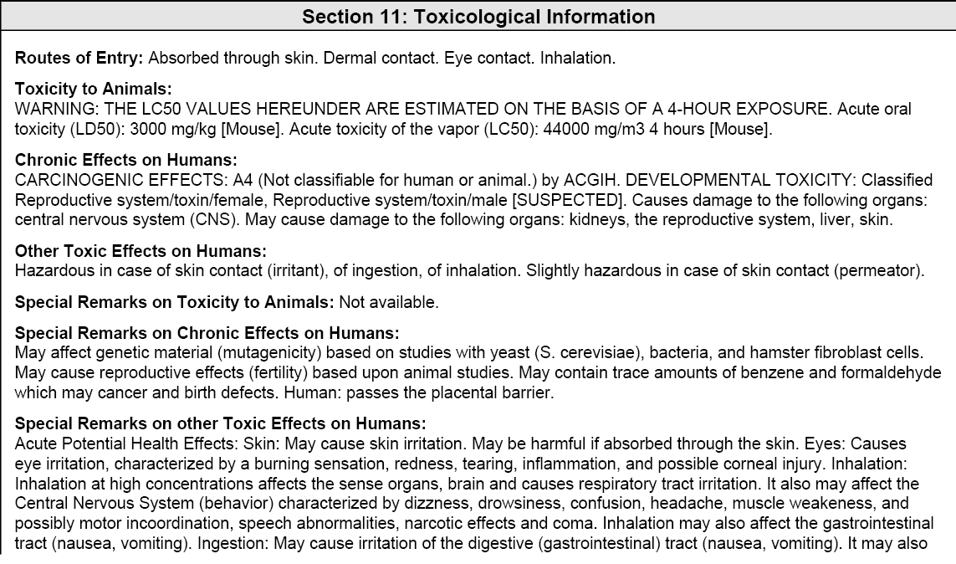

Slide 12
